Slide 1
FINANCIAL BANK AGENCY

Slide 2
LESS TAX DEBIT CARD
This is a newly developed project that will be discussed & reviewed with the bank executives on January 10, 2022 at Power Bank CEO Meeting Room from 12pm to 6pm.
AFFORDABLE RATES
This is to be the topic of discussion and review for the company executives on January 10, 2023 at Power Bank Meeting Room from 12pm to 6pm.
CHILDREN SAVINGS ACCOUNT
This will be discussed and revised by the company executives on January 12, 2024 at the Power Bank Conference Hall from 12pm to 6pm.

Slide 3
Jacob Hitch
Founder & CEO
I am Jacob Hitch and I am the pleased to be a part of one of the strongest banks in New York today : Financial Bank, Inc.
During my time as an assistant bank manager, I was astounded and greatly surprised by the people who are in dire need of help in managing their money through opening a bank account. I was encouraged and inspired to help the people who are in serious need of help in using and managing their own made money which led me to open up this bank company way back in 1994. The first 10 years of this company were anything but smooth sailing. Although we faced lots of failures and challenges which almost led to bankruptcy, the company remained standing through it all and today further strived to attain the sweet success we are in need of achieving.
Today, Power Bank, Inc. is now recognized by various firms and columnist to which many of them regard this company as “The Future of the Banking Industry”. As of 2016, Power Bank, Inc. is now a well renowned bank in New York which has up to 7,000 active employee and up to 3.5 Million bank account users.
As part of our success, I am pleased to announce you our newly developed pending projects to be implemented between 2025 and 2030.

Slide 4
TESTIMONIALS

Slide 5
“
“As one of the leading bank company in the industry, “Financial Bank, Inc. is aimed to deliver the best and quality assured service for all people who are in dire need of monetary assistance. We can give you all you want which is nothing but the best”
-Marcus Stevenson, PhD, 56, Chief Operating Officer

Slide 6
HISTORY
Financial Bank, Inc. is a banking company founded by Jacob Hitch, a former assistant bank manager. Jacob Hitch started his way in banking industry having only $5000 capital and 5 offered banking packages. Today, Power Bank, Inc. is recognized by various firms which has led to the bank being dubbed as “The Future of Bank Industry”.
Power Bank, Inc. provides nothing but the best choices to handle and save your money. This bank aims to embody the definition of what a bank company must do and must be.
.

Slide 7
“Financial Bank is a company that is passionate in providing products and services geared towards those who need help in the marketing department.”
-John Joseph 35, Businessman

Slide 8
Main Goal
Financial Bank, Inc. commits itself towards showcasing the very best bits of what a banking company must be. We aim to provide excellent service and monetary assistance to all of our customers and soon to be customers.

Slide 9
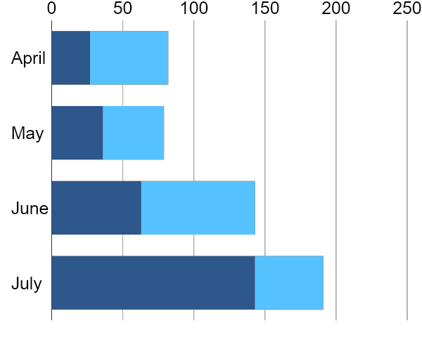
Overview of Growth
40% increase in annual profits as of May 2023.
70% increase in customer service for the year 2024.
50% increase in new clients for the year 2025.

Slide 10
WHAT WE OFFER

Slide 11
Lots of Banking Packages
Competitive and Effective Monetary Assistance
Quality Assured Services
Excellent Customer Care
.

Slide 12
IMAGE GALLERY

Slide 13
The Team
Jacob Hitch
Founder & CEO
Marcus Stevenson
PhD Chief Operating Officer
Stella West
Chief Marketing Officer

Slide 14
FINANCIAL BANK AGENCY
Thank You
+937 83668 financialbank@agency.com

