Slide 1
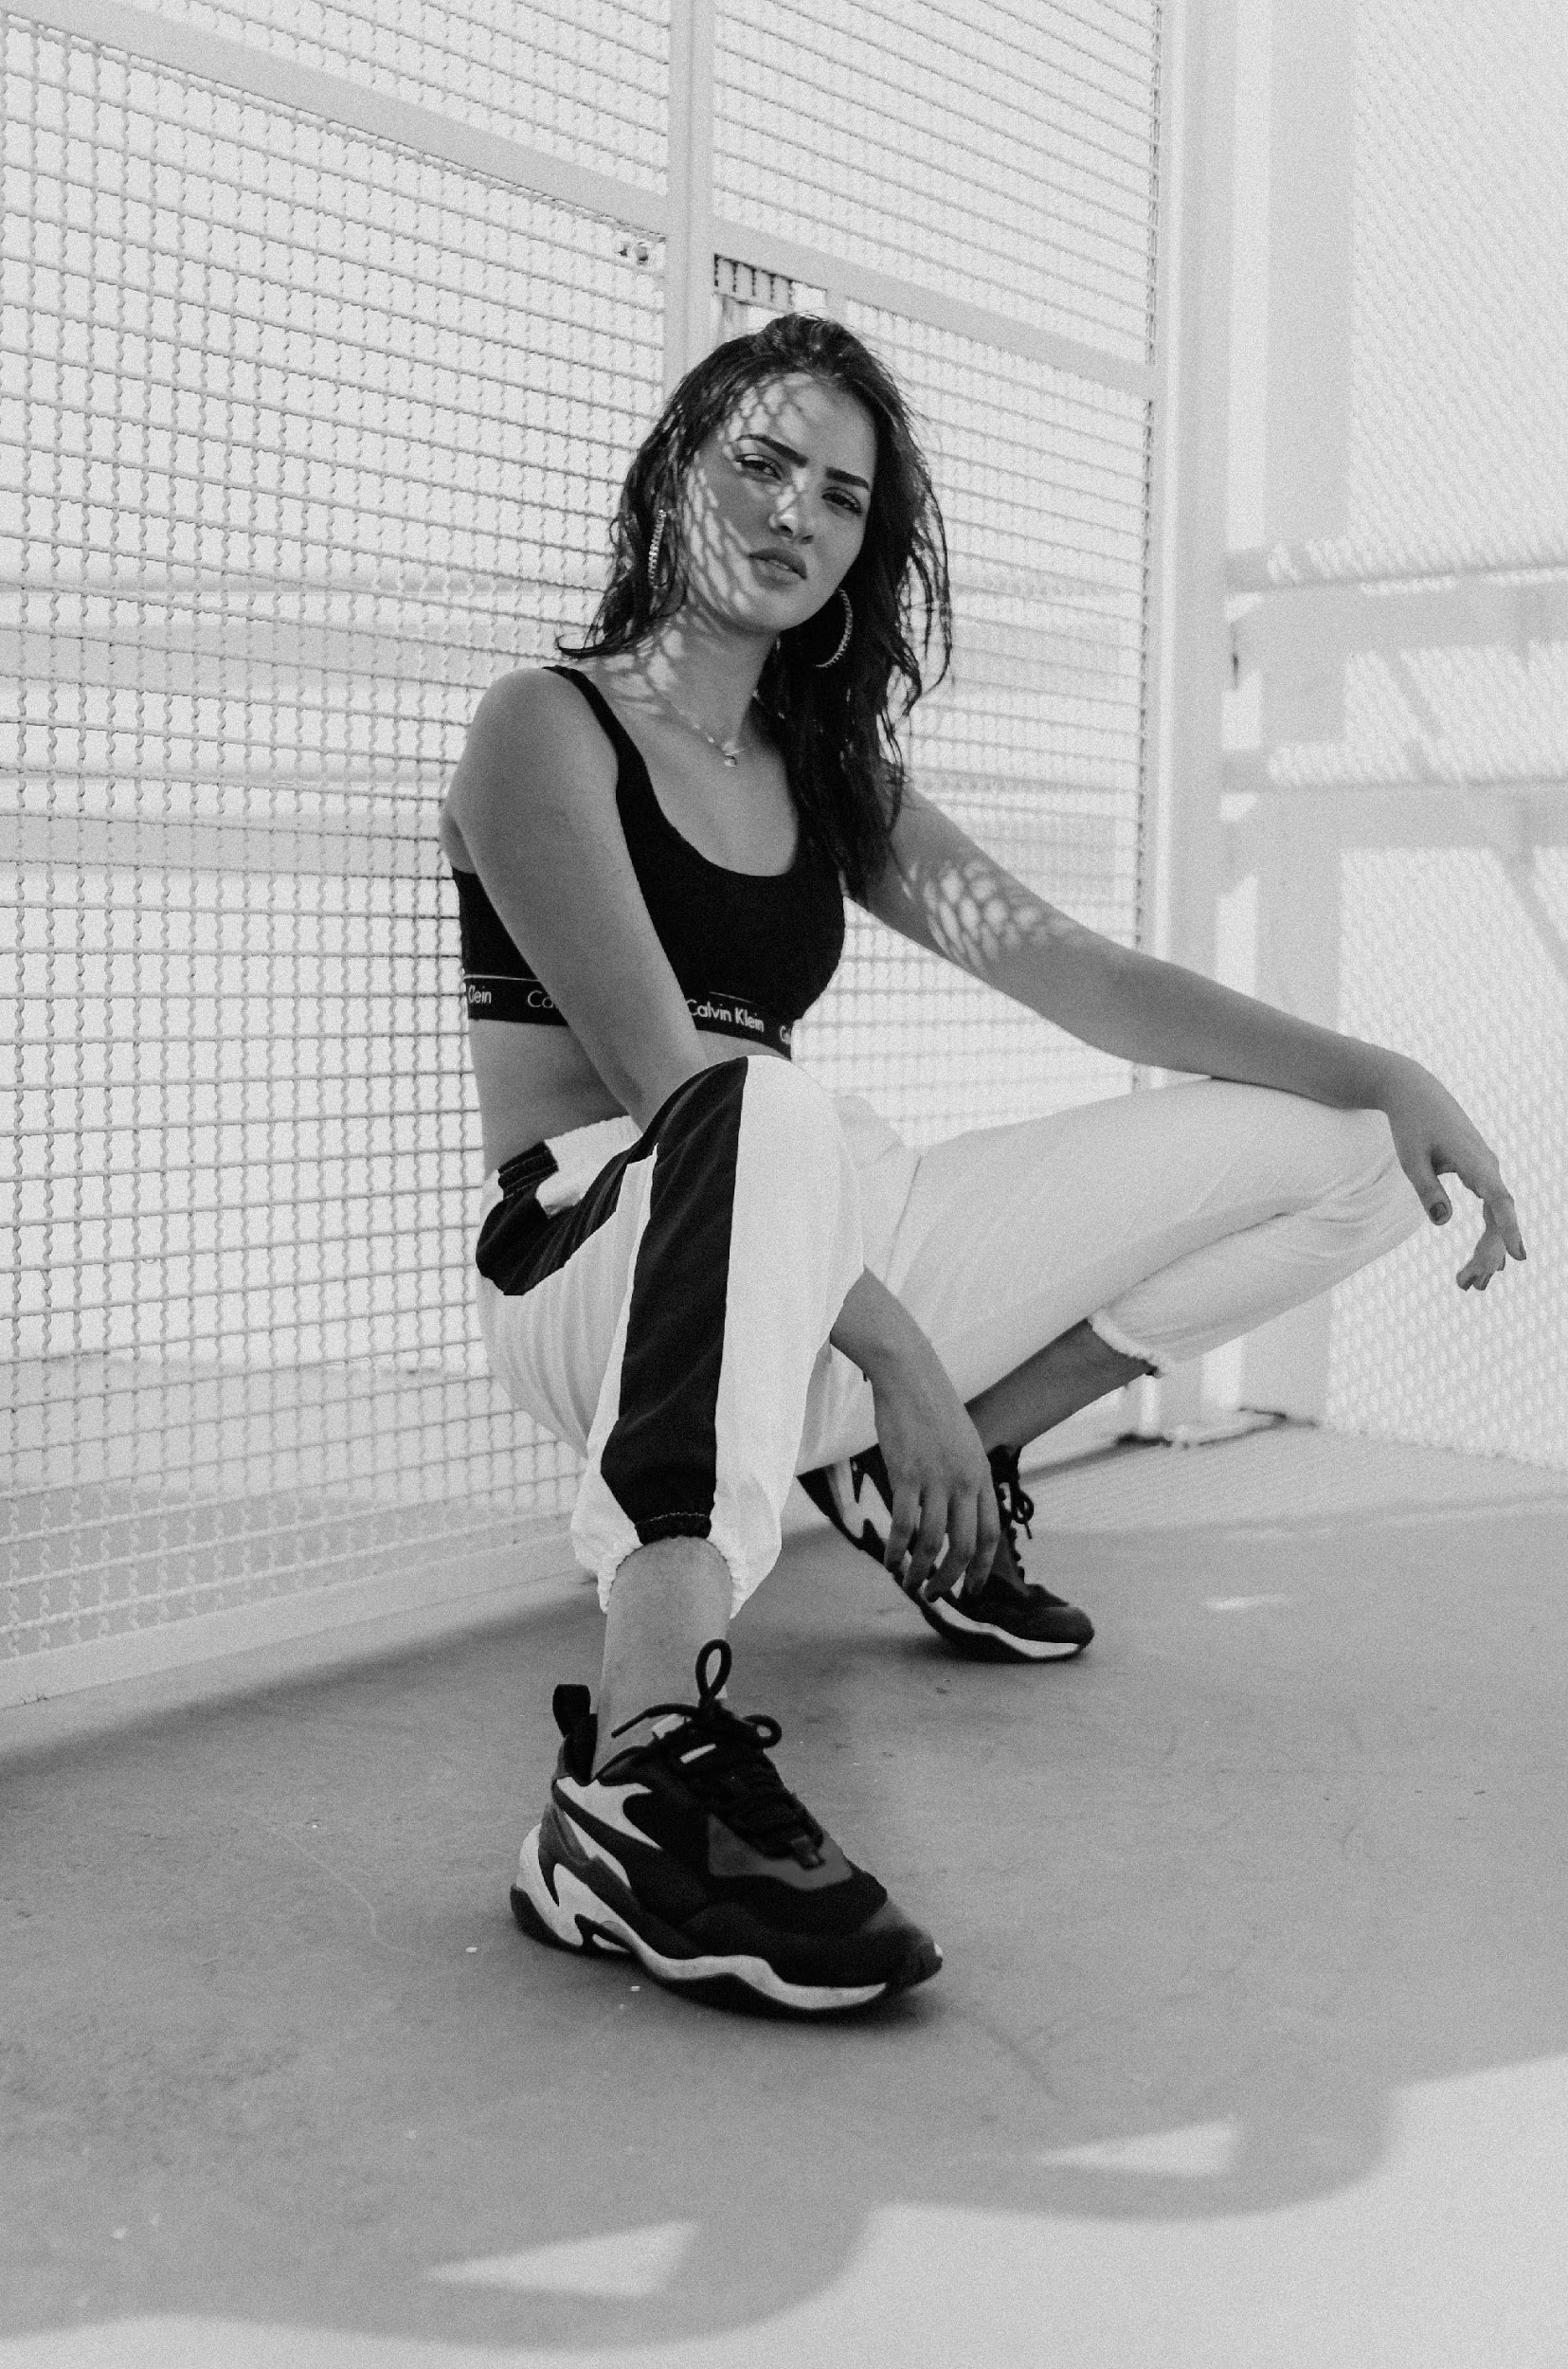
FABULOUS BOUTIQUE AND FASHION
+982 23489234 | fabulousbf@gmail.com | fabulousbf.com

Slide 2
AGENDA
STRENGTHS
PRESENTATION
GOWNS & DRESS
The Shoes & Fashion Accessories will be discussed at the Fabulous Boutique & Fashion Meeting Room on January 12, 2023 from 12 PM to 6 PM. This product launch is aimed to promote the quality products the company has to offer for an affordable price through an extensive marketing campaign.
The Gowns & Dress is a product launch which will be discussed at the Fabulous Boutique & Fashion Meeting Room on January 12, 2024 from 12 PM to 6 PM. This product launch is aimed to promote the quality gowns & dresses for an affordable price through an extensive marketing campaign.
SUMMER OUTFIT CRAZE
This Summer Outfit Craze is a product launch which will be discussed at the Fabulous Boutique & Fashion Meeting Room on May 12, 2024 from 12 PM to 6 PM. The products marketed & sold under this product launch will be mainly colorful, breezy pieces that’ll fit any summer occasion.

Slide 3
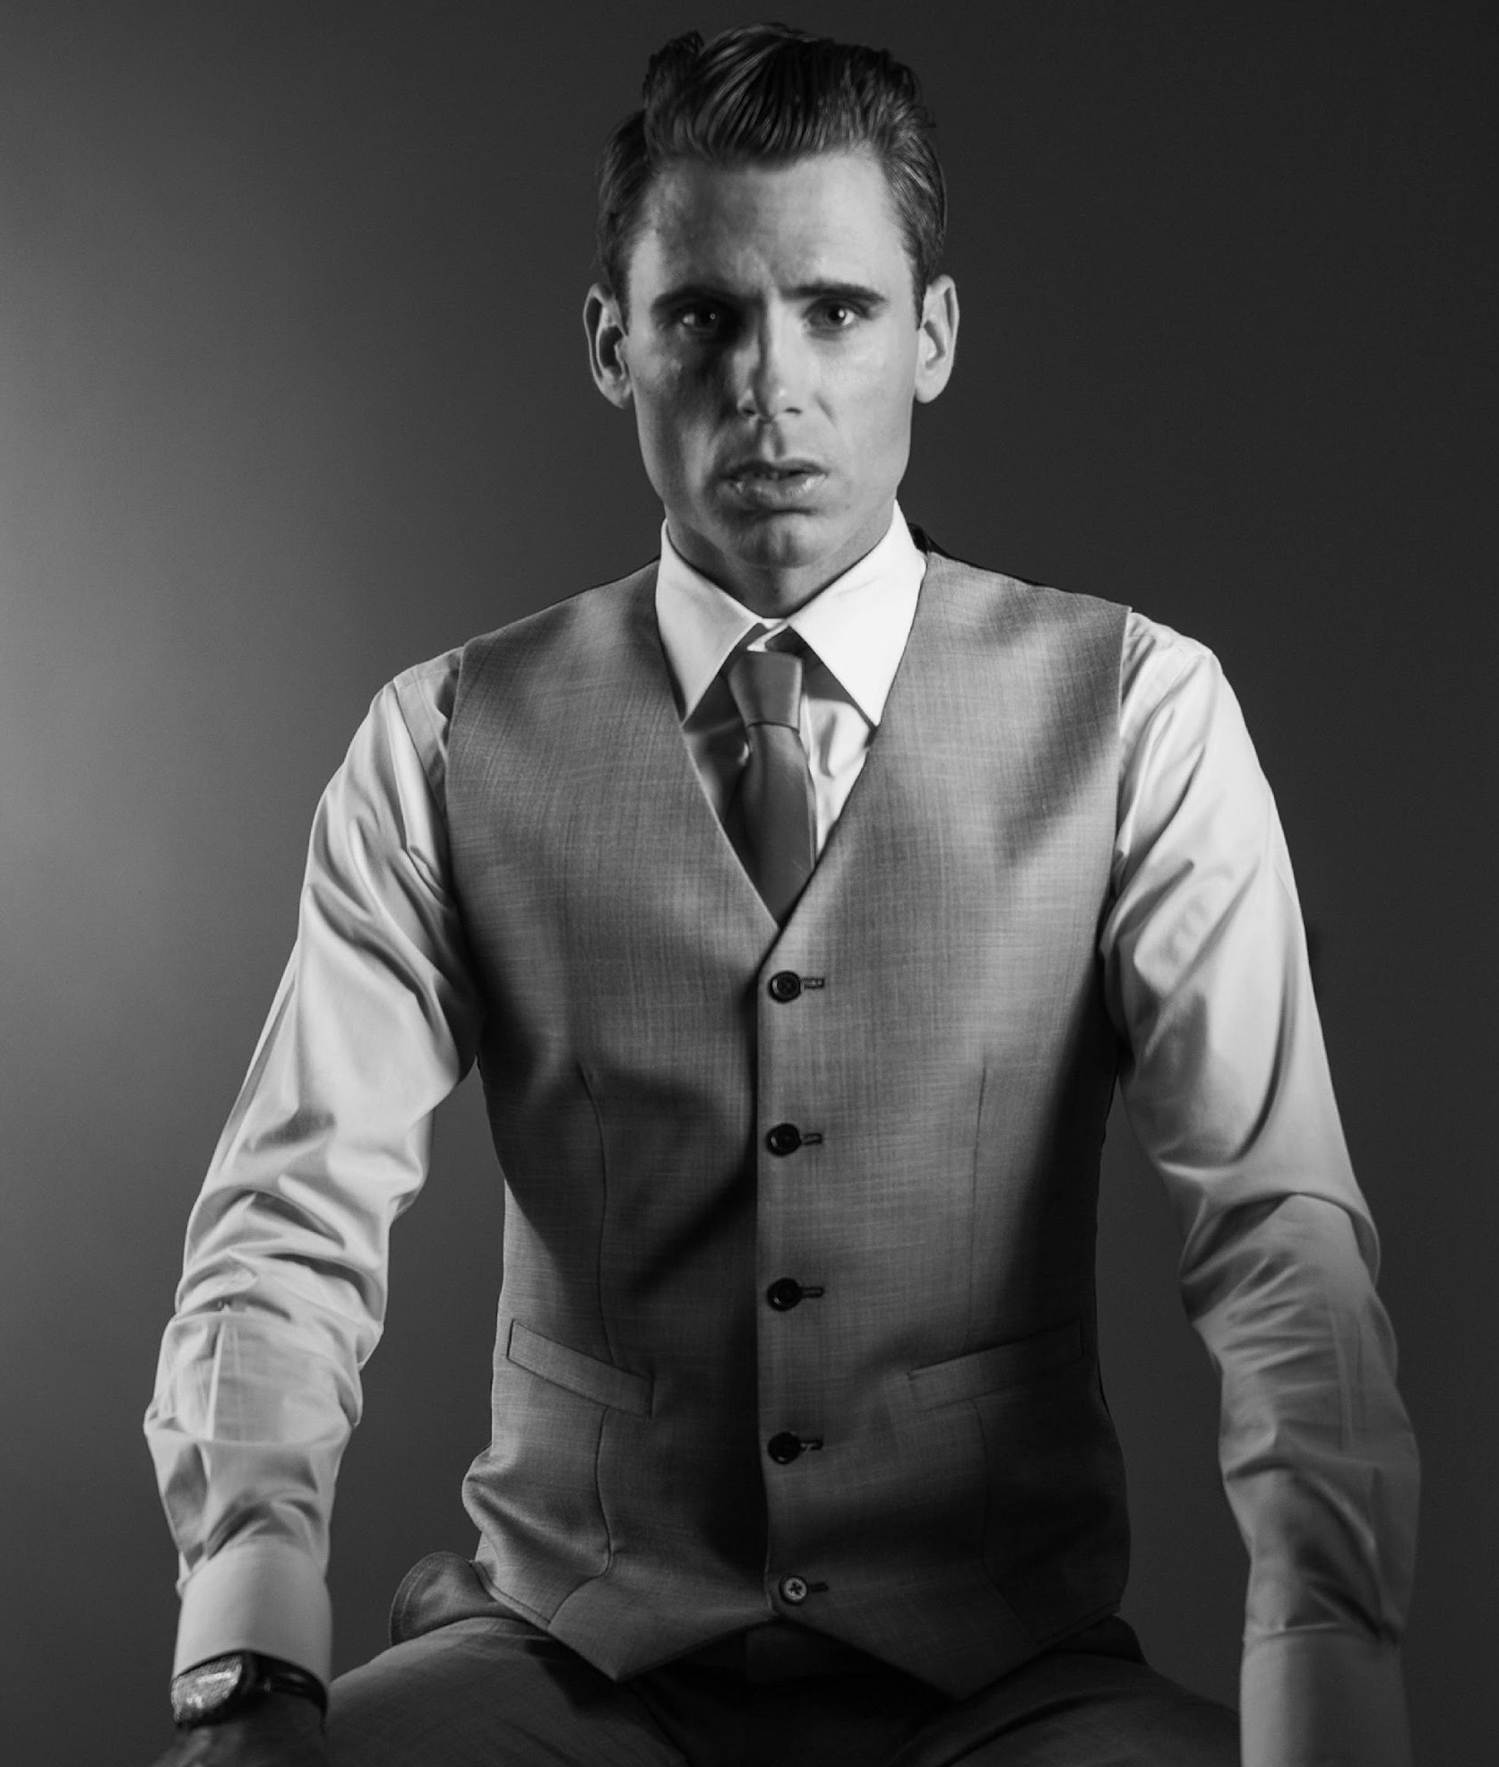
ABOUT
Jerry Halsey
Founder & Chairman
As the founder & chairman of this company I am proud to introduce you the Fabulous Boutique & Fashion. It was founded with an initial aim to provide fabulous fashion products at an affordable price point that various clients can avail of.

Slide 4
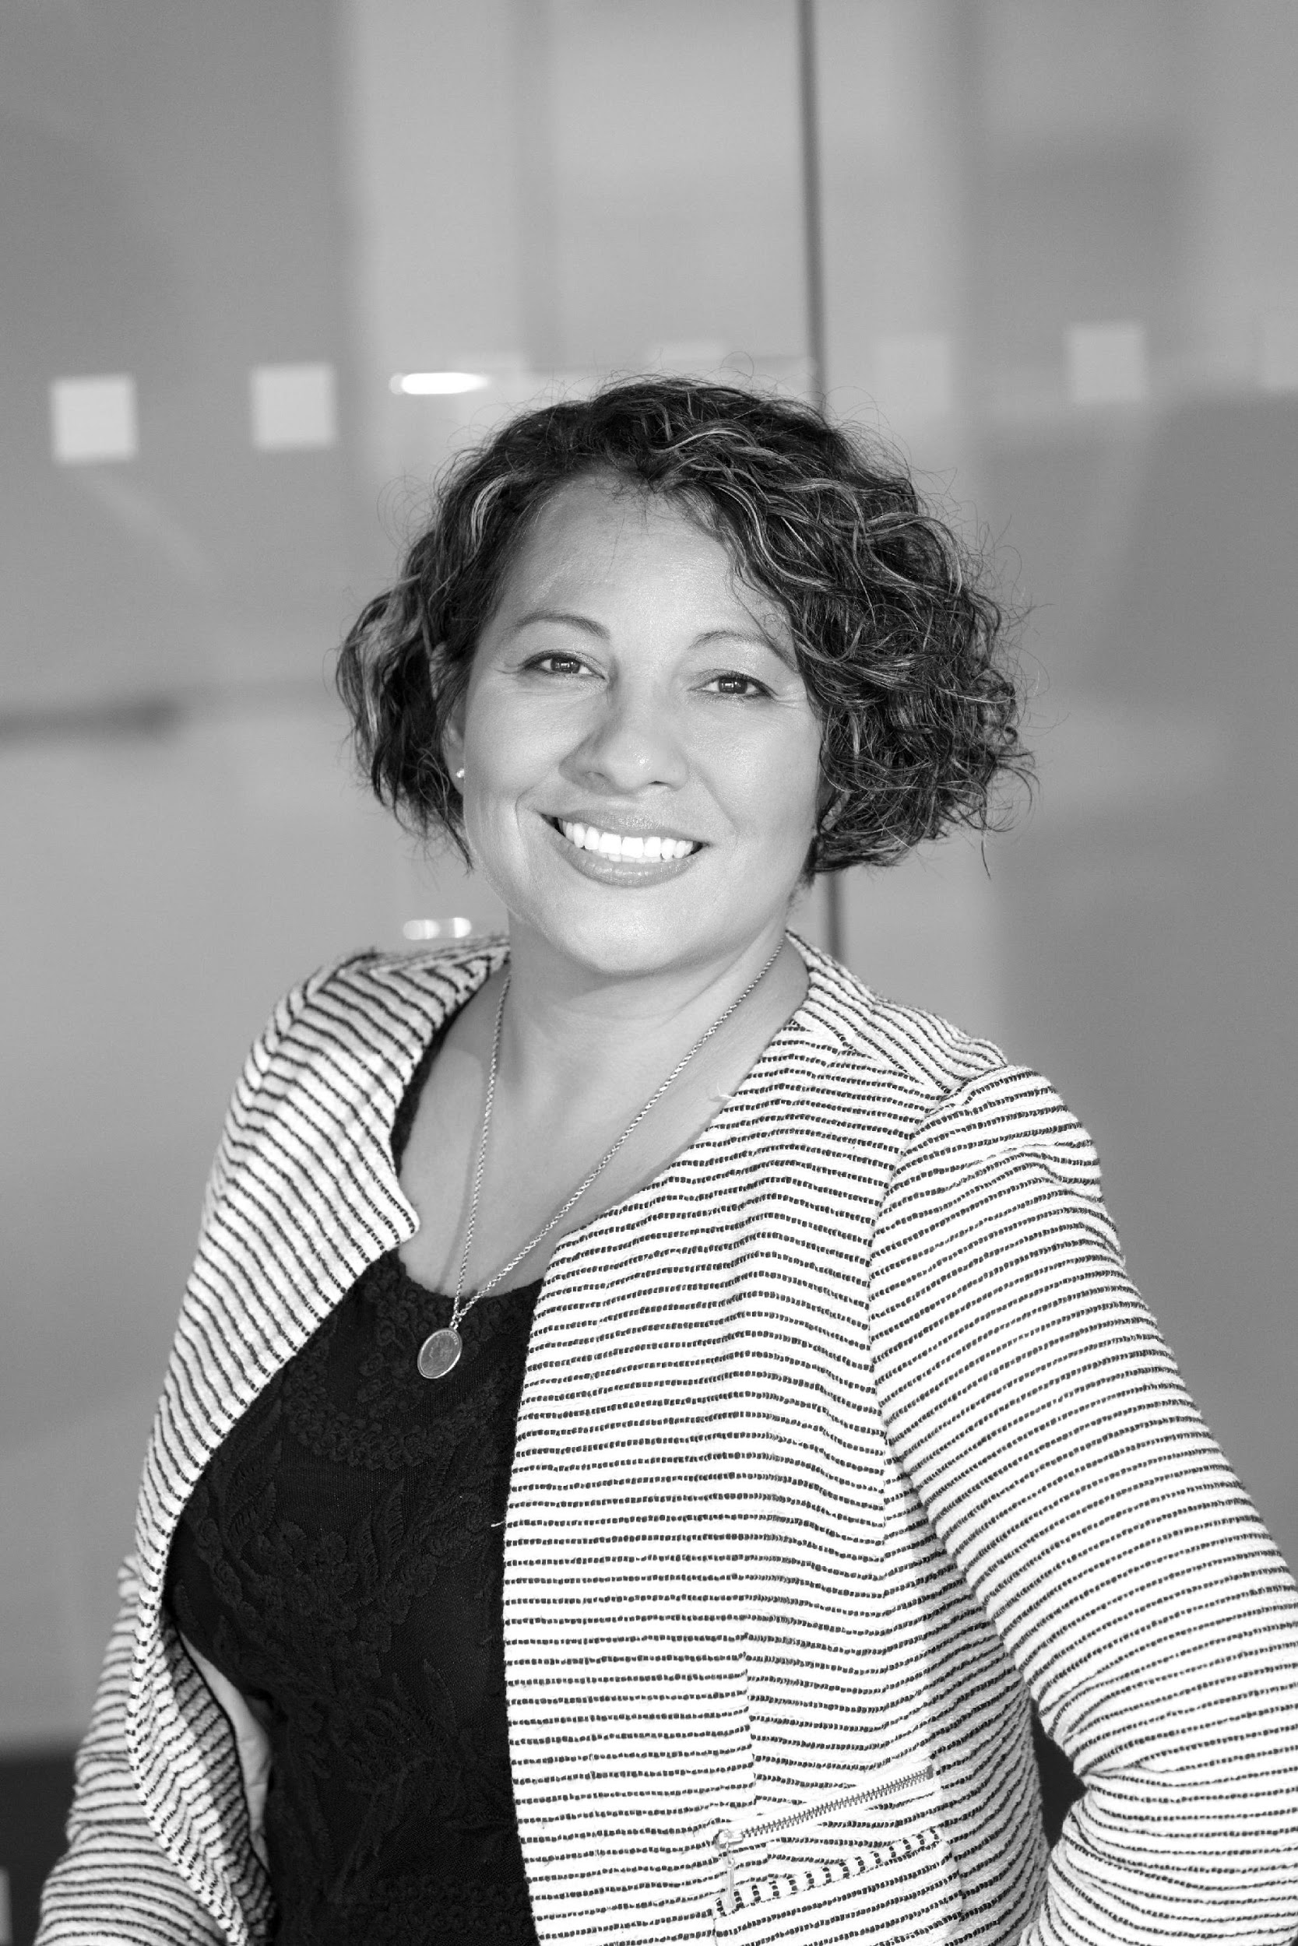
EXECUTIVE’S TESTIMONIALS
“
As one of the executives in the company, we at Fabulous Boutique & Fashion aims to give nothing but fabulously designed fashion pieces in the market at affordable price points. Shop now & discover lots of amazing products that will give you nothing but satisfaction.
- Tony Bettany, 48, Chief Product Officer

Slide 5

Fabulous Boutique and Fashion Meeting Room
January 12, 2023 | 12 PM - 6 PM
The target market for this will be customers who are true blue fashion enthusiasts aged 18 to 39. The product launch under an extensive marketing promotion in the market could gain up to 40% increase in company product sales & gained profits. The initial gained profits from this product launch will be up to $30, 000.
SHOES & FASHION ACCESSORIES

Slide 6

GOWNS & DRESSES
Fabulous Boutique and Fashion Meeting Room
January 12, 2024 | 12 PM - 6 PM
The initial target of this product launch are the customers who are into fashion industry, fashion enthusiasts & individuals aged 18 to 49. The product launch under an extensive marketing promotion in the market could gain up to 45% increase in company product sales & profits.

Slide 7
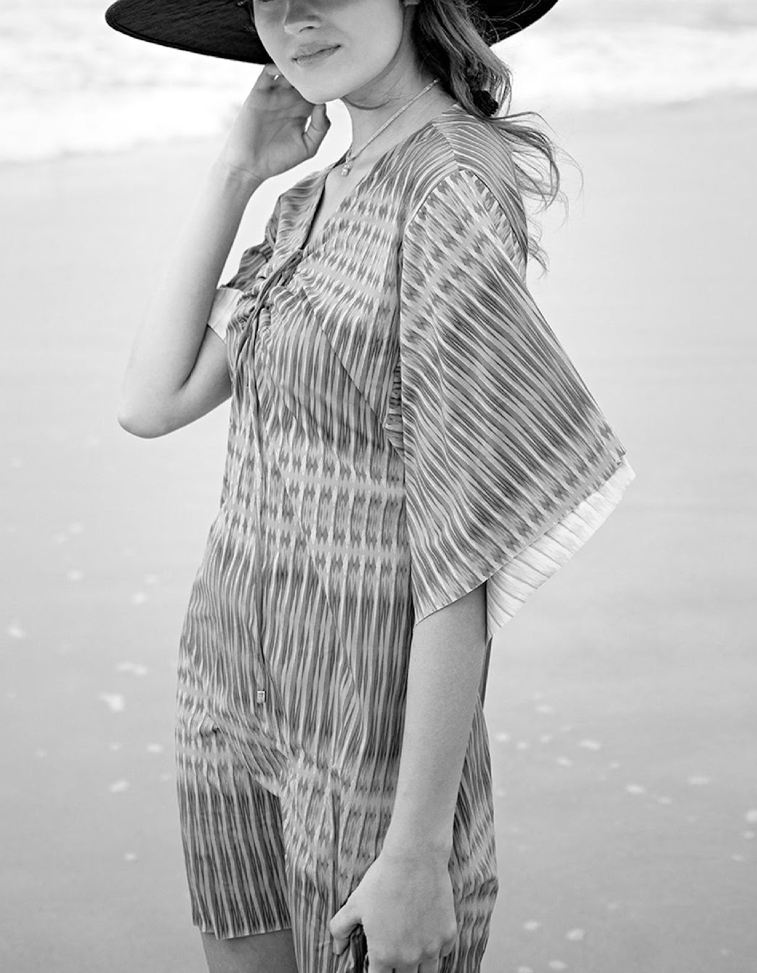
Fabulous Boutique and Fashion Meeting Room
May 12, 2024 | 12 PM - 6 PM
The initial target of this product launch in which the marketing and promoting campaign will be focused on will be the individuals aged from 6 to 70 years. Initially, the product launch under an extensive marketing promotion in the market could gain an up to 50% increase in company product sales & gained profits. The initial gained profits from this product launch will be up to $30, 000 which will sell up to 3, 000 products which can be used for the office renovation & system upgrade of Fabulous Boutique & Fashion.
SUMMER OUTFIT CRAZE

Slide 8
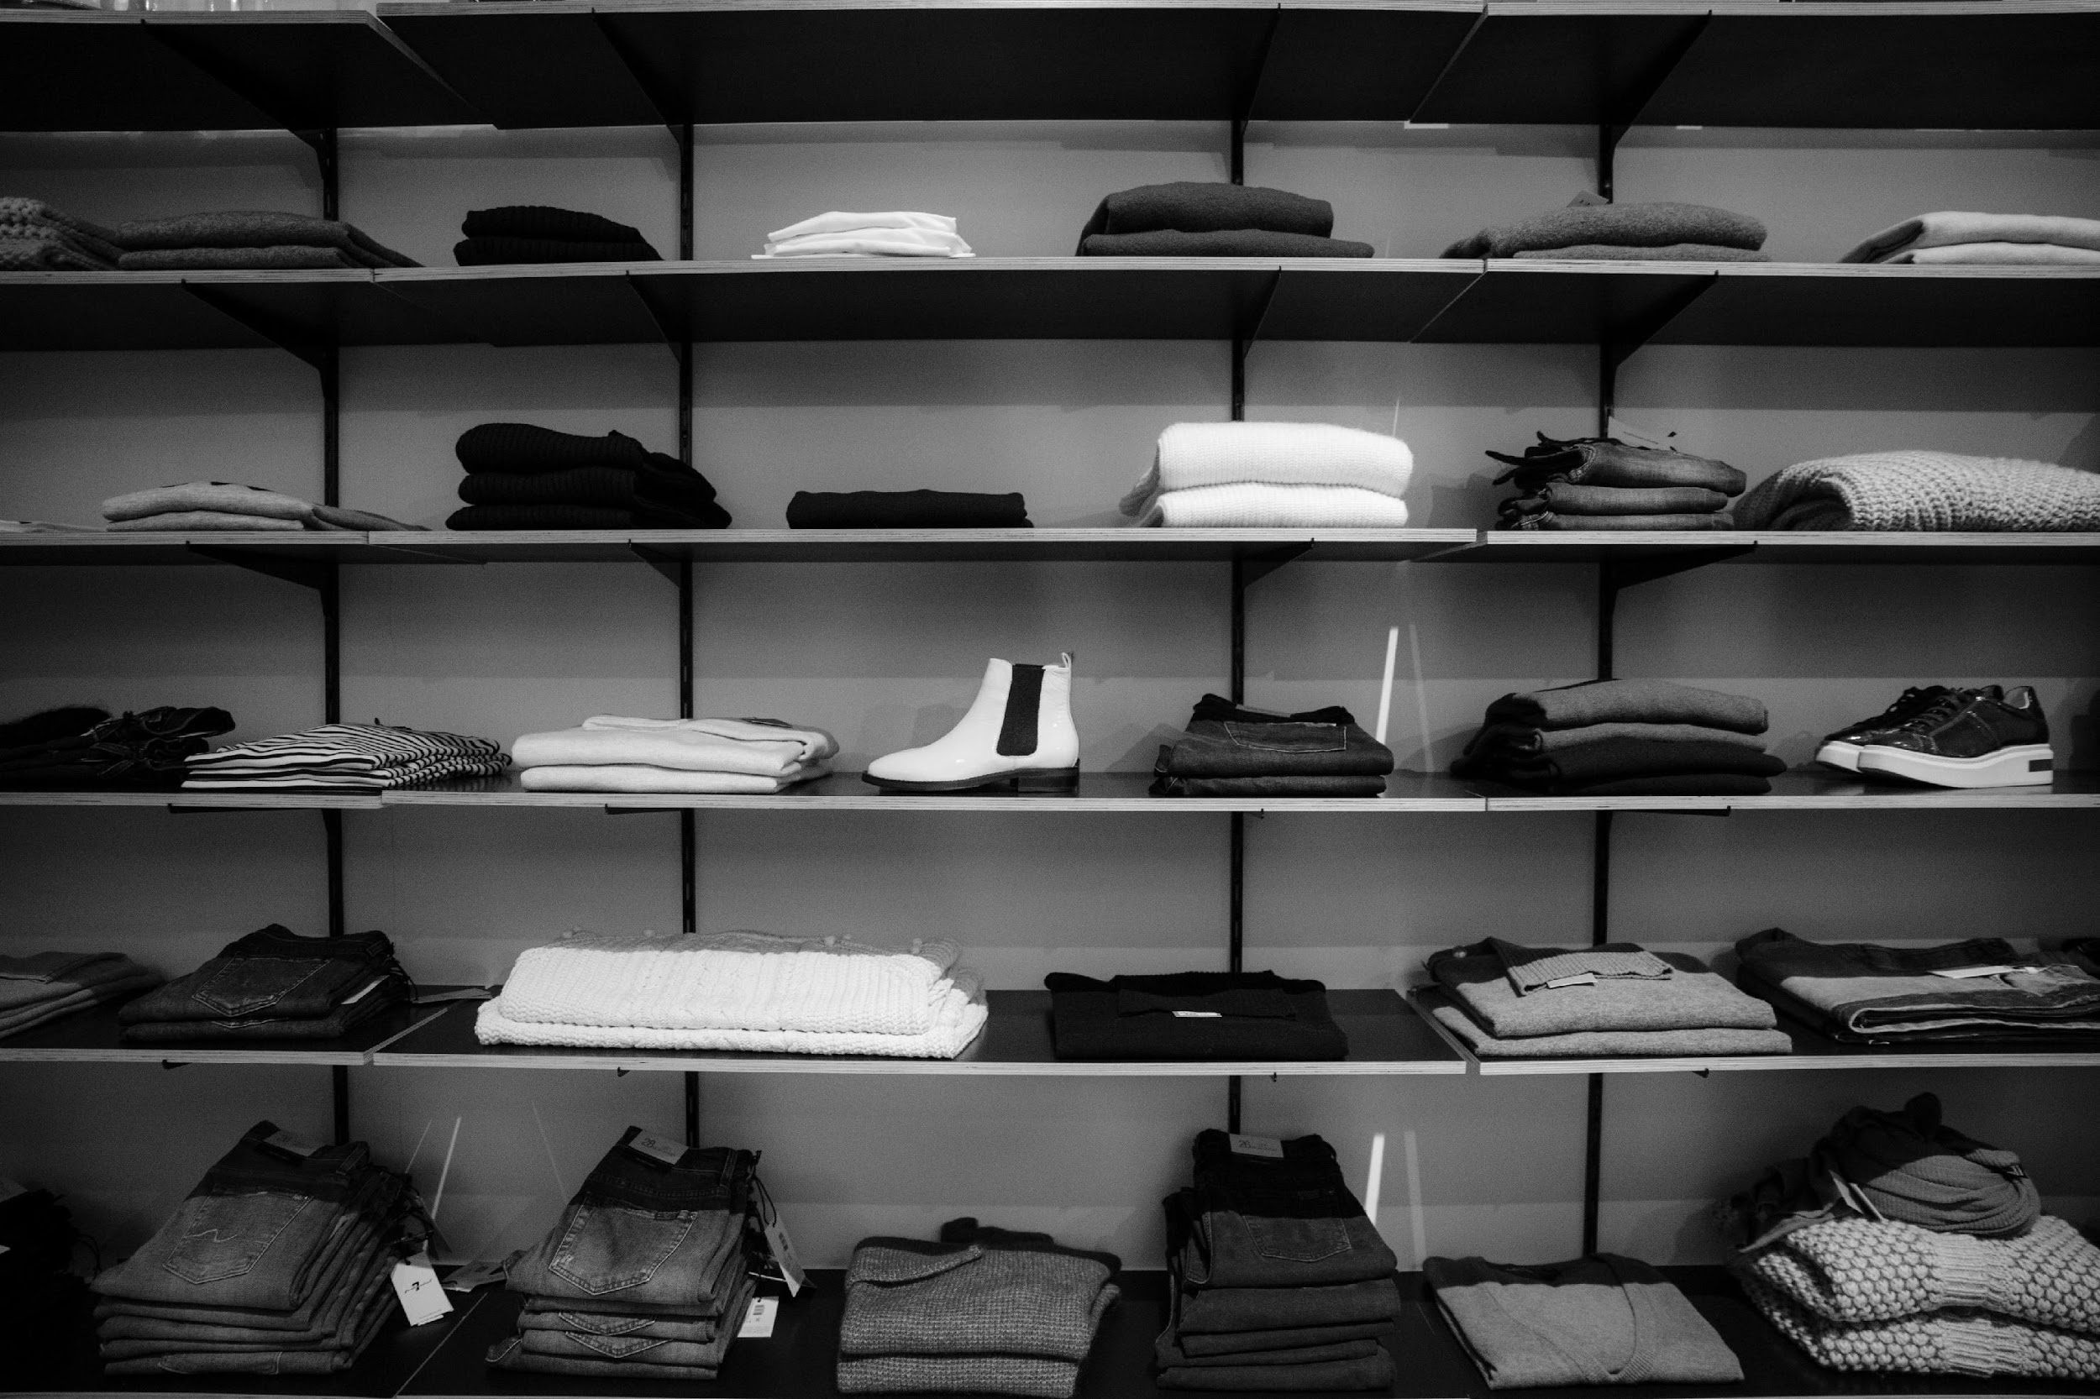
HISTORY
Founded by Jerry Halsey who is an active LGBT rights advocate & fashion designer, Fabulous Boutique & Fashion soars high as being one of the best fashion stores in the industry. Although the company today experienced a success in the industry, Halsey started the company having only $200 starting capital. Today, Fabulous Boutique & Fashion is a leading boutique in the fashion industry.

Slide 9
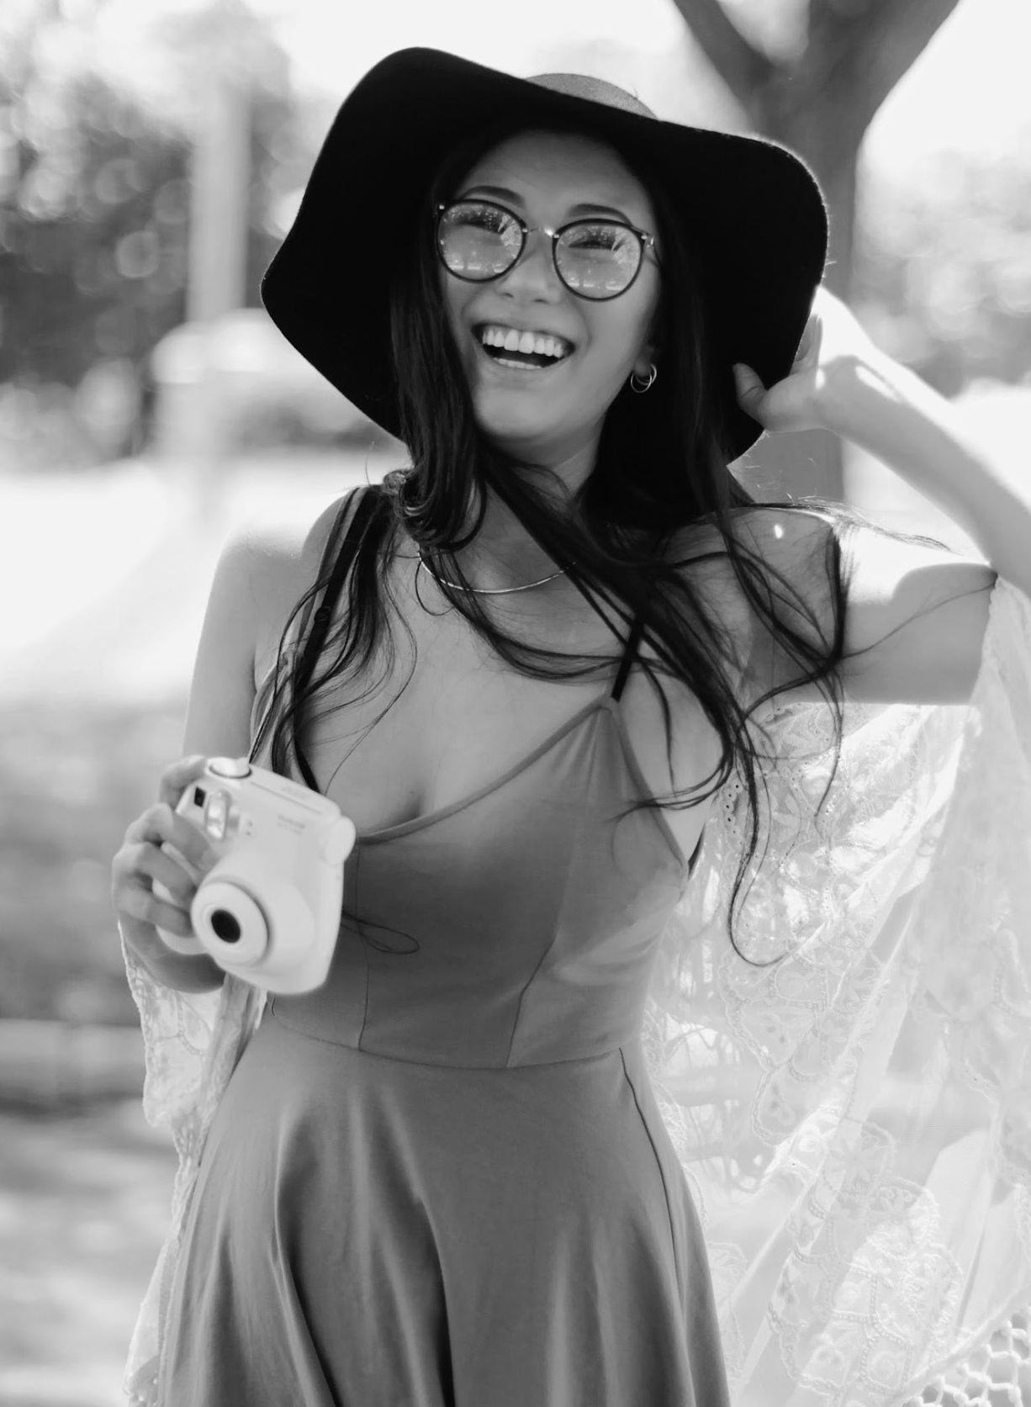
TESTIMONIALS
FROM CLIENT
“
I am always happy & satisfied with my purchases at Fabulous Boutique & Fashion. I highly recommend this shop to all individuals who are looking for quality shoes, gowns, & fashion pieces.
- Laurel Caroline Remedy, 24, Fashion Model & Blogger

Slide 10
MAIN GOAL
As the founder & chairman of this company I am proud to introduce you the Fabulous Boutique & Fashion. It was founded with an initial aim to provide fabulous fashion products at an affordable price point that various clients can avail of.

Slide 11
OVERVIEW OF GROWTH
50%
60%
60%
Increase in annual profits as of December 2022
Increase in customer satisfaction as
of March 2024
Increase in shops sold products in the market as of March 2023

Slide 12
WHAT WE OFFER
Lots of Amazing Products & Promos
On Trend Shoes & Clothes
Excellent Fashion Products
Friendly Customer Care & Service

Slide 13
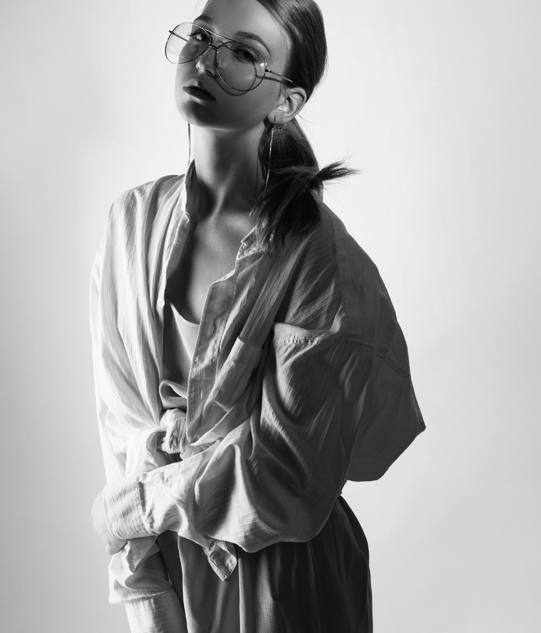
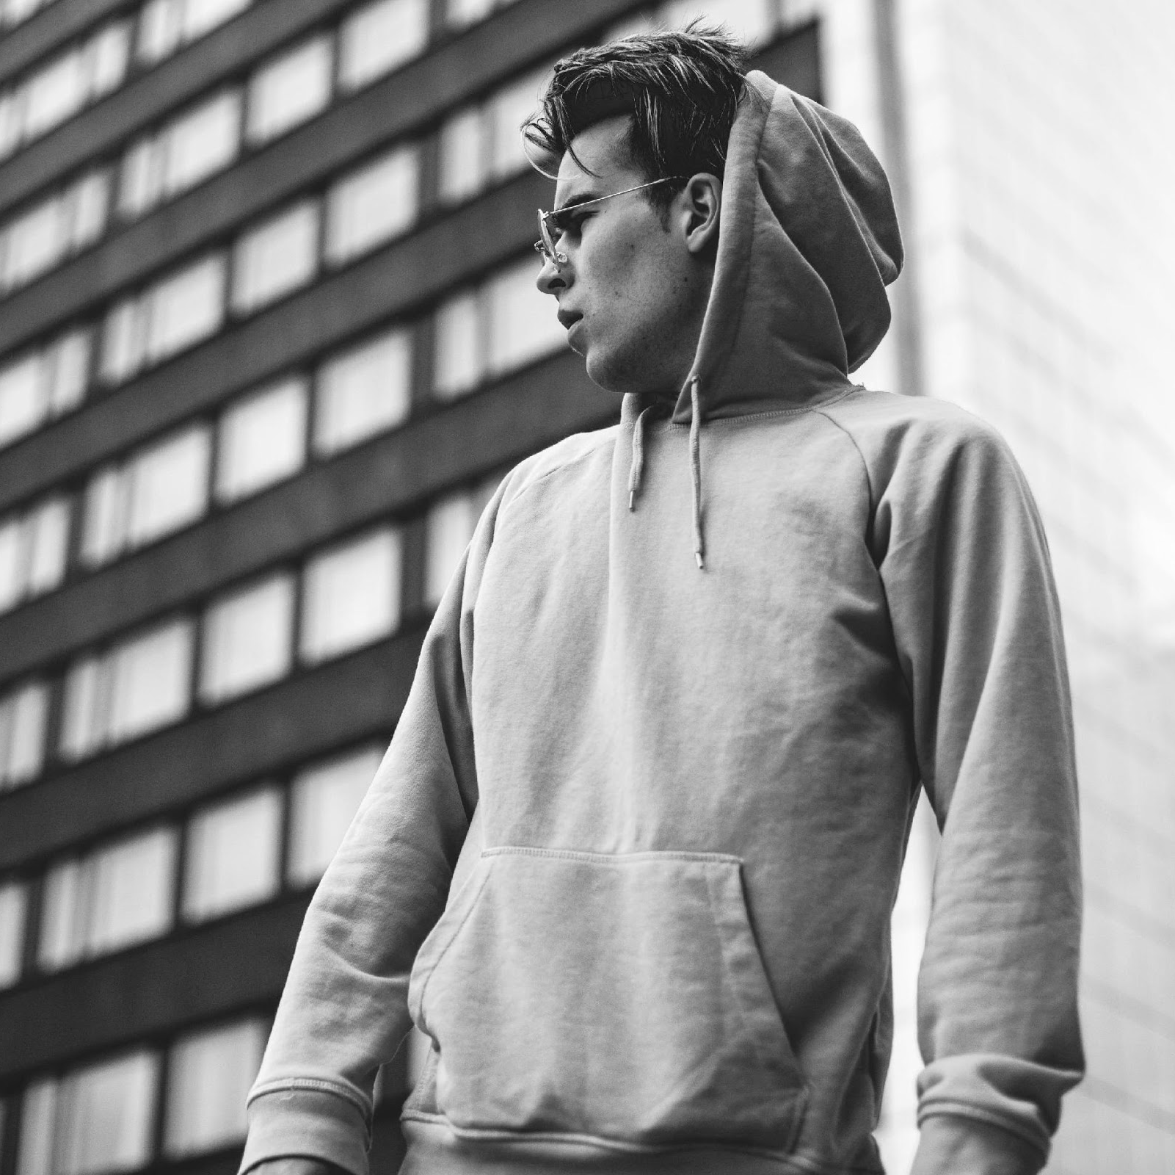
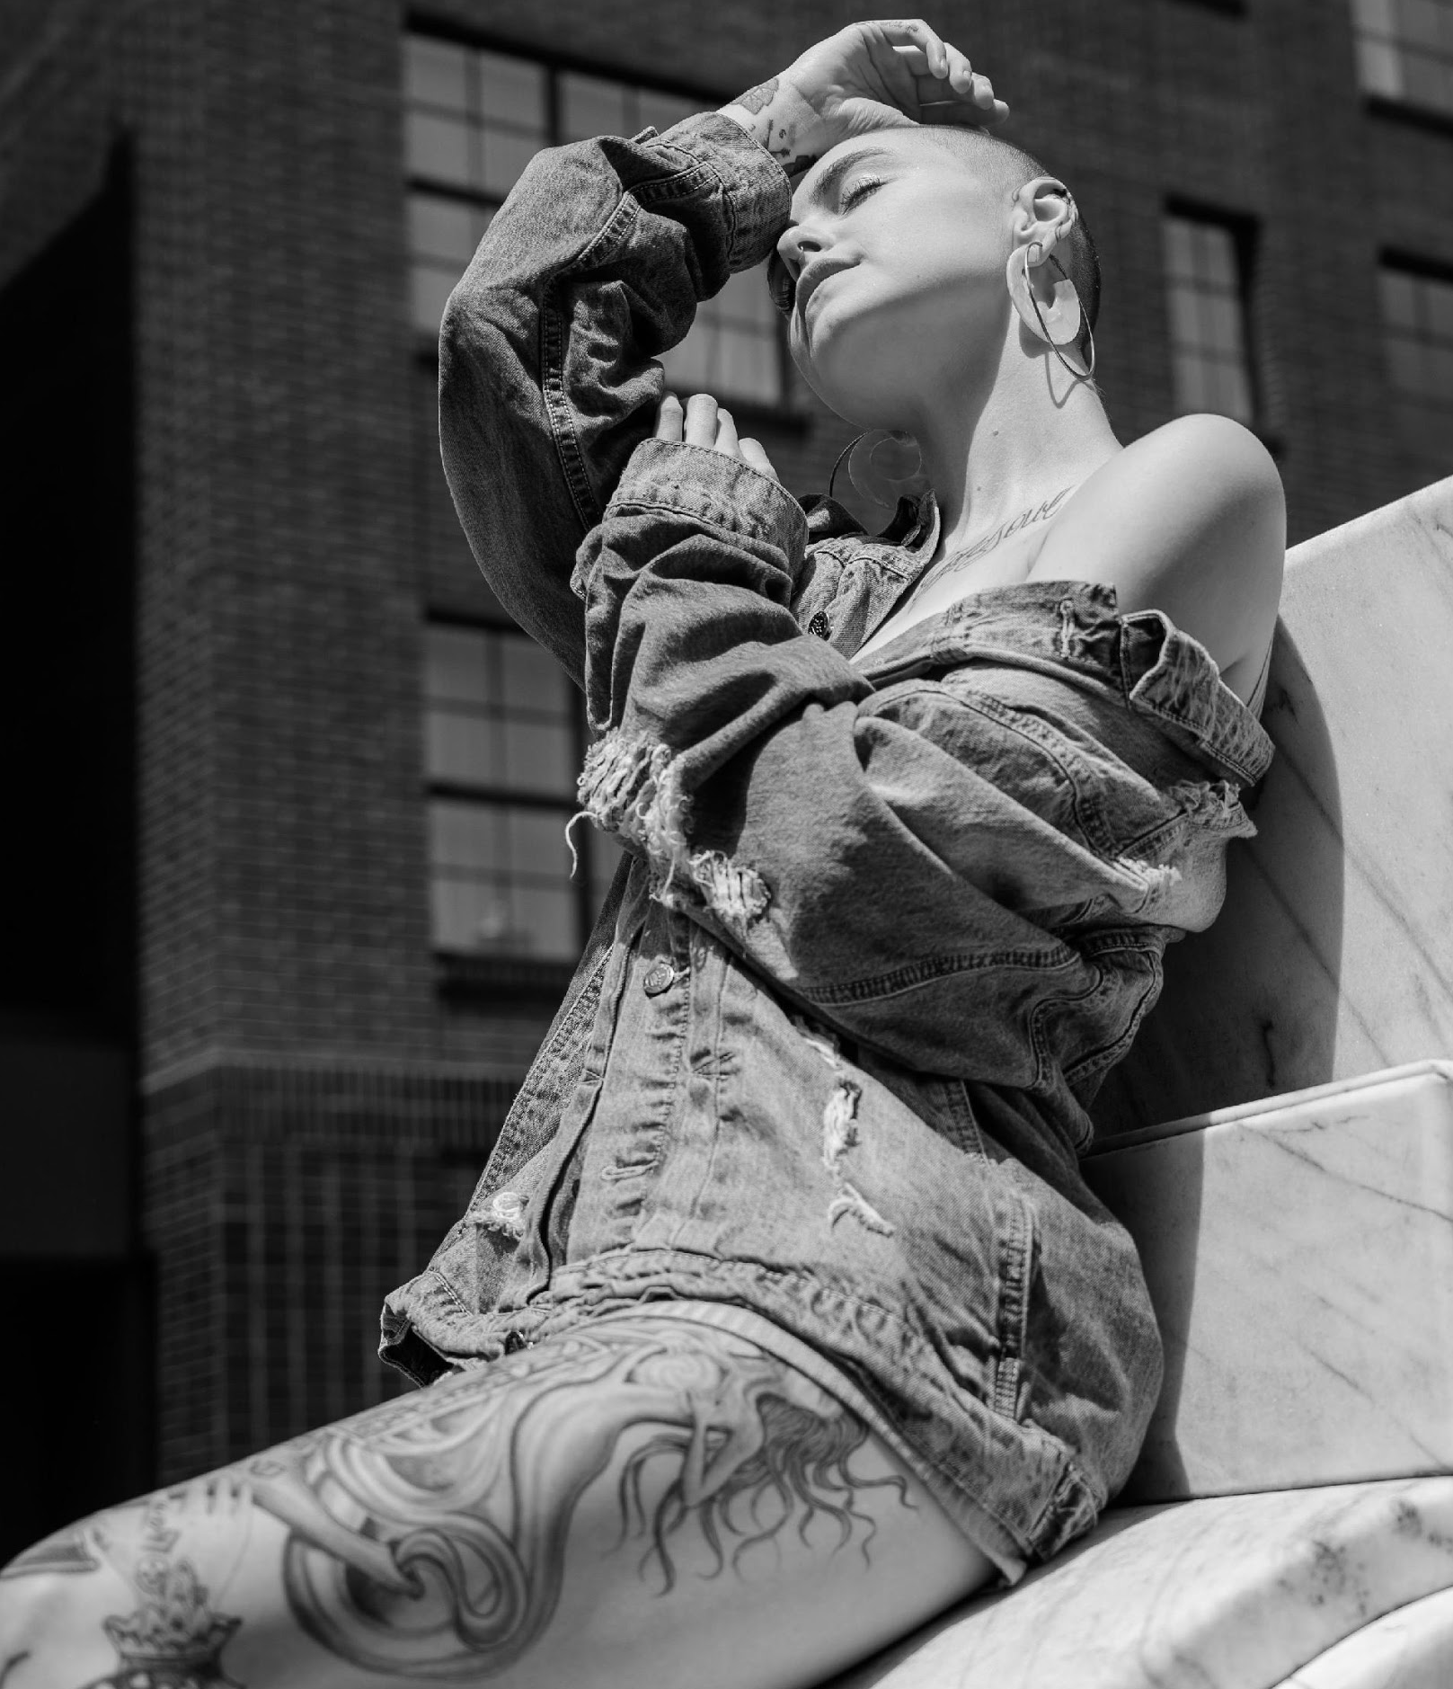
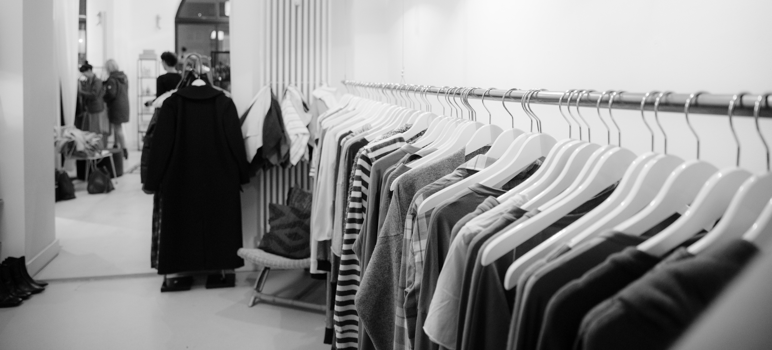
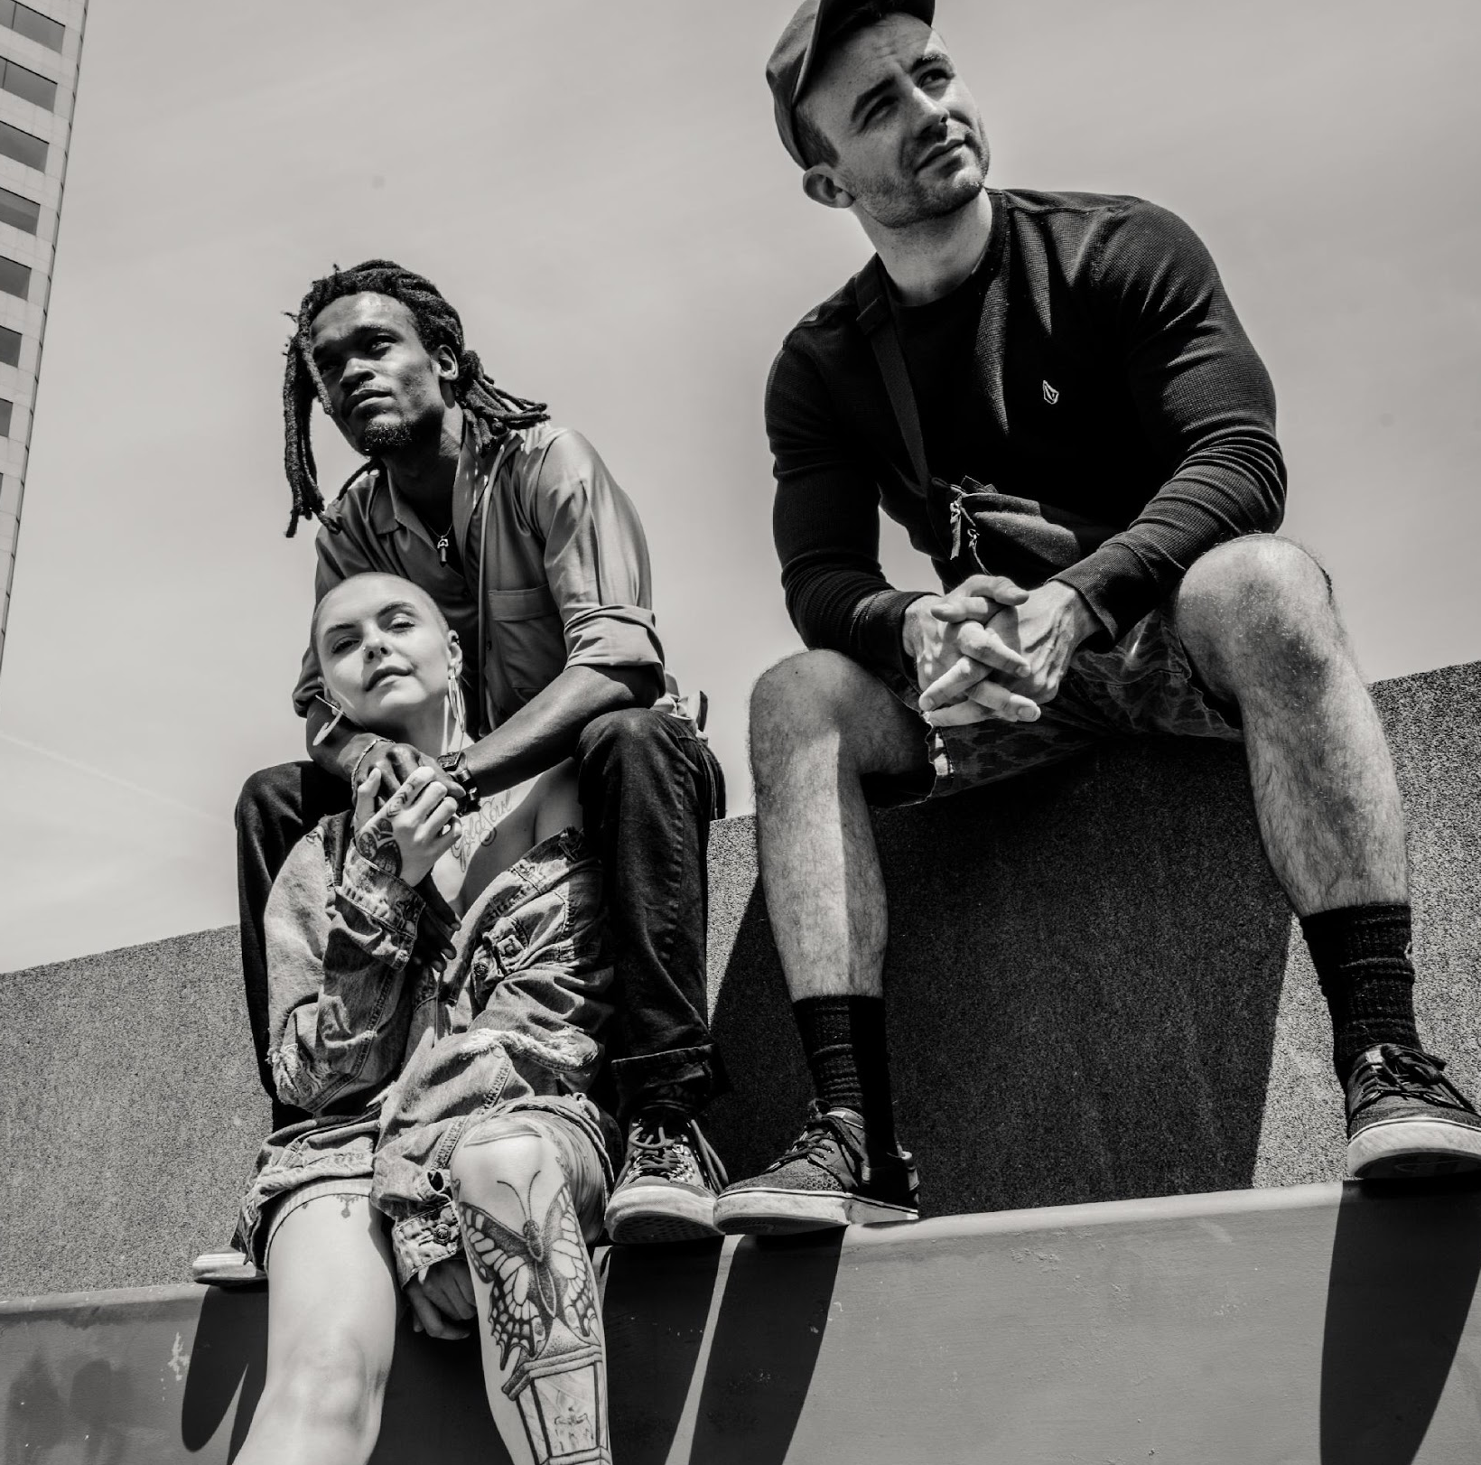
IMAGE GALLERY

Slide 14
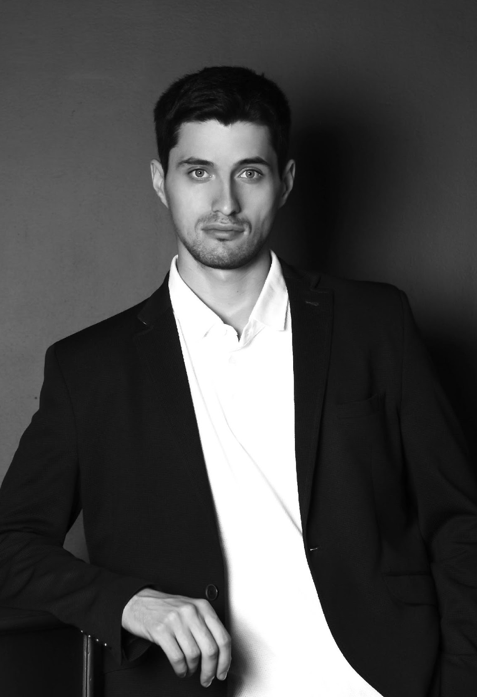
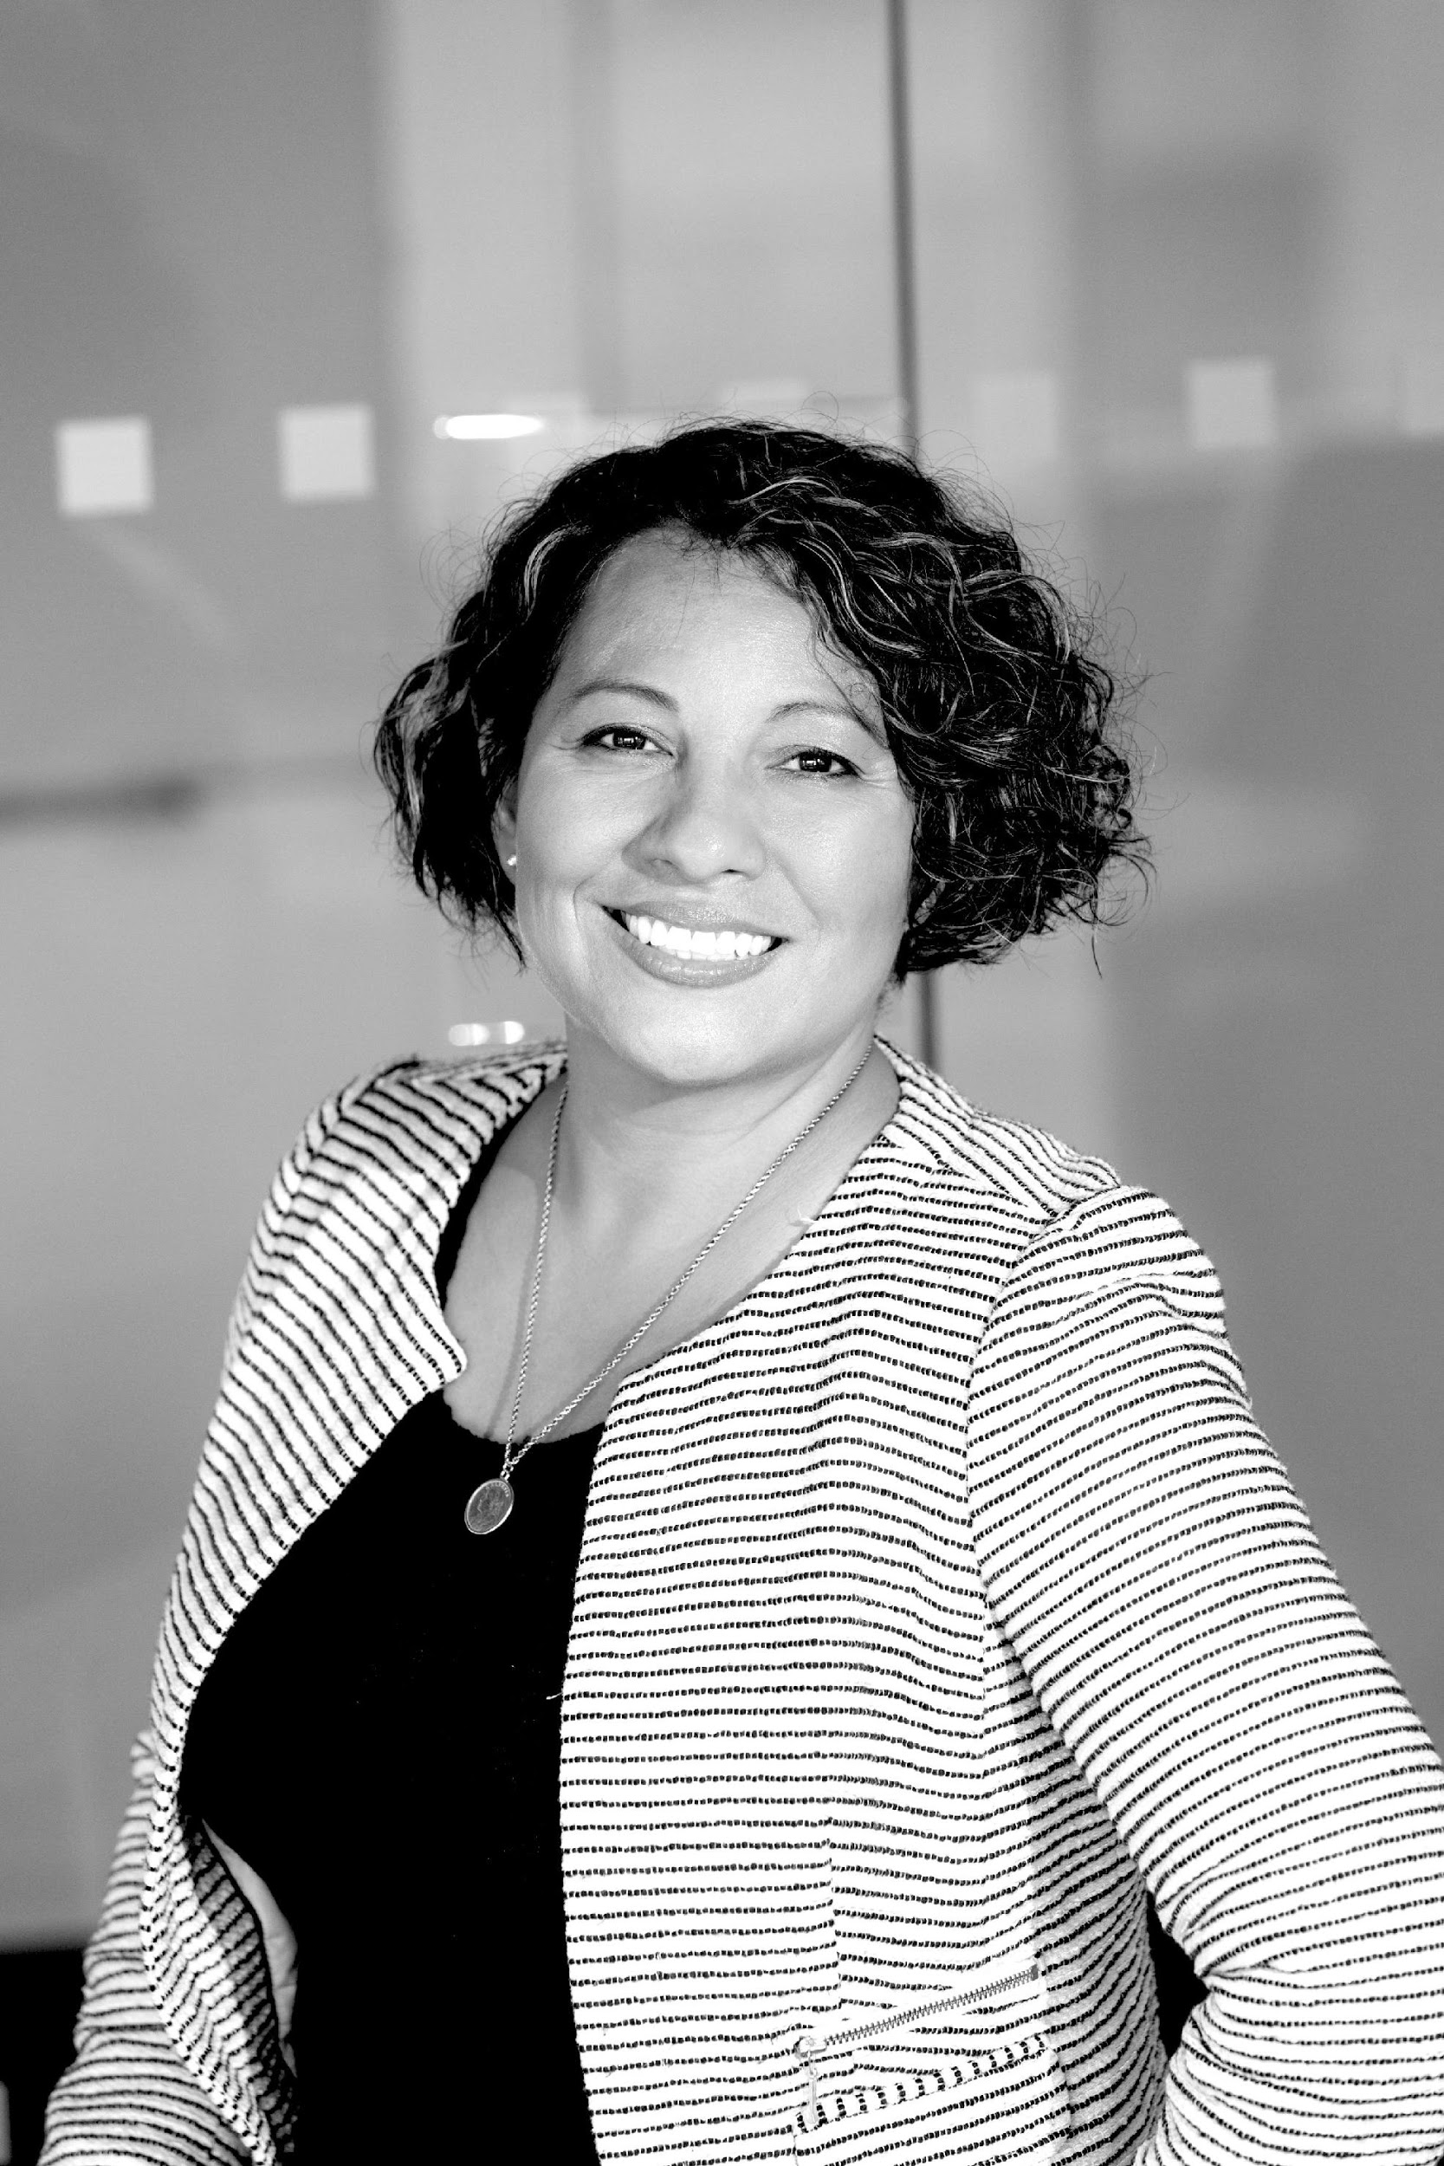
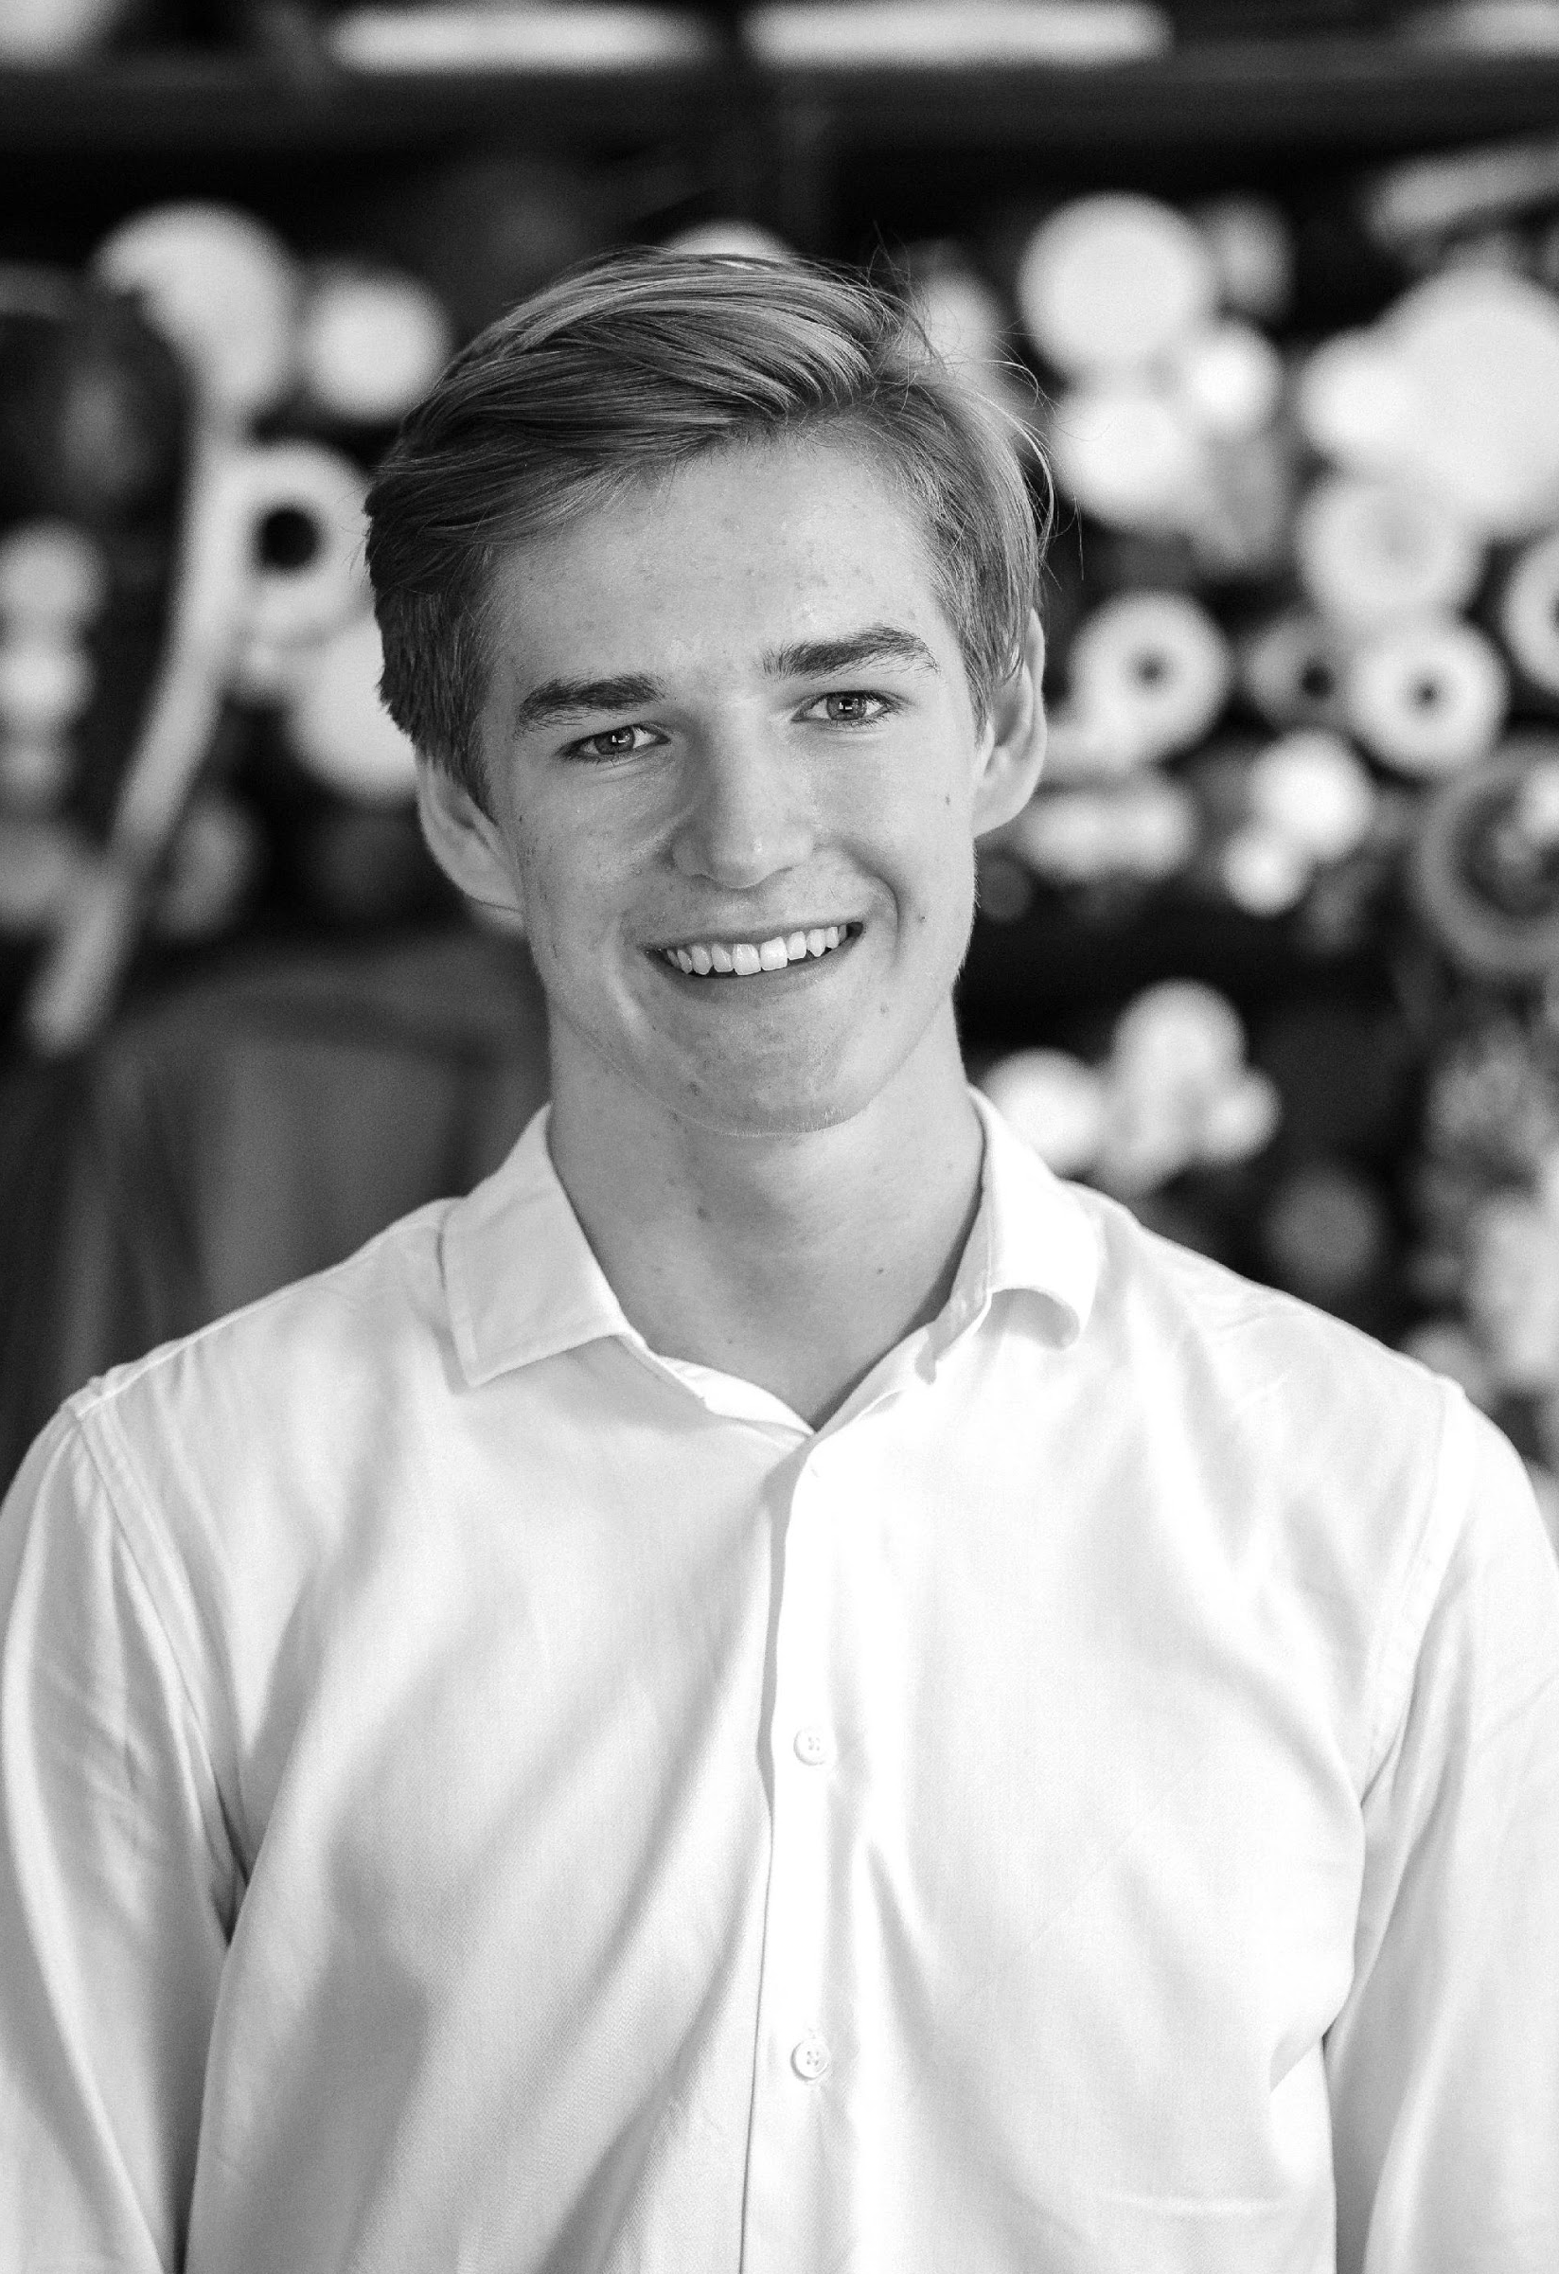
THE TEAM
Jerry Halsey
Tony Bettany
Bill Fernandez
Founder & Chairman
Chief Product Officer
Chief Operating Officer

Slide 15

THANK YOU
+982 23489234 | fabulousbf@gmail.com | fabulousbf.com

