Slide 1
Mic’ Check Recording Studios
94 Summit St. Davenport, IA 52807 | +9082 09284 | record@mic.com

Slide 2
RECORD AN ARTIST: A SPONSORSHIP EVENT
This event is dedicated to all aspiring musicians who aim to record and publish their own music. It will be held on June 30, 2023 at Music Grounds Convention Hall from 1pm to 7pm. Ticket prices start at $50 and will entitle all attendees to have the chance to be awarded with a full album sponsorship, and assistance with the production of their first music video. Perceived profits from this sponsorship event are estimated to be at least $350, 000 and will be used for the system upgrade and office renovation of the studio.
ONE IN MUSIC
Agenda
A concert developed and organized by the band “The Strings” and is aimed to support aspiring musicians all over Texas. This event will be held on July 4, 2024 at the 7 Strings Coliseum Concert Grounds from 8pm to 12am. Mic’ Check Recording Studios will be the major sponsor for the event and will provide the music equipment, manage ticket sales and will be in charge for the marketing campaign of the event. As a major sponsor of this event, The Strings band will promote the brand and logo of Mic’ Check Recording Studios at every gig and concert.
RUN FOR MUSIC EVENT
This event is dedicated to all aspiring musicians who aim to record and publish their own music. It will be held on June 30, 2023 at Music Grounds Convention Hall from 1pm to 7pm. Ticket prices start at $50 and will entitle all attendees to have the chance to be awarded with a full album sponsorship, and assistance with the production of their first music video. Perceived profits from this sponsorship event are estimated to be at least $350, 000 and will be used for the system upgrade and office renovation of the studio.

Slide 3
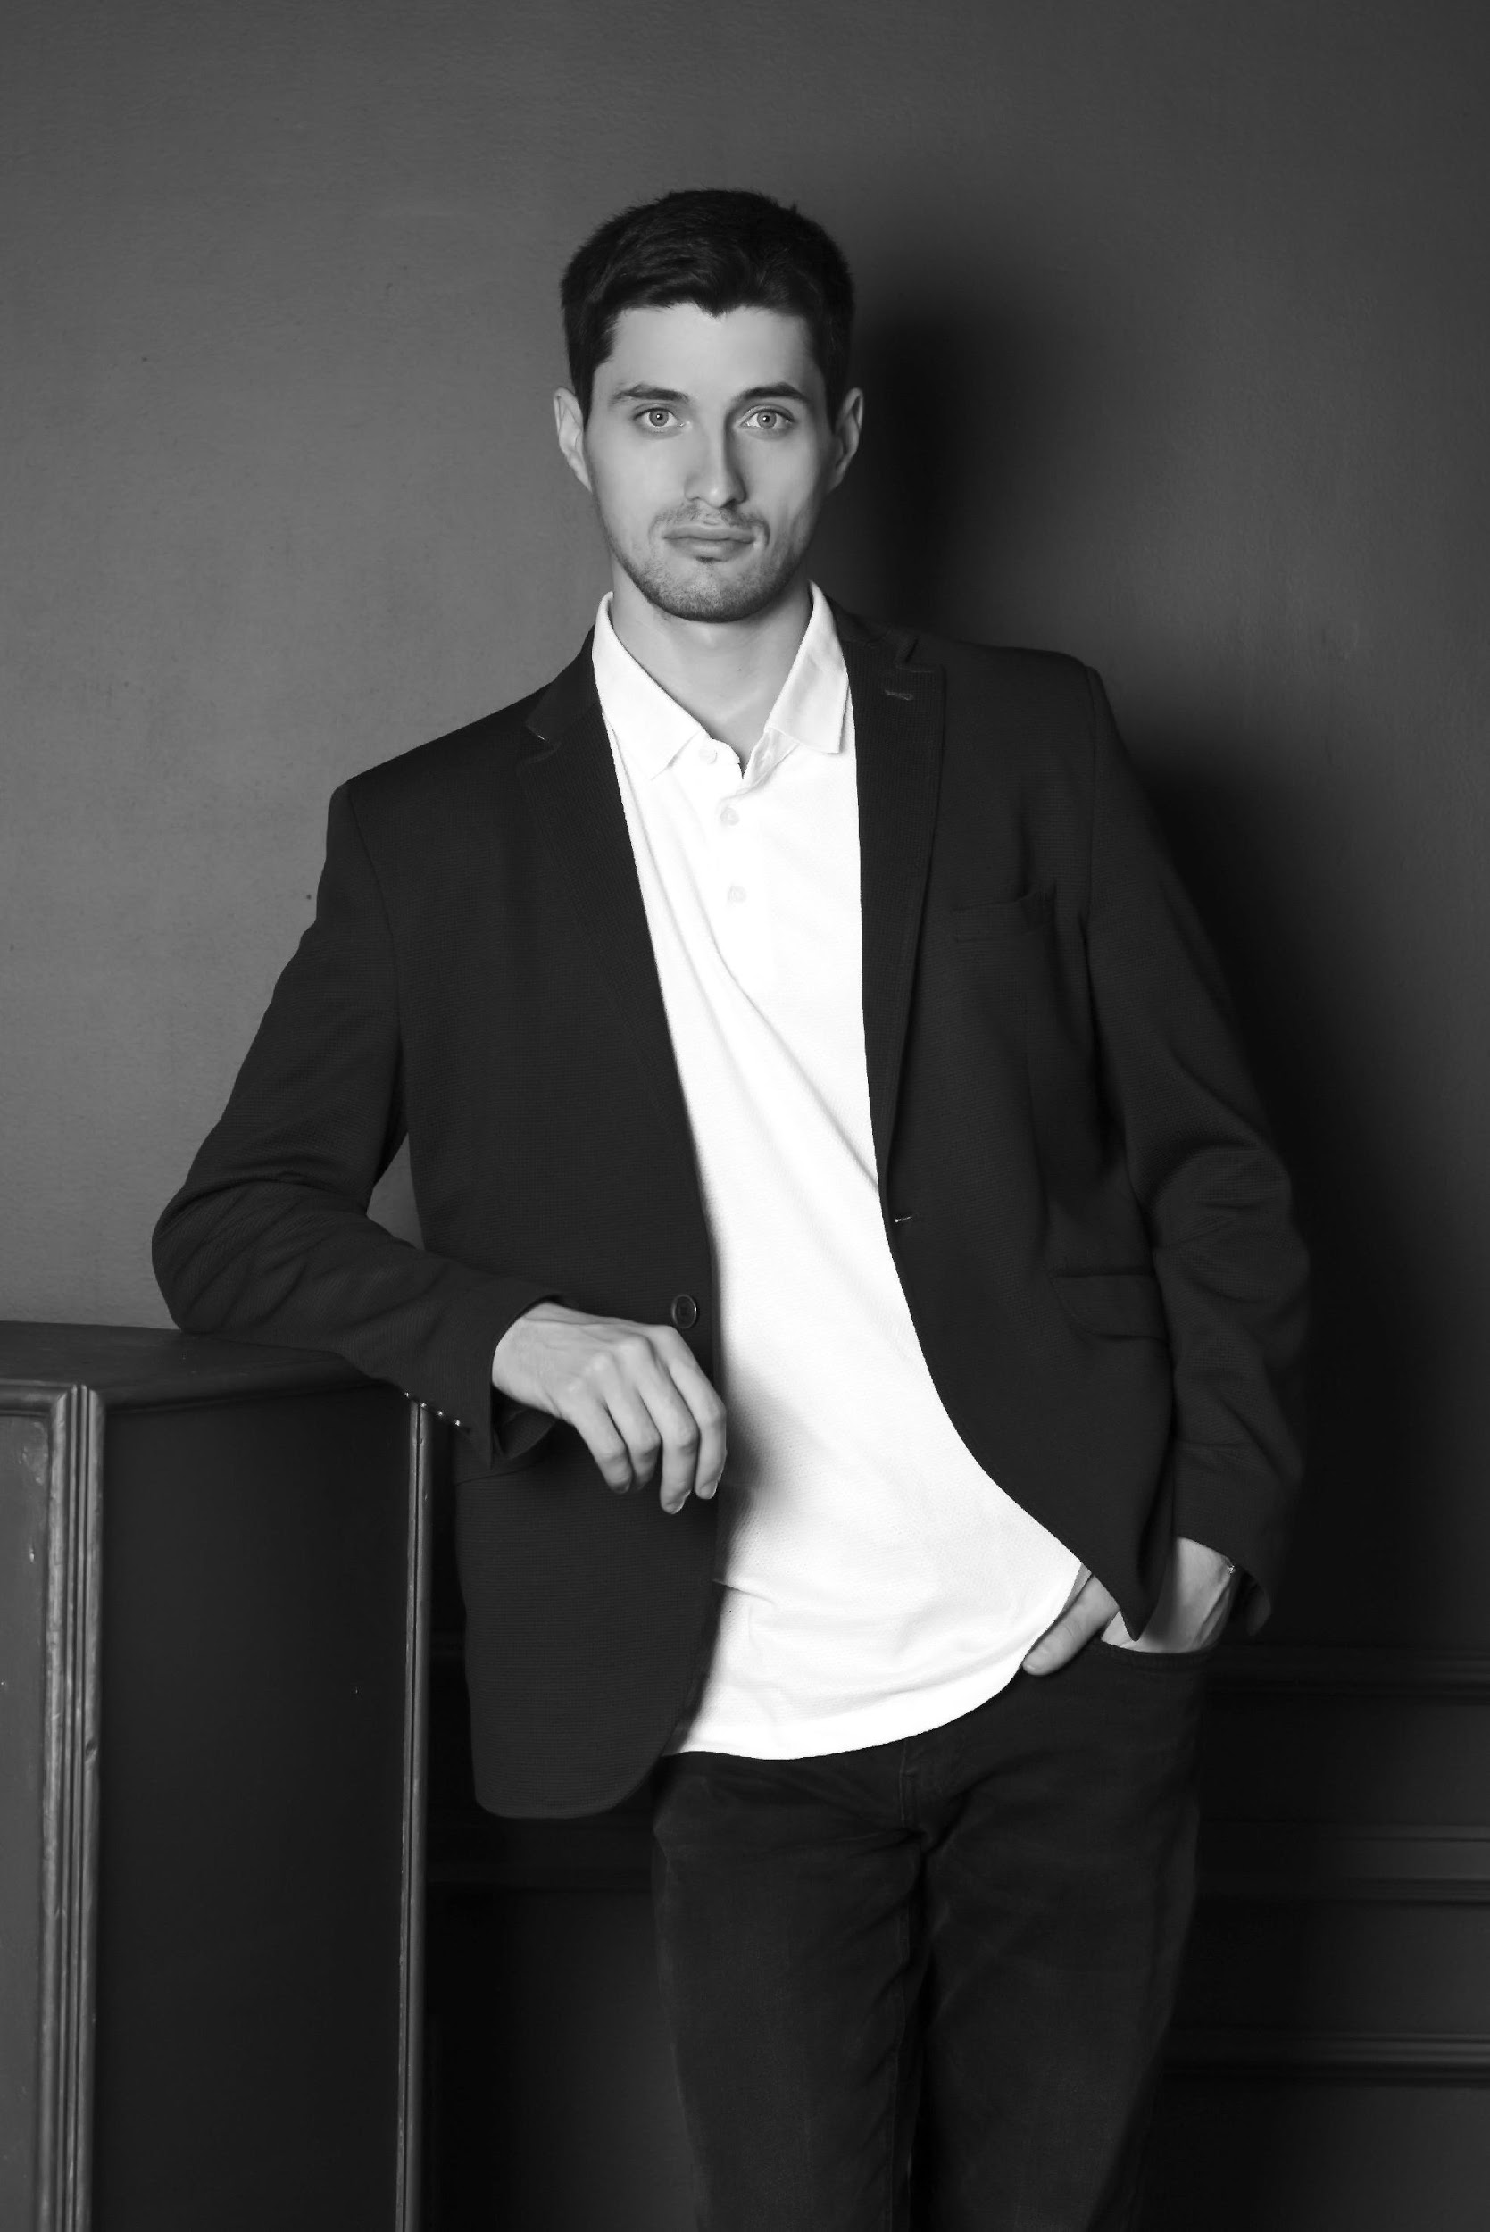
Andre “ManChild” Horry
Mic’ Check Recording Studios is a music recording studio located at Houston, Texas and was founded by rap artist, music producer and entrepreneur Andre “ManChild” Horry. Mic’ Check Recording Studios offers the best quality of sound and service for all musicians who aim to produce and record
their songs.
About

Slide 4
Testimonials
“
Mic’ Check Recording Studios offers a variety of product packages aimed to deliver the best and most authentic quality of sound experience for all musicians that aspire to release and publish
their songs.
-Steve Madison, 47, Chief Sound Engineer

Slide 5
Music Grounds Convention Hall
June 30, 2023 | 1pm to 7pm
This event is dedicated to all aspiring musicians who aim to record and publish their own music. Ticket prices start at $50 and will entitle all attendees to have the chance to be awarded with a full album sponsorship, and assistance with the production of their first music video. Perceived profits from this sponsorship event are estimated to be at least $350, 000 and will be used for the system upgrade and office renovation of the studio.
Record An Artist: A Sponsorship Event

Slide 6
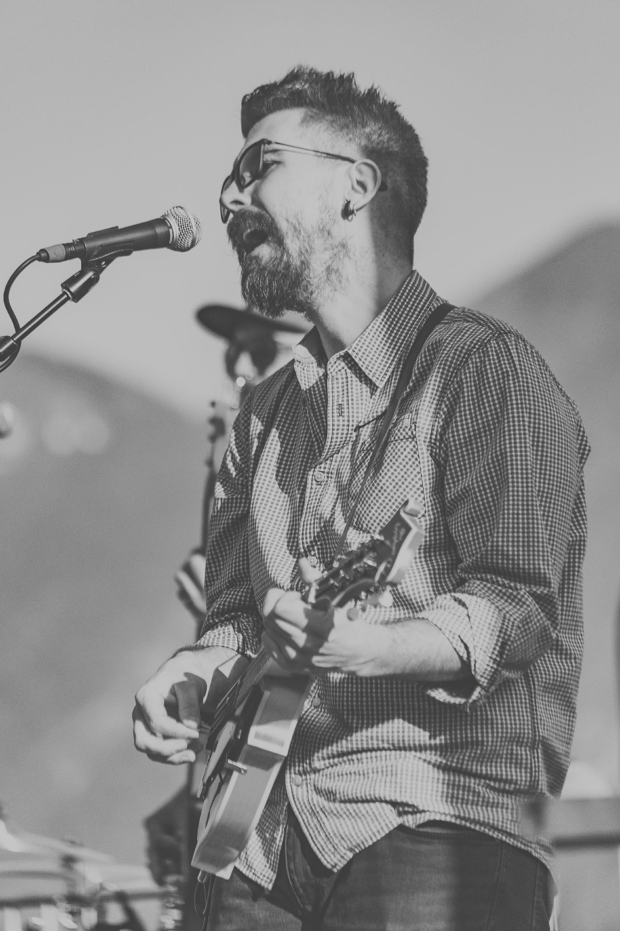
One In
Music
7 Strings Coliseum Concert Grounds
July 4, 2024 | 8pm to 12am
“One in Music” is a concert developed and organized by the band “The Strings” and is aimed to support aspiring musicians all over Texas. Mic’ Check Recording Studios will be the major sponsor for the event and will provide the music equipment, manage ticket sales and will be in charge for the marketing campaign of the event. Profits gained from this sponsorship is estimated to be up to $900, 000 to $1 million and will be used for the opening of the new Manhattan branch of Mic’ Check Recording Studios.

Slide 7
Lincoln Memorial Circle
August 13, 2024 | 5am to 7am
This fun run is organized and developed One Music Academy and will be sponsored by Mic’ Check Recording Studios. As the leading sponsor of this event, Mic Check’ Recording Studios will provide the marketing campaign, ticket sales and event equipments. In return, the One Music Academy will promote the brand and logo of Mic’ Check Recording Studios at every musical activity. Profits gained from this sponsorship agreement is estimated to be between $500, 000 and $700, 000 and will be used for the system upgrade of the new Manhattan branch of Mic’ Check Recording Studios.
Run For Music Event

Slide 8
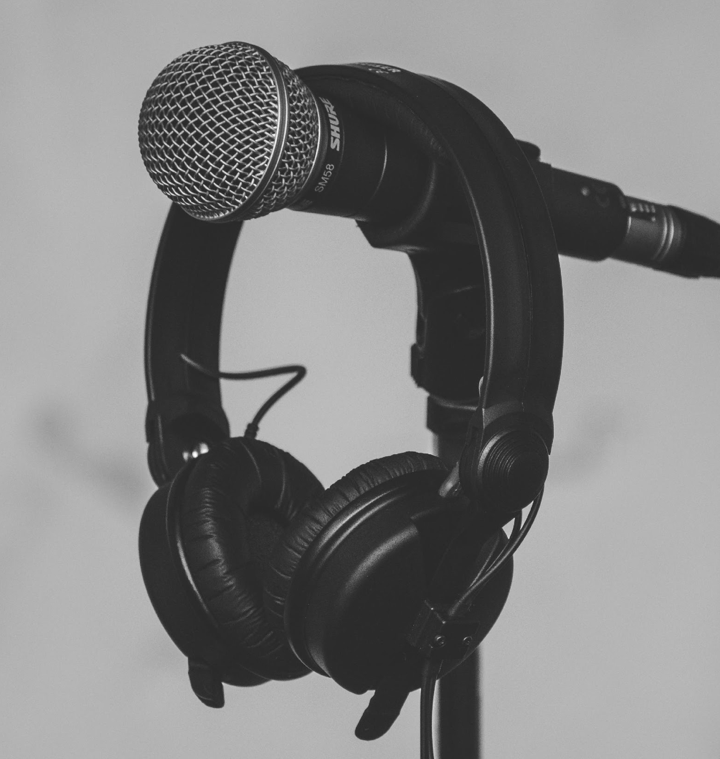
Mic’ Check Recording Studios was founded by Andre “ManChild” Horry in 1997. As a rap artist and music enthusiast, Andre established his own music recording studio to help new musicians unleash their true potential in creating music. The studio achieved its biggest accomplishment after managing the album release of the band “Love Shot” which sold over 5 million copies on its first 2 weeks. Today, the studio is now regarded as one of the leading and best recording studios in Texas and is now extending their brand to Manhattan and Ohio.
History

Slide 9
Testimonials
From Clients
“
As a musician who is in dire need of help in producing my songs, Mic’ Check Recording Studios gave me nothing but the best along with a hassle-free experience while producing my very first album. You can definitely count on them to make it work anytime.
-Johnson Smith, 25, Singer-Songwriter

Slide 10
Mic’ Check Recording Studios commits itself towards helping all musicians in producing the best quality of music they can possibly produce.
Main Goal

Slide 11
60%
Increase in product sales as of December 2025
Overview Of Studio’s Growth
70%
Increase in new clients as of December 2026
50%
Increase in launched albums as of December 2024

Slide 12
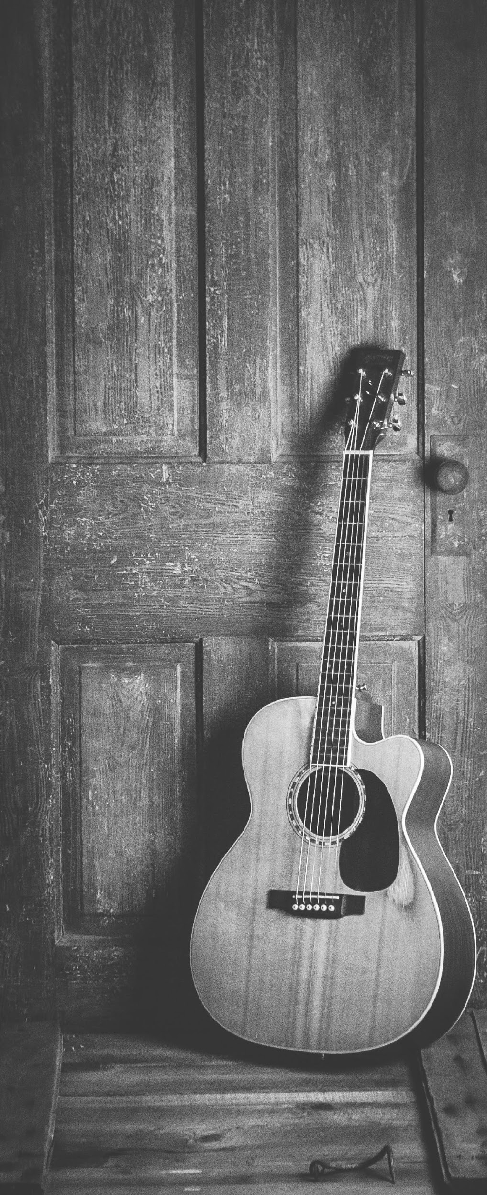
Excellent Music & Soundtrack Editing
Complete Recording Equipment
Lots of Amazing Recording Packages
Quality Assured Services
What
We Offer

Slide 13
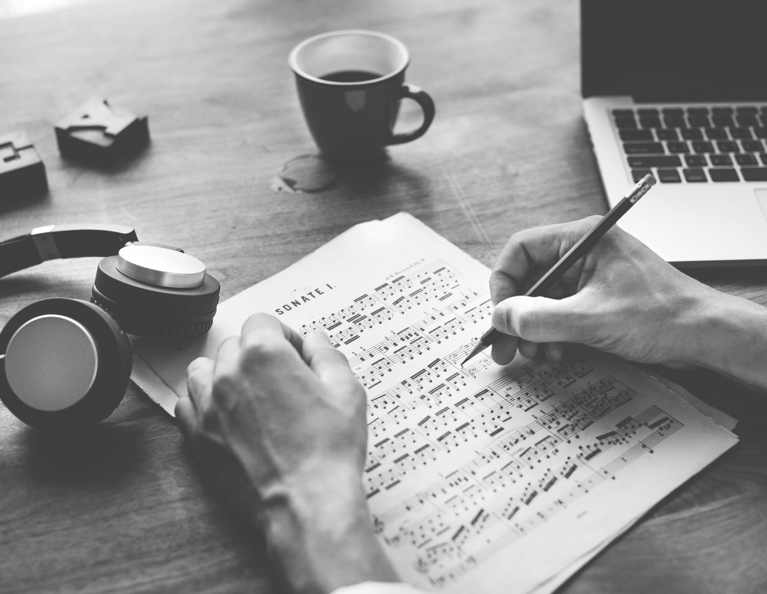
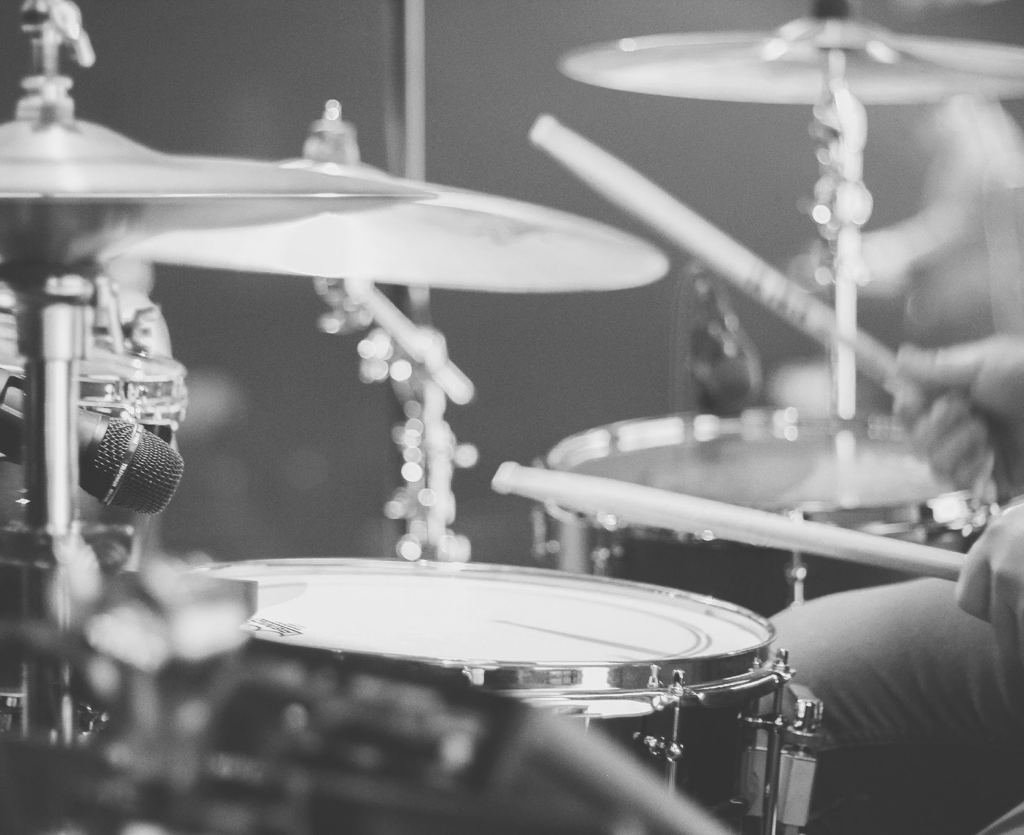
Image Gallery

Slide 14
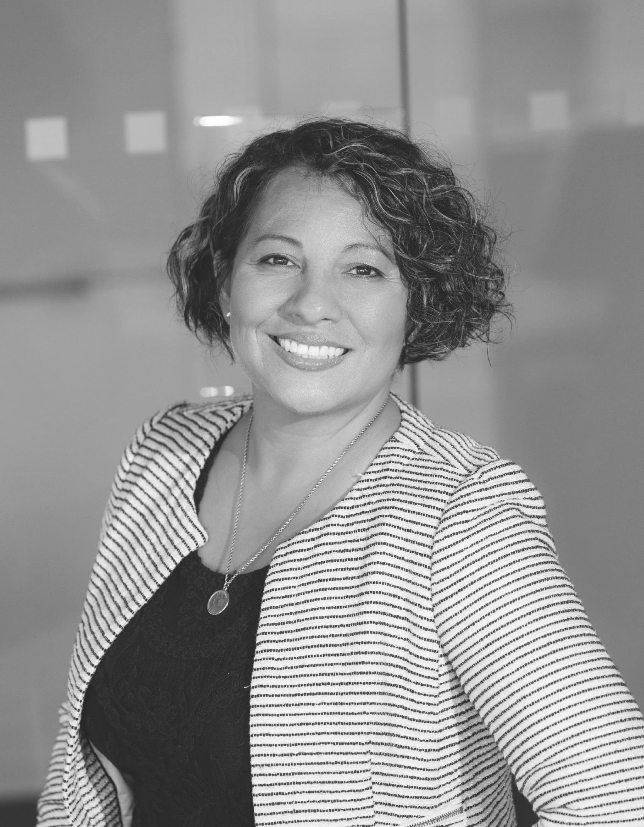
ANDRE “MANCHILD”
HORRY
STEVE
MADISON
LOVELY SHIELA
MANE
Founder & CEO
Chief Sound Engineer
Chief Marketing Manager
The Team

Slide 15
THANK YOU
record@mic.com

