Slide 1
Intertwine, Inc.
+982 23489234
intertwine@gmail.com
us@intertwine.com

Slide 2
AGENDA
01
02
03
Connect & Share
Gather Up
Bimonthly Meeting
This social interaction project aims to a worldwide connection to all people starting January 23, 2024. Connect & Sprovidehare is a free membership and registration project developed by the staff of Intertwine Inc. All profits gained from this project will be used to help restore the amazon rainforest organized by the international NGO Plant.org.
A 60 day worldwide tour from June 4, 2020 to August 4, 2020 starting in Singapore and ending in California. This socializing event is a concert aimed to fighting and raising awareness for depression. Tickets to this event will be $90 for 2 people and will entitle the attendees to 4 free bottles of beer, meet and greet with the event performers and ravekit.
Members of the board, staff and sponsors will be having their meeting at the Intertwine, Inc. headquarters every two months starting November 5, 2019 from 12pm to 6pm to discuss the status of the company’s current budget, profits, future events and marketing impact of the Intertwine, Inc. and its various projects.

Slide 3
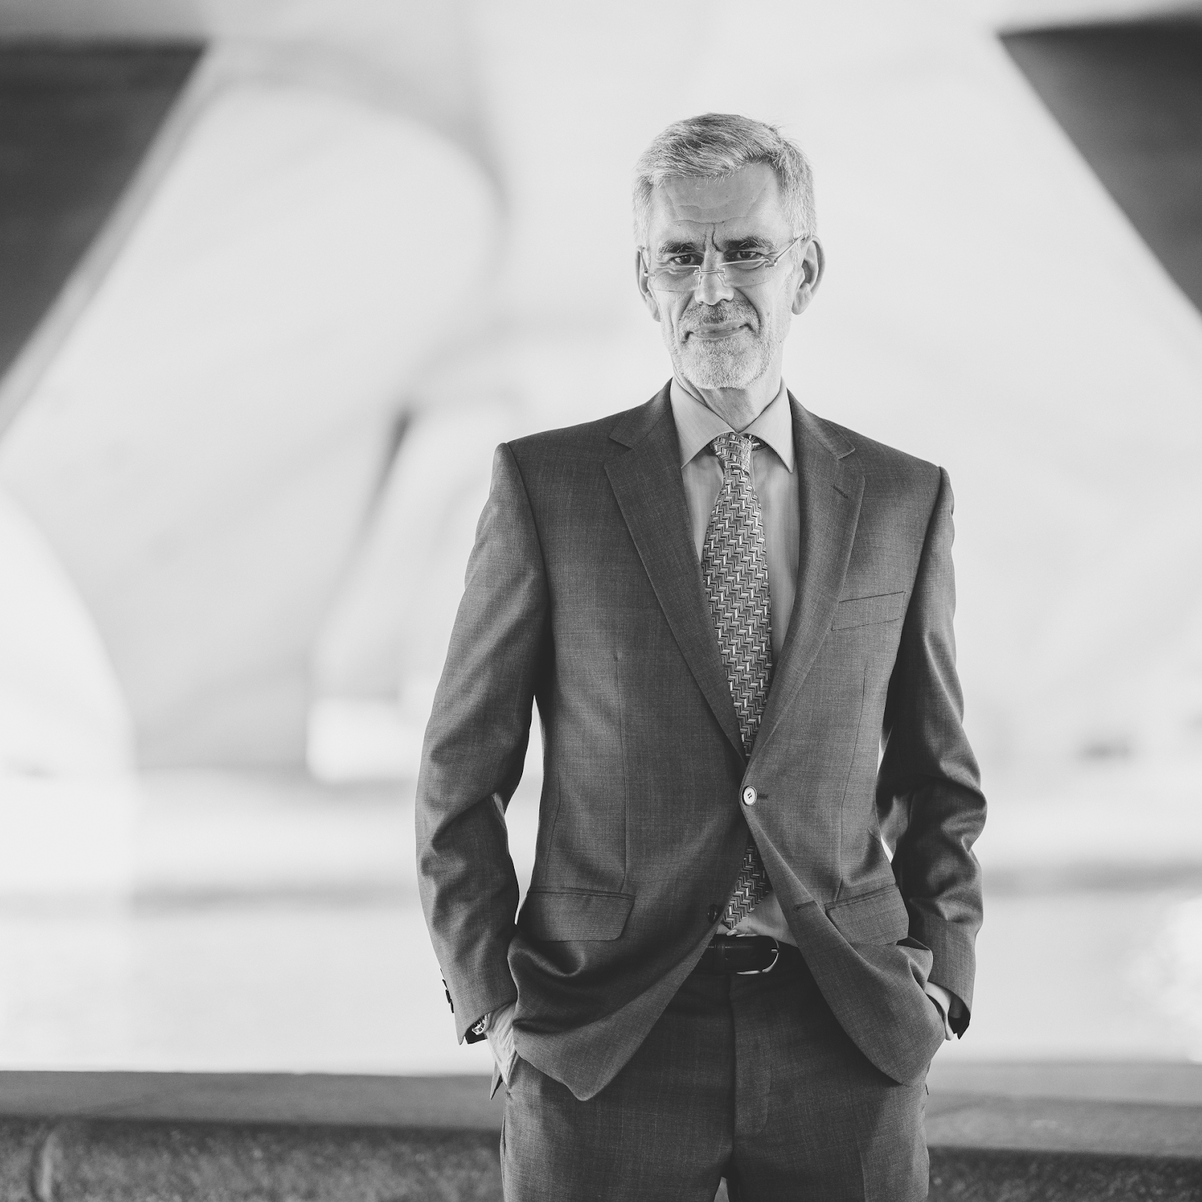
ABOUT
Intertwine, Inc. is a social interaction & networking site located in San Francisco, California. Founded in 2008 by Kevin Wilson, a website programmer and an IT expert from the city of Dallas, Texas.

Slide 4
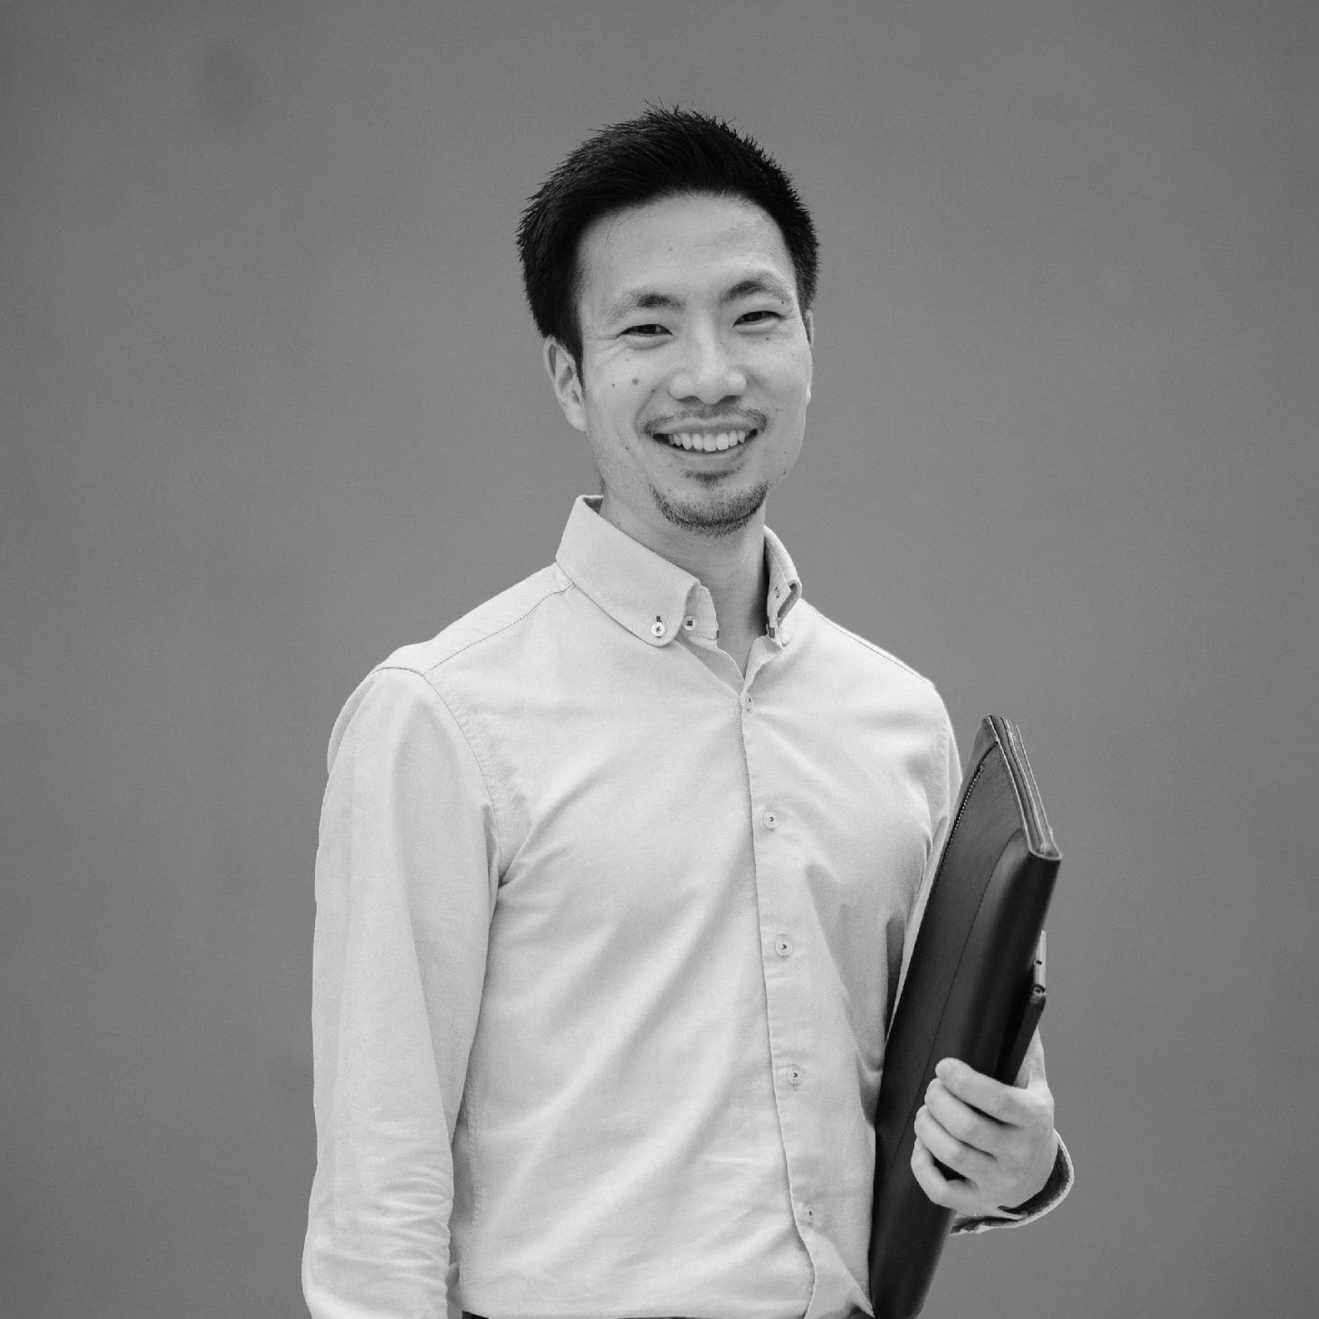
TESTIMONIAL
“
We aim to provide safe, secure, and effective socializing projects and events for all people around the world.
-Dean Blake, 31, Chief Marketing Officer

Slide 5
HISTORY
Intertwine, Inc. was founded in the year 2008 by Kevin Wilson who was a graduate of computer science at Harvard University. Kevin Wilson developed Intertwine, Inc. to raise awareness and fight depression through a social networking site available to all people for free. Today, the incorporation has a total of 500 million active users around the world and has been developing events and projects aimed to lessen the impact of depression and to balance online interaction addiction with personal interactions.

Slide 6
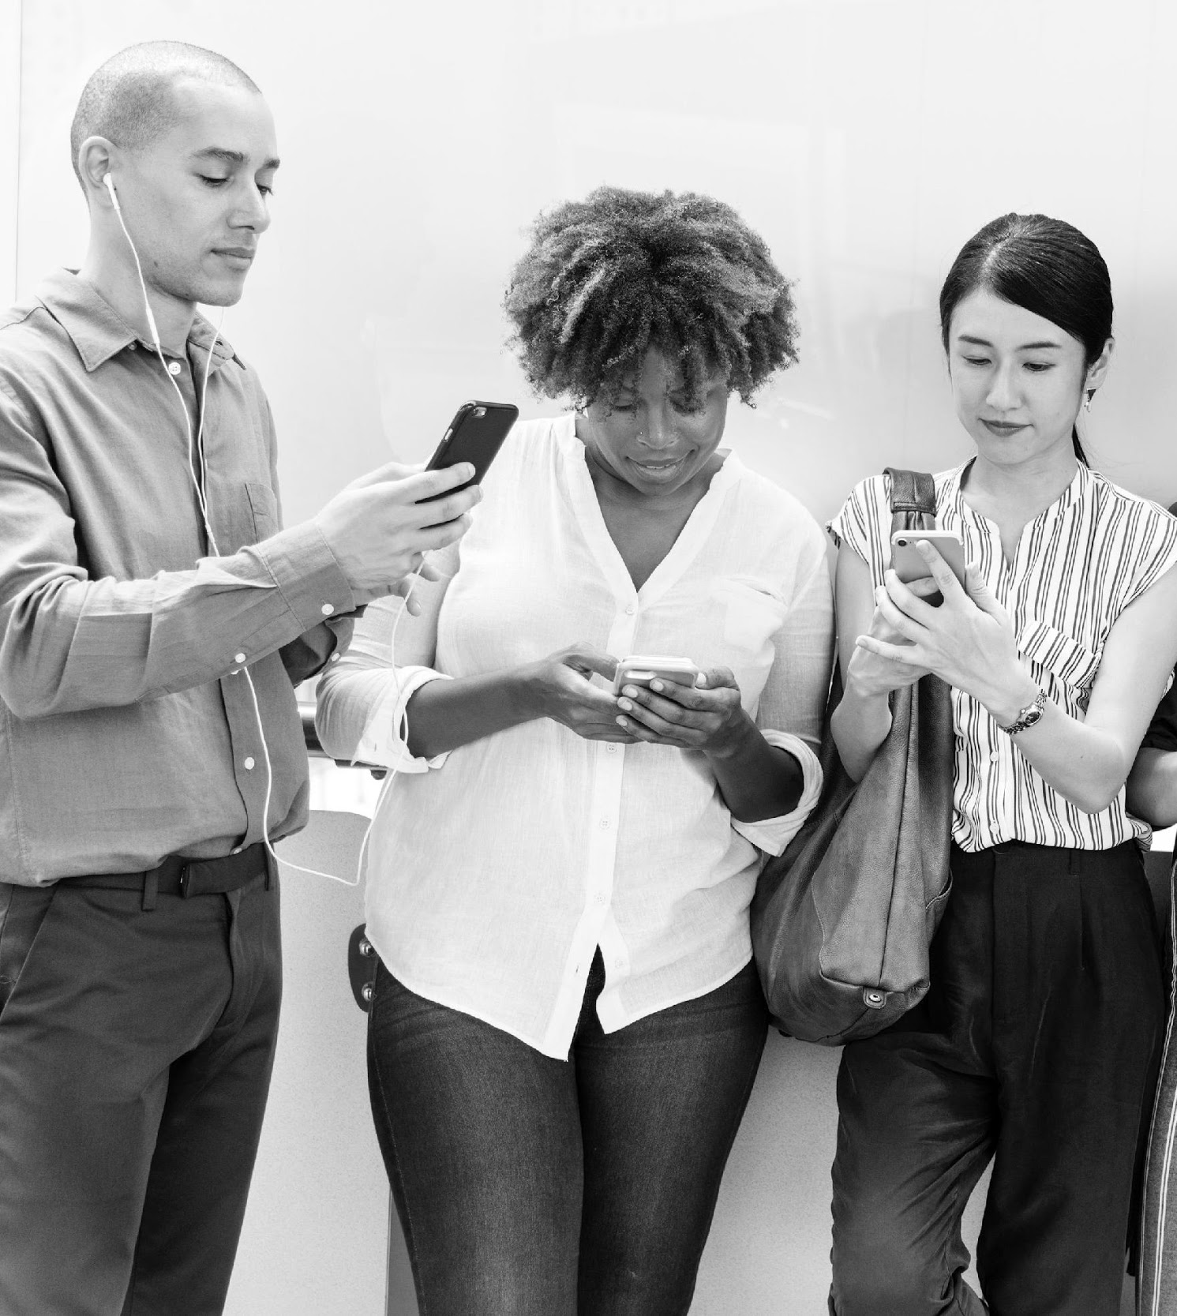
Connect & Share
January 23, 2024
Availability: IOS, Android
Free membership and registration application developed by the staff of Intertwine Inc. available for all people around the world. Gained profits from this project will be used to help the amazon forest restoration organized by the international NGO Plant.org.

Slide 7
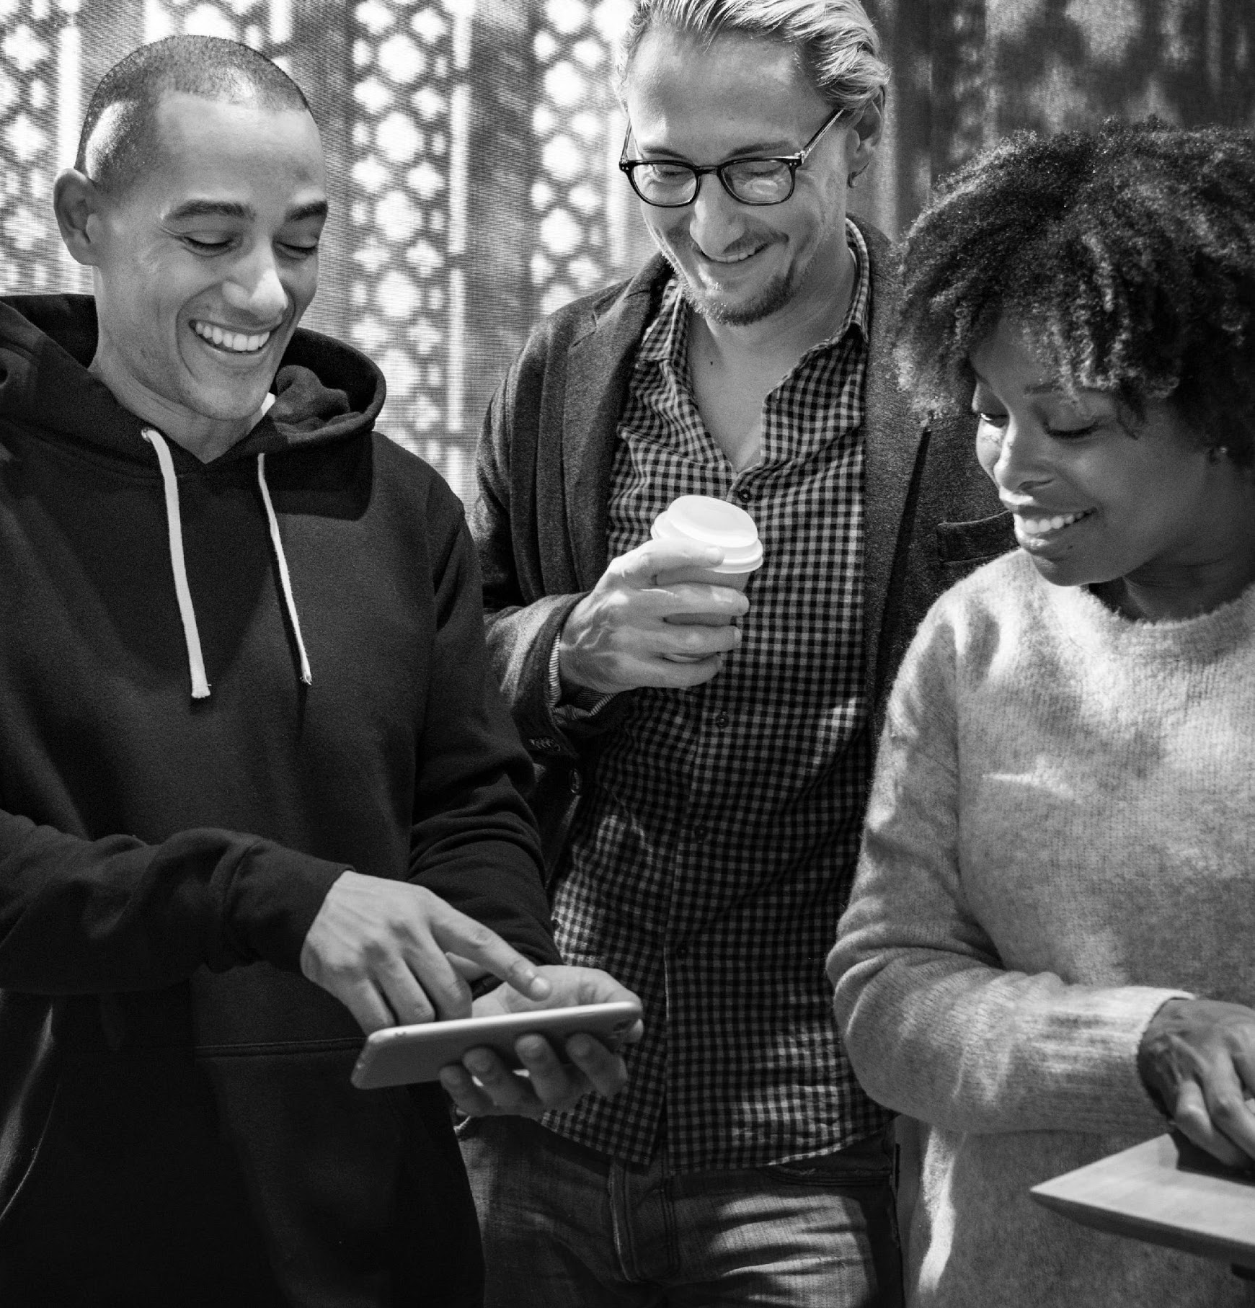
Gather Up
June 4 to August 4
Worldwide tour: From Singapore to California
Location: TBA
A concert aimed to fighting and raising awareness for depression. Tickets to this event will be $90 for 2 people and will entitle the attendees to 4 free bottles of beer, meet and greet with the event performers and ravekit. 60% of all profits will be donated to Mental Awareness & Health Foundation.

Slide 8
Bimonthly Meeting
November 5, 2019
Monterey Blvd, San Francisco, California
General meeting for the members of the Board, staff and sponsors to discuss the status of the company’s current budget, profits, future events and marketing impact of the Intertwine, Inc. and its various projects.

Slide 9
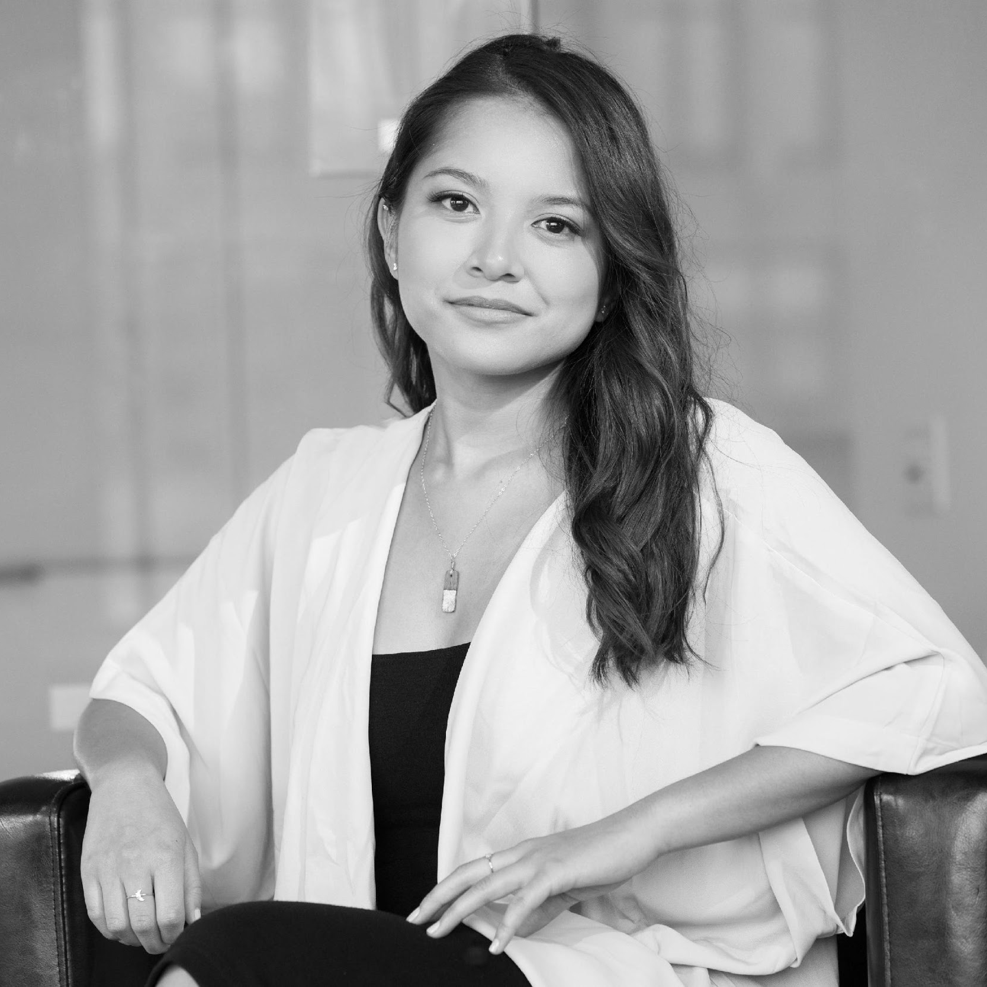
“
The strongest and most reliable social networking site for all people.
-Jenny Parker, 49, Columnist
TESTIMONIAL FROM CLIENT

Slide 10
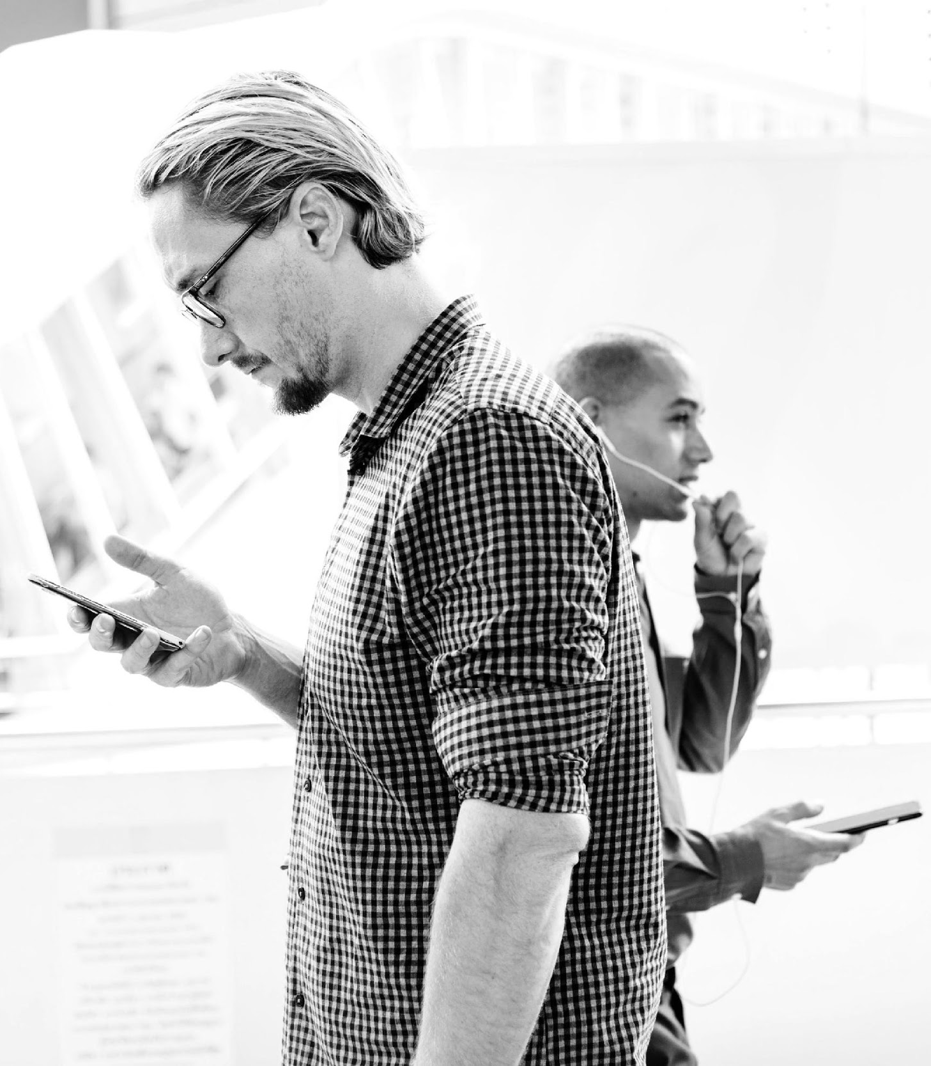
MAIN GOAL
Intertwine, Inc.’s main goal is to become the top social networking site through various social projects and events carefully planned and developed to promote global awareness for depression.

Slide 11
OVERVIEW OF GROWTH
65%
60%
Increase in new members as of January 2021
20%
Increase in satisfaction event reviews as of June 2020
Increase in monthly profits as of May 2020

Slide 12
WHAT WE OFFER
01
02
03
Nonstop Worldwide Interaction
Easy to Use Socializing Apps
Friendly and Reliable Staff

Slide 13
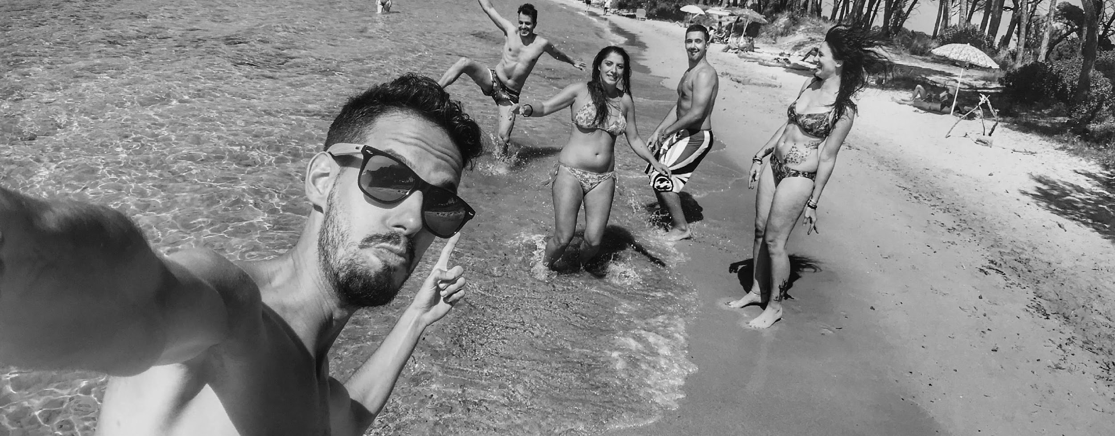
IMAGE GALLERY

Slide 14
BOARD MEMBERS
Kevin Wilson
Dean Blake
Kelly Jones
Founder & Chairman
Chief Marketing Officer
Chief Operating Officer

Slide 15
THANK YOU
+982 23489234
intertwine@gmail.com
us@intertwine.com

