Slide 1

Simple
Pitch Deck

Slide 2
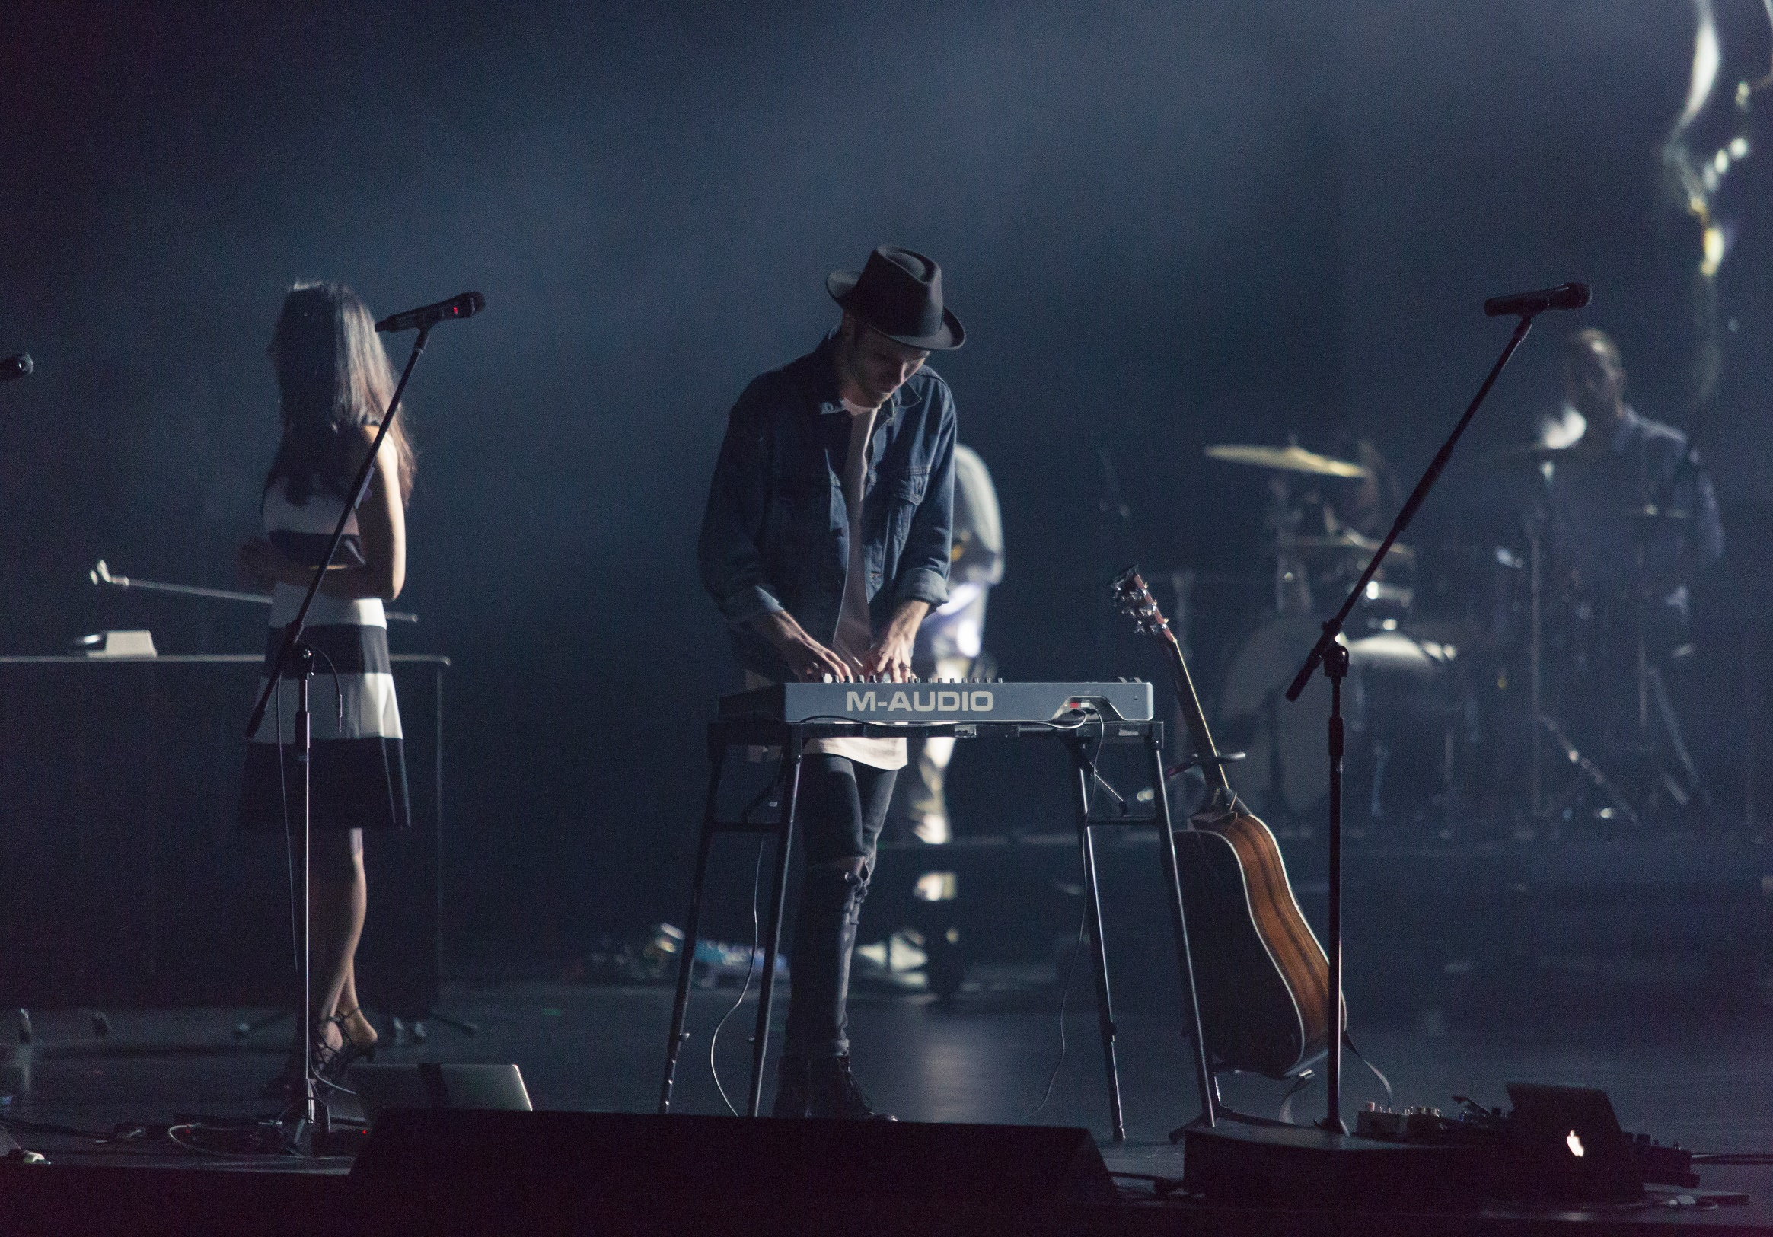
About Us
Inlay Music Academy is a private music school based in New York, New York. Operating since 1999, it was founded by the late music maestro Steve Paul who was a DMA of music graduate from Yale University.

Slide 3

Vision
Inlay Music Academy’s vision:
To become the leading music school across the country;
To establish 4 campuses by 2040; and
To become an internationally recognized music school.

Slide 4

Mission
Our mission is to provide the best instrumental and musical training and education possible for all our students as well as music enthusiasts.

Slide 5


Our Staff
Claire Buoyant, PhD
George Alto, D.M.A
President
Vice President of Student Affairs
In charge of overall management.
Secures the highest quality of music training and music curriculum.
Provides the quality service for students outside the classroom.
Ensures the development and growth of each individual in the academy.

Slide 6


Our Staff
John King, PhD
Mark Wall, D.M.A
Music Writing Head Coordinator
Instrumental Head Coordinator
Head coordinator under music writing.
Provides effective and efficient music writing strategies and exercises.
Head coordinator under musical instrument teaching.
Provides effective and efficient instrumental strategies and exercises.

Slide 7

The Problem
According to a survey conducted by Rolling Dome Magazine in June 2017, around 600+ music academies around the country are on the verge of financial bankruptcy due to the outdated and passé musical teachings being taught across the institution. Additionally, the high tuition fees and expensive instruments added to the decline of various musical institutions. This results to various potential customers who are music enthusiast to pursue other careers and other studies.

Slide 8

Our Solution
Inlay Music Academy offers effective musical programs for all students who wish to learn music through effective music and instrument lessons at reasonably affordable prices.

Slide 9

Advantages
By giving proper musical training at competitive price points, we can draw in more students because we are more effective and efficient. We provide a wholesome, discipline based, yet fun approach to learning the musical arts as well as insightful services for those who wish to become a future maestro. Additionally, we are provided with quality instruments and facilities.

Slide 10
Variety Music Program
Our newly launched program called “VARIETY MUSIC” is aimed to promote new styles of musical rhythm and genres by fusing the soul from yesterday and learning the new vibe of today. This project also aimed to revive the golden age of music enthusiasm through rigorous yet fun learning activities for only $90 with free music sheets and own musical instrument provided by the academy.

Slide 11

Traction
Based on the Rolling Dome Magazine’s conducted survey about 10, 000+ people ,in New York alone, are music enthusiasts who wish to pursue a music career.

Slide 12
Target Market
The chosen target market will be the residents of New York. This specific group of individuals were chosen based on the following factors :
Around 25% of New York’s population are 18 to 40 years old.
25%
Up to 20% to 50% of New York’s total population are music enthusiasts who wish to learn more about music.
50%
More than 60% of musical enthusiasts are willing to learn new skills.
60%

Slide 13
Competition
Based on a survey conducted in 2016, Inlay Music Academy concluded that the following institutions will be considered as direct competitors on the basis that they offer similar services :
Vibrato Music School fee starts at
Chorus Music Academy fee starts at
New York Academy of Music fee starts at
$120
$100
$99.99

Slide 14
Alternative Solutions
The alternative solutions Inlay Music Academy can provide are the following:
Free program consultation and study outline.
10% discount on every full paid taken course program.
Free musical instrument rental for all students with grades above 85.
10%
Discount

Slide 15
Business Model
The company will utilize the following business model which will be implemented by early 2019:
[SPECIFY BUSINESS MODEL]
Revenue equivalent to roughly $110,000 to $120,000 will be expected by the end of 2019.

Slide 16

Schedule
The company’s schedule will be as follows :
[SPECIFY COMPANY SCHEDULE]

Slide 17
Investment
In order to officially begin, the company will require a budget estimated between $90,000.00 and $100,000.00. This amount will be collected from the following sponsors :
1. D’addario Strings and Accessories
2. Fender Amps and Guitars
3. Zildjian Cymbals & Drums
Each sponsor has agreed to contribute and invest at least $35, 000.00 for Inlay Music Academy.

Slide 18

Contact Us
Visit our school every Monday to Saturday from 8am to 6pm at [ADDRESS].
For more information, contact us at any of these contact details :
[Phone Number]
[Email]
[Website]

Slide 19
Thank You

