Slide 1
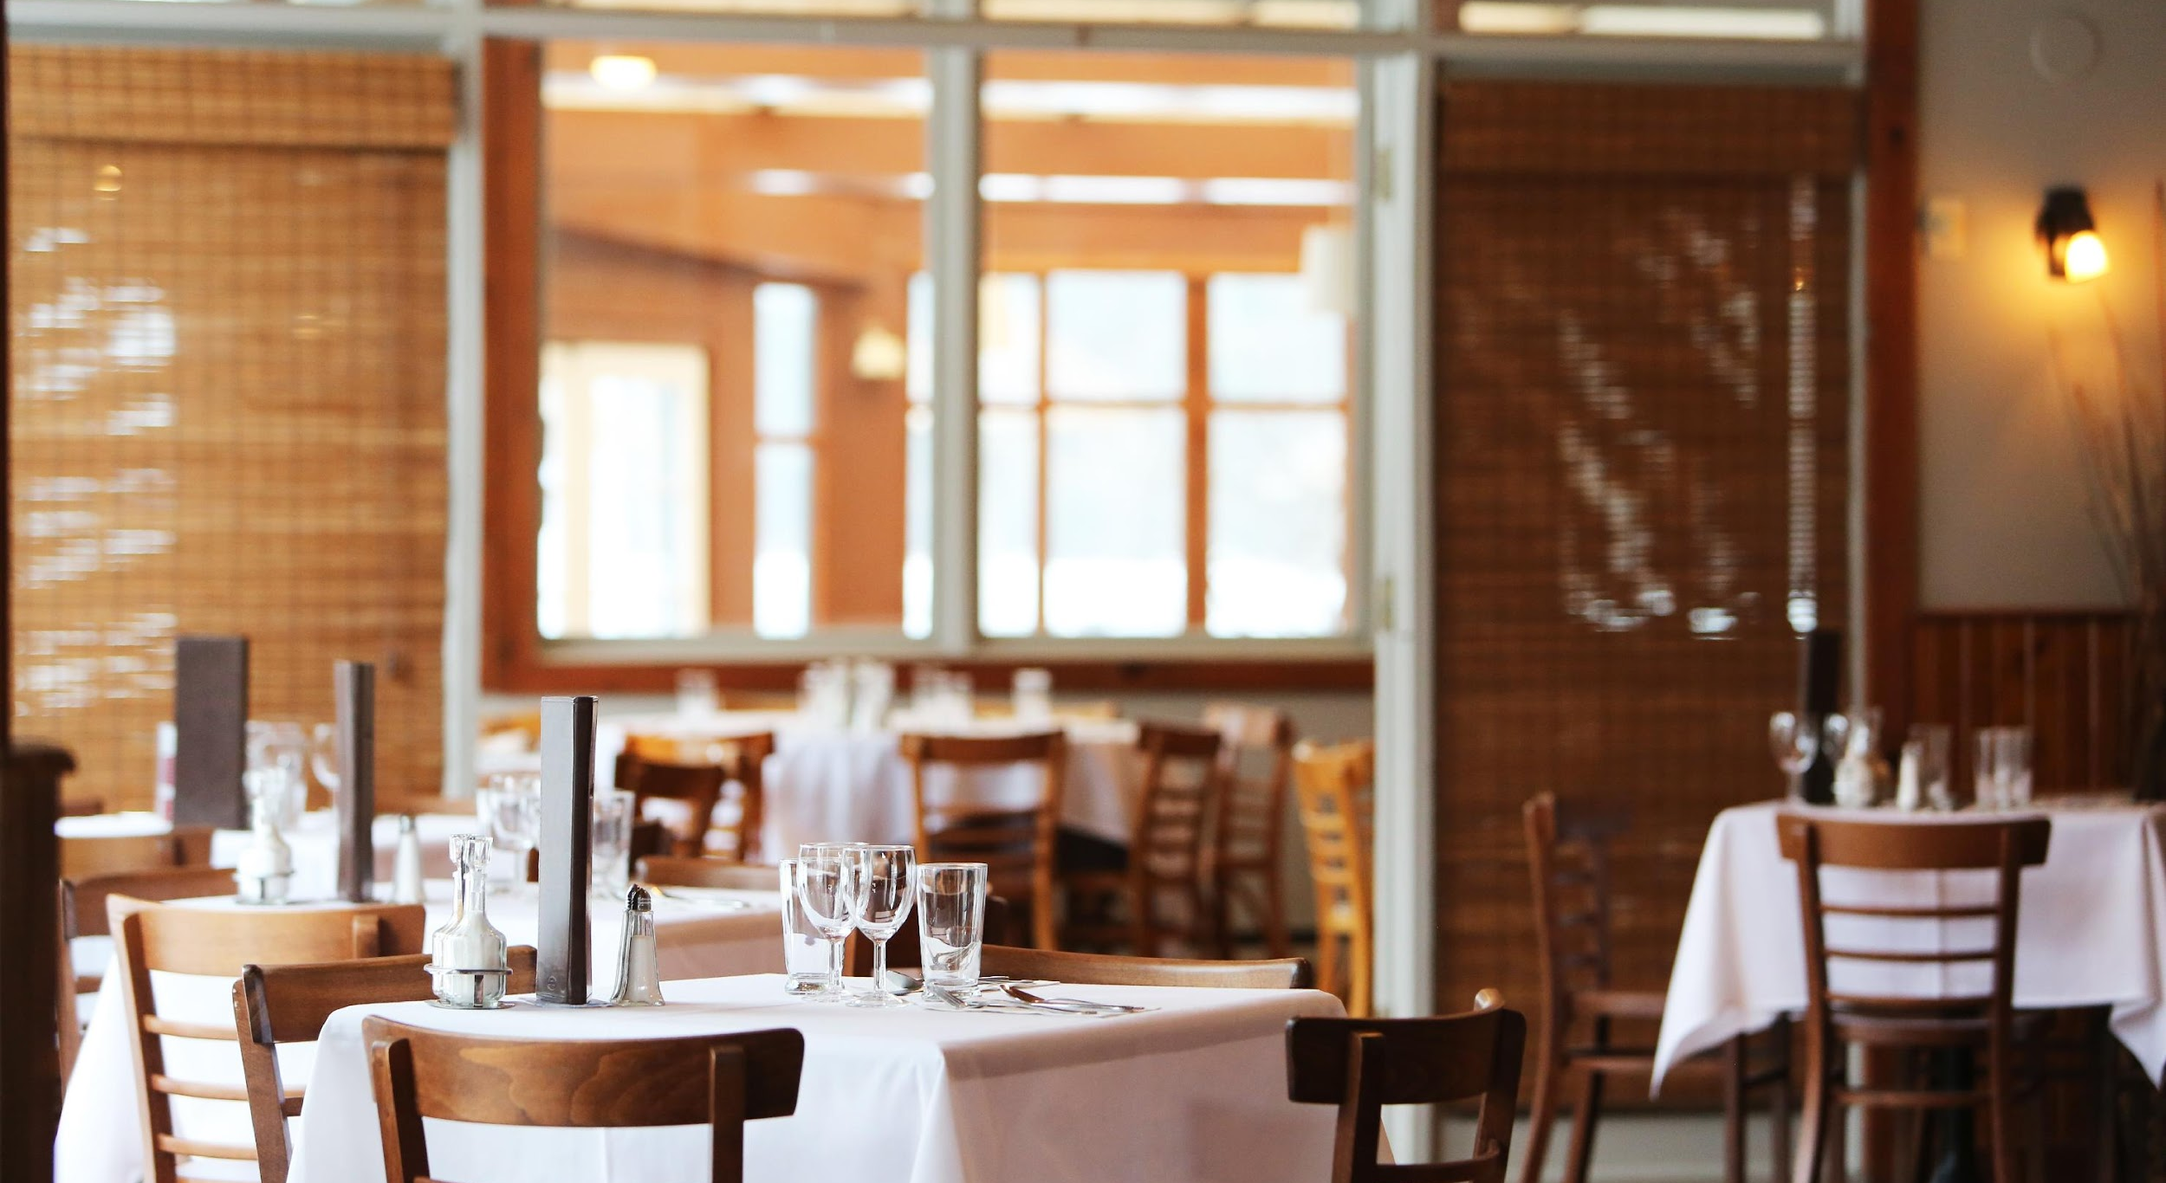
EUZENT’S RESTAURANT & CAFE
94 Summit St. Davenport, IA 52807
+9082 09284 | euzents@hotmail.com
Freshly Baked Goodness Since 1989
euzentcf.com

Slide 2
AGENDA
01
SUMMER CRAZY DISCOUNT
02
GRANDEAU LE
COOK FEST
03
MONTHLY BOARD MEETING
This food and dessert sale will be held at Queens, New York on April 1, 2020 from 10am to 10pm. Tickets start at $50 each and will feature all of our best homemade dishes and beverages at affordable prices. Profits gained from this event will be used for the construction and opening of Euzent’s 3rd branch at Los Angeles, California.
This event will be held at the newly opened Dallas branch on July 20, 2021 from 10am to 8pm. Tickets will be at $100 each and will feature a grand cook fest with lots of authentic freshly made dishes and unlimited drinks & beverages. 80% of profits will be donated to the Save Earth foundation. The remaining 20% of profits will be used to upgrade Euzent’s cooking and baking facilities.
Members of the Board will be having their meeting at the Euzent’s Los Angeles branch on June 28, 2020 from 12pm to 6pm to discuss the current status of products, sales and marketing impact from January 01, 2020 to May 1, 2020. The agenda of this meeting is to update all members with the current status, progress, and marketing impact to be implemented at the Euzent’s Restaurant and Cafe for the second half of 2020.

Slide 3
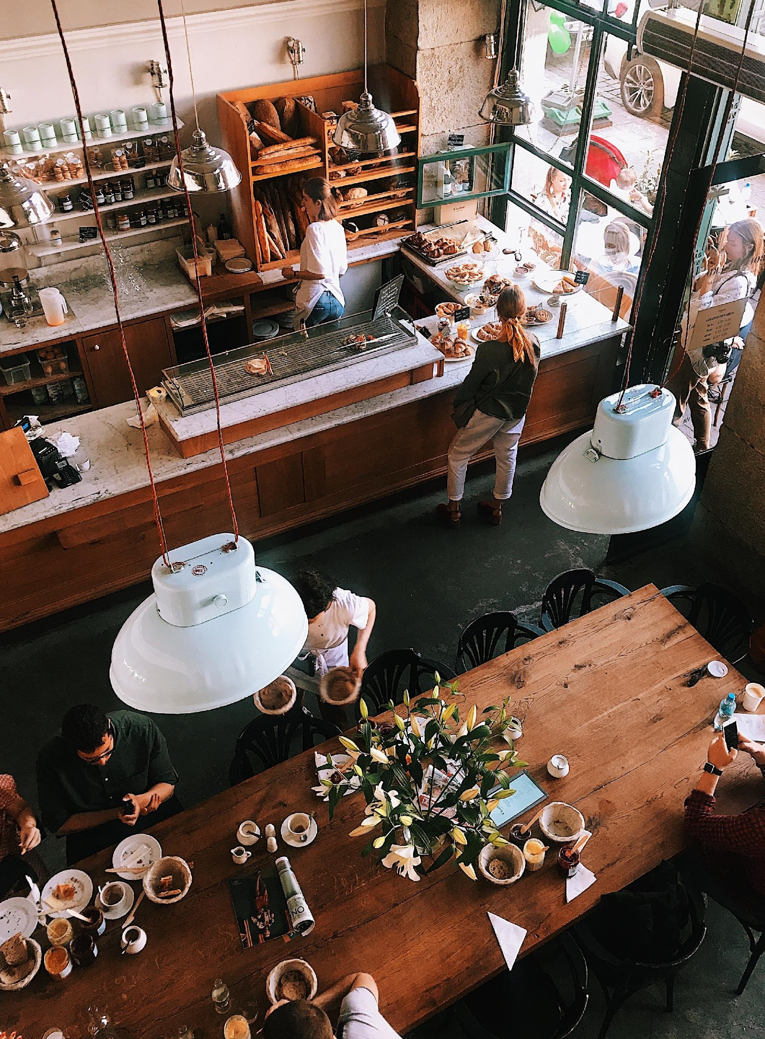
ABOUT
Euzent’s Restaurant and Cafe is a French themed restaurant located at the progressive city of Queens, New York. With 3 branches established and counting, Euzent’s Restaurant and Cafe aims to serve you the delicious and freshly cooked dishes for at conveniently affordable prices.
Founded in 1989 by Steve Roberts, a restaurateur, philanthropist and former chef.

Slide 4
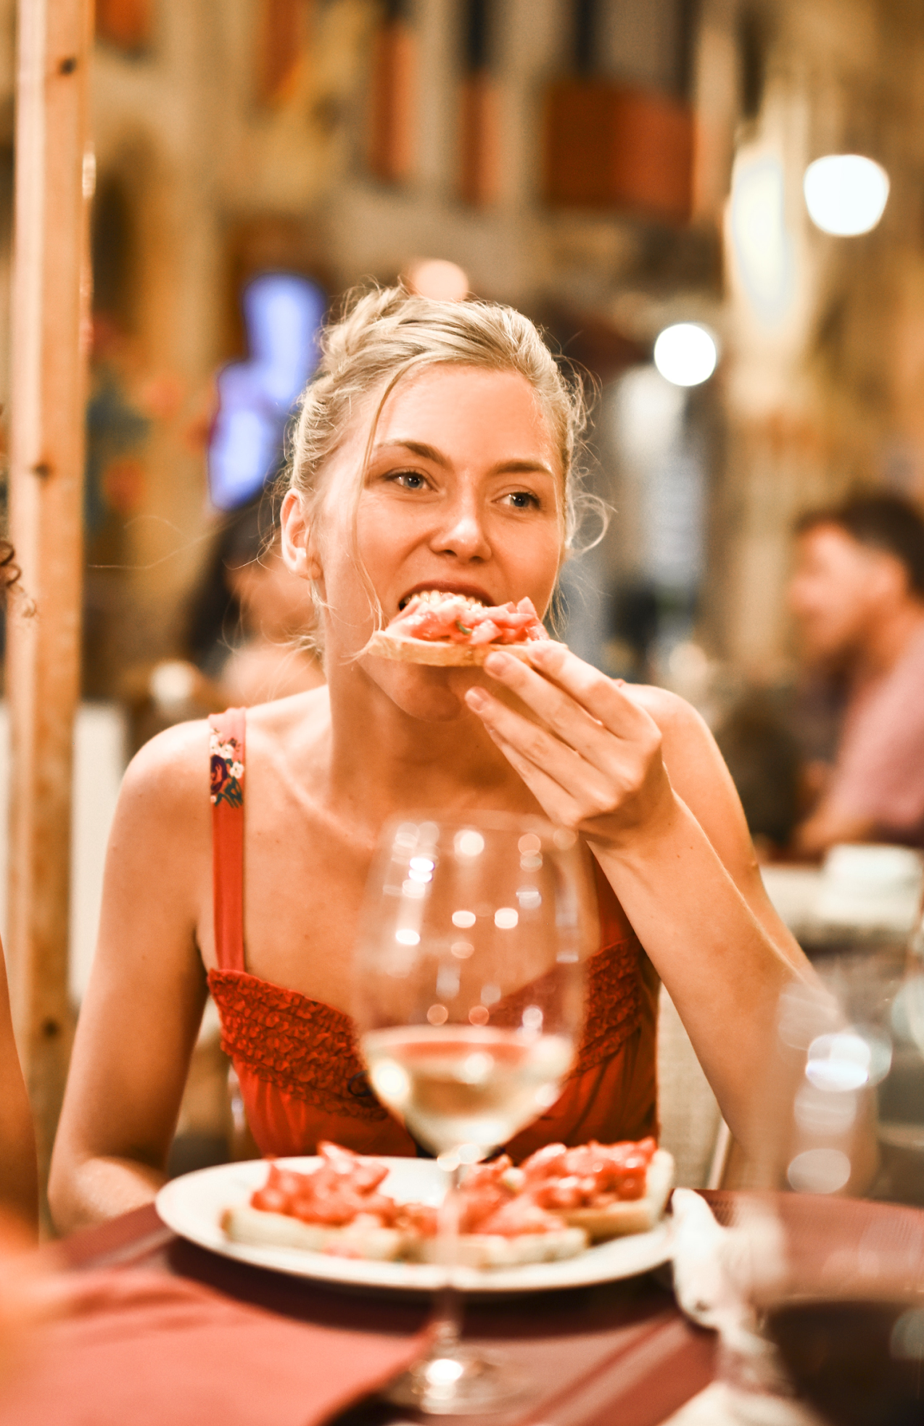
TESTIMONIALS
“Euzent’s Restaurant & Cafe is a welcoming restaurant that gives you the taste of the authentic, freshly made French cuisine without having to travel from New York to France.”
- Steve Roberts, Owner and CEO
“Euzent’s Restaurant & Cafe prioritizes all guests and visitors and give the best possible experience with their delicious French cuisine.”
- Caroline Madison, Executive Chef

Slide 5
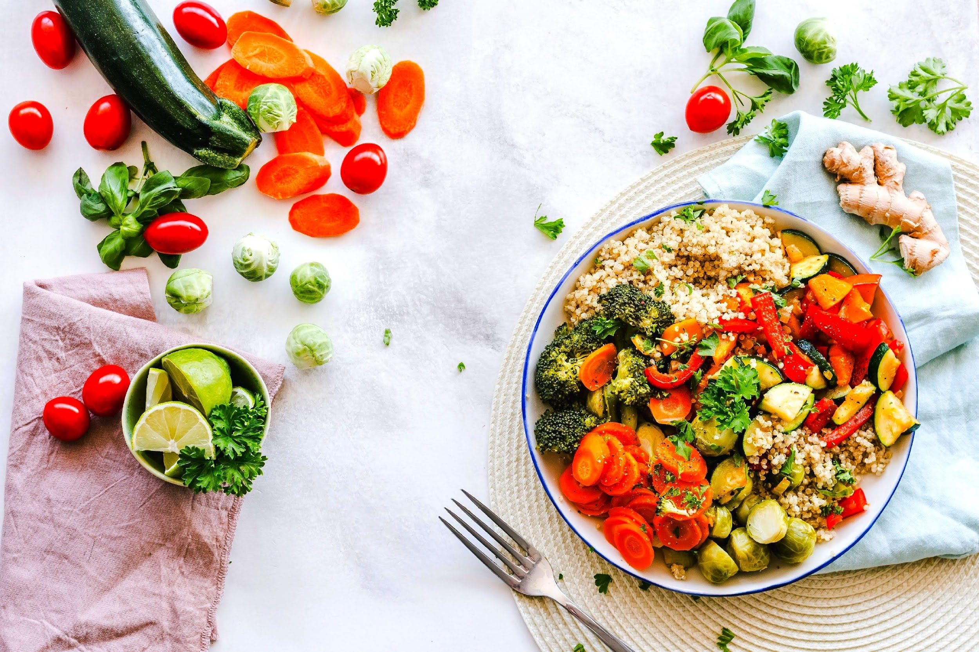
HISTORY
Euzent’s Restaurant & Cafe was founded in the year 1989 by Steve Roberts, a graduate of Hotel & Restaurant Management at New York University. The cafe is aimed to give authentic French cuisine at affordable price points. It currently has 3 branches fully operating and aimed to deliver quality food, desserts, and beverages accompanied by friendly service.

Slide 6
SUMMER CRAZY DISCOUNT
Tickets start at $50 each and will feature all of our best homemade dishes and beverages at affordable prices. Expect lots delicious food, thirst quenching drinks, and tempting desserts. Profits gained from this event will be used for the construction and opening of Euzent’s 3rd branch at Los Angeles, California.
April 1, 2020 | 10am to 10pm
Euzent’s Restaurant & Cafe L.A Branch

Slide 7
GRANDEAU LE
COOK FEST
Tickets will be at $100 each and will feature a grand cook fest with lots of authentic freshly made dishes and unlimited drinks & beverages. 80% of profits will be donated to the Save Earth foundation. The remaining 20% of profits will be used to upgrade Euzent’s cooking and baking facilities.
July 20, 2021 | 10am to 8pm
73rd Avenue, Queens, New York

Slide 8
MONTHLY BOARD MEETING
Members of the Board will meet to discuss and review the current status of Euzent’s Restaurant & Cafe’s product, sales and marketing impact from January 01, 2020 to May 1, 2020. The agenda of this meeting is to update all members with the current status, progress, and marketing impact to be implemented at the Euzent’s Restaurant and Cafe for the second half of 2020.
June 28, 2020 | 12pm to 6pm
Euzent’s Restaurant & Cafe Los Angeles Branch

Slide 9
TESTIMONIALS FROM GUESTS
“I am always happy and satisfied with my purchases at Euzent’s. They do their best to help me find coffee and pastries that are delicious yet affordable.”
-Julie Moore, 29, Food Columnist

Slide 10
MAIN GOAL
The main goal of Euzent’s Restaurant & Cafe is to serve the real taste of French cuisine and the authentic experience of French dishes at affordable price points.

Slide 11
OVERVIEW OF GROWTH
Increase in monthly profits as of December 2020
Increase in satisfaction with food services as of March 2020
Increase in
customer reviews as of March 2021
30%
45%
70%

Slide 12
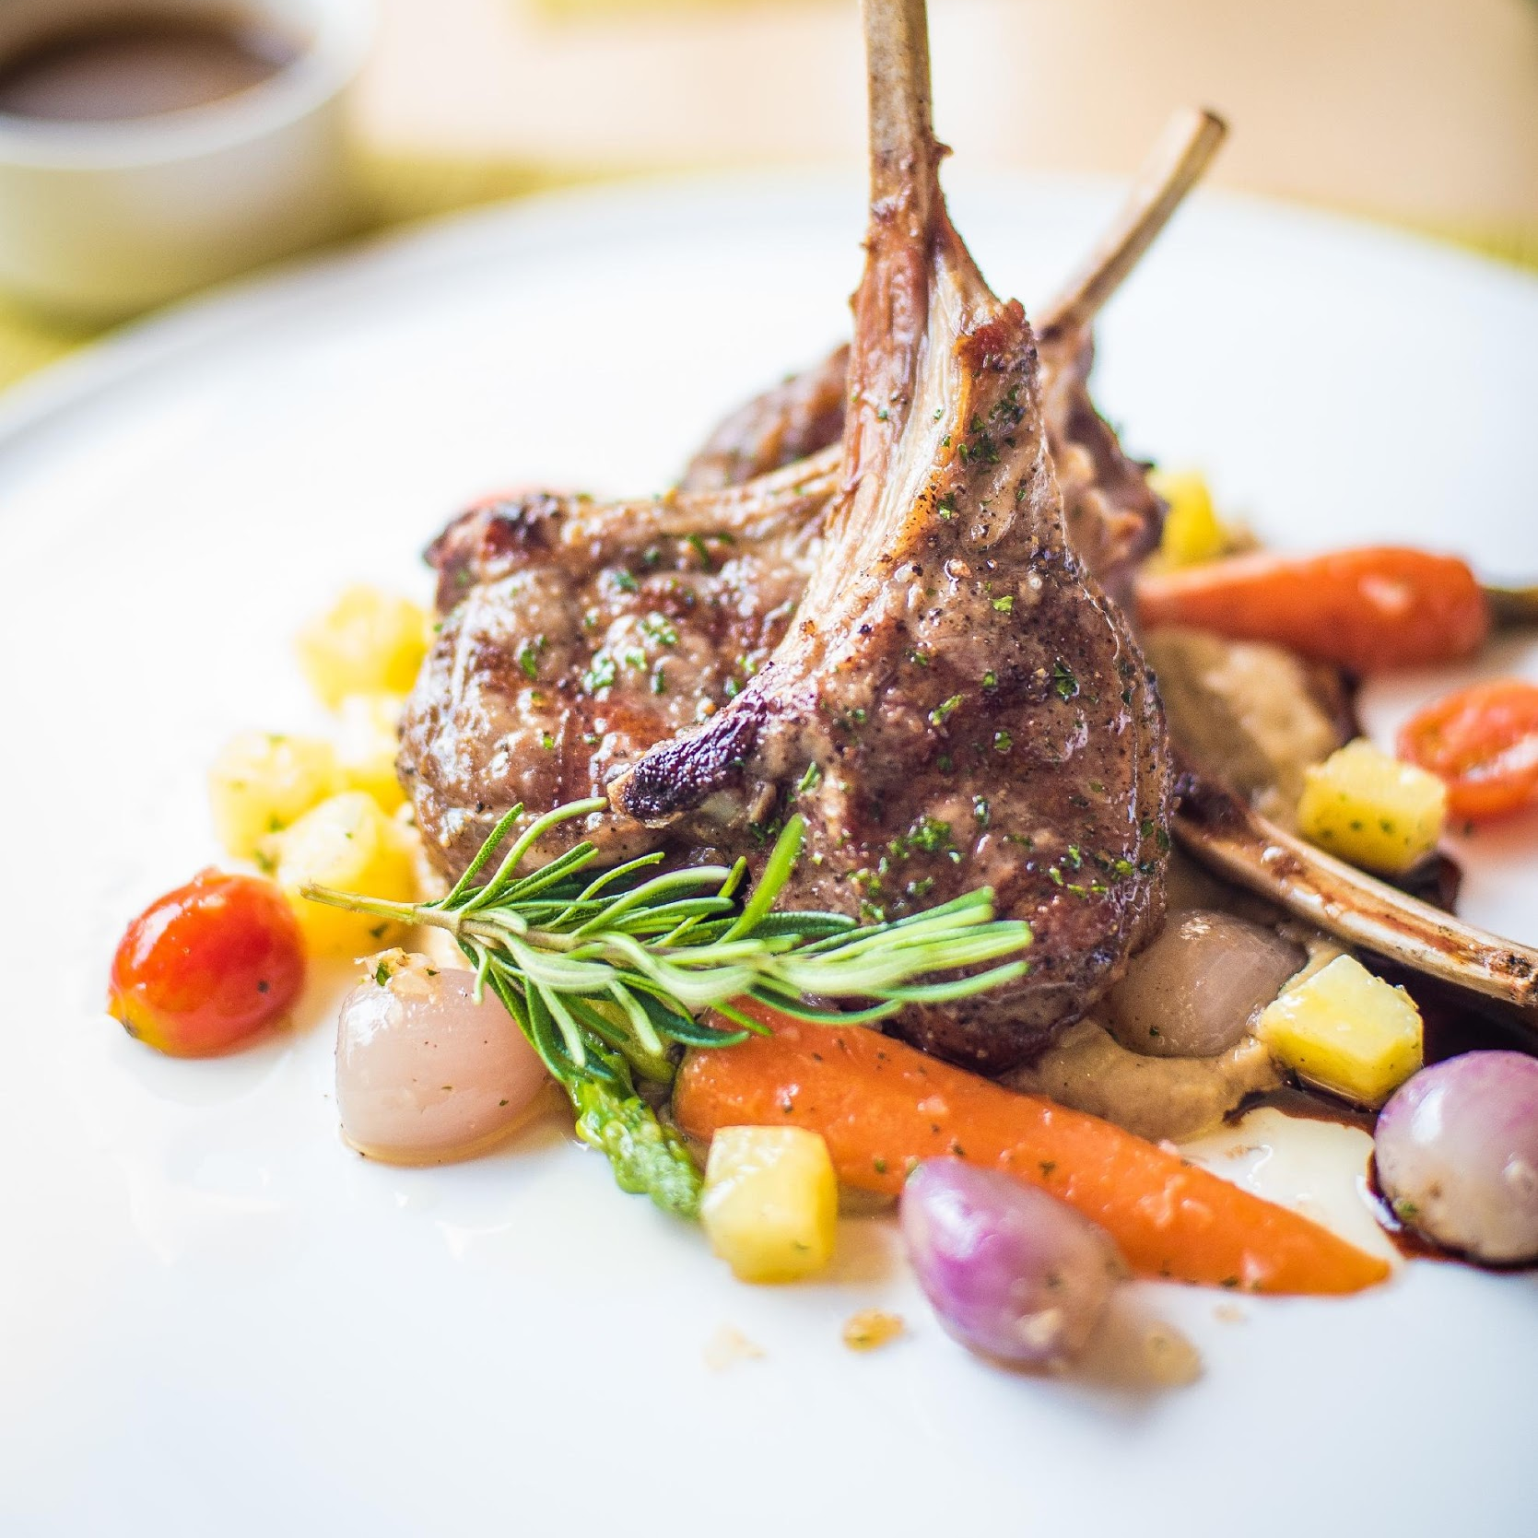
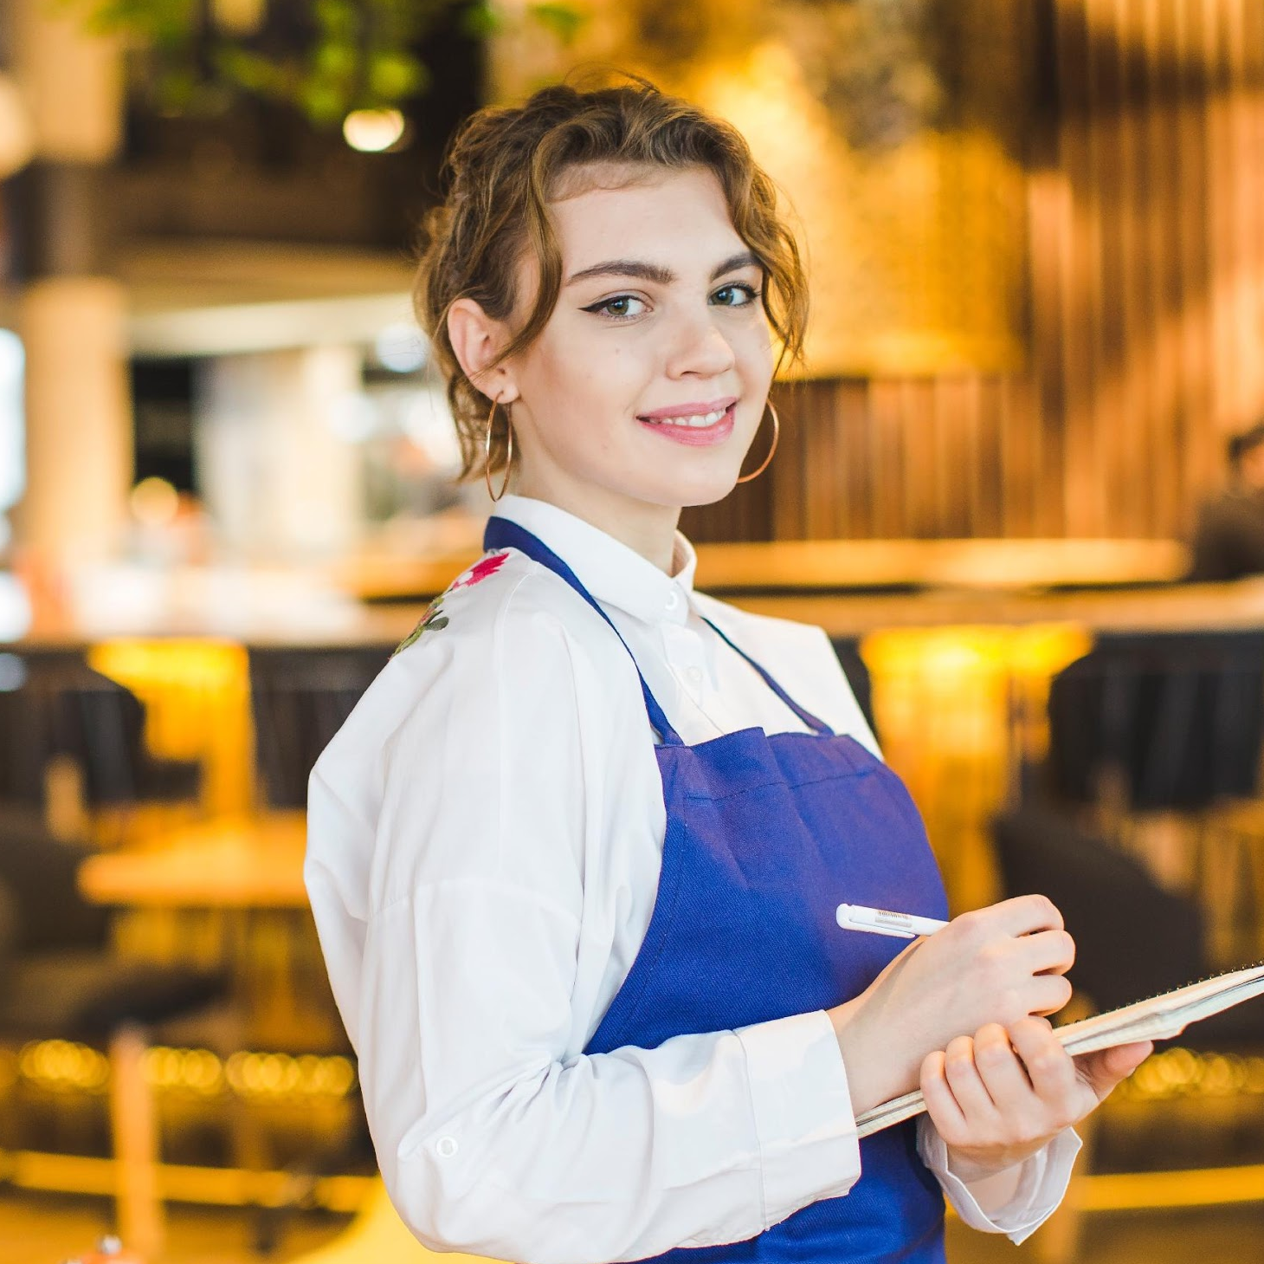
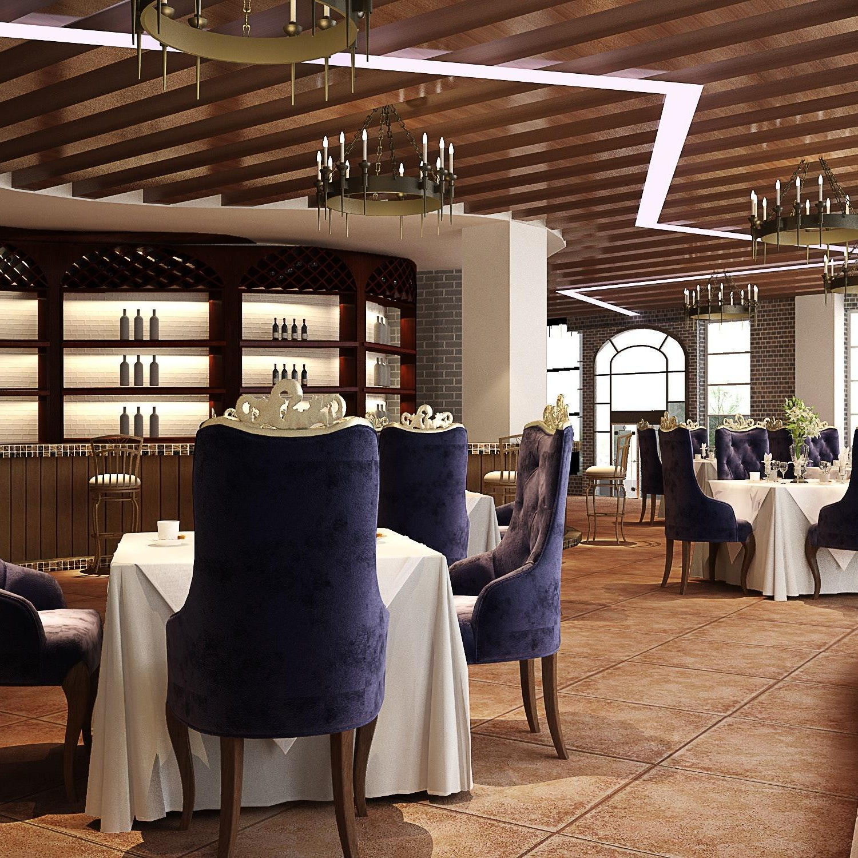
WHAT WE OFFER
100% Authentic French Cuisine
Friendly & Reliable Service
Party & Function Rooms

Slide 13
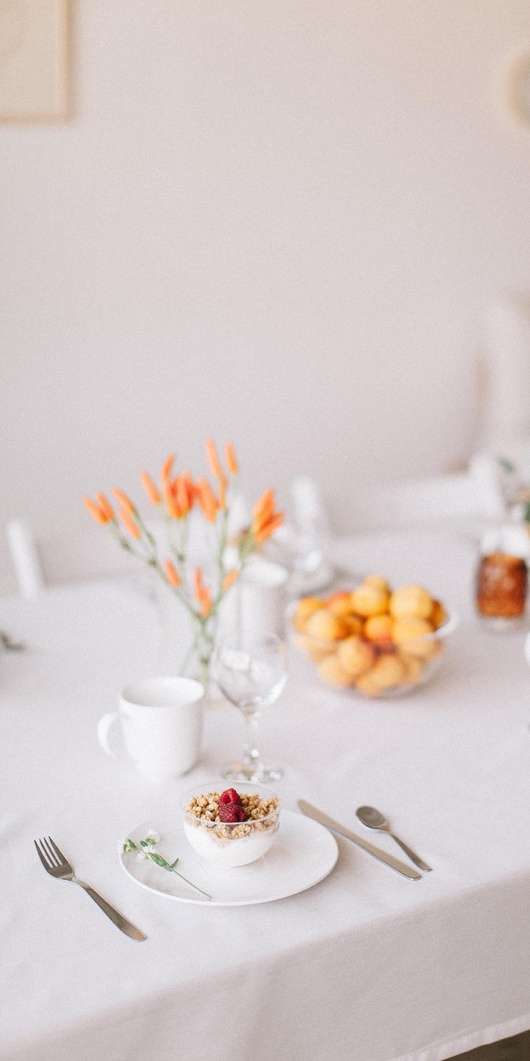
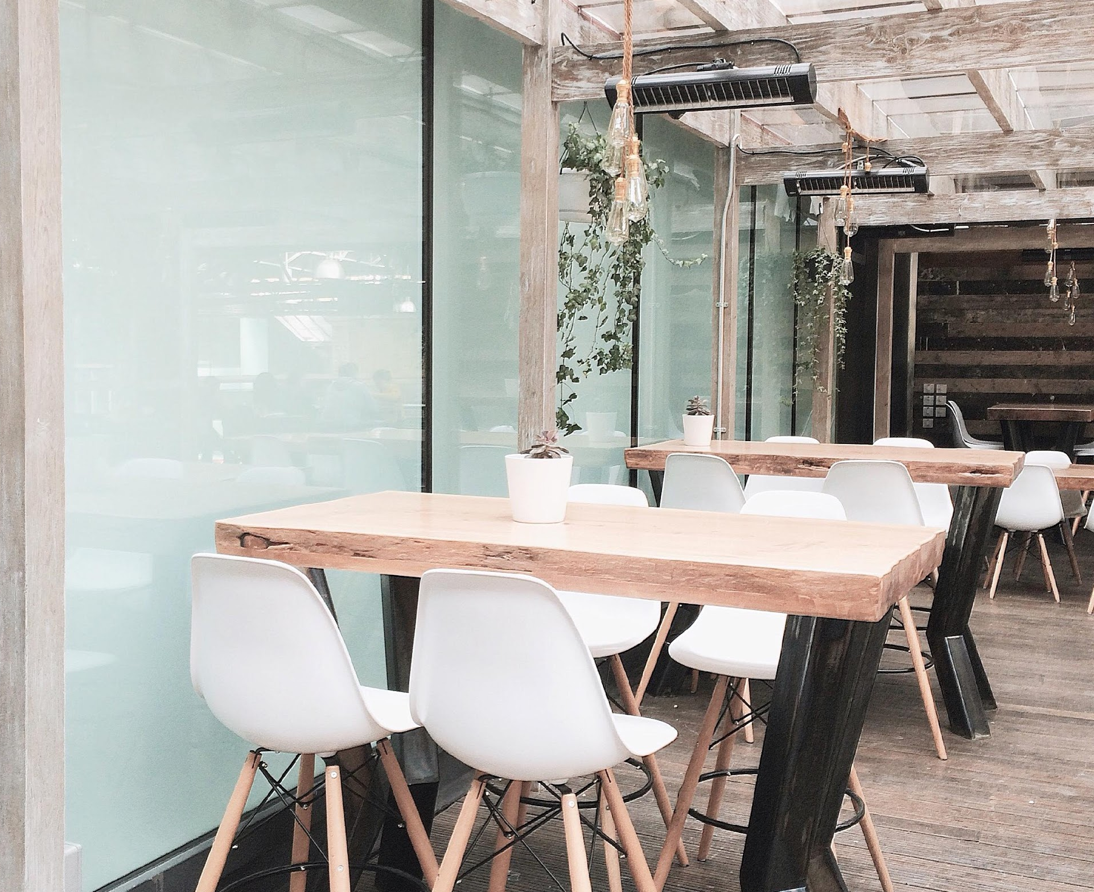
IMAGE GALLERY

Slide 14
OUR STAFF
Steve
Roberts
Carlile Madison
Peter
Brooks
Marc
Queens
Owner & CEO
Executive Chef
Sous Chef
Station Chef

Slide 15
THANK YOU
euzentcf.com

