Slide 1
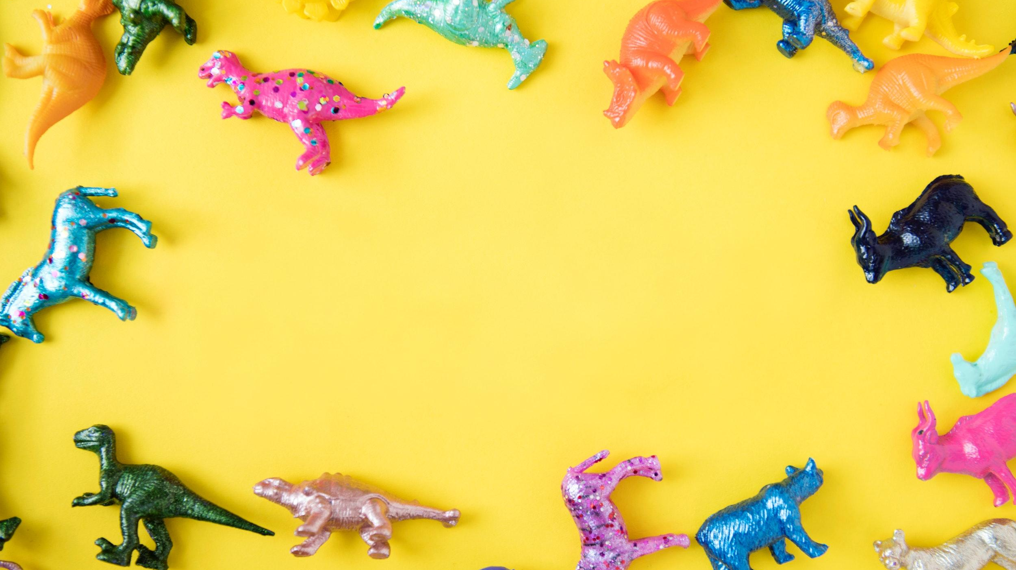
FUN
CRAZE TOY
STORE
+827 238108 | invest@hope.com

Slide 2
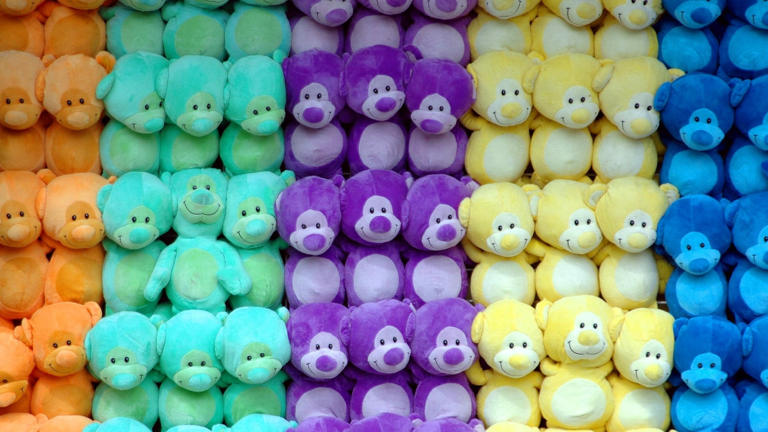
MARKETING AGENDA PRESENTATION
KIDS TOY
SECTION
ACTION FIGURE &
COMIC TOYS SECTION
1 DAY CRAZY SALE
ON GREAT SELECTIONS
This will be presented to the executives of Fun Craze Toy Store on January 12, 2023 from 12pm to 6pm. This section will be presented in order to initiate a promotional marketing campaign to boost the sales and advertise the items under this section for all kids who wish to own new and good quality toys.
This will be presented to the executives of Fun Craze Toy Store on January 10, 2024 from 12pm to 6pm. This section is aimed to be presented in order to initiate a promotional marketing campaign to boost the sales and advertise the toys under this section for all comic book toys and action figure fans who wish to own amazing and cool action figure from the famous characters in the industry.
This 1 day crazy sale on great selections is a marketing strategy which will be presented to the executives of Fun Craze Toy Store on January 16, 2024 from 12pm to 6pm. The aim of this sale is to boost the sales and advertise all toys sold by the store for all who wish to own new, amazing and excellent quality toys.

Slide 3
Kevin Forster
Founder & Chairman
As the founder and chairman of this company I proudly present to you the strongest and most customer friendly toy store, Fun Craze Toy Store. This to store has been in the industry since 2001 and has been providing children (and children at heart) with the most in demand toys at competitive prices. The store has been critically acclaimed and widely praised by the consumers as one of the best toy stores due to the variety in merchandise sold as well as accommodating services made and offered by the crew and management.

Slide 4
Executives
Testimony
“Being regarded as “The Best Toy Provider” in the industry, we are happy to give you more access to the best toys and figurines available in the market today.”
-Wendy Mills, 47, Chief Product Officer

Slide 5
KIDS TOY
SECTION
Fun Craze Toy Store CEO Meeting Room
January 12, 2023 | 12pm to 6pm
The section will promote toys from different animated and cartoon characters like Mickey Mouse, Bugs Bunny, Tweety Bird, Peppa Pig and many more for an affordable and convincing price points. It also feature items like bags, kids study table, tumblers and products that would help your child boost their imagination. If implemented , the section will feature a monthly promo and big sale on great product selections which will entitle most of the valued and potential customers to a discount of up to 80%. This is estimated to give the company a 40% increase in sales and profits for the first 3 months after its implementation and availability in the market. The generated and gained profits from this marketing boost will be donated for the office renovation and monetary assistance of “Adopt Kid Foundation”.

Slide 6
ACTION FIGURE & COMIC TOYS SECTION
Fun Craze Toy Store CEO Meeting Room
January 10, 2024 | 12pm to 6pm
The section will promote action figure and comic toys from different movies and comic book characters like Superman, Batman, Luke Skywalker, RoboCop and many more for an affordable and convincing price points. It will also entitle those who purchase the items to exclusive discounts. The marketing boost for the toy section is projected to give the company a 50% increase in sales and profits for the first 2 months after its run and availability in the market. The generated and gained profits from this marketing boost will be donated for the office renovation and monetary assistance of “Save Earth One Foundation”.

Slide 7
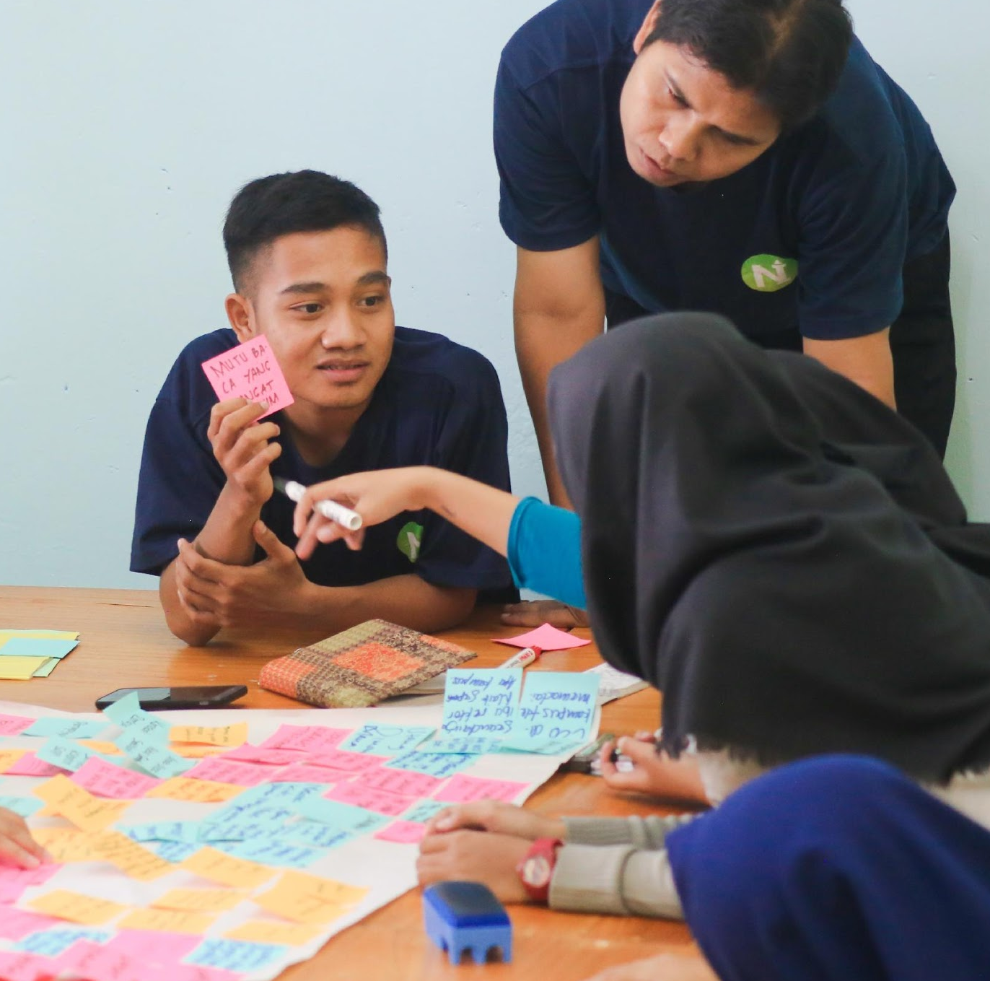
1 DAY CRAZY SALE ON GREAT SELECTIONS
Fun Craze Toy Store CEO Meeting Room
January 16, 2024 | 12pm to 6pm
The sale will feature some of our best selling items such as Batman, Tweety Bird, Tasmania and many more at very affordable and reasonable prices. This event will entitle customers to discounts of up to 70% discount. The marketing boost for the toy section is projected to give the company a 65% increase in sales and profits after its execution. The generated and gained profits from this marketing boost will be donated for the office renovation and monetary assistance of “One Life in Earth Foundation”.

Slide 8
History
Fun Craze Toy Store was founded & started by Kevin Forster with a capital of just $1000 and 20 toys available. The store wasn’t a success during its early years due to the strong competition of the different toy store providers way back then. In 2010, the store found its initial break and success after handling the production of some of the famous characters in Hollywood by selling and marketing the characters into toys. This contributed greatly to the store’s success after 6 months due to the positive and critical acclaim from the critics and clients who mostly and generally are toy and action figure collectors.

Slide 9
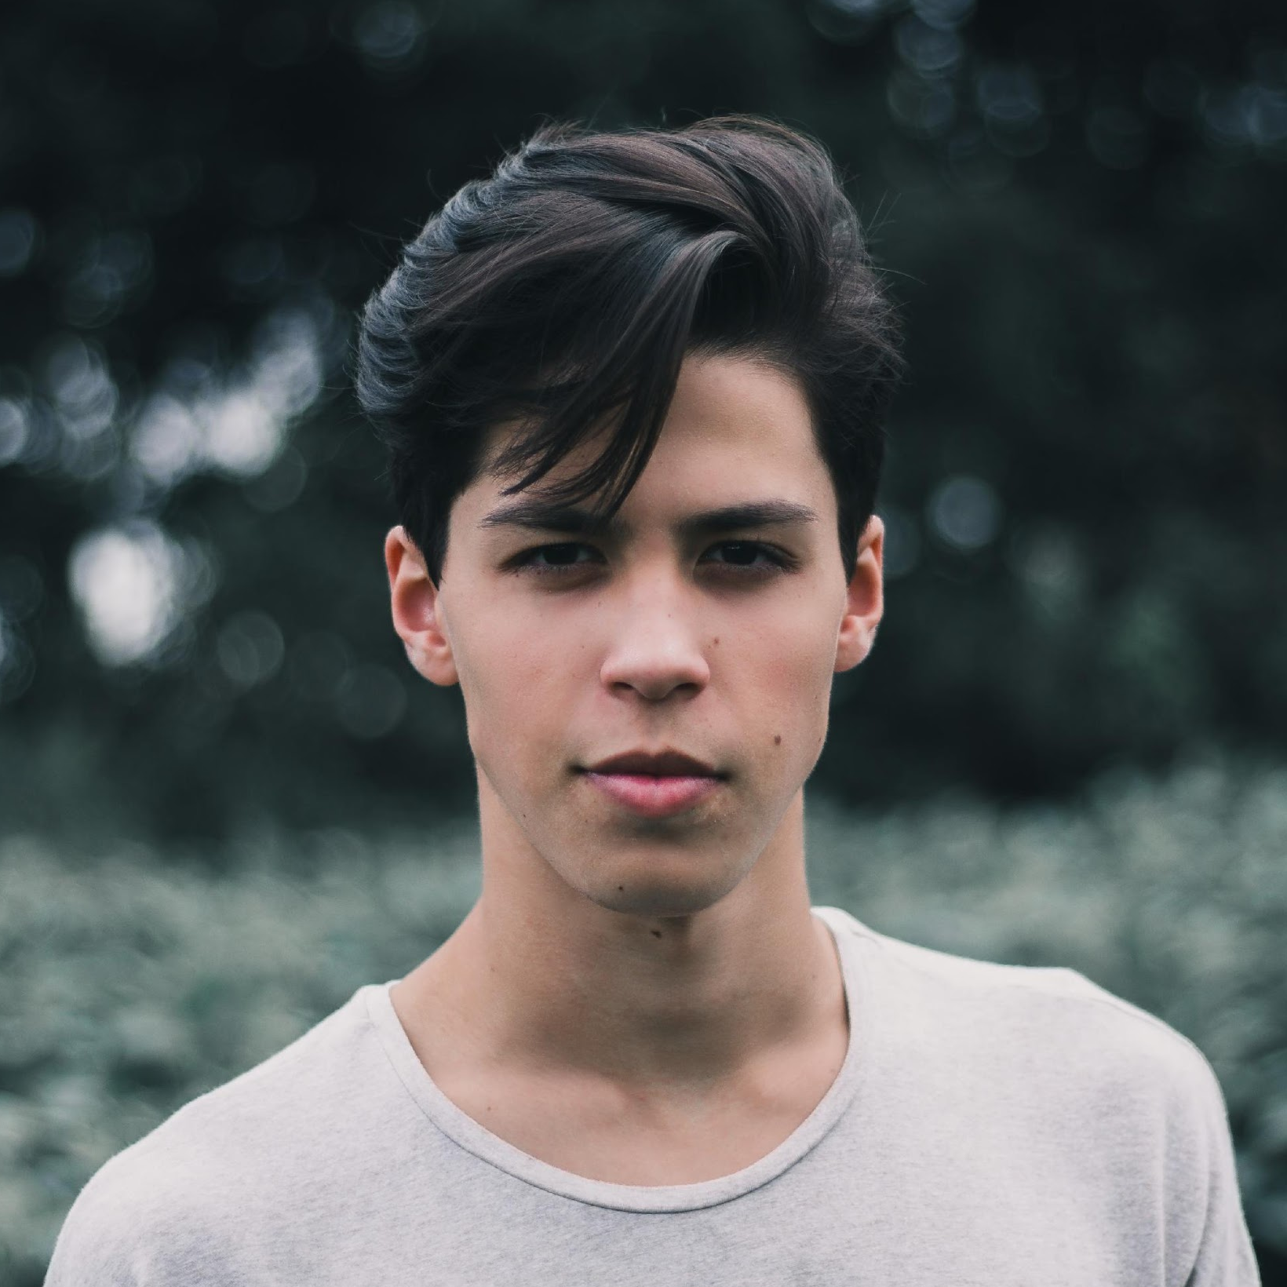
Executives
From Client
“I’ve been an avid collector of action figures and only the Fun Craze Toy Store gave me the satisfaction in quality and design consistently. 100% would recommend them to anyone!”
-Tom Queenston, 19, Action Figure Collector

Slide 10
Main Goal
Fun Craze Toy Store commits itself in providing the best and most authentic quality of toy products at affordable and convincing price points.

Slide 11
Overview
of Growth
63%
increase in annual profits as of December 2025.
70%
increase in customer satisfaction with produced toys as of March 2024.
40%
increase in sold products in the market as of March 2023.

Slide 12
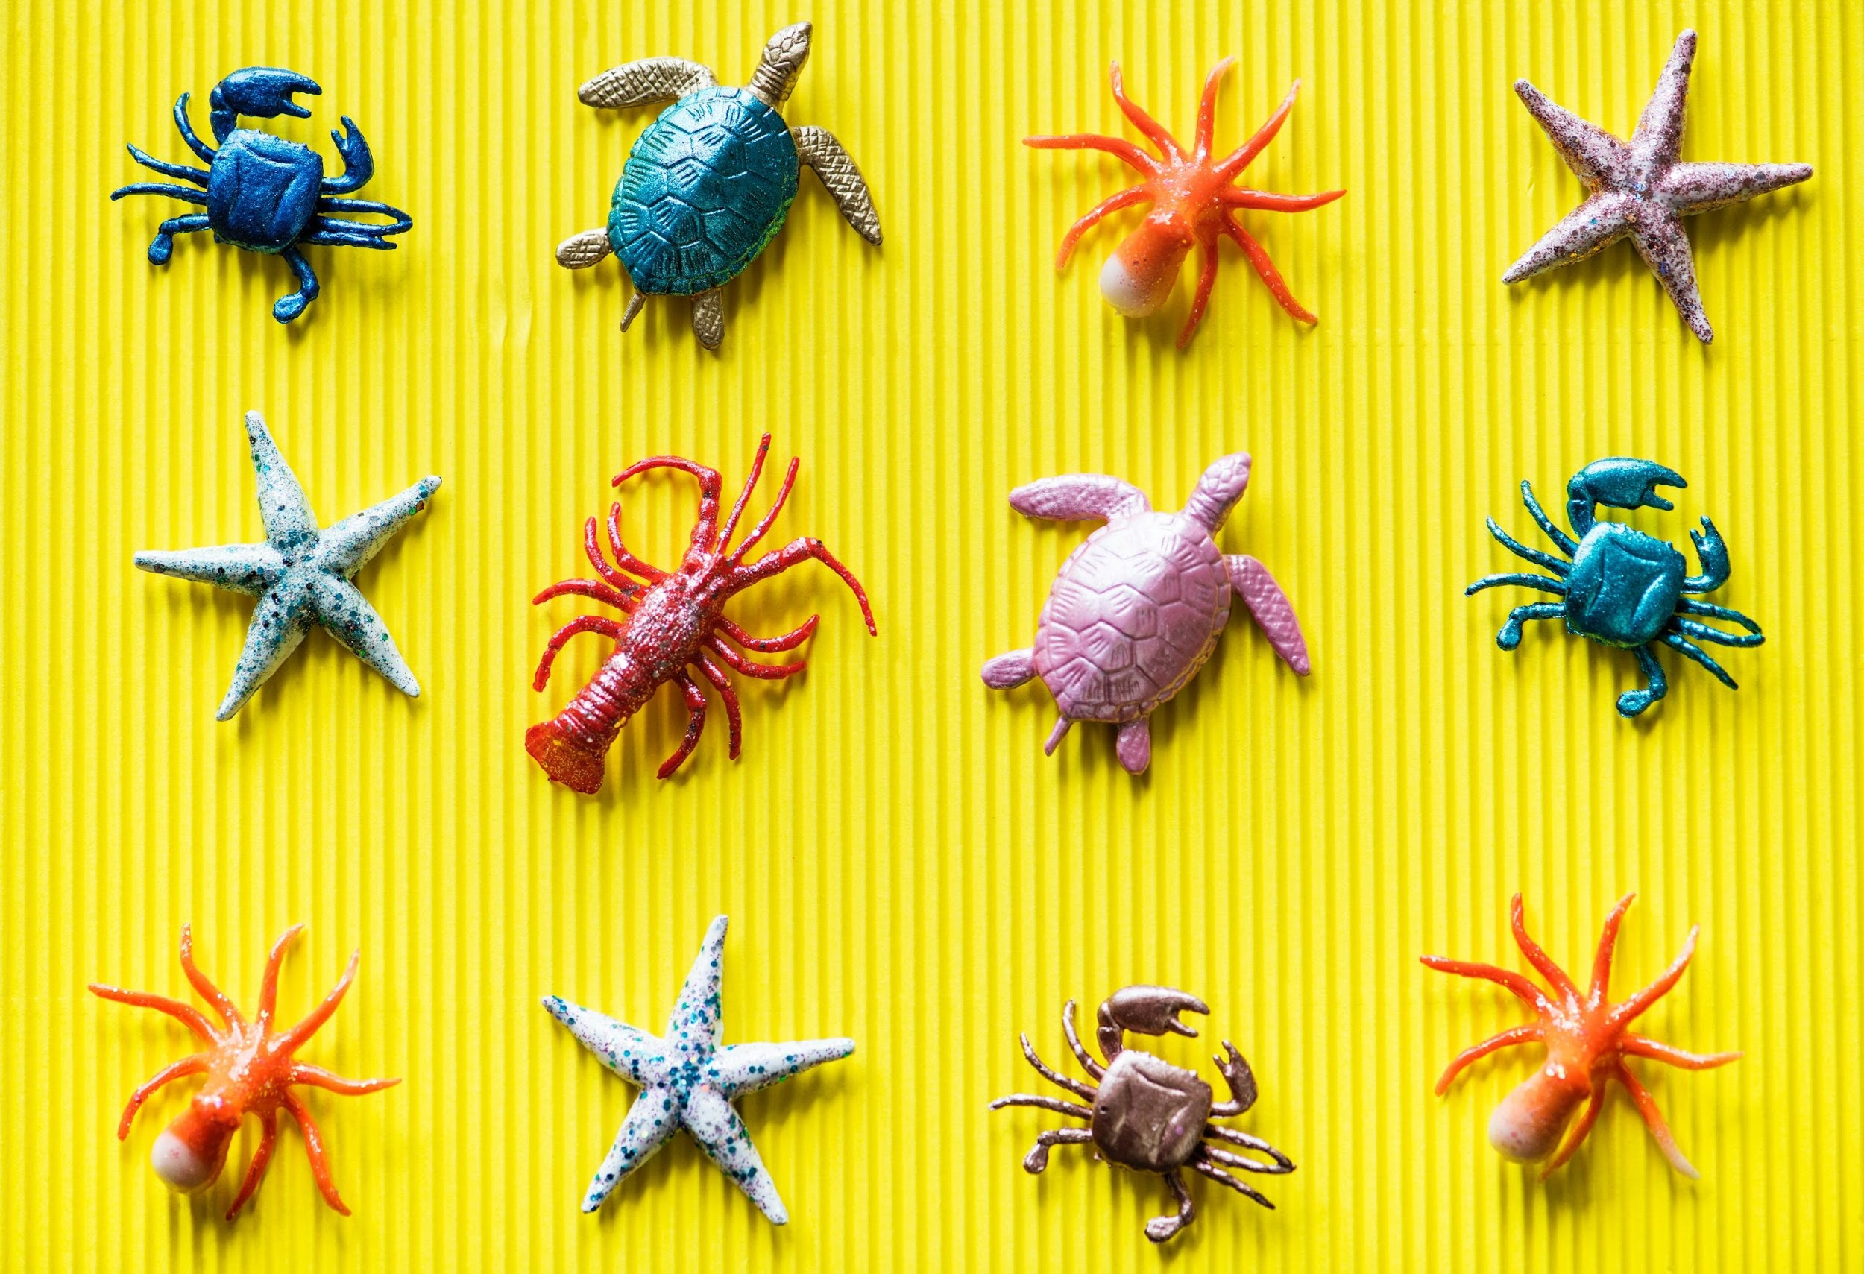
What We Offer
Excellent Quality and Affordable Products
Lots of Amazing Toys
World Wide Shipment
Friendly Customer Care & Service

Slide 13
Image Gallery

Slide 14
The Team
Wendy Mills
Carter Hall
Kevin Forster
Chief Operating Officer
Chairman & Founder
Chief Product Officer

Slide 15
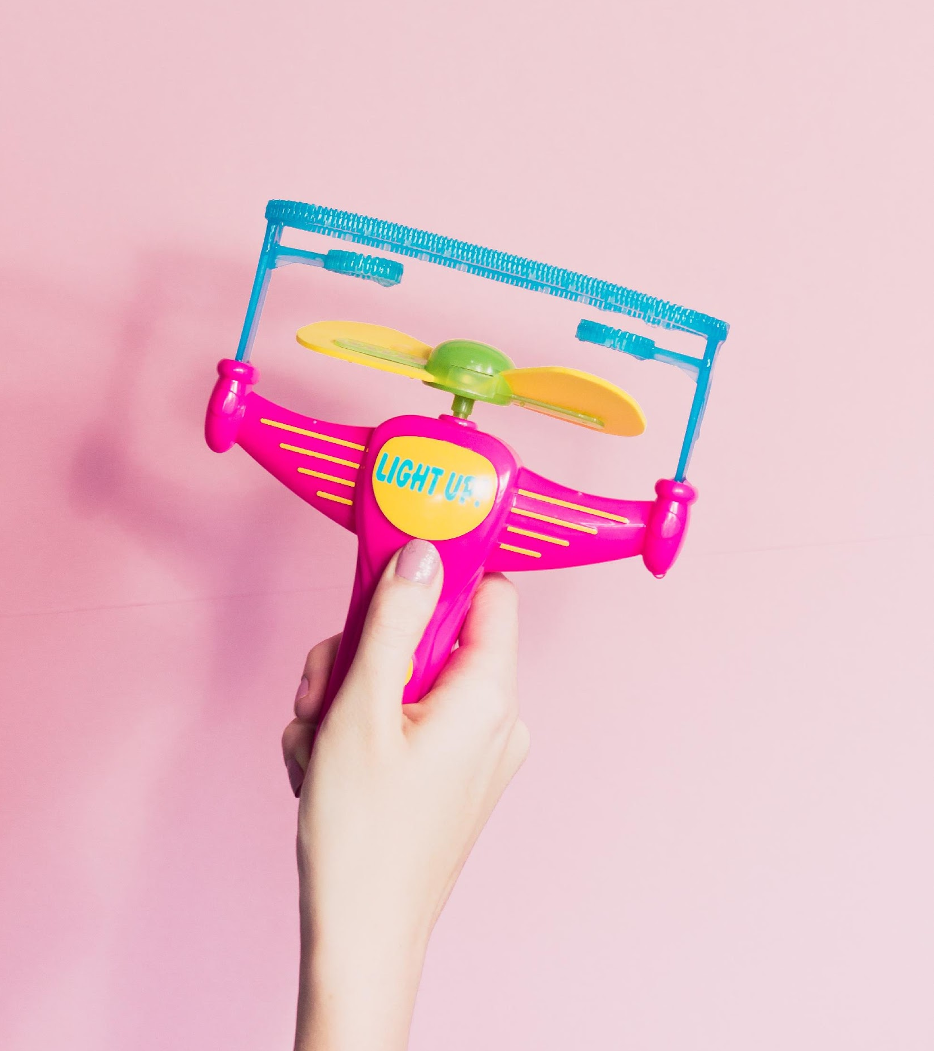
THANK
YOU
+827 238108 | invest@hope.com

