Slide 1
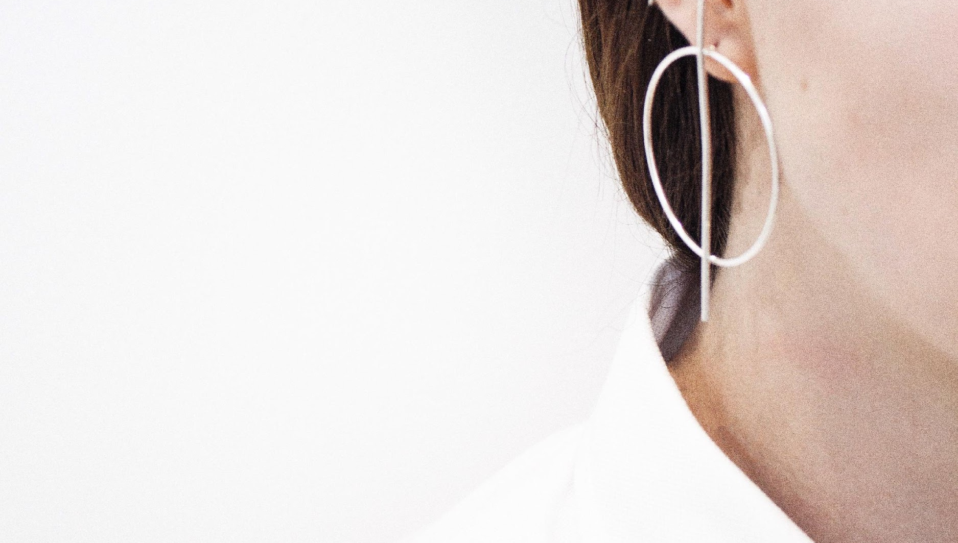
BRIGHT
JEWELRY
JEWELRY & ACCESSORY
+209 8328784 • brightjewelry.com
brightjewelry@gmail.com

Slide 2
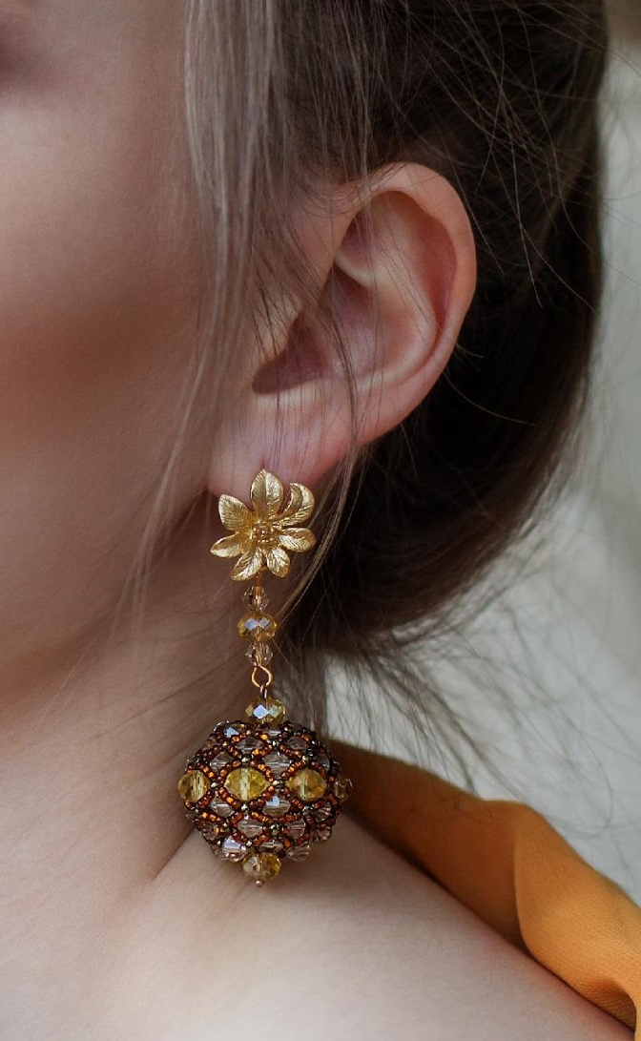
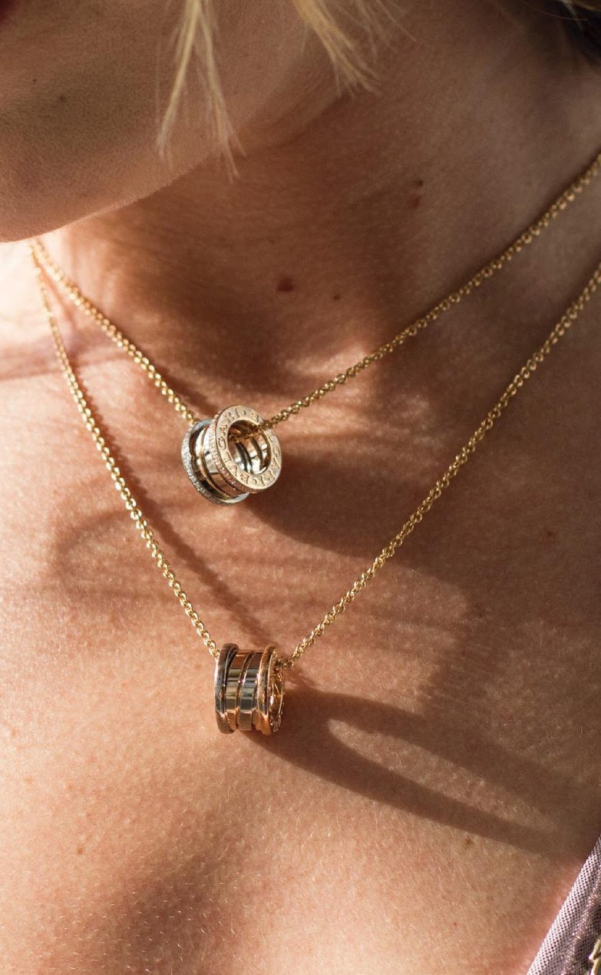
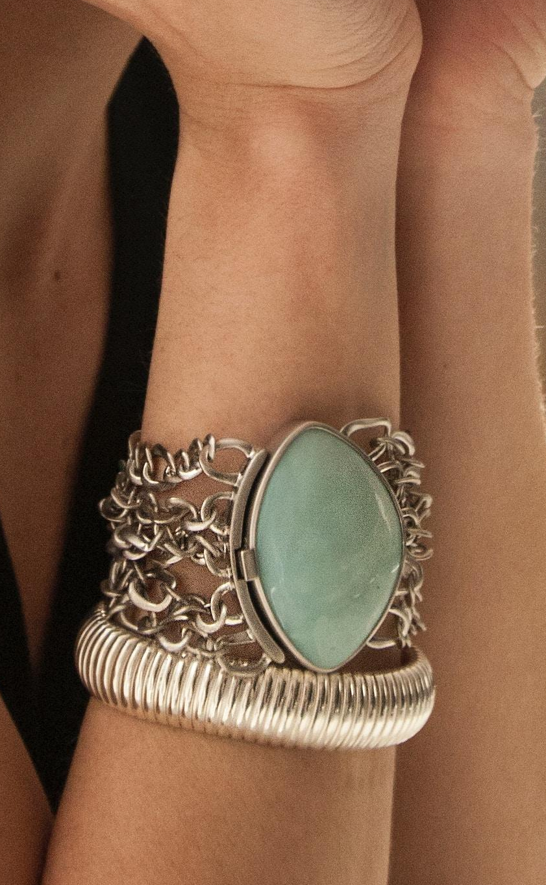
UPCOMING PROJECTS

Slide 3
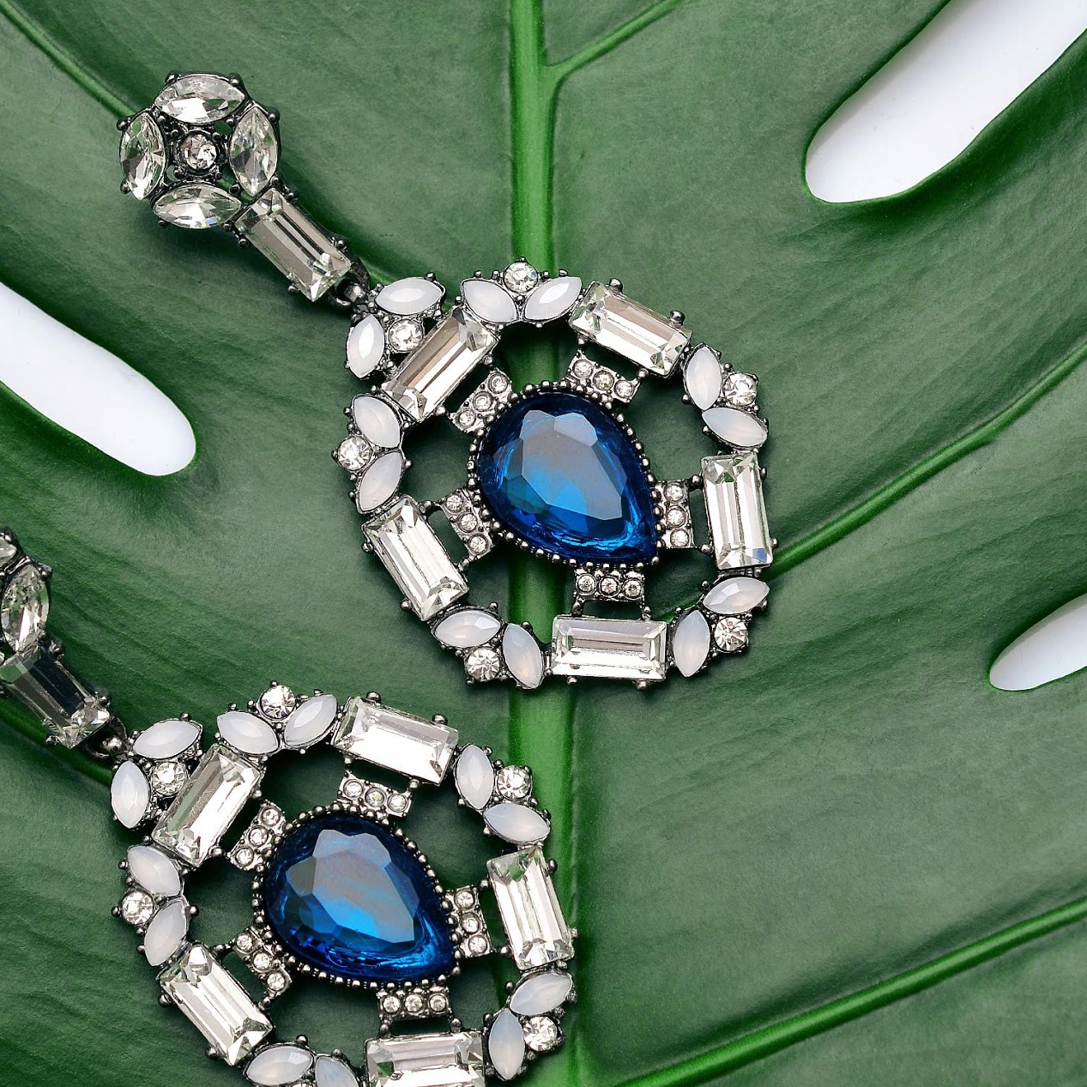
1
ALL JEWEL CONVENTION
The All Jewel Convention will be held at Downtown Convention Center on March 15, 2022, from 10 PM to 6 PM. This grand convention is a newly developed project by Bright Jewel & Accessory which will showcase all top-notch jewel products sold by the company.

Slide 4
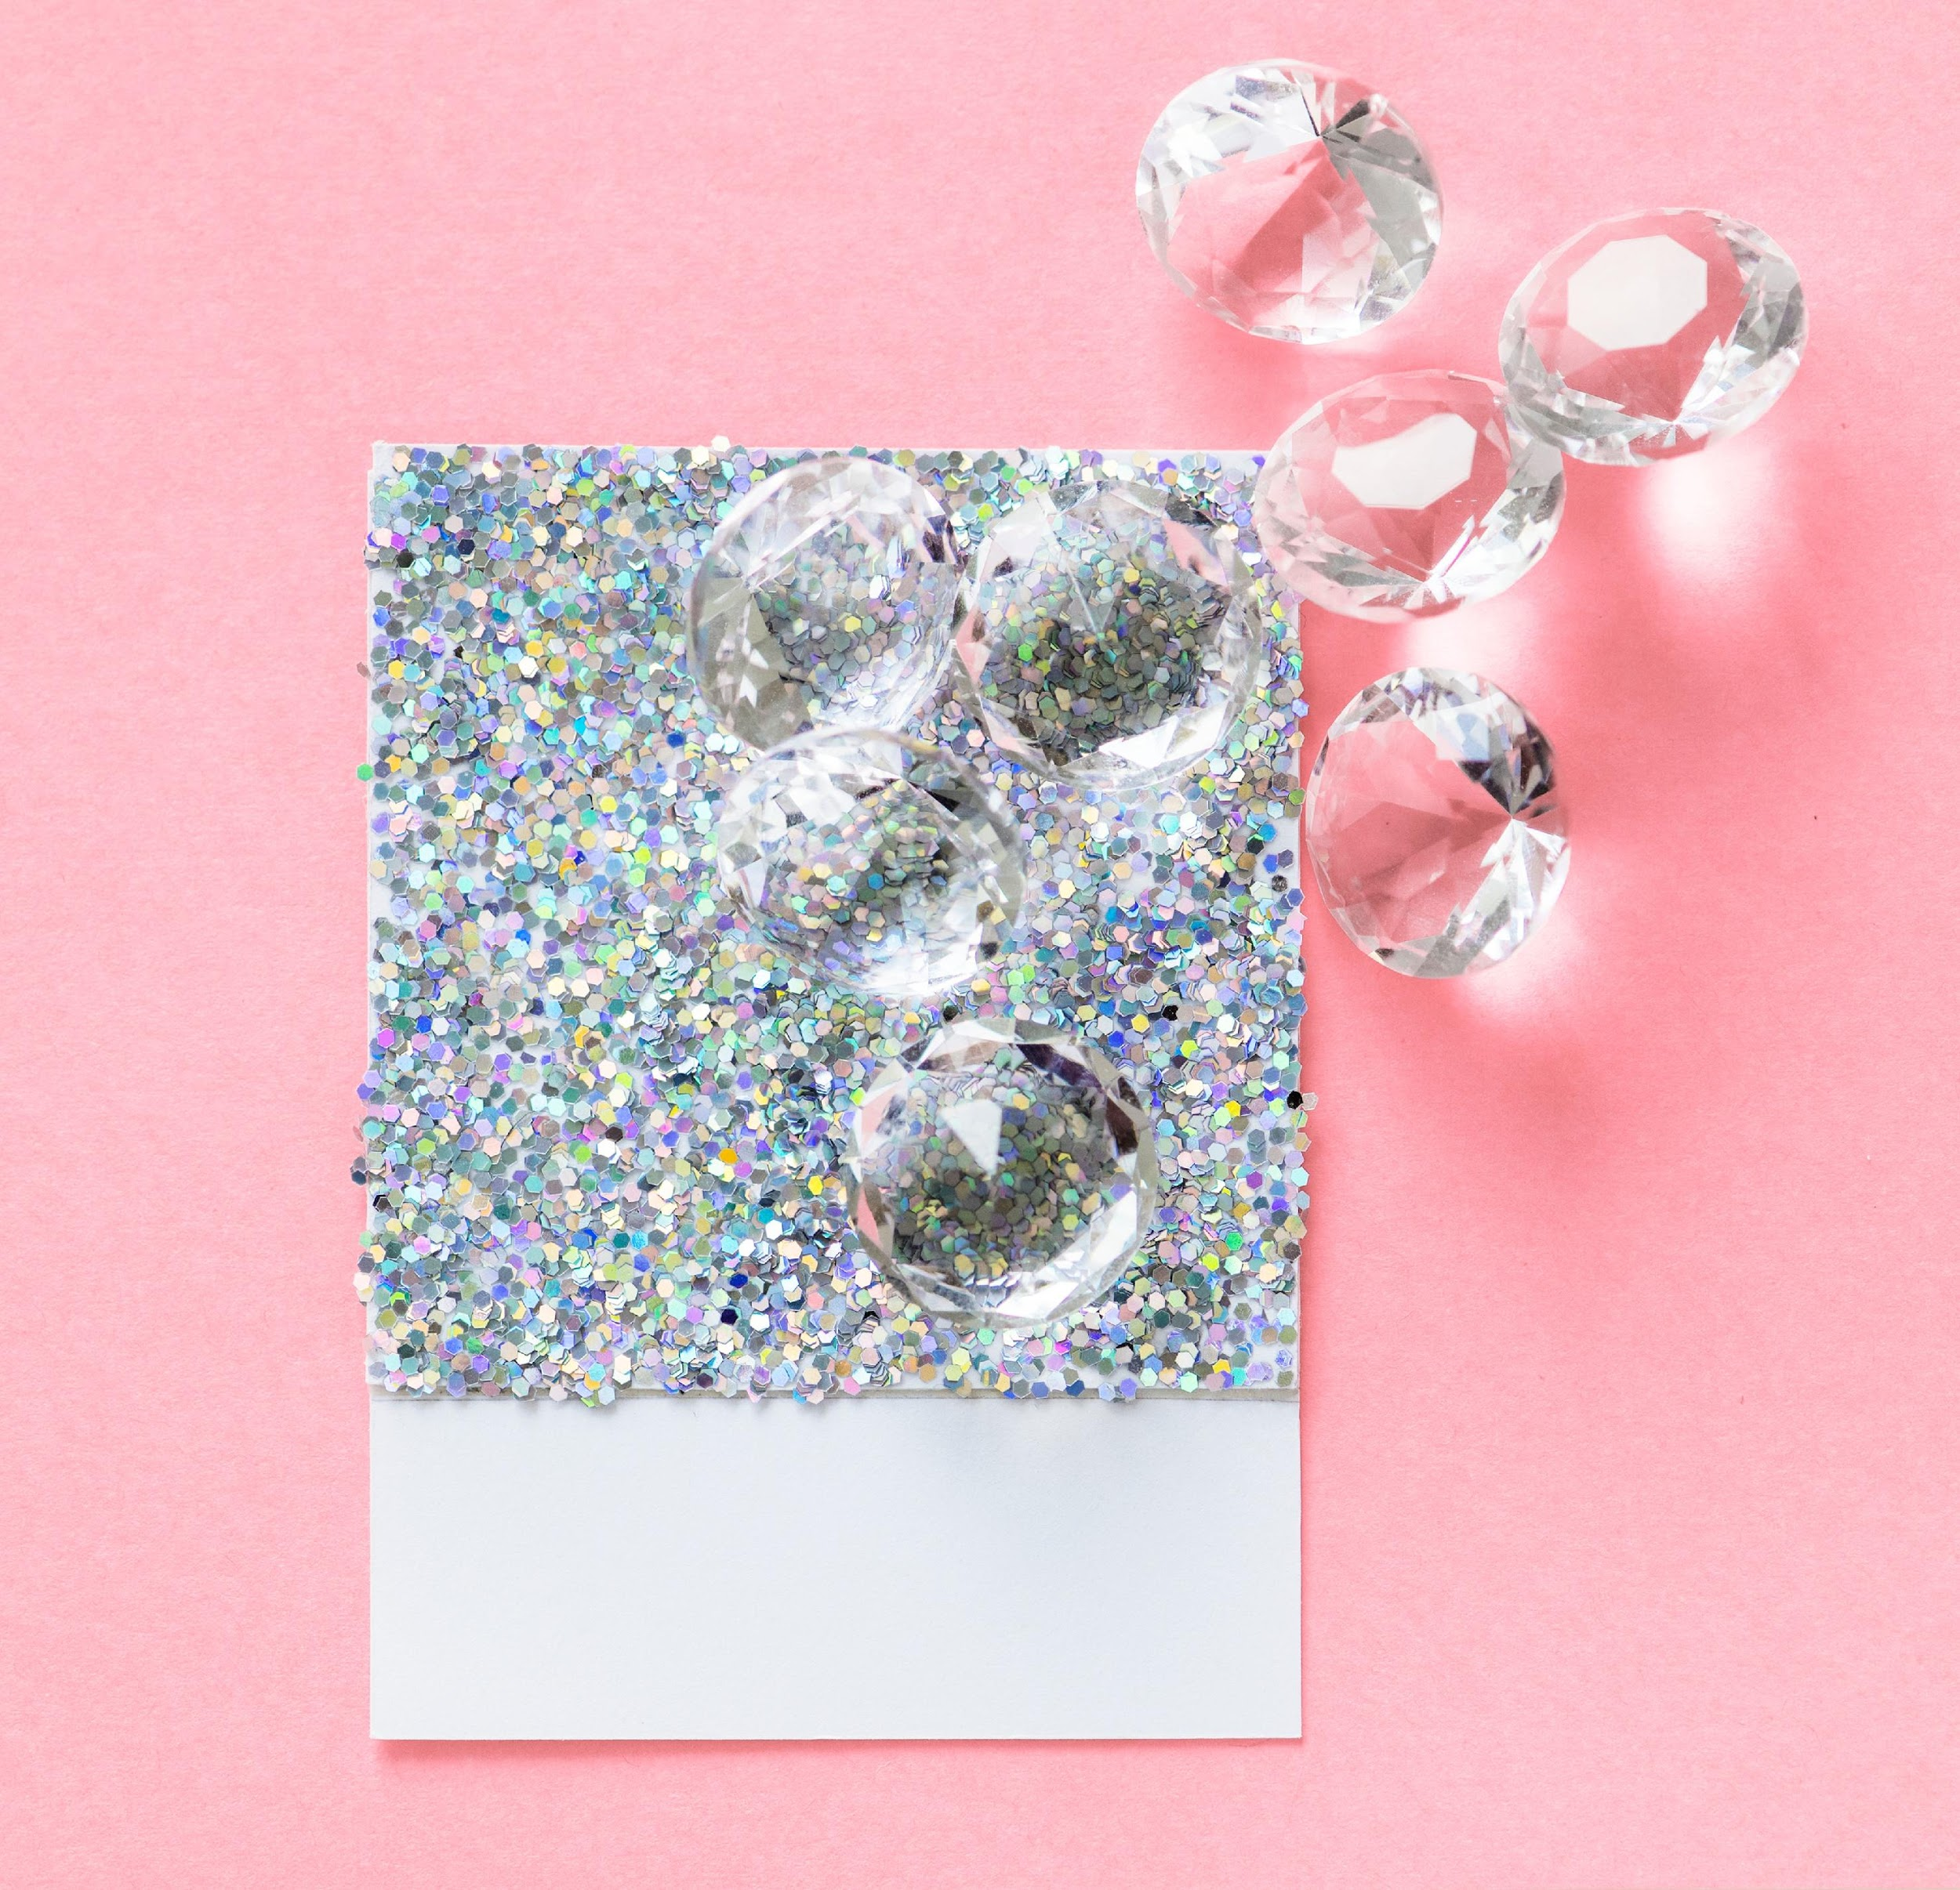
PINK DIAMOND EXHIBIT
The Pink Diamond Exhibit project will be held at Smart Advance Convention Center on July 17, 2022, from 10 PM to 6 PM. This newly developed exhibit aims to showcase & boast the expensive, glorious looking Pink Diamond on a 1 night only event which will be hosted by Alexander Trotsky who is the owner and founder of Bright Jewel & Accessory.
2

Slide 5
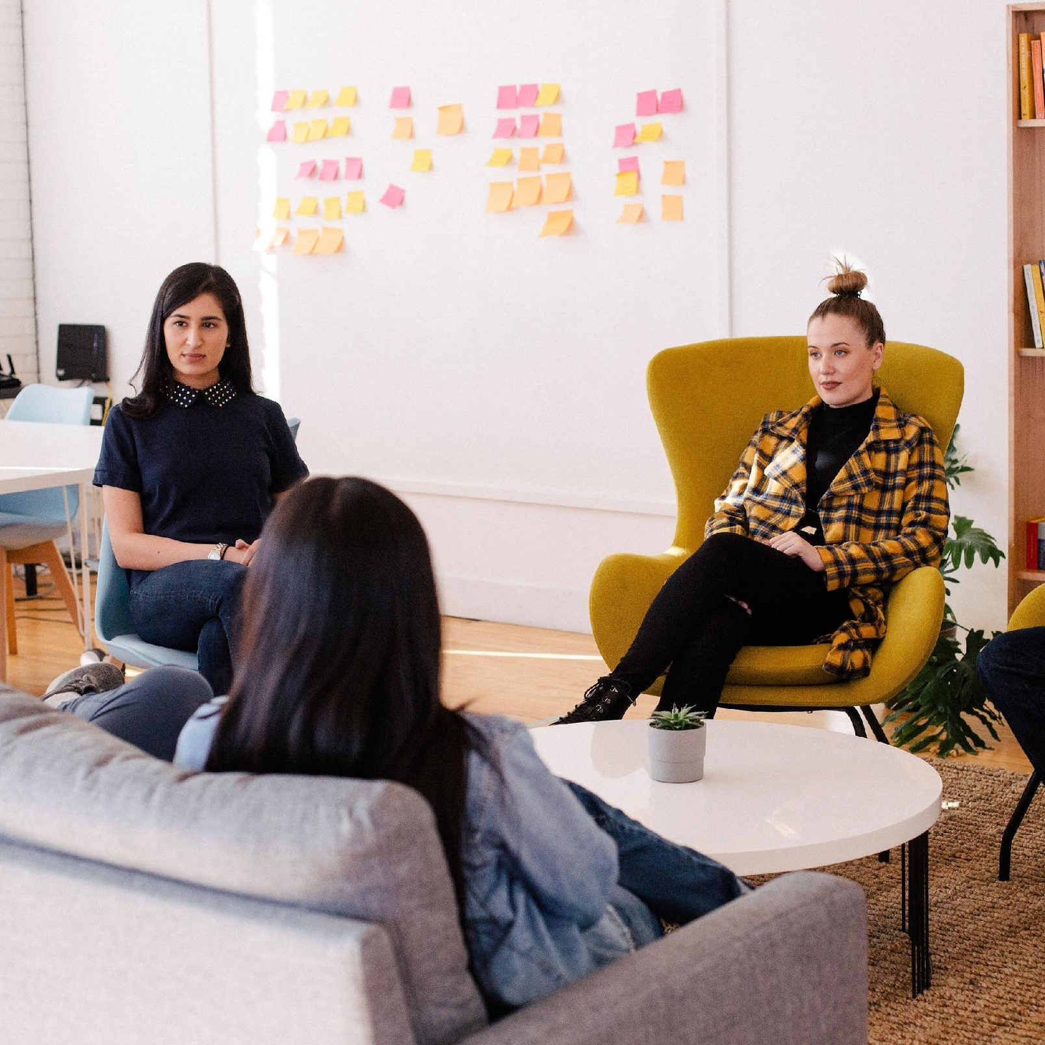
MONTHLY
BOARD MEETING
The monthly board will be held at Bright Jewelry & Accessory Meeting Room on January 10, 2021 from 12 PM to 6 PM. This monthly meeting will discuss the handled events of the company for the year 2022 & will review the guidelines & objectives for the events.
3

Slide 6
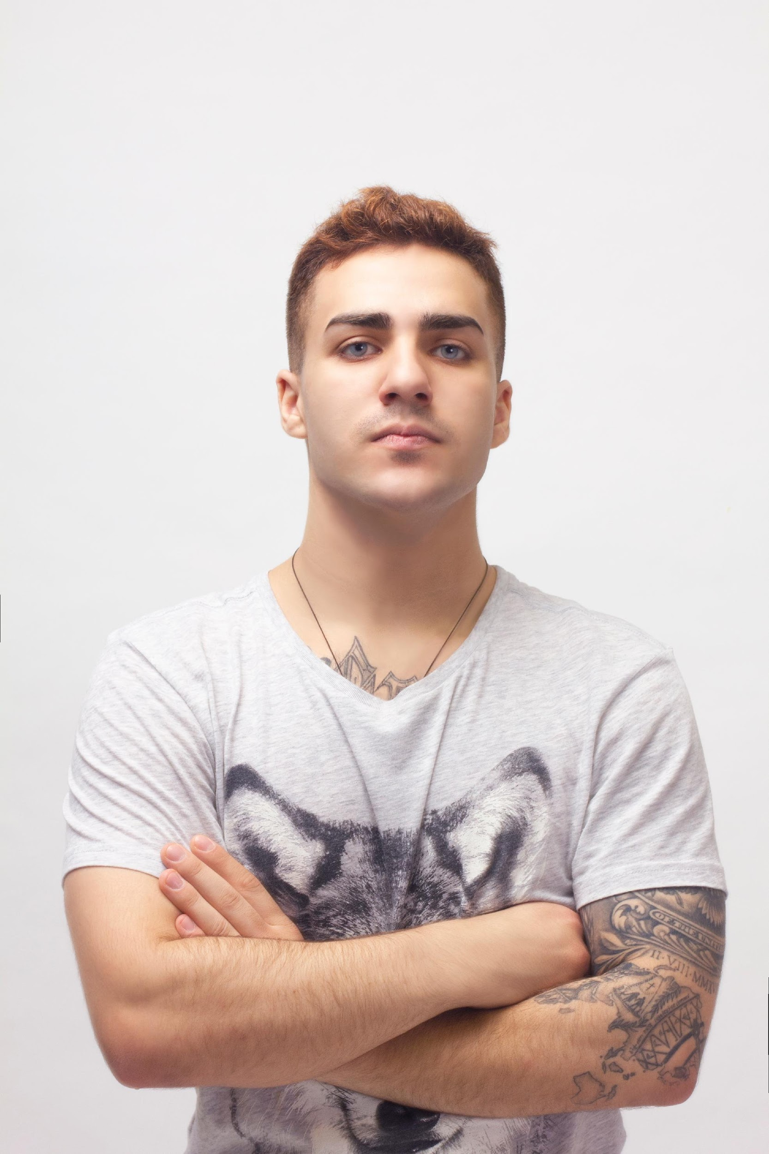
ABOUT
Alexander Trotsky
Founder & CEO
As the founder of Bright Jewelry & Accessory, I welcome you to our beloved company.
Started & founded in 1985, Bright Jewelry & Accessory has been planning & producing sophisticated, elegant jewelry & fashion accessories for a long period of time.
We tend to emphasize the beauty of the jewel while at the same time fused it with the exuberance of the beholder. With lots of amazing made products, our company boasts over 1, 000 uniquely styled jewelry pieces sold in the market.

Slide 7
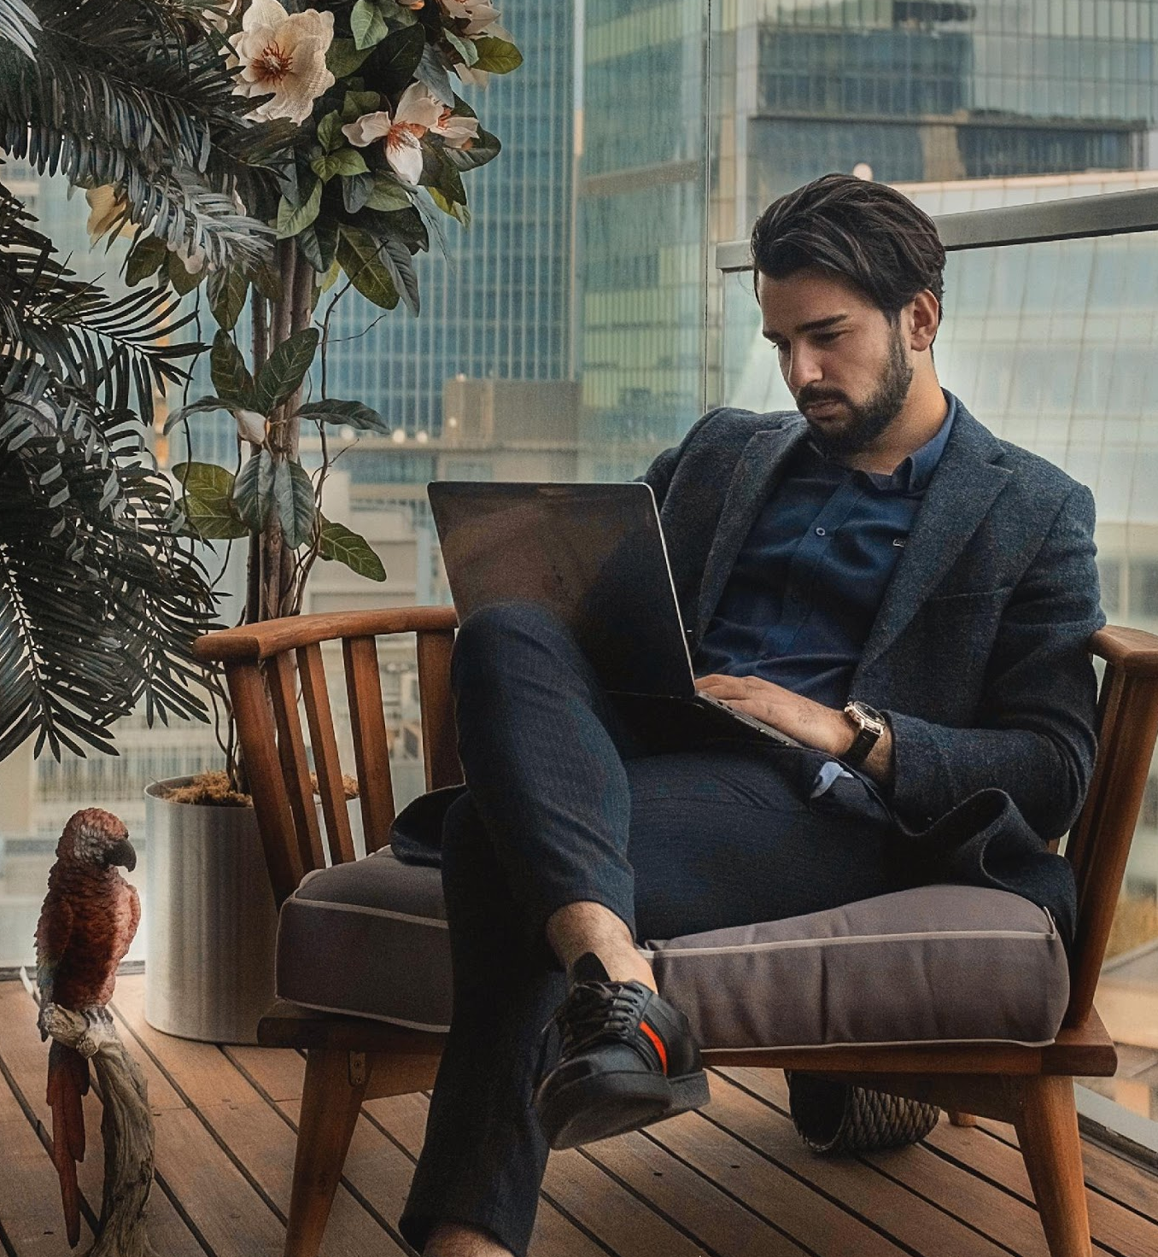
TESTIMONIALS
“
Bright Jewelry & Accessory gives you the most excellent made jewels in the market. Our company ensures that all of our products were sophisticatedly engineered and formed in an uncompelling manner.
Ken Washington, 49, Chief Marketing Officer

Slide 8
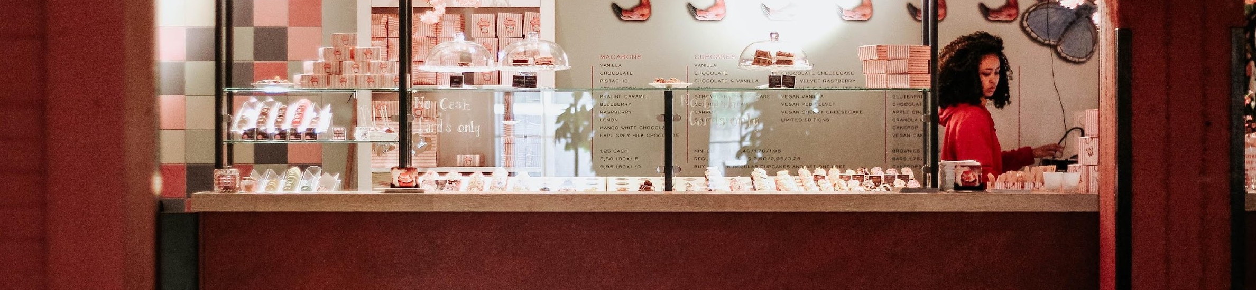
ALL JEWEL CONVENTION
60% of the profits accumulated from this convention will be donated to “Kid’s Life Foundation Center” & the other 40% of the profits gained from the convention will be allocated to the marketing campaign of the company for future products.
Downtown Convention Center
March 15, 2022 • 10 PM to 6 PM

Slide 9
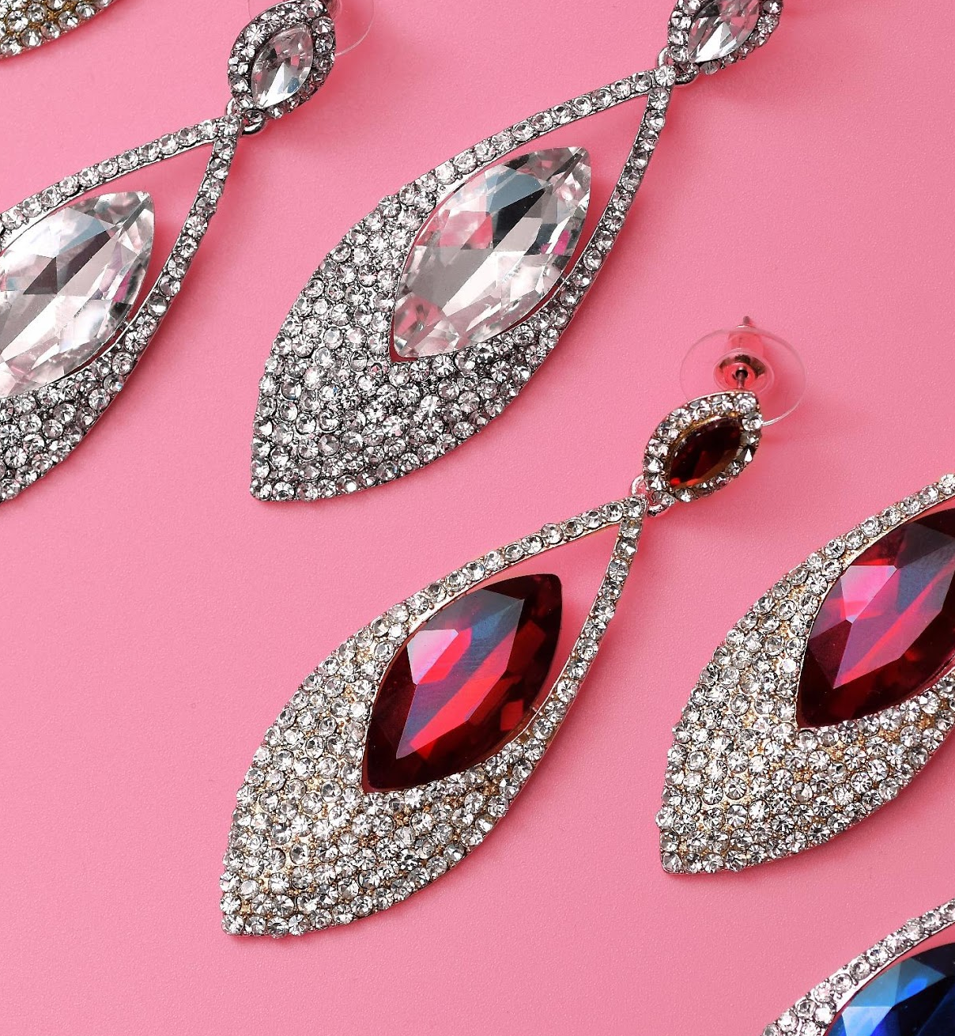
PINK DIAMOND EXHIBIT
60% of the profits gained from this event will be donated to “Save Earth Foundation” while the 40% of the accumulated profits from this exhibit will also be donated to “Earth One Foundation”.
Smart Advance Convention Center July 17, 2022 • 10 PM to 6 PM

Slide 10

MONTHLY
BOARD MEETING
This monthly meeting will discuss the handled events of the company for the year 2022 & will review the guidelines & objectives for the events. The monthly board meeting is projected to help the company further increase its sales & product publicity to invite more clients & customers to purchase jewels & accessories at the Bright Jewelry & Accessory.
Bright Jewelry &
Accessory Meeting Room
January 10, 2021 • 12 PM to 6 PM

Slide 11

HISTORY
Bright Jewelry & Accessory was founded & established by Alexander Trotsky in 1985 having only $10, 000 starting capital & only 30 different offered products in the market. The company faced lots of trials & challenges during its early years in the industry due to the extreme competition in the industry & lack of attention given by the public.
In 1989 the company almost filed for bankruptcy because of the major decline in sales. However, Trotsky managed to save the company’s reputation through loaning from different banks that would give sufficient money to regain its status.

Slide 12
TESTIMONIALS FROM CLIENTS
“
For over 10 years as a fashion designer in the industry I’ve been using the accessories made by Bright Jewelry & Accessory. I’ve paired them with all of my designed items like gowns, gloves, dresses, & shoes. I must say that I am 100% satisfied with their jewelry.
Princess Beauty Adorable, 37, Fashion Designer

Slide 13
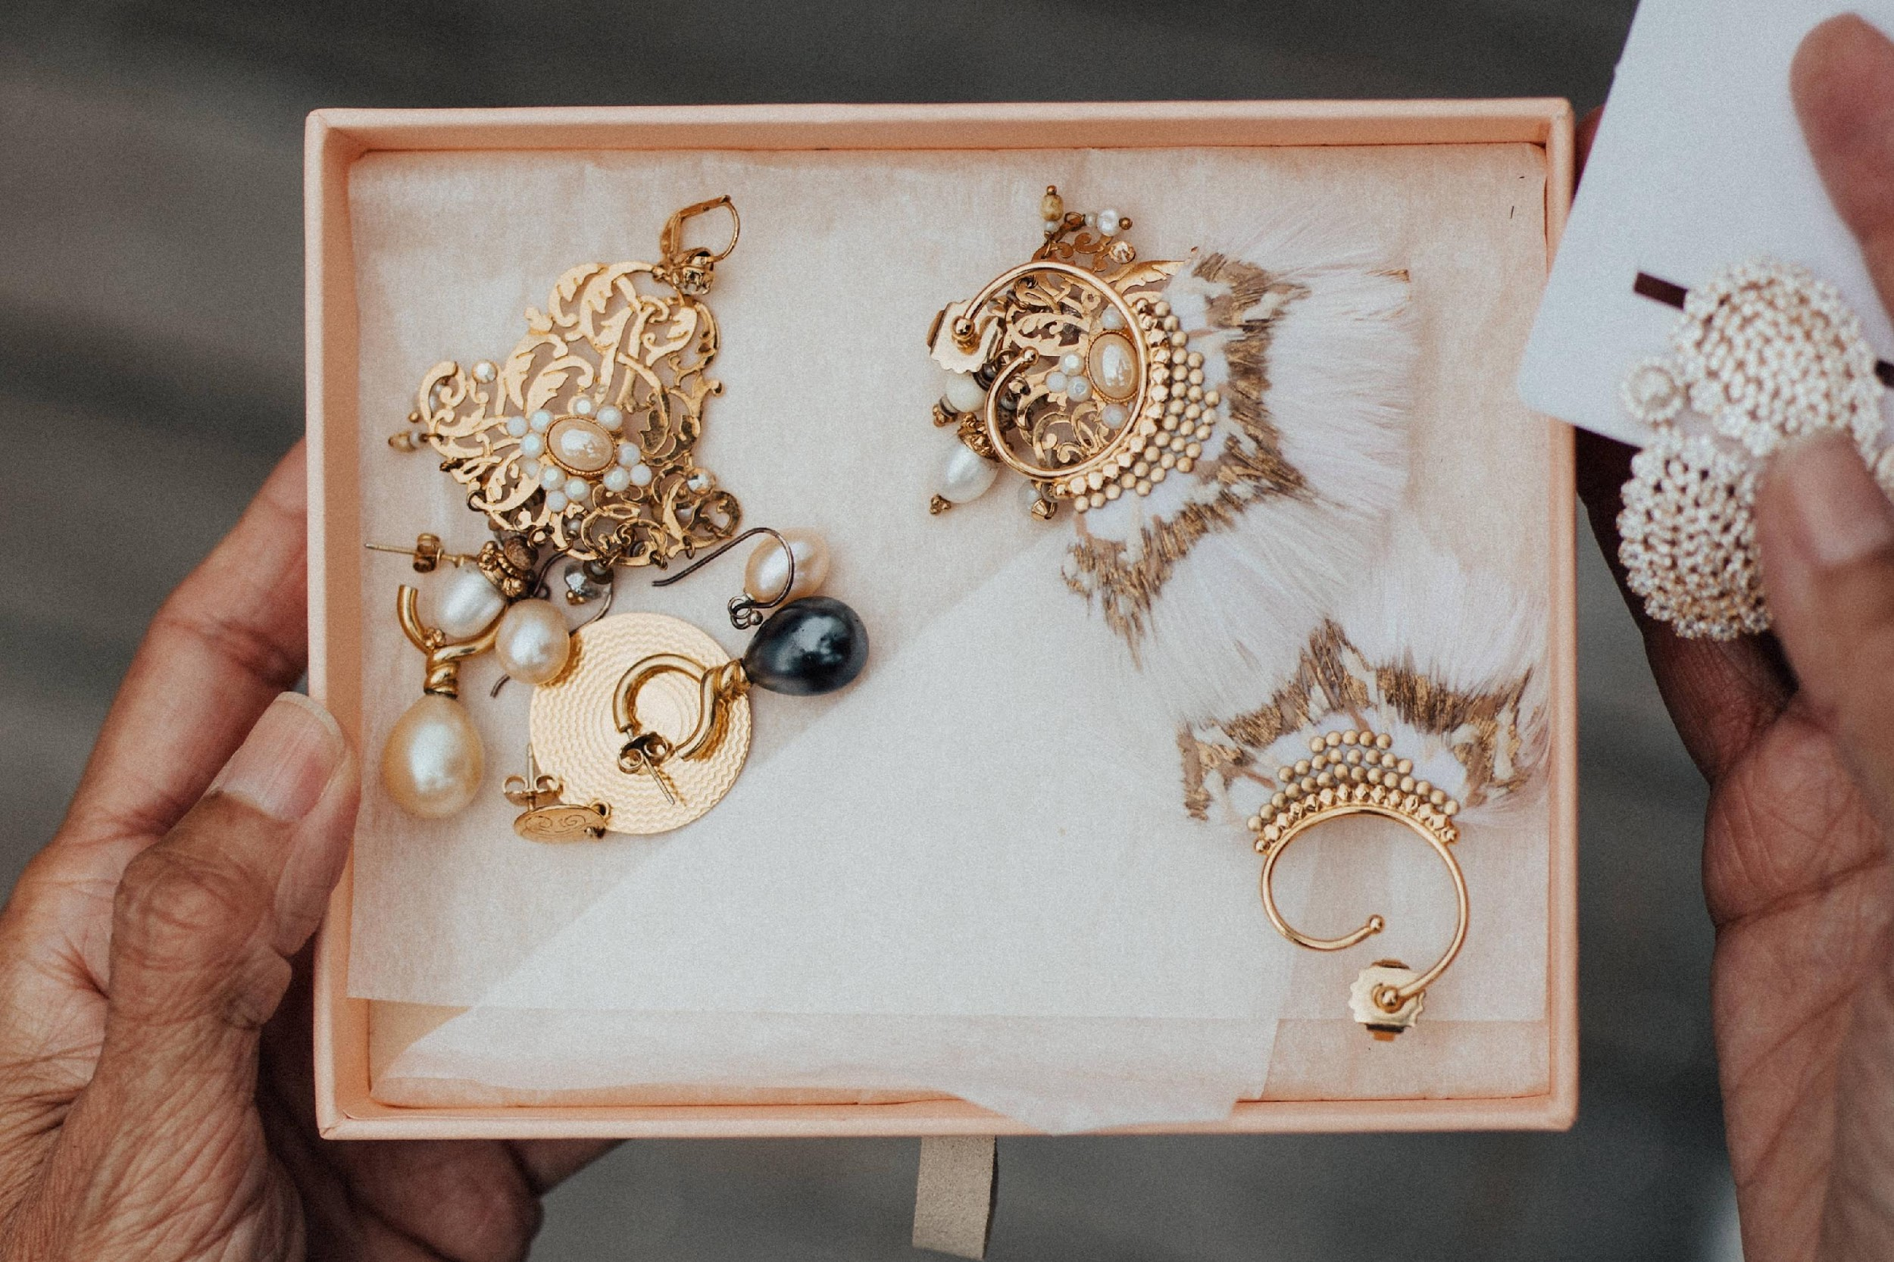
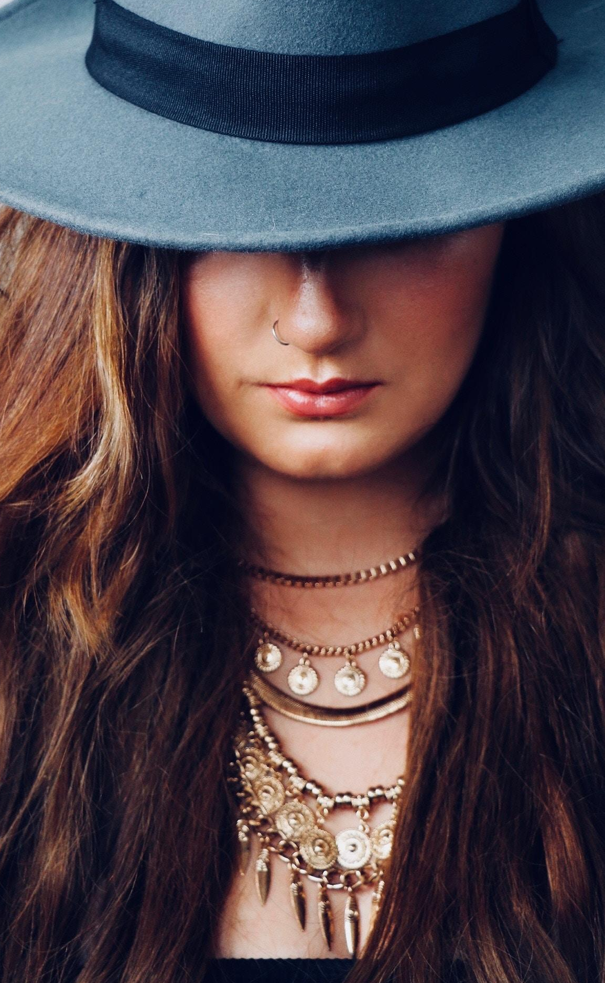
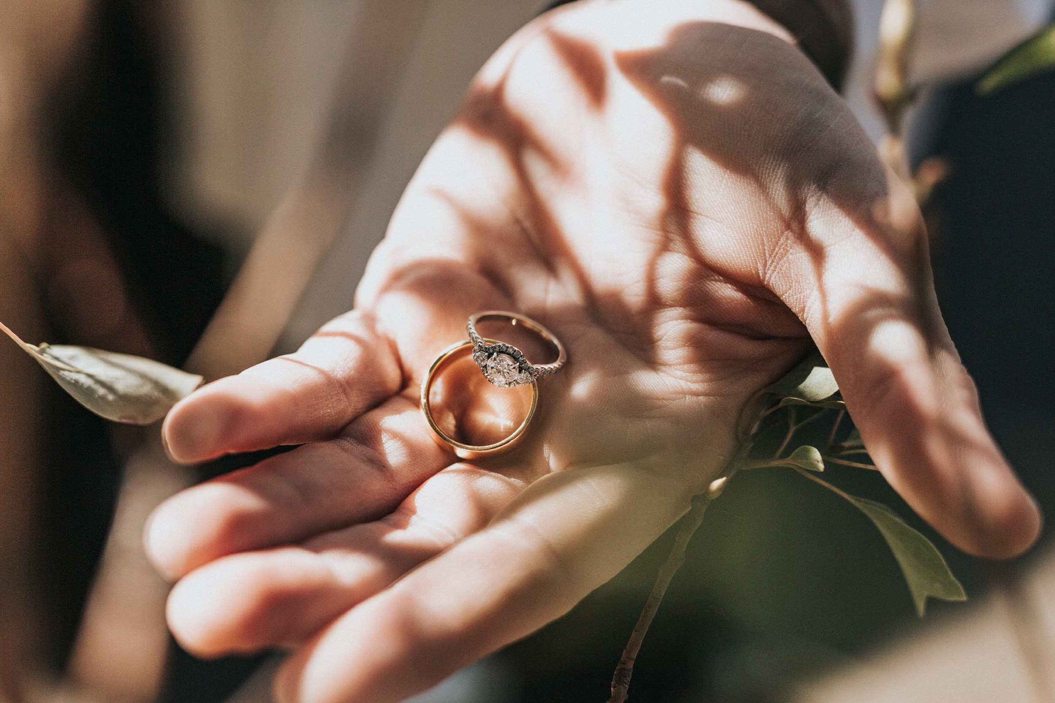
MAIN GOAL
Bright Jewelry & Accessory commits itself to providing clients with excellent jewelry & fashion accessories in the industry through a meticulous, sophisticated collection of pieces.

Slide 14
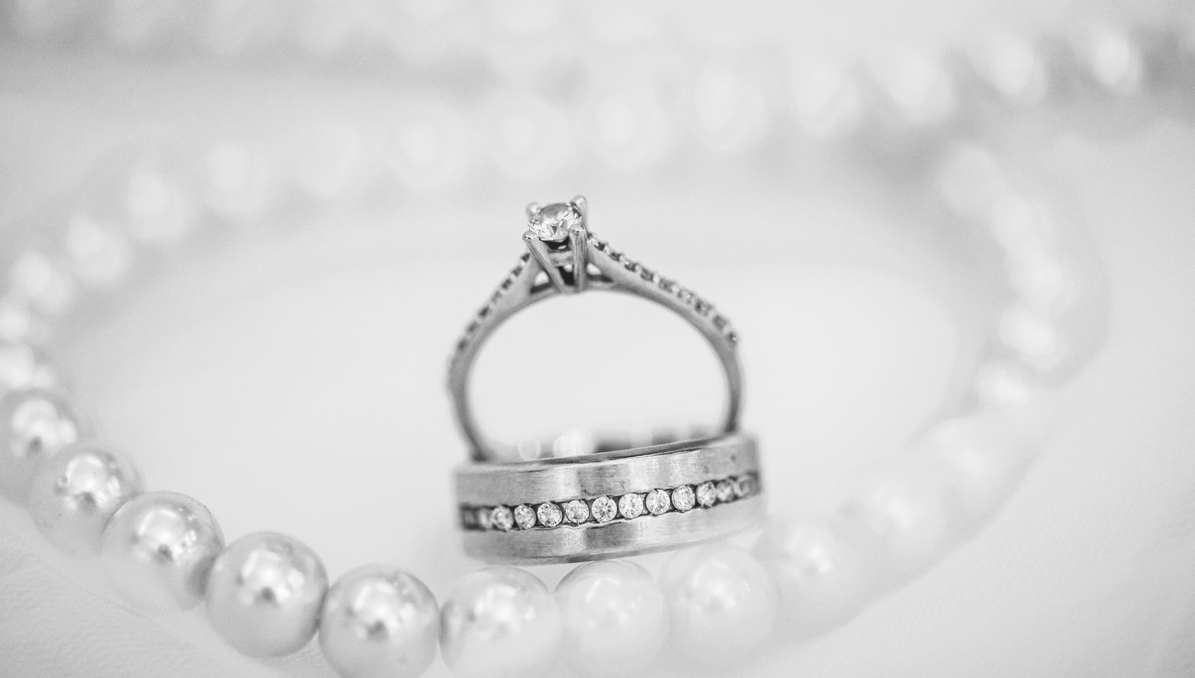
OVERVIEW GROWTH
40%
70%
50%
increase in profits for the year 2022 to 2023.
increase in sold products
as of December 2022.
increase in new clients as
of December 2022.

Slide 15

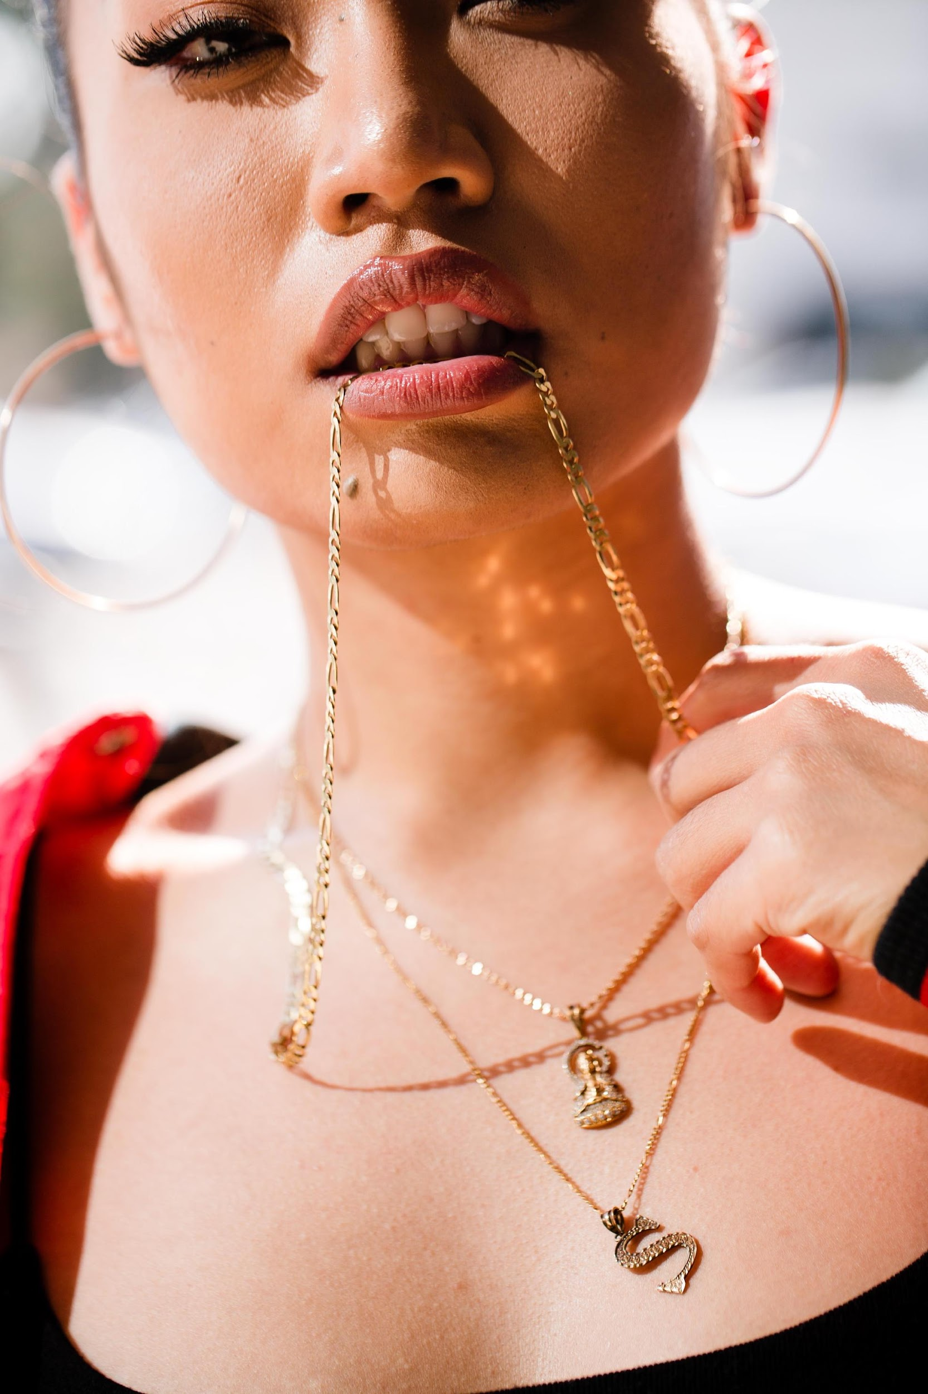
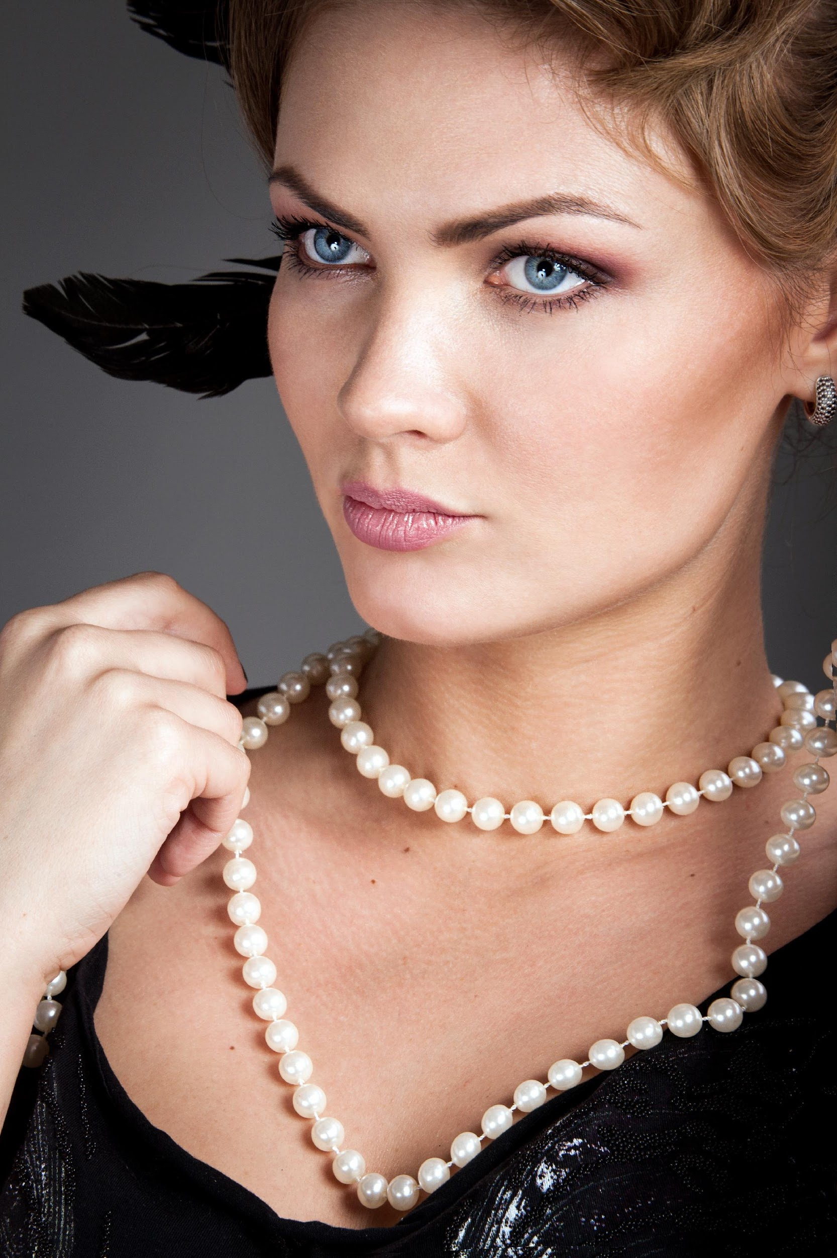
WHAT WE OFFER
Excellent Made Jewelry & Accessories
Lots of Freebies with Free Lifetime Warranty
Sophisticatedly Engineered Products
Quality & Friendly Customer Care

Slide 16
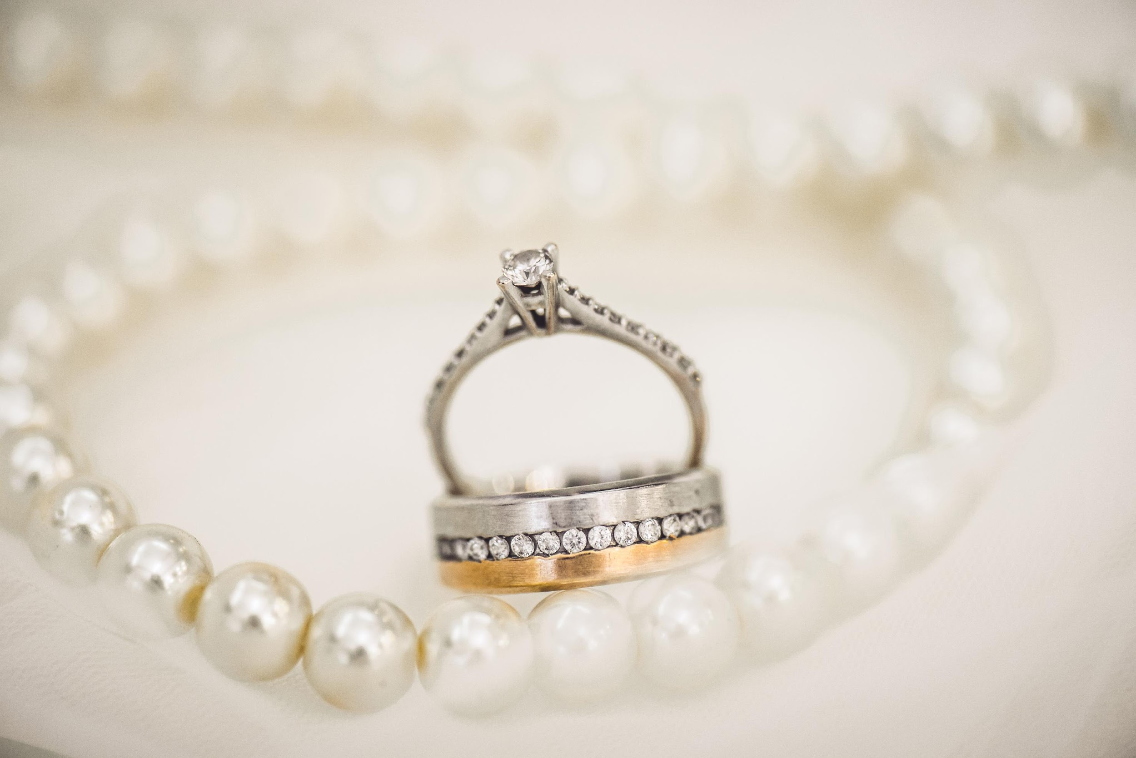
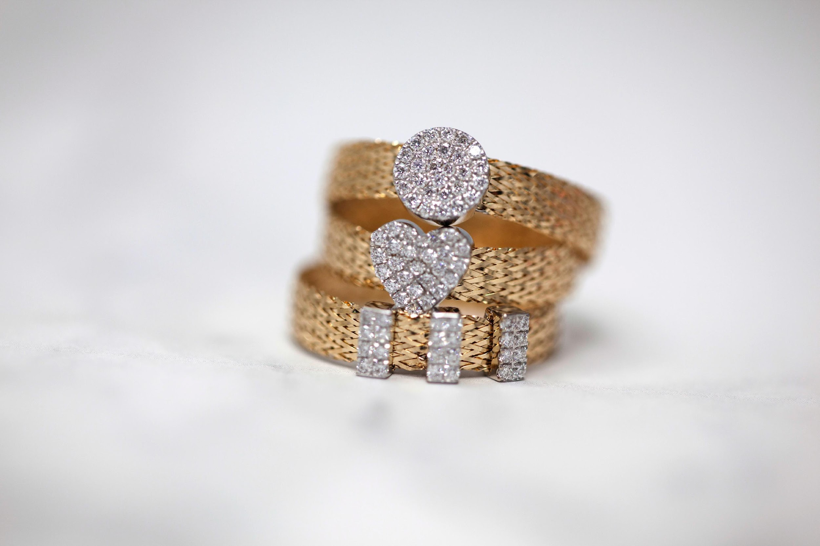
IMAGE
GALLERY

Slide 17
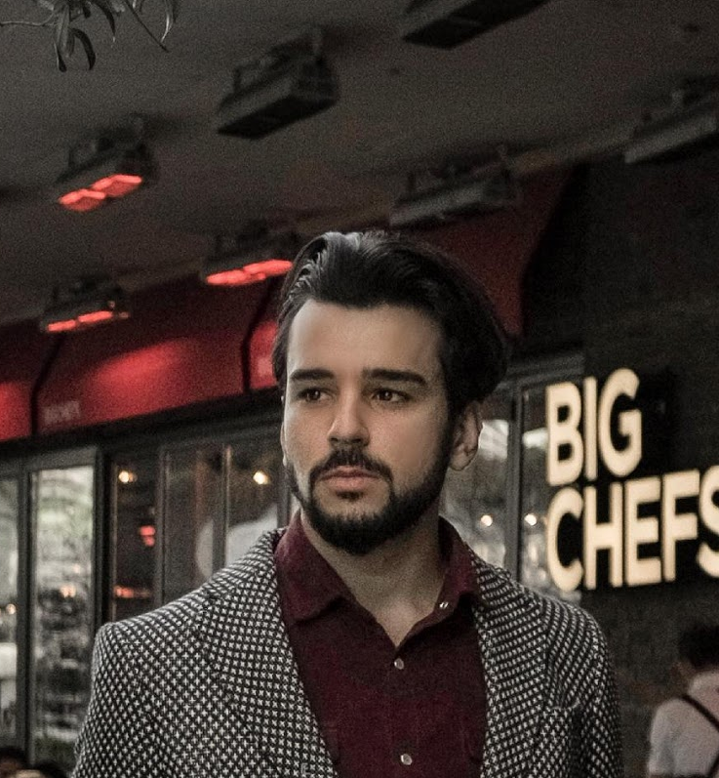
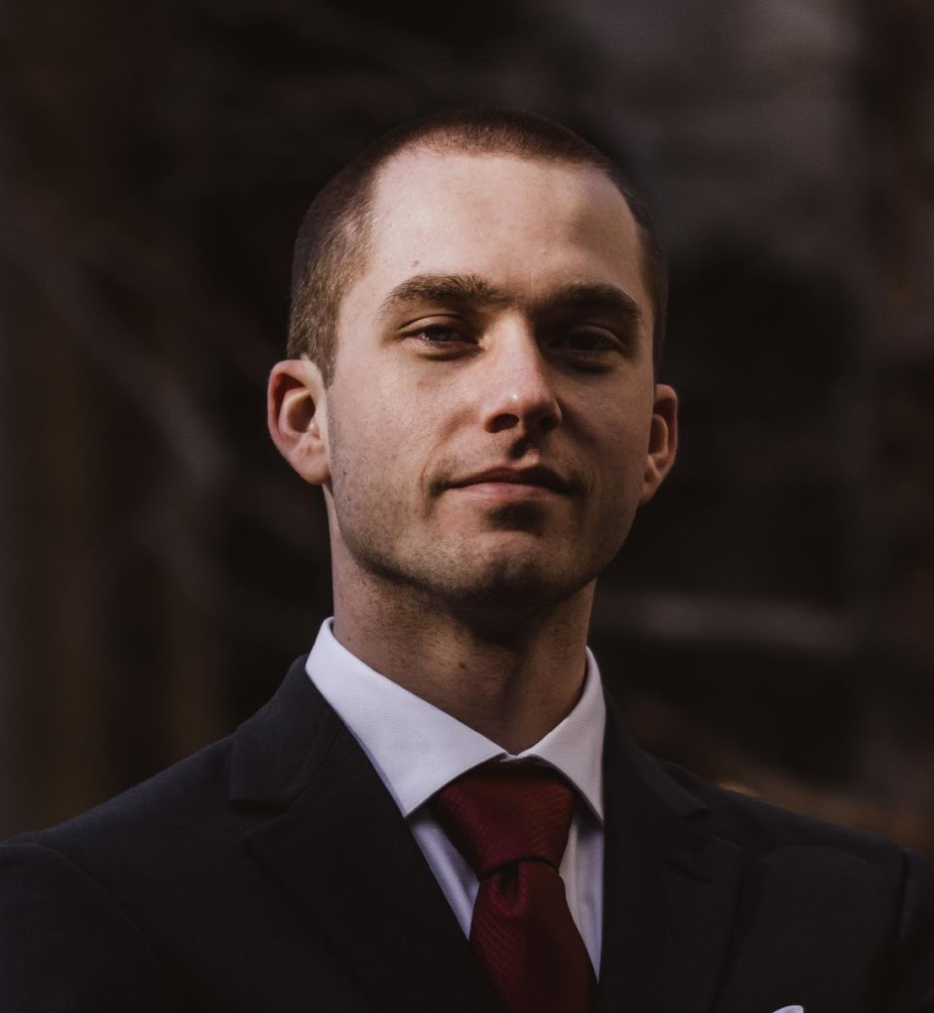
THE TEAM
Alexander Trotsky
Ken Washington
Jose Valdez
Founder & Chairman
Chief Marketing Officer
Chief Operating Officer

Slide 18
THANK YOU!
+209 8328784 • brightjewelry.com
brightjewelry@gmail.com

