Slide 1
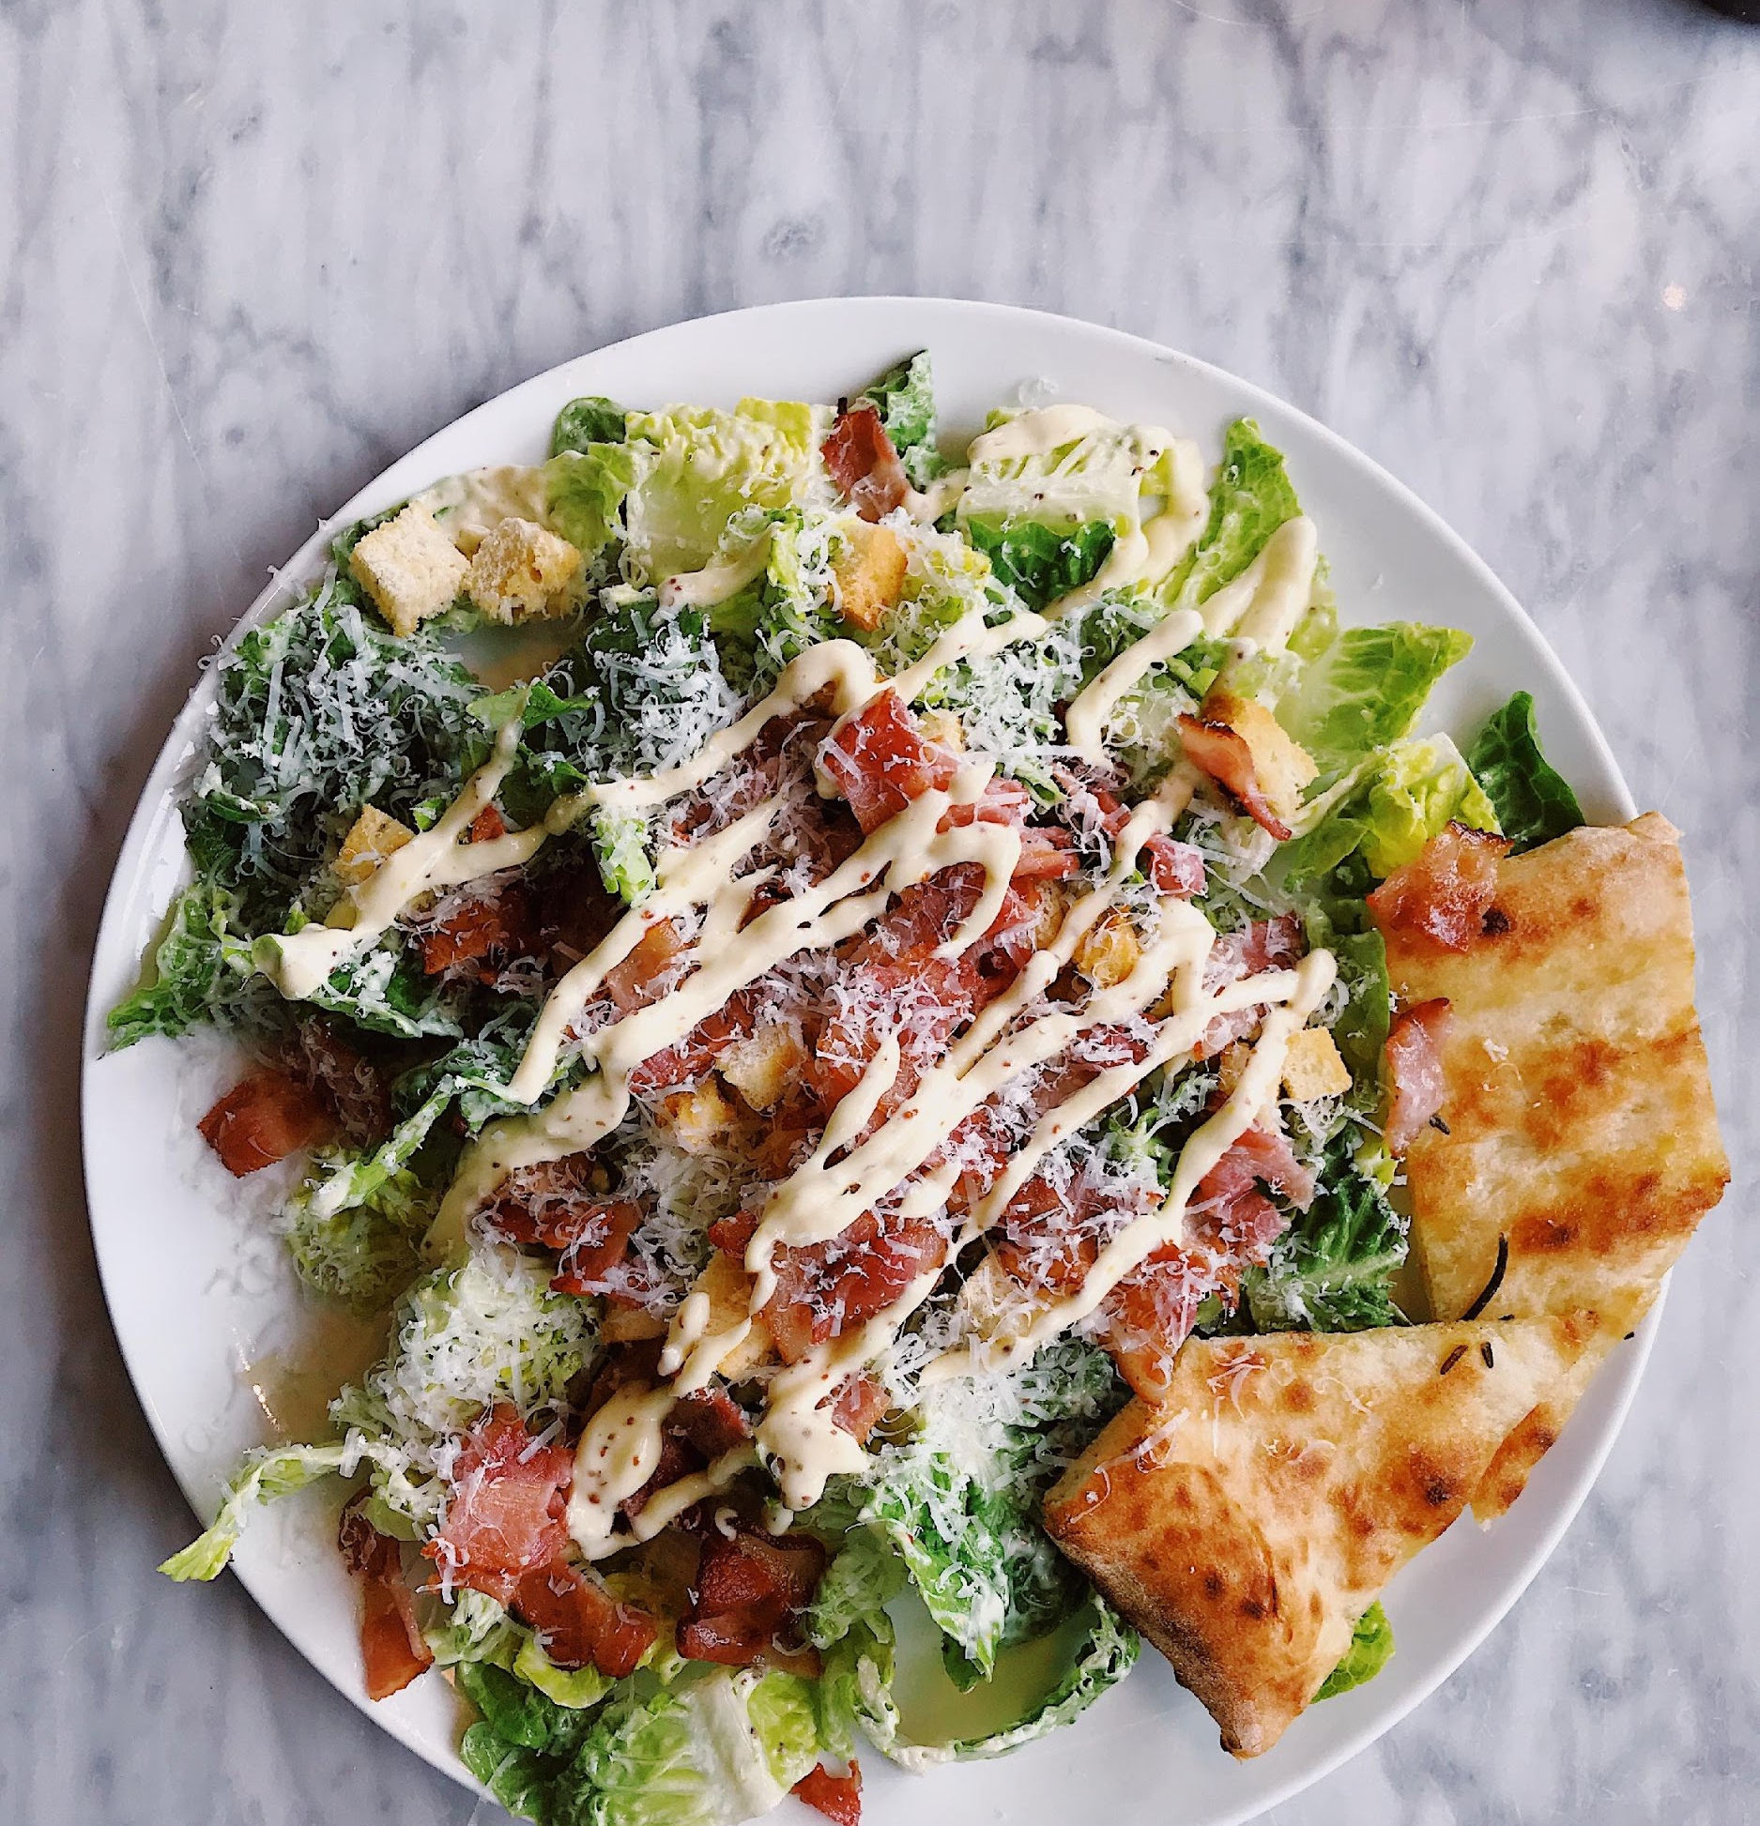
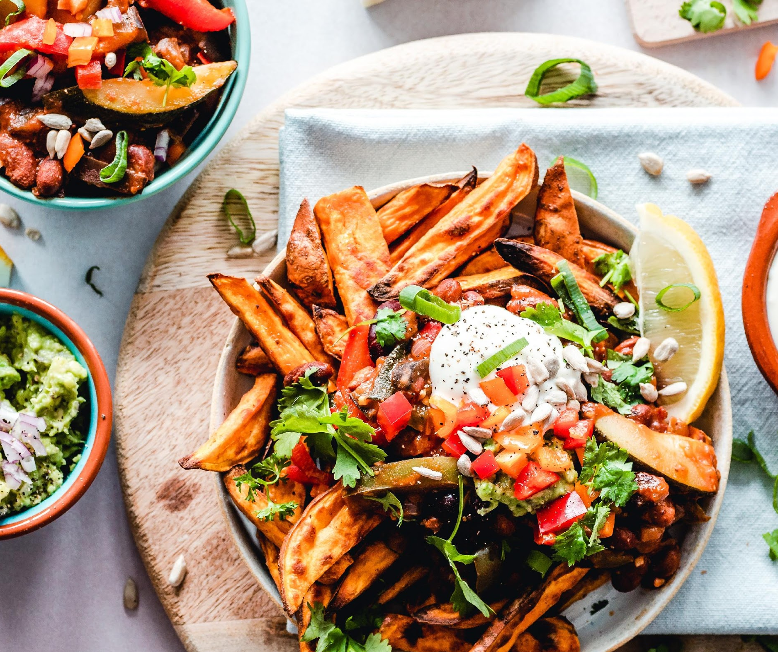
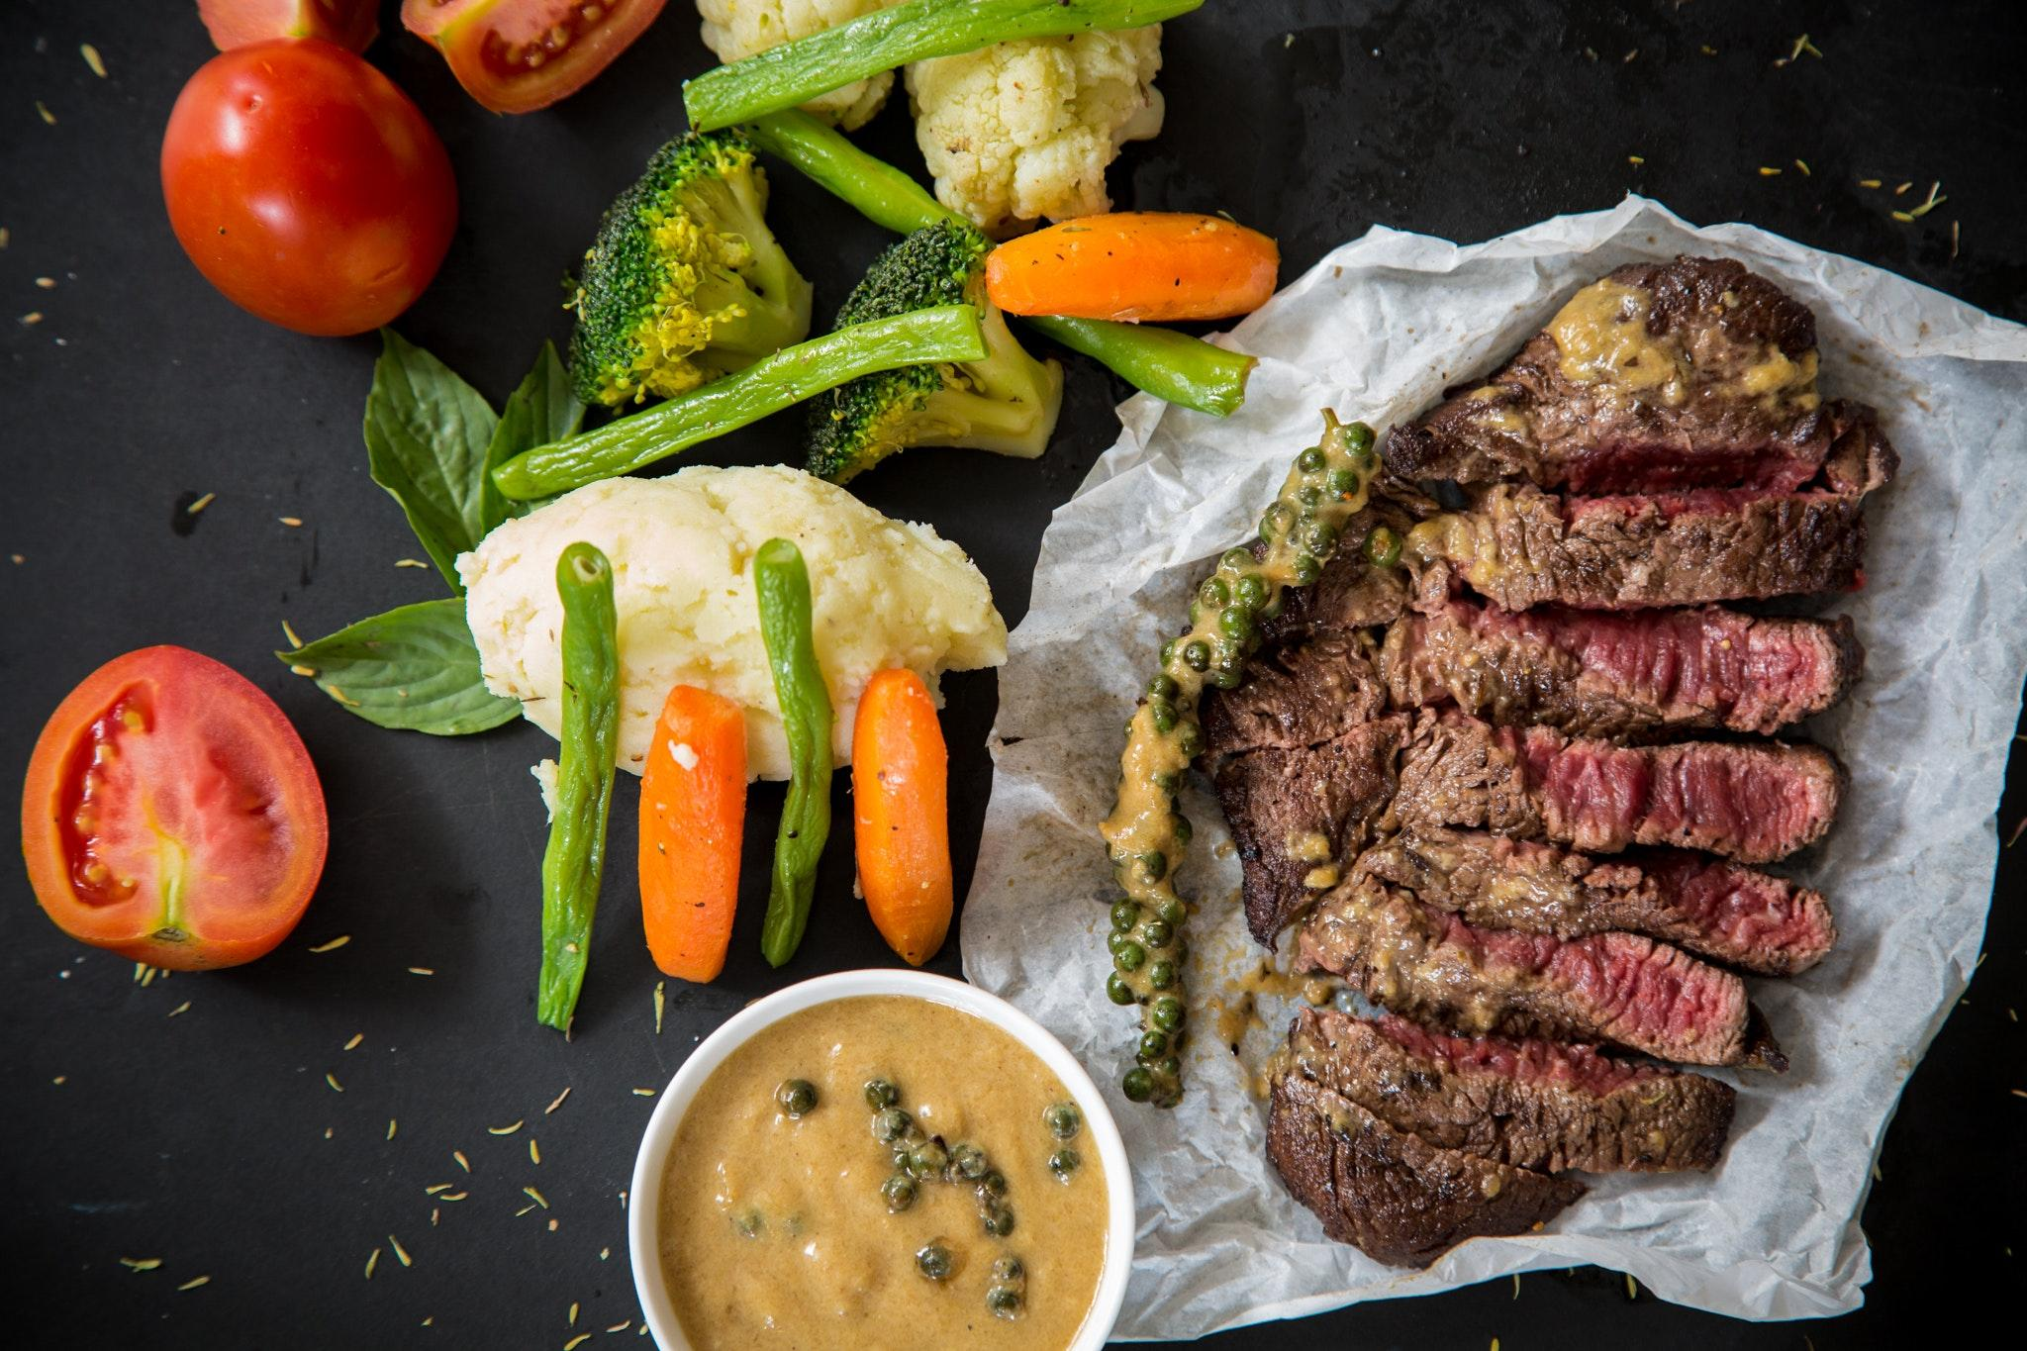
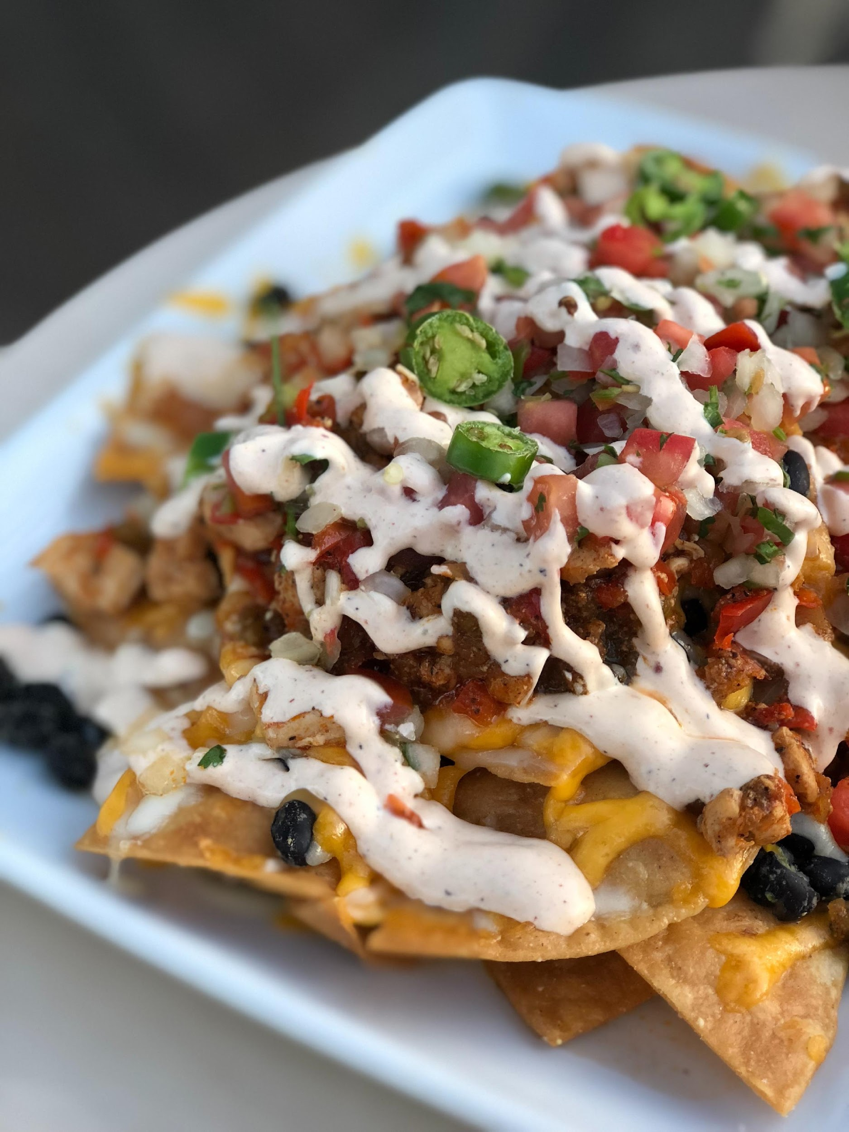
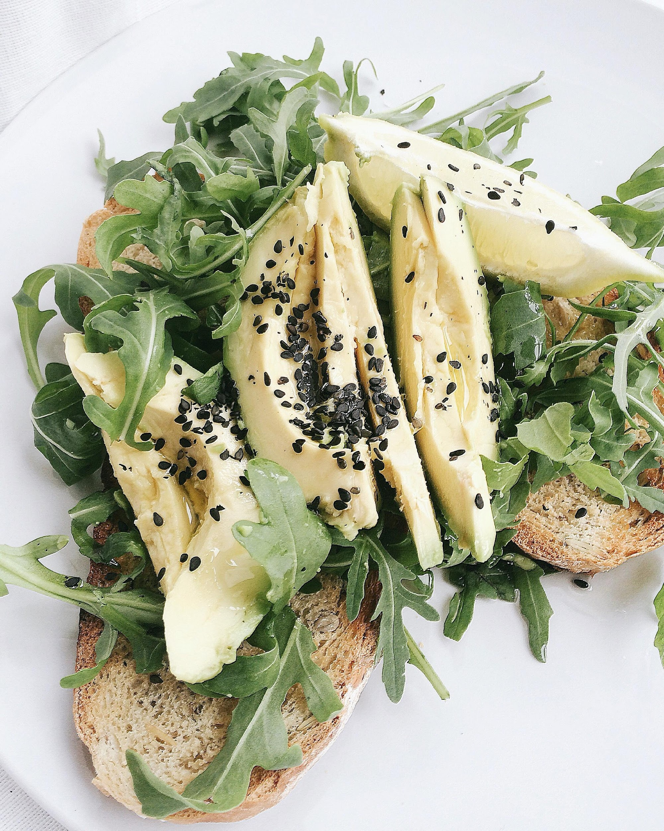
sunnycareclinic.com | 918-920-5001
sunnycareclinic.com
Restaurante
DE MEXICO
restau.com | 918-920-5001
restau@gmail.com

Slide 2
The Company
Products & Services
Execution
Financial Plan
Client Commentary

Slide 3
The Company
Executive Summary
This business plan is intended for Restaurante de Mexico, the hottest new all-authentic Mexican Restaurant in the idyllic American town of Hickory, North Carolina. The restaurant will be owned & operated by four partners who equally share a passion for Mexican culture. Because of the apparent demand for Mexican cuisine in Hickory, the owners believe that Restaurante de Mexico will be a hit in town & may even have the potential to compete with other established Mexican restaurants in the neighboring cities of Charlotte & Greensboro.

Slide 4
The Company
Mission
Restaurante de Mexico brings the exciting flavors of traditional Mexican food to the quiet idyllic state of North Carolina where food is mostly US- or Euro-centric.
Vision
To bring the Hickory community together into one happy & satisfied family with every bite of Restaurante de Mexico's delectable cuisine.

Slide 5
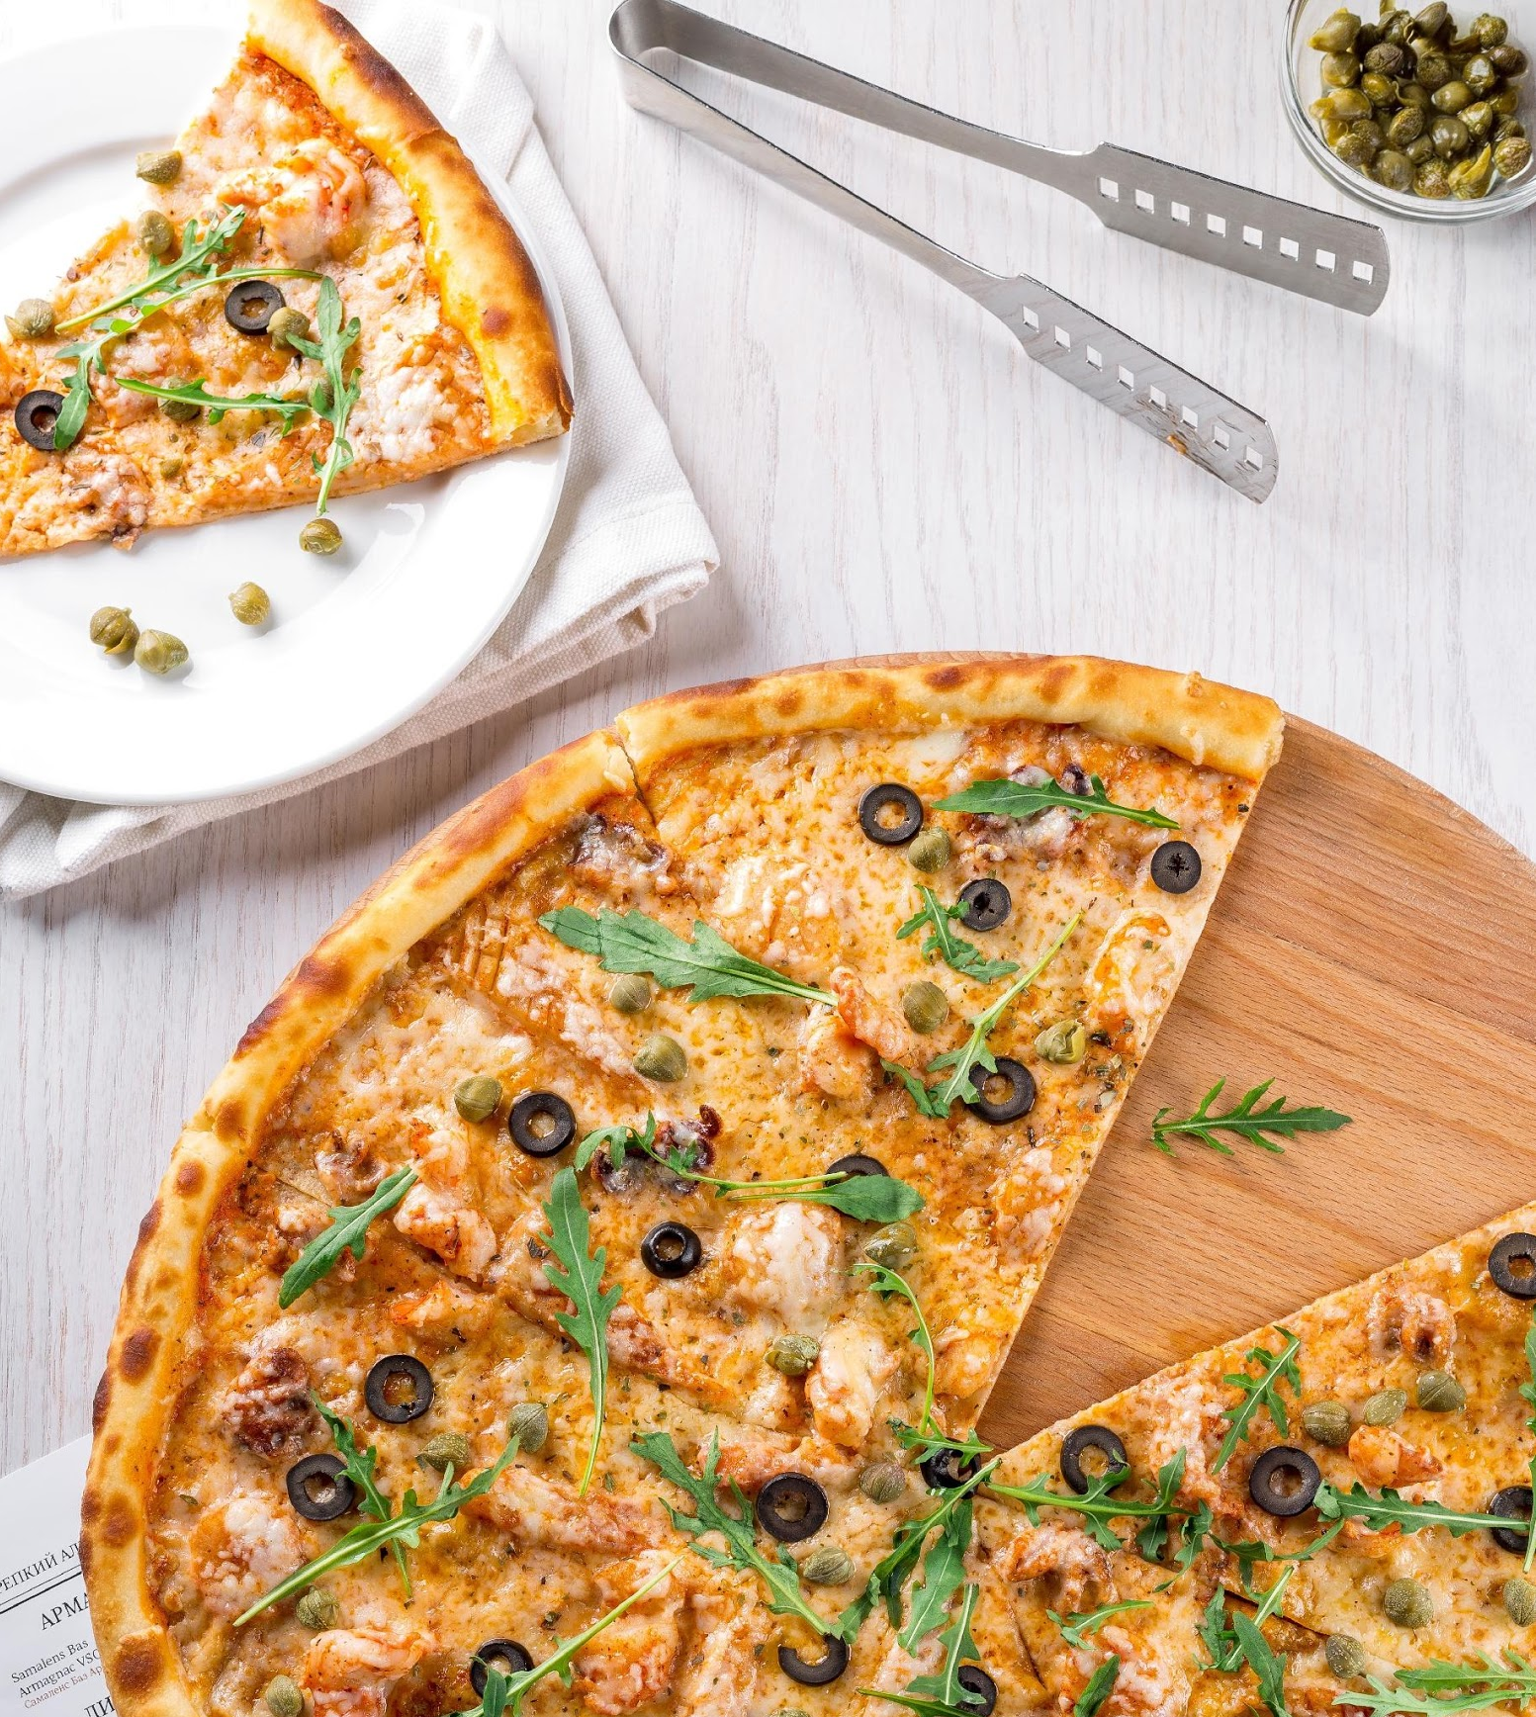
The Company
Philosophy
Jacklyn Reynolds, owner & operator of Restaurante de Mexico, believes that consuming food should be an enjoyable experience shared with family.Latin culture values togetherness & Restaurante de Mexico aims to bring the people of Hickory closer together through its one-of-a-kind dining experience.

Slide 6
The Company
Outlook
One of Restaurante de Mexico's goals is to build a solid customer base within the town of Hickory. Having only a total population of less than 800, Restaurante de Mexico has the potential to attract at least 40% to 50% of the townsfolk by the end of the first year of operations. This amounts to an estimated $150,000.00 in first-year sales. The business is expected to break-even as early as the second quarter of the second year of operations. If the company increases profit by 60% in the third year of operations, two branches will be opened in the neighboring cities of Charlotte & Greensboro.

Slide 7
The Company
Organizational
Structure
Type of
Industry
Business
Structure
Ownership
Hospitality Industry
General Partnership
Jacklyn Reynolds

Slide 8
The Company
Organizational
Structure
The restaurant will be owned & operated by four partners namely Jacklyn Reynolds, Raymond Wallace, Kenneth Moore, & Connie Webb.
Jacklyn Reynolds will be in charge of the restaurant operations. The restaurant will have a general manager who oversees its day-to-day operation. Her efforts will be recompensed by incremental profit sharing. It will be in her best interest to see that the restaurant operations are running smoothly.

Slide 9
The Company
Organizational
Structure
A proposed organizational structure in the future may include a director of restaurant operations when restaurant locations will exceed three and/or if we expand to other North Carolina cities. This will pave the way for efficient restaurant operations. It will also provide a supervisory level between the restaurant management level & executive level.
At this juncture, an accountant will be added to the team. Also, a sales director will be added to execute the expansion strategy & to improve the growth of the existing restaurant business.

Slide 10
The Company
Jacklyn Reynolds
General Manager
Raymond Wallace
Operations Manager
Management Team

Slide 11
The Company
Connie Webb
Finance Officer
Kenneth Moore
Executive Chef
Management Team

Slide 12
The Company
Company Milestones
Short-Term Goals | Milestones
Gather initial labor force for the restaurant opening | - Hired kitchen and admin staff on November 23, 2018 - Employee orientation and training in the first week of December until the present
Know more about the main competitors in the area | - Conducted primary market research for the whole month of November - Discussed the development of a marketing plan with the marketing team

Slide 13
The Company
Company Milestones
Long-Term Goals | Milestones
Achieve positive customer feedback for the restaurant service and products | - Conduct research on the preferences of potential customers starting in the first week of December - Employee training on effective customer service
Achieve a steady 3-5% increase in sales every quarter for the fiscal year 2019 | - Execute the sales and marketing plans for the fiscal year (ongoing) - Initial sales plan for Q1 and Q2 of 2019 submitted for approval (December 12, 2018)

Slide 14
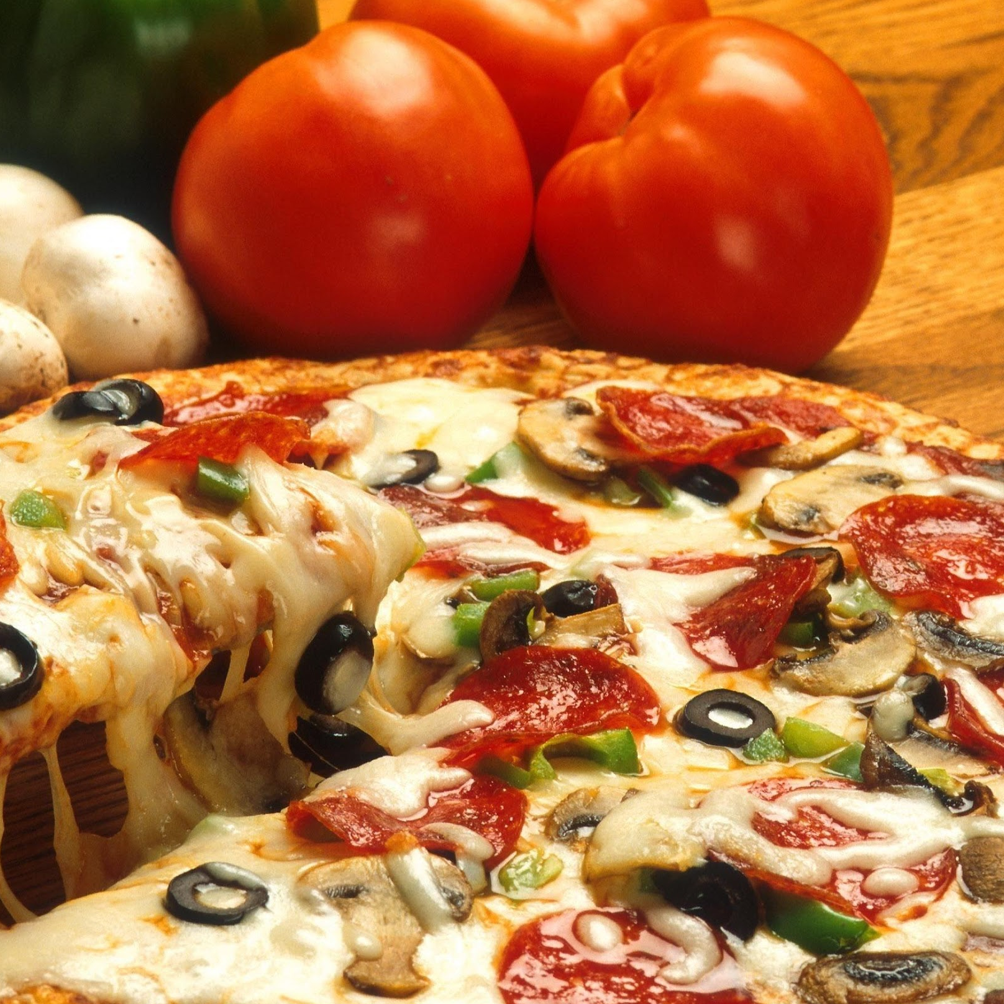
Products and Services
Value Proposition
Everyone is family here at Restaurante de Mexico." This follows the business philosophy of enjoying a meal in the spirit of togetherness. The proximity of Restaurante de Mexico to its primary target market is also a strong selling point since its main competitors are located mostly in Charlotte & Greensboro.

Slide 15
Products and Services
Pricing
Strategy
The restaurant owners are confident that the target customers can afford the fairly priced offerings. Each price has been computed considering the costs for making the dish (ingredients, labor, profit). Price bundling will be utilized in the special menu offering.

Slide 16
Products and Services
Marketing Plan
Considering the size of Hickory, marketing the Restaurante de Mexico brand will involve mostly traditional means such as print advertisements & word-of-mouth announcements. To stick with the traditional Mexican vibe, a fiesta will be held at the town square. Door-to-door sampling will also be done by the general manager & executive chef themselves along with a couple of assistants.

Slide 17
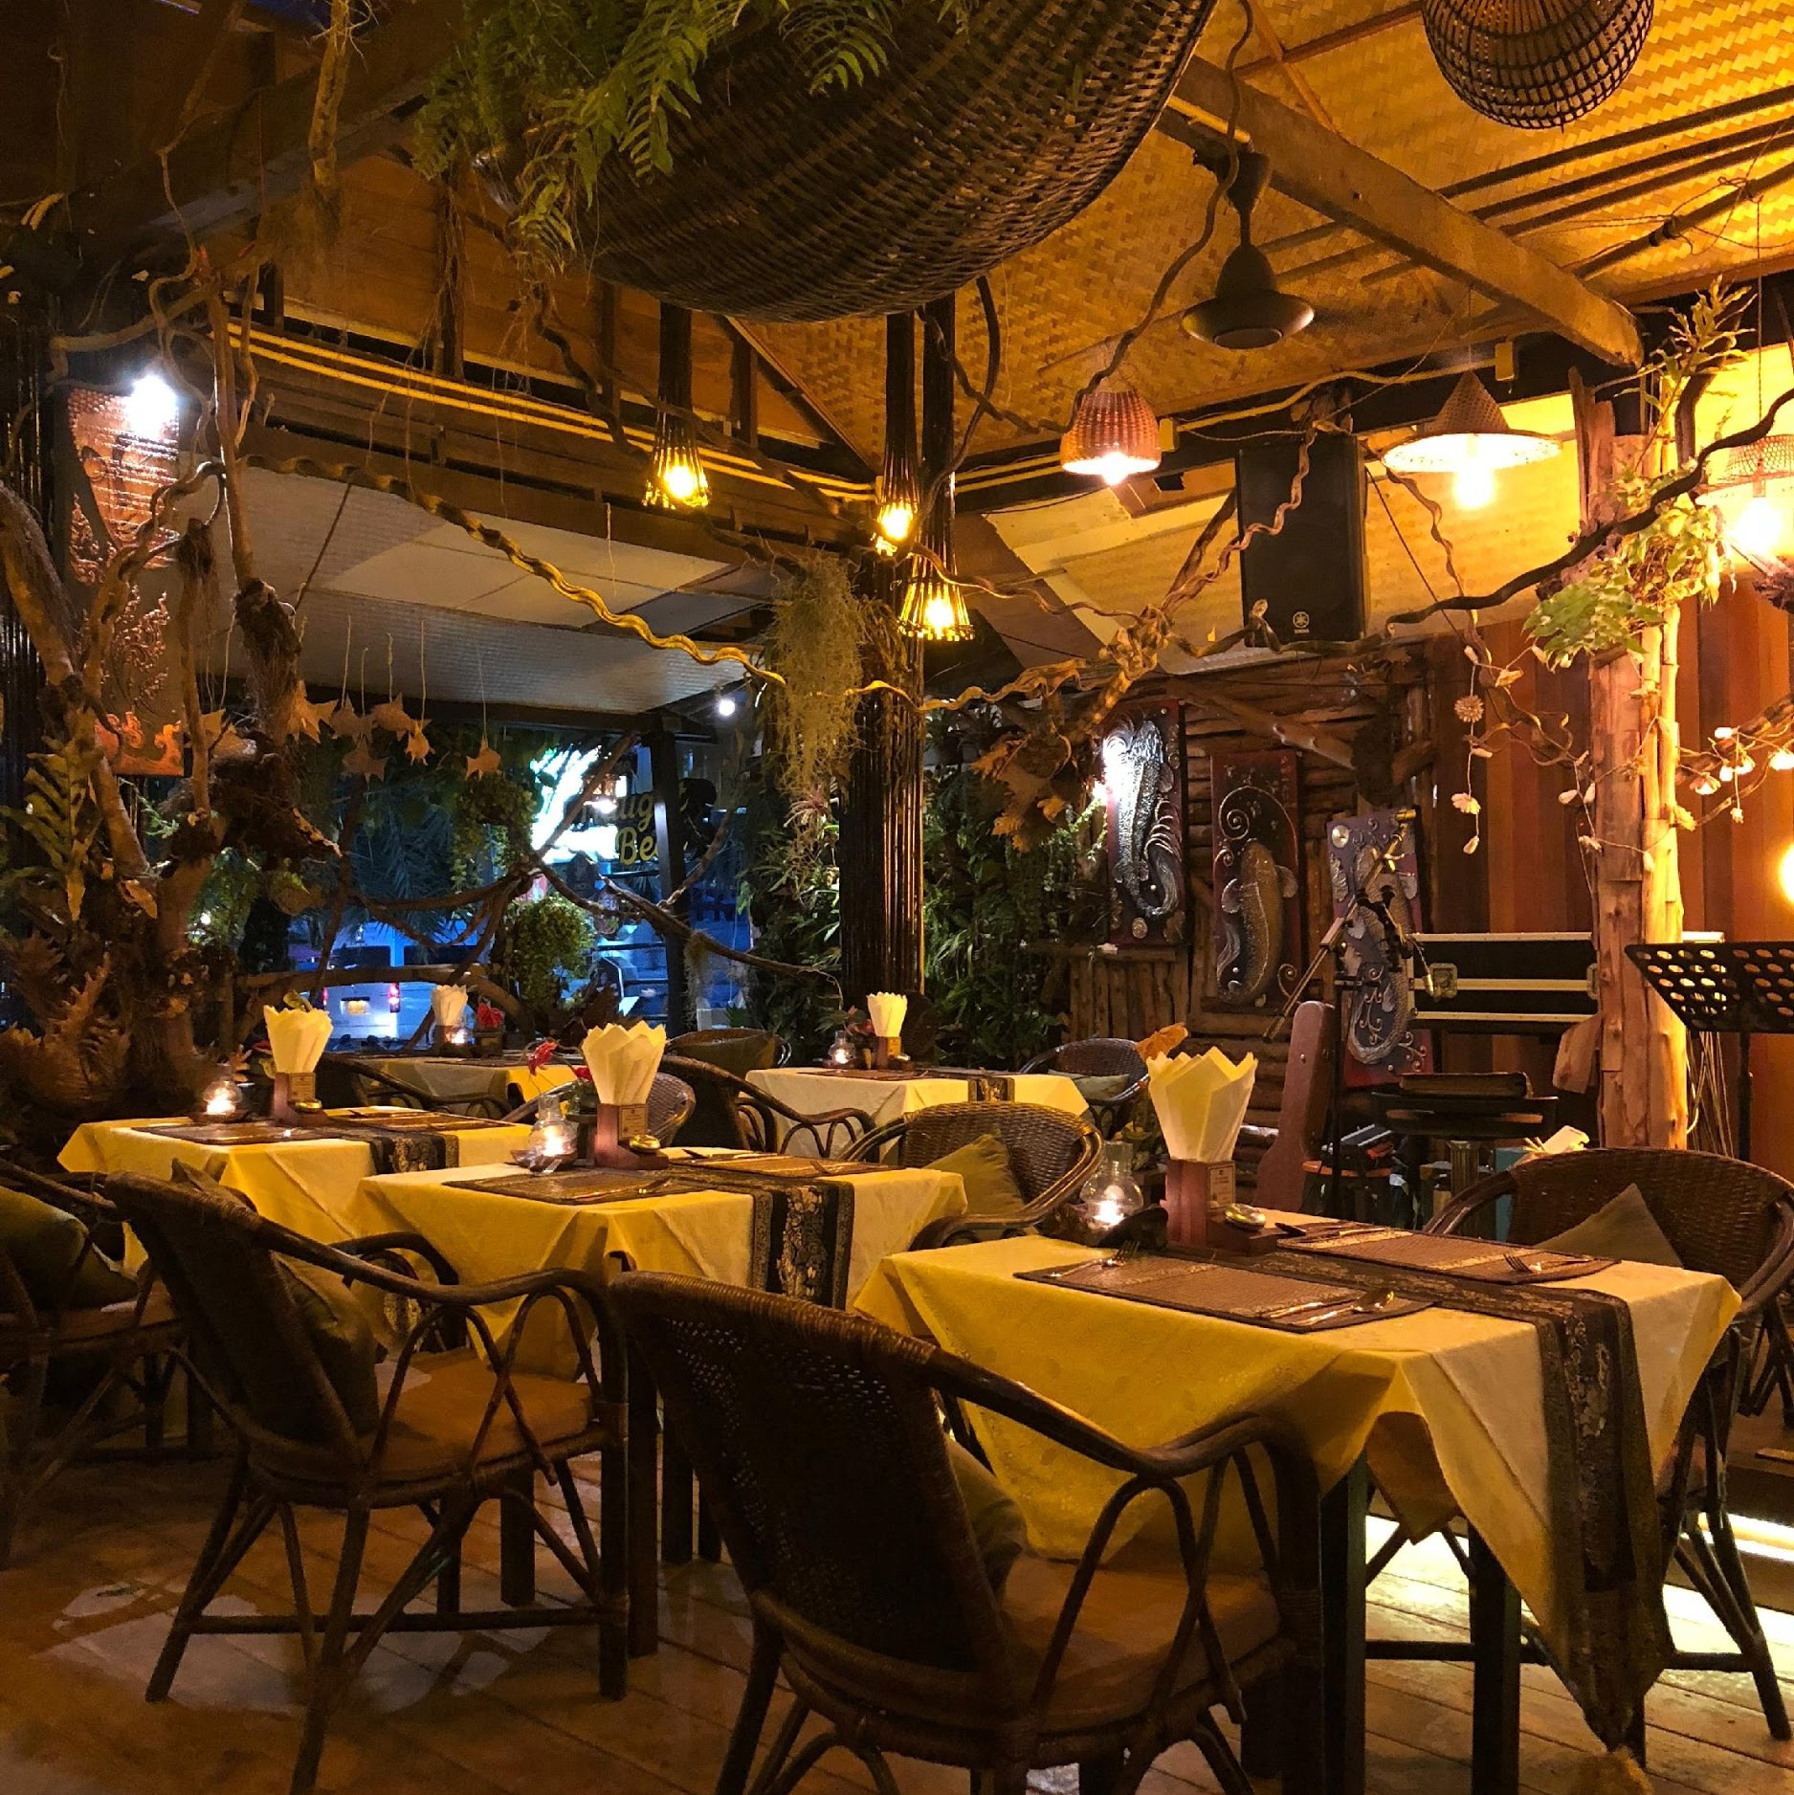
Execution
Marketing
Research
A recent study revealed that more people prefer casual & affordable dining with dishes served in small plates. A growing trend in Mexican restaurants is to offer fusion menu, combining Mexican with either Japanese or Chinese dishes. Online applications are also changing the restaurant business. Restaurante de Mexico will focus in providing casual & affordable dishes.

Slide 18
Execution
Market Research
Company | Strengths | Weaknesses | Opportunities | Threats
Restaurante de Mexico | Close proximity to the primary target market Products will be prepared by an expert chef specializing in Latin cuisine, ensuring an authentic Mexican taste | Newly established, less customer base Higher operational costs due to the need for the importation of raw ingredients | Hickory citizens are always on the lookout for exciting gastronomic experiences Improving local economy | Taco Bell will always be a cheaper and faster alternative Traditional marketing strategies may not be effective considering the changing dynamics of the market

Slide 19
Financial Plan
Financial Plan
0.7%
Every year
The financial plan for Restaurante de Mexico is based on the following assumptions:
The economic growth of Hickory will be the steady despite being slow within the first three years of operation.
Operational expenses will increase by a mere 0.7% every year.
The business will be in high demand between the 2nd and 3rd quarter of the first year of operations, thereby increasing sales by 2.5% to 3.5%.
2.5%
3.5%

Slide 20
Financial Plan
6.7%
Annually
$35,000.00
Business
Financing
$60,000.00
Each partner will contribute $35,000.00. The company will also acquire a business loan worth $60,000, payable in 5 years time with an interest of 6.7% annually. Loan installments will be paid through a portion of the restaurant's net profits.

Slide 21
Client Complimentary
“
If you’re hungry, there’s no other place to go but here. Restaurante de Mexico is the best Mexican restaurant in town. Prompt service & superb food awaits you!
Faith Diaz, 27
Entrepreneur

Slide 22
Client Complimentary
“
So far, this is my favorite Mexican restaurant in Hickory. Their tacos & quesadillas are unbeatable, but my favorite will always be burritos. Try them all now & you’ll never regret a day of gastronomic feast.
Steven Crozier, 30
Engineer

Slide 23
sunnycareclinic.com | 918-920-5001
sunnycareclinic.com
Thank
You!

