Slide 1
BEST BUILD GYM
+76 37368 8728 | gym@bestbuild.com

Slide 2
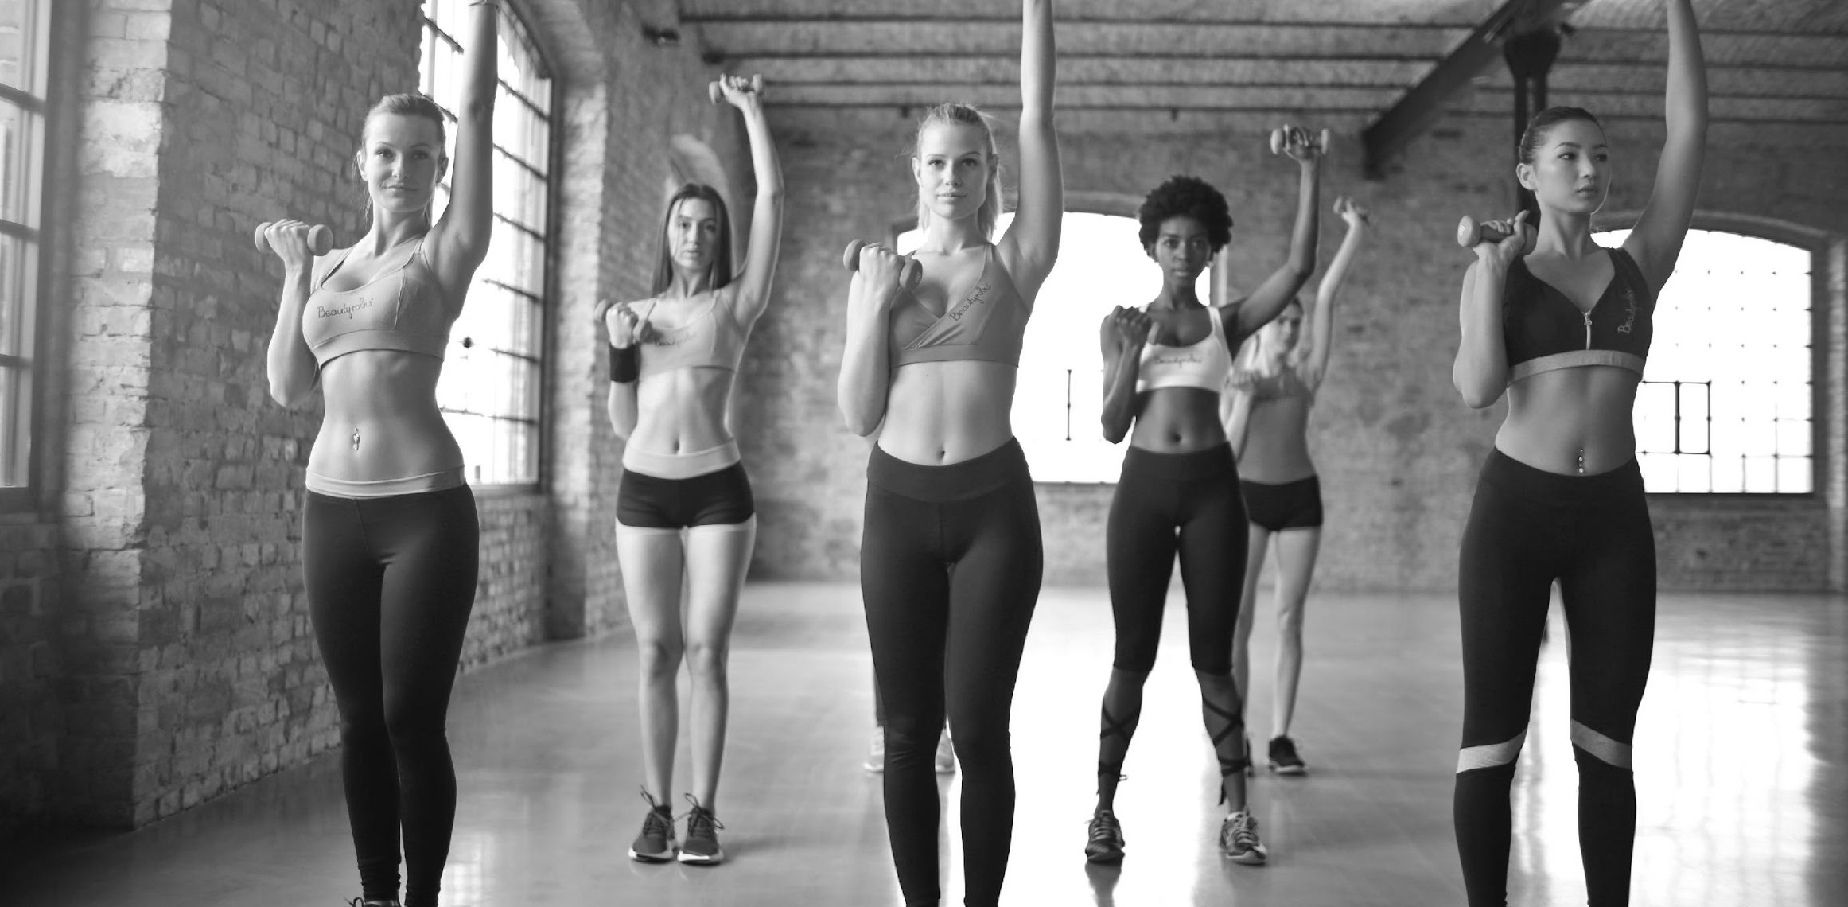
AGENDA

Slide 3
60-DAYS TO FITNESS PROGRAM
This will be held at the 2nd floor of Best Build Gym on January 03, 2022 from 9am to 8pm and is aimed to showcase new, fast & healthy ways to effectively lose fat after the holidays. Tickets start at $39.99 and includes a free gym start kit and 1 free trial session with a personal trainer.
The tentative gained sales from this event is estimated to be up to $50, 000 for the first 2 weeks. Profits gained from this event will be used for the upcoming fun run organized by Best Build Gym titled “Run for Trees”.

Slide 4
CROSSFIT X
This newly developed program will be open to all crossfit enthusiasts and will be launched at Best Build Gym Training Center on May 30, 2022 from 10am to 8pm. It is aimed to provide reliable crossfit training programs at affordable price points.
Admission fee starts at only $49.99 and will entitle all attendees to 1 free 1 hour long session with a personal crossfit trainer. The estimated gained sales from this event will be up to $45, 000 for the first 3 weeks. Profits gained from this program will be donated to the “Save The Forest Organization”.

Slide 5
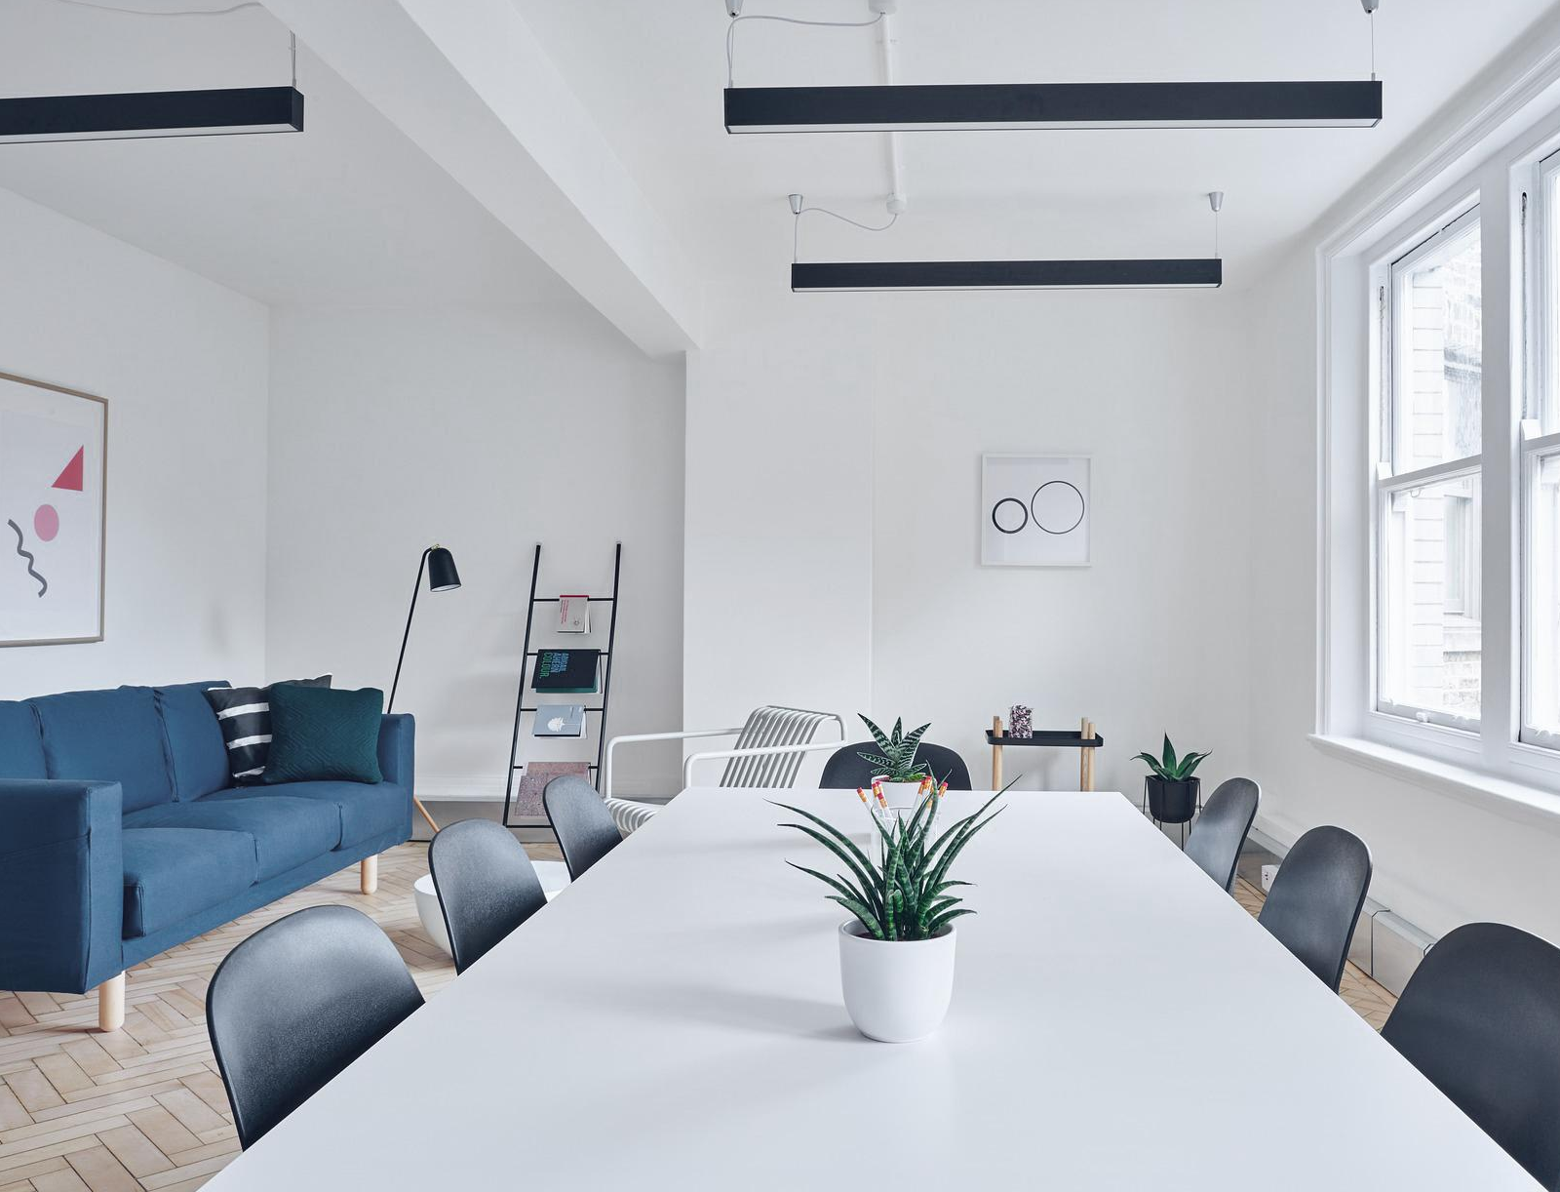
FAT LESS, MUSCLE MORE
This program is dedicated to all clients who are in need of workout assistance for the upcoming summer. Its launch will be held at Best Build Gym Grounds on April 1, 2023 from 9am to 10pm. Tickets start at $29.99 and will provide all attendees to a free gym starter kit as well as one free ,one hour long session with a personal trainer.
This program is estimated to acquire up to $80, 000 profit in sales for the first 2 weeks. Profits gained from this program will be donated to “Give a Seed, Plant a Tree Project” developed by local government units in Arizona.

Slide 6
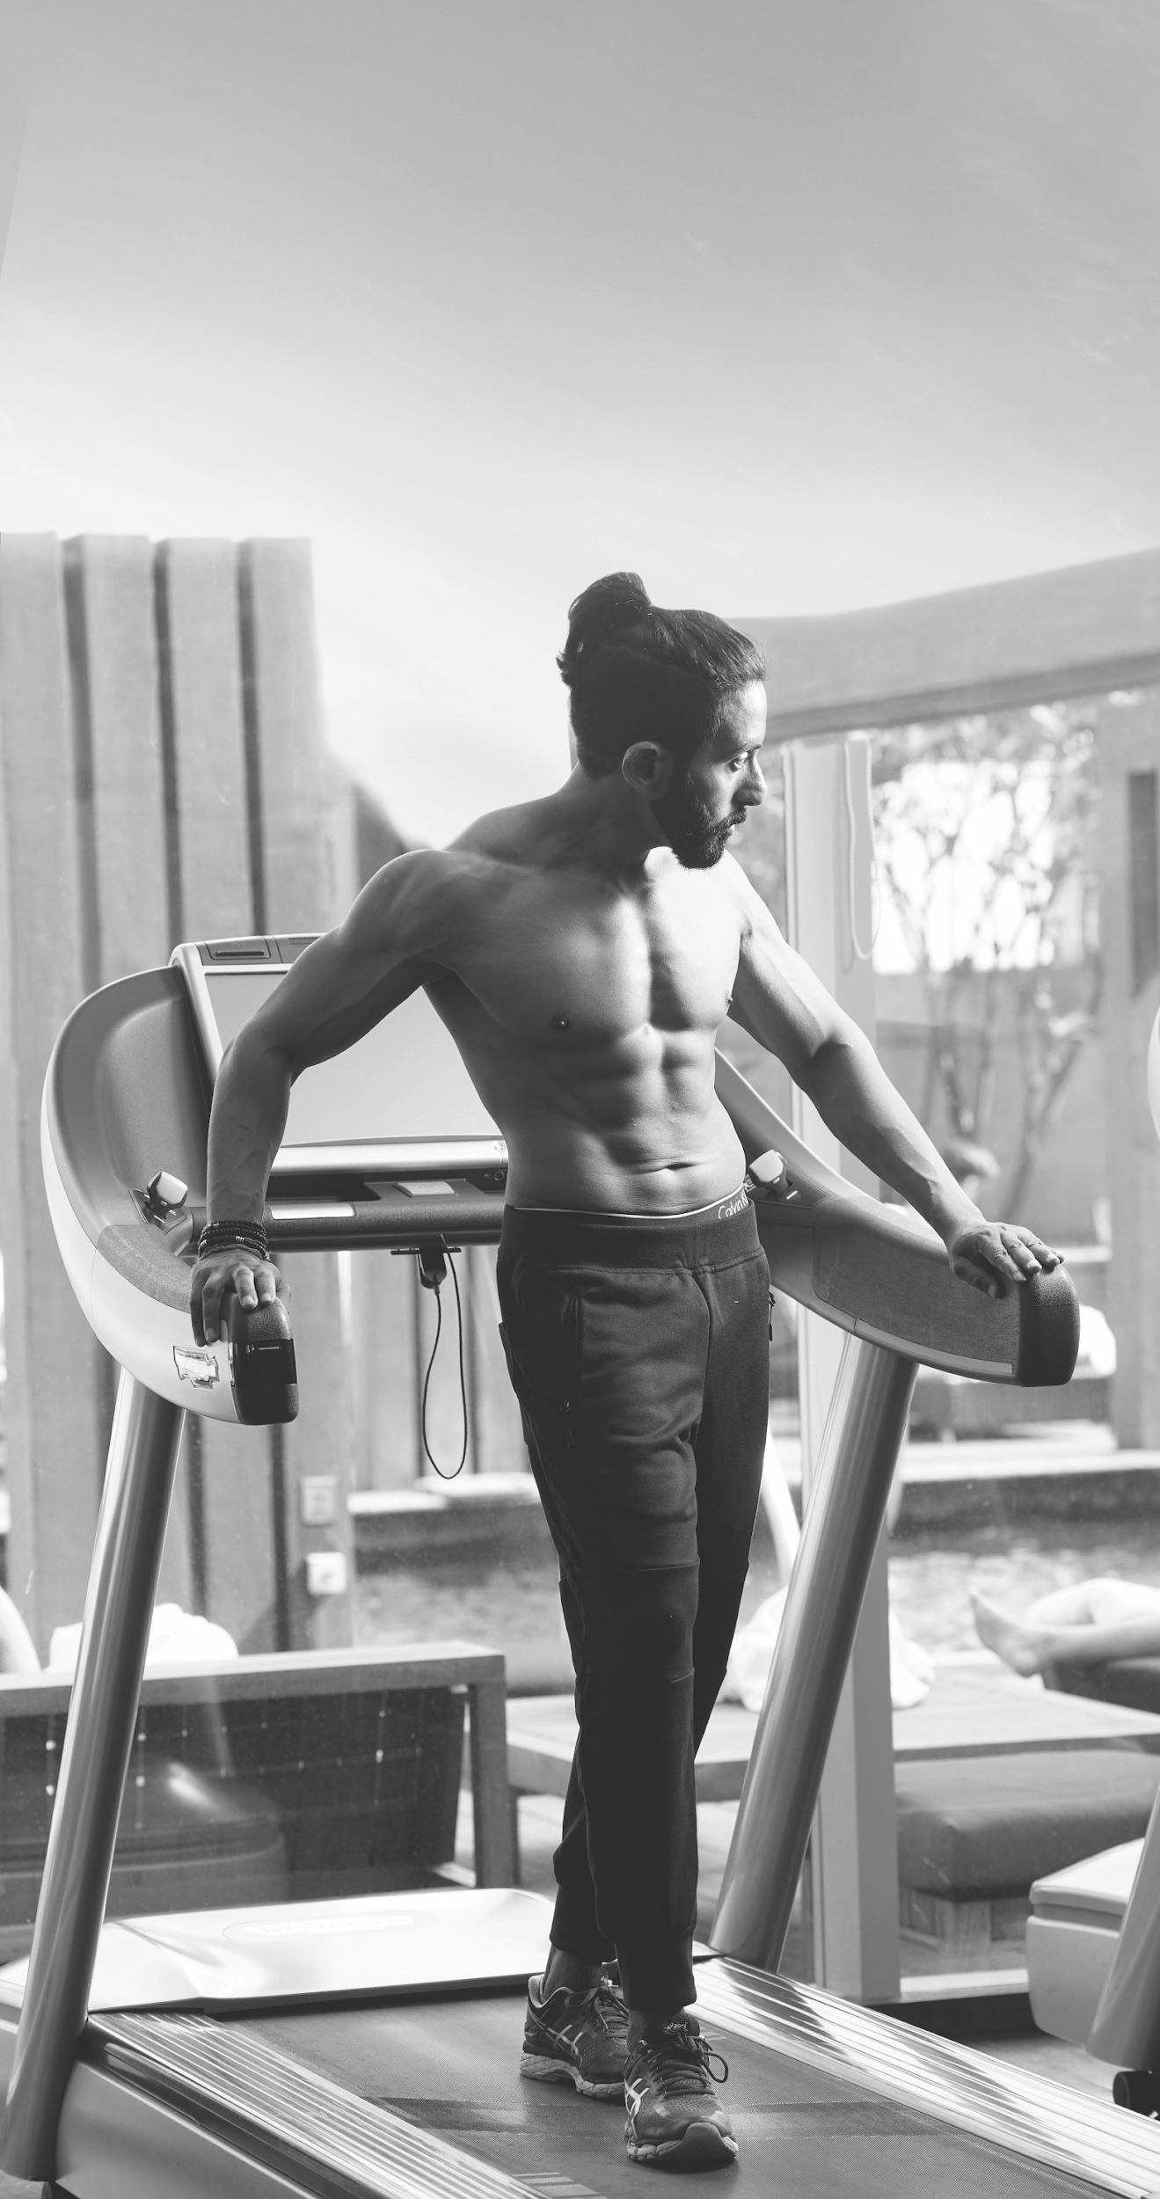
ABOUT
Bruce Hulk
Founder & Owner
Best Build Gym is known for its top notch quality gym services and for training top performing bodybuilders and athletes in the industry of fitness and sports. Started by Henry Hulk who was a former bodybuilder and gym enthusiast, Best Build Gym offers reliable and reasonably priced workout packages for all gym and fitness enthusiasts.

Slide 7
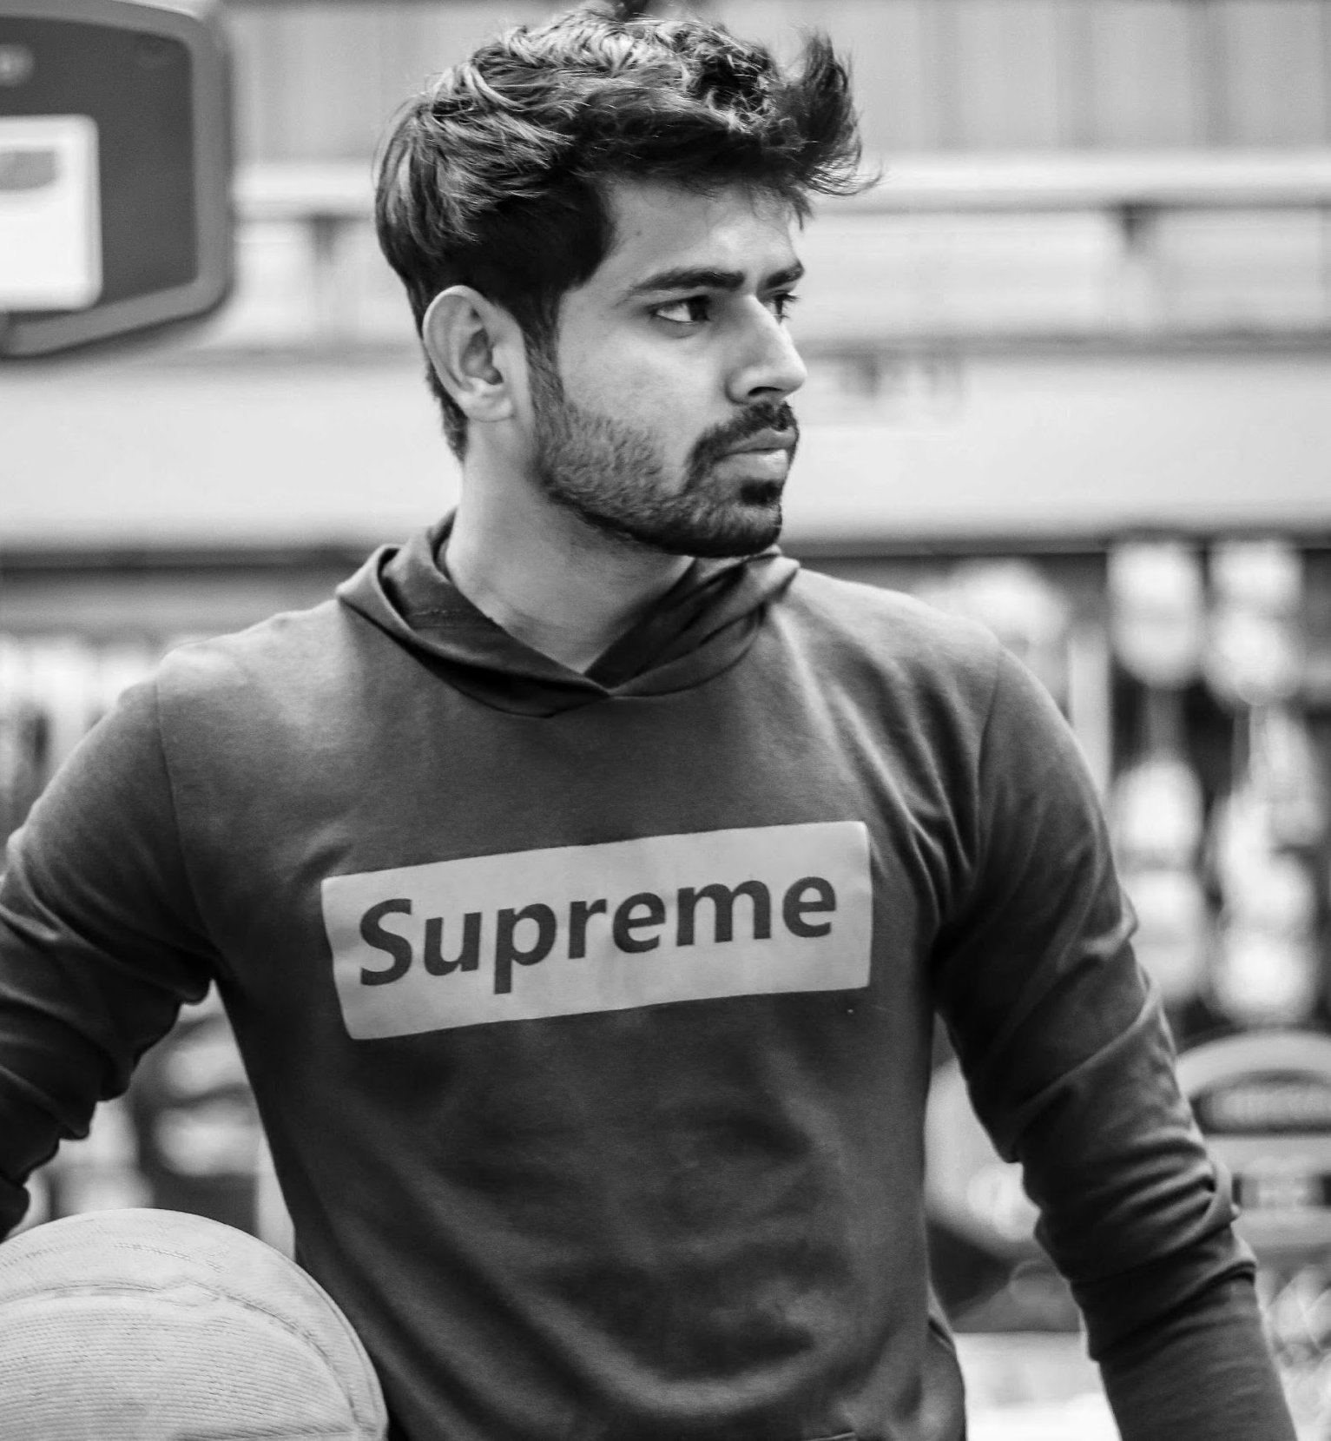
“The packages and fitness programs offered by Best Build Gym are always and will always be affordable and customer friendly. It is in you if you got what it takes to pursue your aimed and ideal body figure!.”
-Morgan Whey, 31, Personal Trainer at Best Build Gym
TESTIMONIALS

Slide 8
This event is aimed to showcase new, fast & healthy ways to effectively lose fat after the holidays. Tickets start at $39.99 and includes a free gym start kit and 1 free trial session with a personal trainer. The tentative gained sales from this event is estimated to be up to $50, 000 for the first 2 weeks. Profits gained from this event will be used for the upcoming fun run organized by Best Build Gym titled “Run for Trees”.
60-DAYS TO FITNESS PROGRAM
Best Build Gym 2nd floor
January 03, 2022
9am to 8pm

Slide 9
This program is dedicated to all clients who are in need of workout assistance for the upcoming summer. Its launch will be held at Best Build Gym Grounds on April 1, 2023 from 9am to 10pm. Tickets start at $29.99 and will provide all attendees to a free gym starter kit as well as one free ,one hour long session with a personal trainer.
This program is estimated to acquire up to $80, 000 profit in sales for the first 2 weeks. Profits gained from this program will be donated to “Give a Seed, Plant a Tree Project” developed by local government units in Arizona.
FAT LESS, MUSCLE MORE
Best Build Gym Grounds
April 1, 2023
9am to 10pm

Slide 10
HISTORY
Best Build Gym was founded by Henry Hulk during his tenure as a world famous bodybuilder in 1988. With only $500 as starting capital and only 2 types of gym equipment on offer, Best Build Gym rose to prominence and achieved its success after being recognized by World Boxing Association as the best boxing gym in 2006. Today,the gym has over 1000 different gym equipments and has produced 10 different famous athletes and gym personalities in the industry.

Slide 11
TESTIMONIALS
“If you are looking for the best gym experience that a gym studio can offer, worry no more because Best Build Gym can give you the best and most effective workout regimens and equipment that will help you get in shape.”
-Angel Woods, 25, Columnist at Entertainment.com

Slide 12
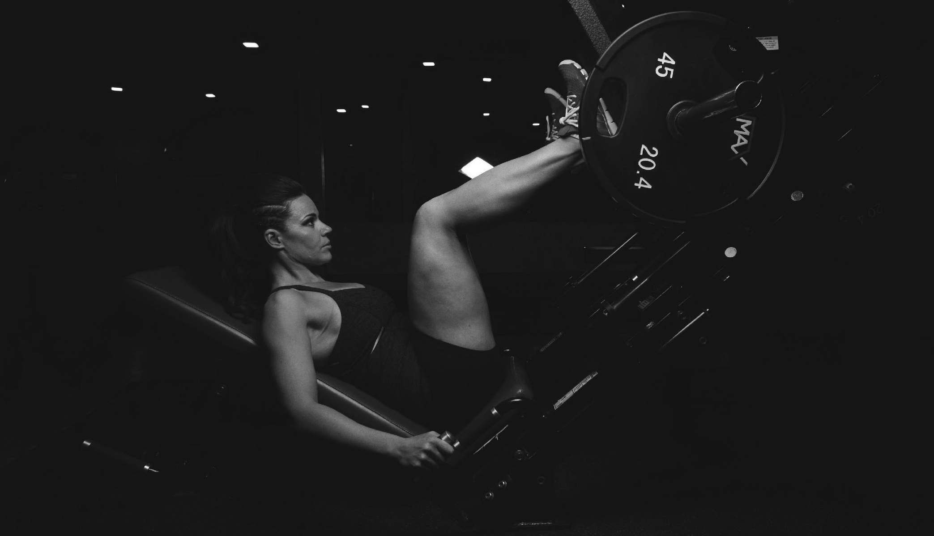
MAIN GOAL
Best Build Gym commits itself to aspire and inspire people to become physically fit to boost their physical confidence in a reliable, affordable, and healthy way.

Slide 13
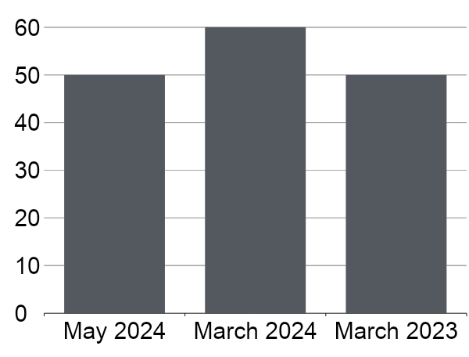
SALES OVERVIEW
50% increase in product profits as of May 2023.
70% increase in new members as of June 2025.
60% increase in sold training packages as of January 2024.

Slide 14
BEST BUILD GYM OFFERS
1
Effective Gym Products
3
State of the Art Gym Facilities
2
Lifetime Membership Card
4
Quality and Friendly Customer Care

Slide 15
IMAGE GALLERY

Slide 16
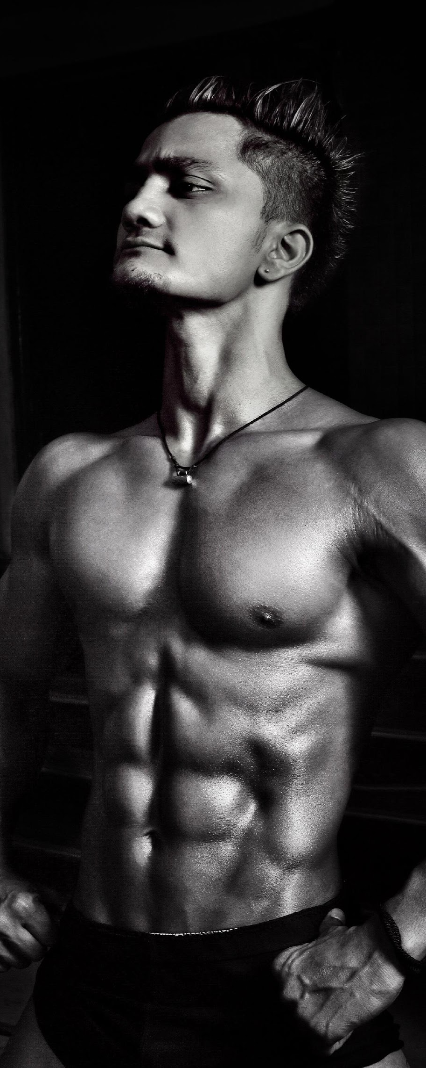
Negan “Big Tank” Rock
Gym Head Trainer
GYM MANAGEMENT
Henry Hulk
Founder & Owner
Joe Hogan
Chief Quality Control Officer

Slide 17
THANK YOU!
+76 37368 8728
gym@bestbuild.com

