Slide 1
DENTAL CLINIC
SPARKLING WHITE
+76 37368 8728 | sw@dental.com

Slide 2
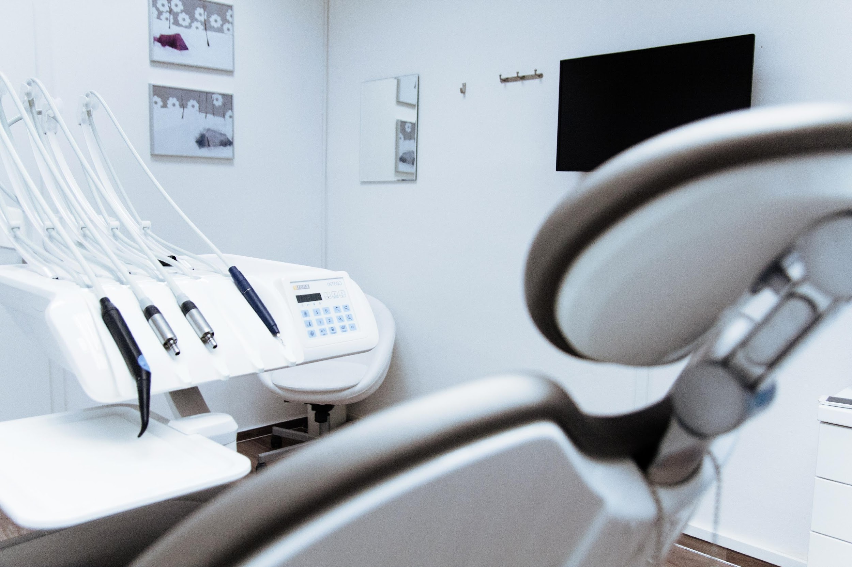
AGENDA

Slide 3
DENTAL OUTREACH
This annual outreach event will be held at 56th Street on February 14, 2022 from 9am to 6pm. Tickets start at $30 which includes dental cleaning, dental check-up, tooth extraction and a free toothbrush and toothpaste. Profits accumulated from this event will be donated for the renovation of Save Earth Foundation’s office and system upgrade.

Slide 4
This one day event will be held at the Grand Convention Hall on March 16, 2023 from 9am to 6pm. Tickets start at $35 and will entitle all attendees to dental cleaning, dental check-up, free dental kit and also include up to 30% off on selected dental package. 60% of the accumulated profits from this event will be utilized for the renovation of the London Kids Charity Foundation’s office.
The remaining 30% will be used for Sparkling White Dental Hospital office renovation and equipment upgrade.
DENTURES FOR EVERYONE

Slide 5
MONTHLY STAFF MEETING
Staff members of the Sparkling White Dental Hospital will be having their monthly meeting at Genesis Restaurant on January 13, 2020 from 12pm to 6pm. This meeting is for the review and planning for the new set of rules and guidelines to be implemented strictly at the hospital this coming 2021. The meeting will also include forming and establishing new products and packages for future events.

Slide 6
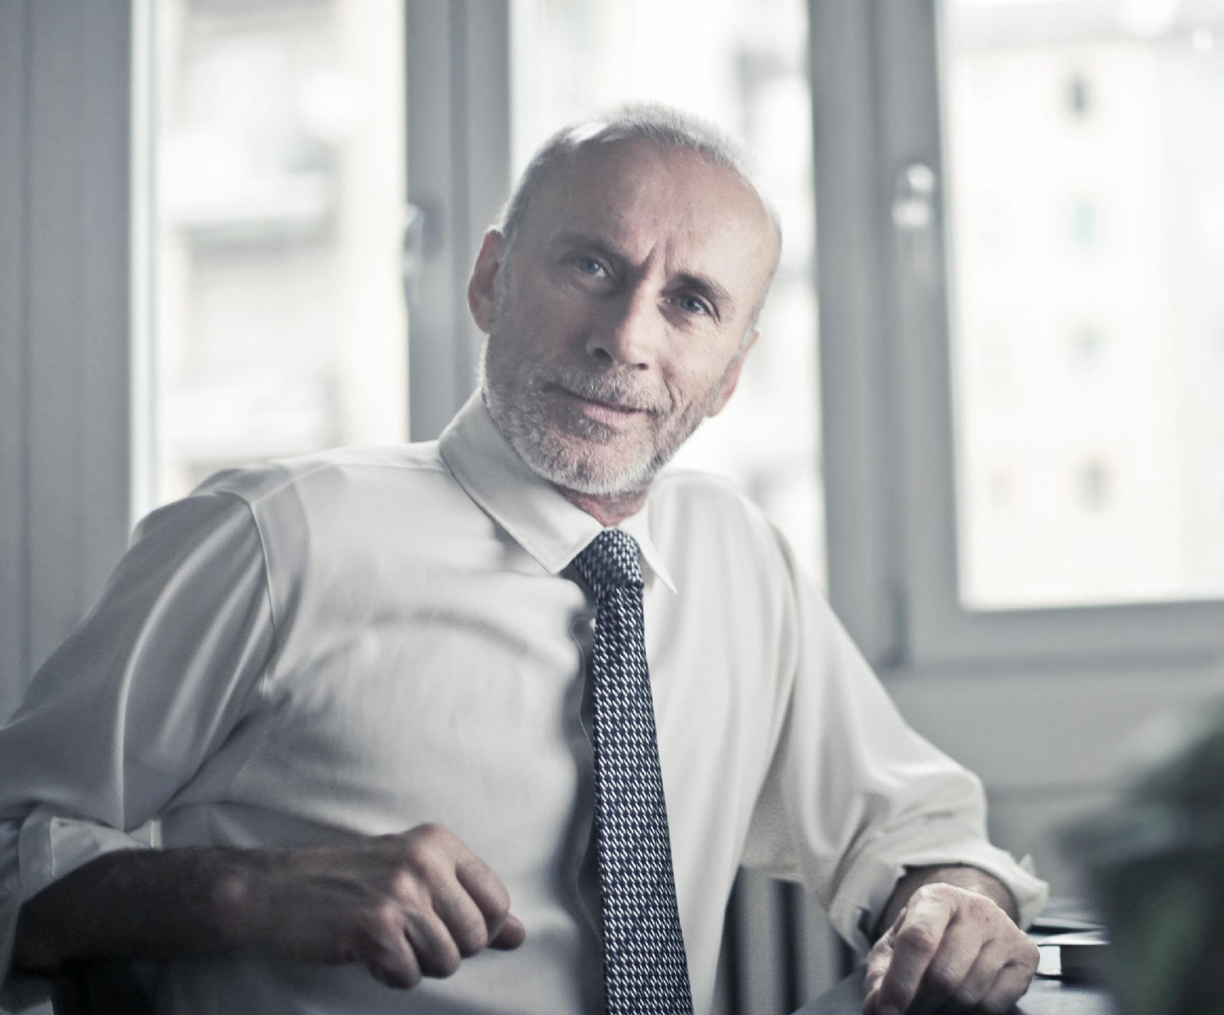
Welcome to Sparkling White Dental Clinic.
This hospital exhibits the dedication and complete focus of our well trained dentists and staff members who dedicate their chosen profession in helping people solve their dental problems. Sparkling White Dental Clinic wouldn’t be the successful clinic it is today without our beloved and loyal clients and sponsors.
The clinic’s first few years gave us challenges which tested our dedication, integrity, and honesty at times. Today, we consider those challenges as reminders of our strength that will always guide us in becoming the best and most reliable dental hospital in the country.
Jeremy Stockton | Founder & CEO

Slide 7
“Sparkling White Dental Clinic is a company that is passionate and determined in providing products and services geared towards those who are in need of reliable dental services.”
-Jeremy Stockton, 59, Founder & CEO
CEO MESSAGE

Slide 8
DENTAL OUTREACH
56th Street
February 14, 2022
9am to 6pm
Tickets start at $30 which includes dental cleaning, dental check-up, tooth extraction and a free toothbrush and toothpaste. Profits accumulated from this event will be donated for the renovation of Save Earth Foundation’s office and system upgrade.

Slide 9
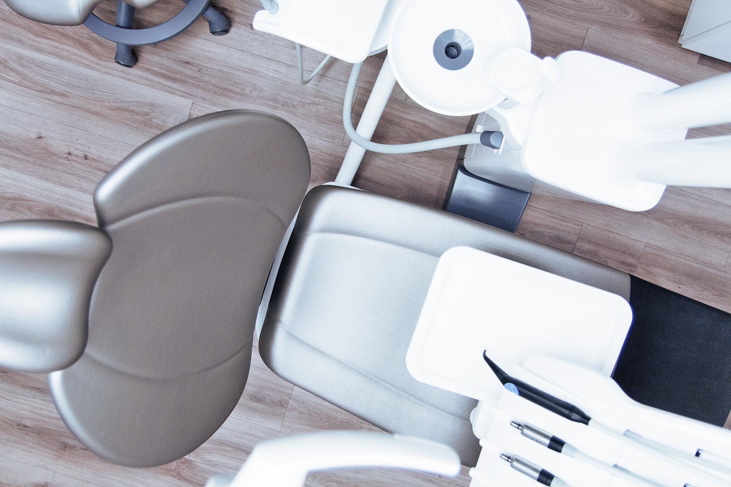
Tickets start at $35 and will entitle all attendees to dental cleaning, dental check-up, free dental kit and also include up to 30% off on selected dental package. 60% of the accumulated profits from this event will be utilized for the renovation of the London Kids Charity Foundation’s office. The remaining 30% will be used for Sparkling White Dental Hospital office renovation and equipment upgrade.
DENTURES FOR EVERYONE
Grand Convention Hall
March 16, 2023
9am to 6pm

Slide 10
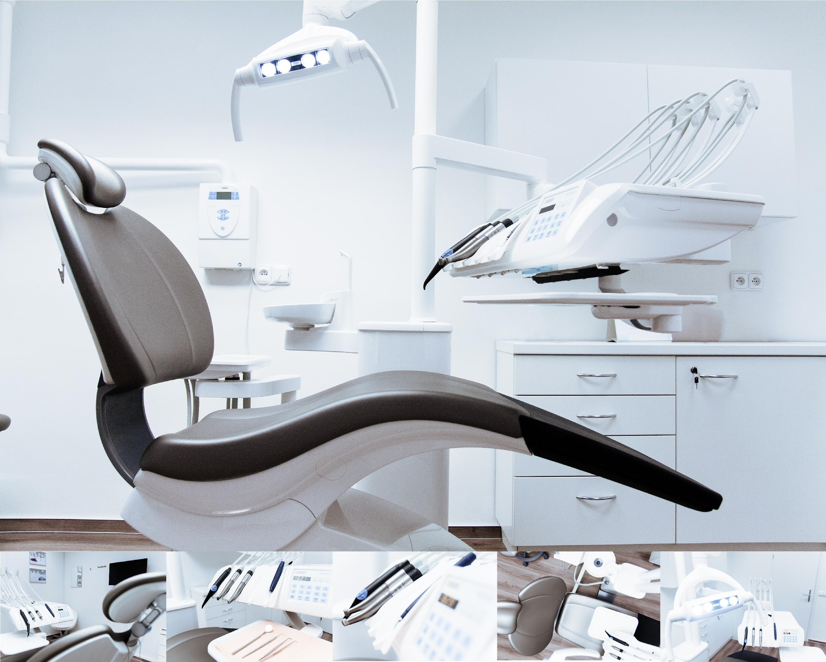
DENTAL OUTREACH
56th Street
February 14, 2022
9am to 6pm
This meeting is for the review and planning for the new set of rules and guidelines to be implemented strictly at the hospital this coming 2021. The meeting will also include forming and establishing new products and packages for future events.

Slide 11
Founded by Jeremy Stockton in 1999, Sparkling White Dental Clinic strives to become the leading dental clinic in the country. Today, the company has 7 fully operating clinic branches in California, Chicago and Texas.
HISTORY

Slide 12
TESTIMONIAL FROM A CLIENT
“I am always happy and satisfied with the service I got at Sparkling White Dental Clinic. They do their best to give the best dental service at affordable and convincing prices.”
-Jenny Smith, 26, Health Columnist

Slide 13
MAIN GOAL
Sparkling White Dental Hospital’s main goal is to become the leading dental clinic in the country by producing quality, effective, and reliable dental products and services.

Slide 14
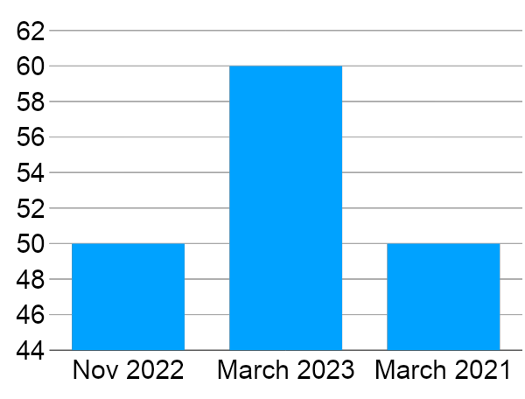
OVERALL GROWTH
50% increase in annual profits as of November 2022.
60% increase in client satisfaction as of March 2023.
80% increase in new clients as of March 2021.

Slide 15
WHAT WE OFFER
Safe & Effective Dental Packages
Free Dental Consultation
Affordable Dental Services
High Quality Dental Equipments

Slide 16
IMAGE
GALLERY

Slide 17
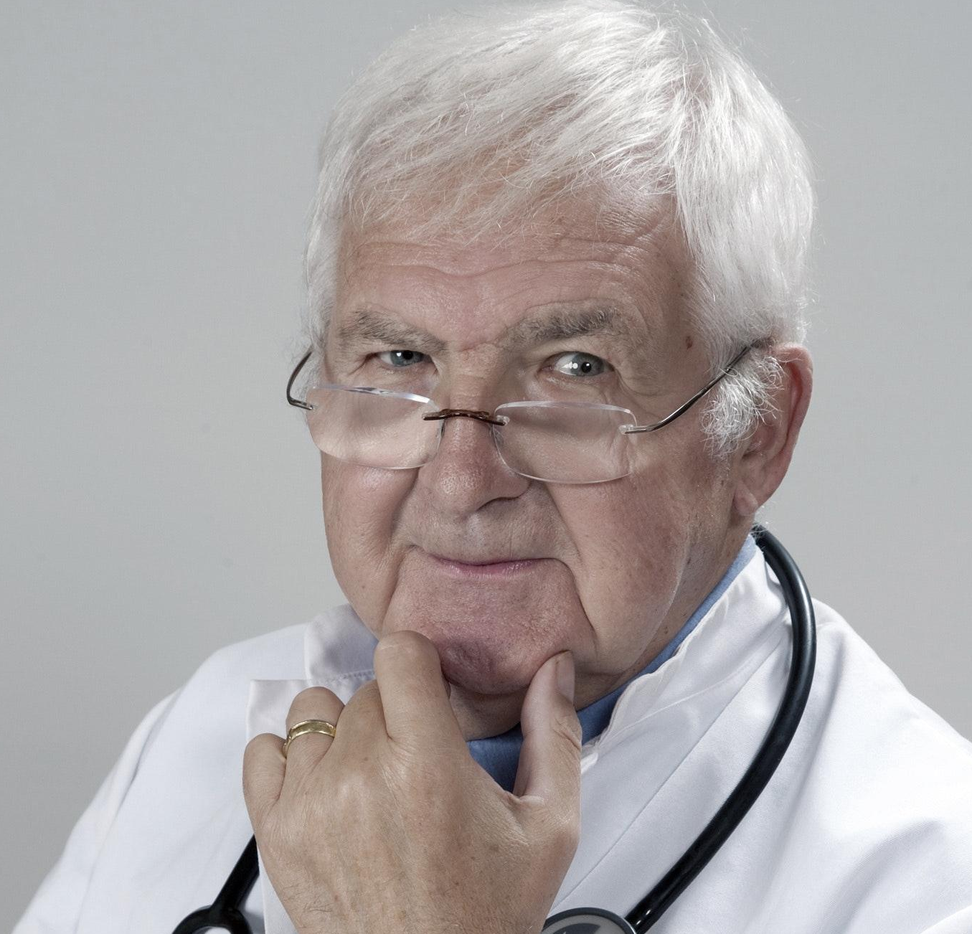
THE MANAGEMENT
Jeremy Stockton
Chairman & Chief Executive Officer
Ashley Love
Chief Operating Officer
Lance Peterson
Marketing Manager

Slide 18
THANK YOU!
+76 37368 8728
sw@dental.com

