Slide 1

CREATIVE
Pitch Deck

Slide 2
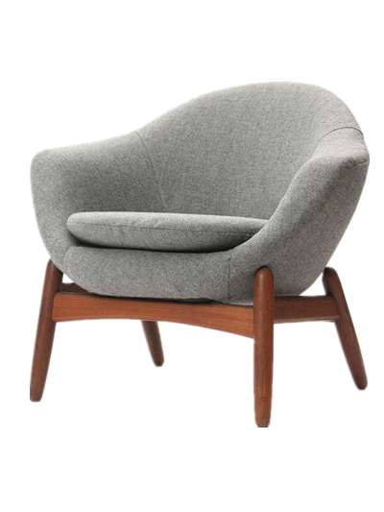
About Us
Great Home Furniture is a hardware, furniture and appliance company store based in Metro Detroit, Michigan that was founded and established by Harvey Winston in the year 2003.

Slide 3

Vision
We envision to become a hardware company that provides quality hardware, furniture, and appliances that are convenient, reliable, and will last for a very long time.

Slide 4

Mission
Our mission is to become the top hardware company store across the country and to establish 5 major branches across the state by 2030.

Slide 5


Management
James Horn
Chief Executive Officer
Manages the company’s overall operations and resources.
Main communicator between the board of directors and corporate operations
Jeremy Pierre
Chief Operating Officer
Manages and sustains the company’s development and growth financially and technically.

Slide 6


Management
Bern Smith
Quality Control Inspector
Manages and monitors the quality of products being sold in the market.
Ensures the production standards of the company.
Kevin Barnes
Customer Service Representative
Interacts with the customers by providing information about the company and its products.

Slide 7

The Problem
Lifestyle Magazine’s most recent survey suggested that at least 50 hardware and furniture companies closed down in 2017 due to bankruptcy caused by low profit due to poor services and bad quality products.

Slide 8
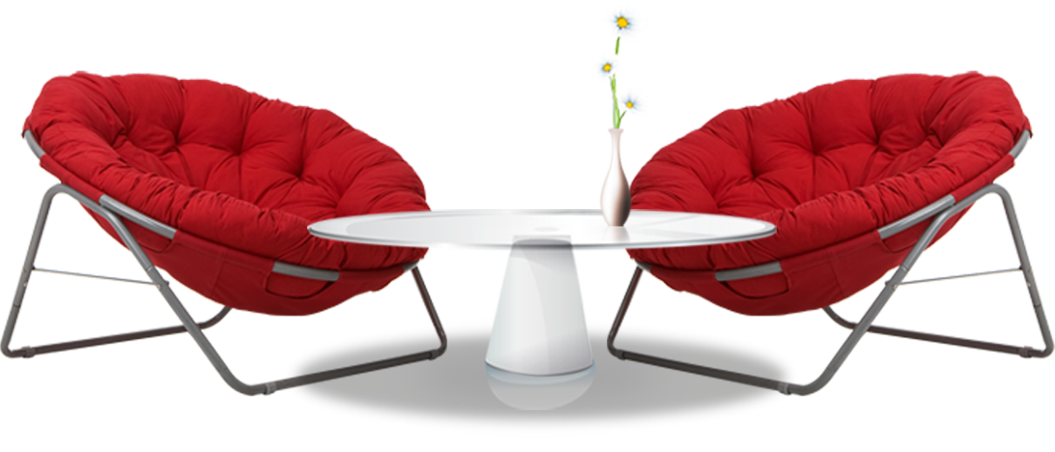
Our Solution
Great Home Furniture offers top notch home equipment for all who are building, renovating and constructing house at reasonably affordable prices.

Slide 9

Advantages
Our staff provides the best service and assistance for all who wish to avail of beautifully designed, long lasting hardware and furniture. Additionally, we provide quality of products suitable for your house and budget.
Well trained, professional, accommodating staff.
Beautifully designed hardware and furniture.
Well connected with other well known hardware companies.
Competitive, affordable price points.

Slide 10

Build And Grow
BUILD AND GROW is a newly developed program aimed to provide quality furniture pieces at reasonable prices starting at $29.99.

Slide 11

Traction
Based on the census about 10,000+ companies and 90, 000+ individual in Metro Detroit, Michigan are seeking furniture for their homes and offices.

Slide 12
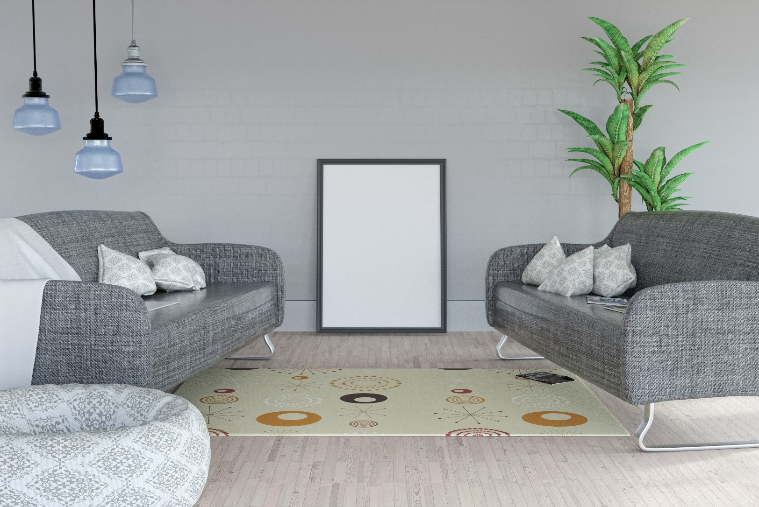
Target Market
The chosen target market will be the residents of Metro Detroit. This specific group of individuals were chosen based on the following factors :
Up to 10, 000+ of Metro Detroit’s entire population are businesses and companies.
Around 133, 177 of Metro Detroit’s total population are renters in need of furniture.
Around 256, 985 of Metro Detroit’s total population are businessmen in need of furniture.

Slide 13

Competition
Based on a survey conducted in 2016, Great Home Furniture concluded that the following institutions will be considered as direct competitors on the basis that they offer similar services :
Jets Home ware offers variety of house appliances and furniture starting at $30.
Handy Build Appliances offers house construction equipment and furniture starting at $39.99.
Best Build offers a variety of house appliances and furniture starting at $29.99.

Slide 14
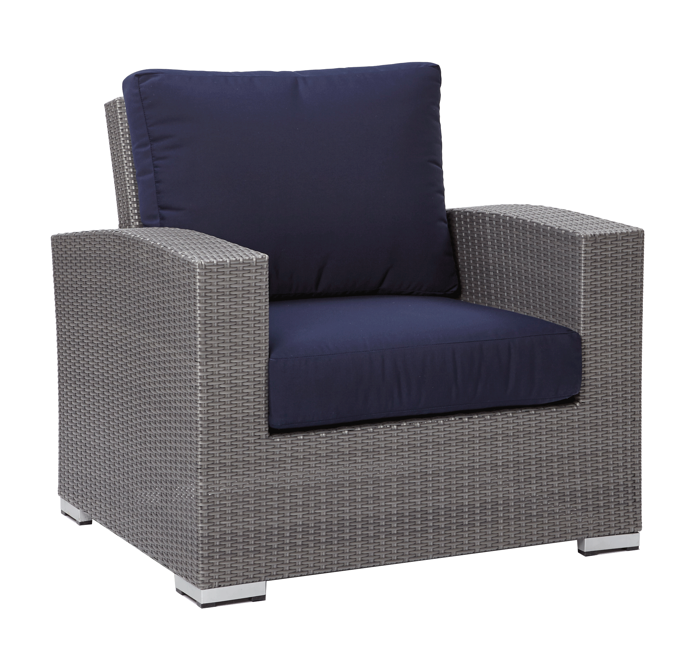
Alternative Solutions
The alternative solutions Great Home Furniture can provide are the following:
Up to 10% - 50% discount on great selections.
Free equipment delivery and installation.
Lifetime advantage membership card.

Slide 15

Business Model
The company will utilize the following business model which will be implemented by early 2019:
[SPECIFY BUSINESS MODEL]
Revenue equivalent to roughly $100,000 to $120,000 will be expected by the start of 2020.

Slide 16


Schedule
The company’s schedule will be as follows :
[SPECIFY COMPANY SCHEDULE]

Slide 17

Investment & Sponsorship
In order to officially begin, the company will require a budget estimated between $80,000.00 and $90,000.00. This amount will be collected from the following sponsors :
1. Smith Investment Corp.
2. Assure Insurance Company
3. Land Traders Merchandise
Each sponsor has agreed to contribute and invest at least $25, 000.00 for Great Home Furniture.

Slide 18
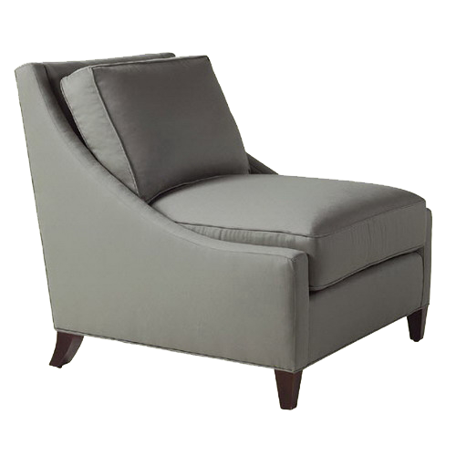
Contact Us
Visit our store every Monday to Saturday from 9am to 6pm and Sunday from 10am to 7pm at [ADDRESS].
For more information, contact us at any of these contact details :
[Phone Number]
[Email]
[Website]
[Social Media Account/S]

Slide 19

Thank You

