Slide 1
RETCO
INDUSTRIES
COMPANY
PROFILE

Slide 2
Presentation
Contents
`
The Company
Offers & Services
Execution
Operational Plan
Startup Summary
Client Commentary

Slide 3
The
Product
Retco Industries is a company that started as a fuel & energy company. It’s currently expanding its business into the medical & other scientific fields.
Founded by Henry Gilligan Sr., the company has employed over a million people. The company is currently under the leadership of Co-CEOs by siblings Henry Gilligan Jr. & Cora Gilligan.

Slide 4
The
Company
Retco Industries is a company that started as a fuel & energy company. It’s currently expanding its business into the medical & other scientific fields.
Founded by Henry Gilligan Sr., the company has employed over a million people. The company is currently under the leadership of Co-CEOs by siblings Henry Gilligan Jr. & Cora Gilligan.

Slide 5
Company
Mission
Our mission is to improve the lives of our clients & employees.
Company
Vision
To become one of the most trusted & reliable company when it comes to our services.

Slide 6
Outlook
The company believes that through their work & their business, many lives can be improved, which in turn will lead to the improvement of many our lives through mutual connection. Retco Corp believes in the domino effect, where one act can lead to a chain reaction, both good & bad.

Slide 7
Organizational
Structure
Type of Industry:
Industry
Business Structure:
Proprietorship
Type of Industry:
Proprietorship, Henry Gilligan Jr. & Cora Gilligan

Slide 8
Organizational
Structure
Retco Industries is a company that started as a fuel & energy company. It’s currently expanding its business into the medical & other scientific fields.
Founded by Henry Gilligan Sr., the company has employed over a million people. The company is currently under the leadership of Co-CEOs by siblings Henry Gilligan Jr. & Cora Gilligan.

Slide 9
Management
Team
Laura Hawkins
Timothy Raymond
Technical Director
Project Manager
Creativity, Teamwork, Leadership, Performance Management
Teamwork, Organization, Critical Thinking, Communication, Client Management

Slide 10
Company
Description
Retco Industries provides all manner of products ranging from everyday items, food & medicine. The company has also expanded to other products like technology & machinery.

Slide 11
Pricing
Strategies
Retco Industries uses a combination of cost-plus & price bundling when offering its services.
This combination best suits the company & is common in the industry.
Formula
Profit Margin = 1-(Expenses/Net Sales)
Retco Industries
Profit Margin = 1 - ($114,000/$350,000)
=1 - 0.33
=-0.67 or 67%

Slide 12
Maketing
Plan
Retco Industries aims to promote its brand across the world. It wants to use social media to reach the target market.
Promotional videos & other content will be posted regularly to keep business active. Along with social media marketing, Retco Industries will also use traditional methods of contacting these businesses through cold emails.

Slide 13
Maketing
Research
Retco Industries provides all manner of products ranging from everyday items, food & medicine.
The company has also expanded to other products like technology & machinery.

Slide 14
Financial
Plan
1
The financial plan for the products of Retco Industries is based on the following assumptions:
2
Assumptions:
The financial plan for the products of Retco Industries is based on the following assumptions:
Operational expenses will increase by a mere 0.7% every year.
3
The business will be in high demand between the 2nd & 3rd quarter of the first year of operations.

Slide 15
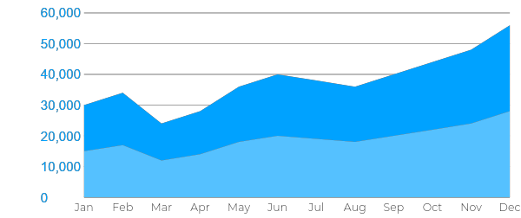
Financial
Plan
Monthly Expenses:

Slide 16
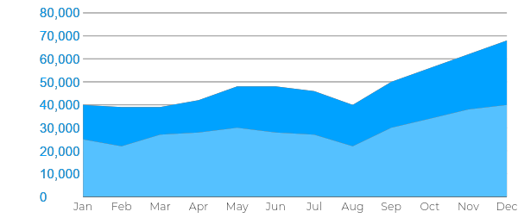
Financial
Plan
Monthly Revenue: Estimated Monthly Revenue 2023

Slide 17
Start-Up
Summary
Total Funding Required:
The start-up cost of 70K USD will be provided by the owner, which will be used for salary, equipment & other operations expenses.
Start-Up Funding
Start-Up Expenses | $40,000
Start-Up Assets | $30,000
Total Funding Required | $70,000.00

Slide 18
Start-Up
Summary
Total Assets
Assets
Non-Cash Assets from Start-Up | $18,000
Cash Requirements from Start-up | $5,000
Additional Cash Raised | $5,000
Cash Balance on Starting Date | $2,000
Total Assets | $30,000

Slide 19
Start-Up
Summary
Total Capital & Liabilities
Capital
Planned Investment
Owner | $60,000
Other | $0
Additional Investment Requirement | $0
Total Planned Investment | $60,000
Loss at Start-Up (Start-Up Expenses) | -$20,000
Total Capital | $50,000
Liabilities | $0
Total Capital & Liabilities | $50,000

Slide 20
Start-Up
Summary
Start-Up
Requirements Start-Up Expenses Rent - 5 Months | $10,000
Advertising | $5,000
Legal Fees | $5,000
Staff Training | $8,000
Insurance | $12,000
Other | $0
Total Start-Up Expenses | $50,000
Start-Up Assets
Cash Required | $10,000
Start-Up Inventory | $10,000
Other Current Assets | $6,000
Long-Term Assets | $4,000
Total Assets | $30,000
Total Requirements (Total Start-Up Expenses + Total Assets) | $70,000

Slide 21
Start-Up
Summary
Financial Statements
Balance Sheet Projection
 | FY2021 | FY2022 | FY2023
Cash | $85,000 | $100,000 | $125,000
Accounts Receivable | $5,000 | $7,500 | $11,000
Inventory | $5,000 | $7,500 | $11,000
Other Current Assets | $5,000 | $7,500 | $11,000
Total Current Assets | $100,000 | $122,500 | $158,000

Slide 22
Start-Up
Summary
Financial Statements
 | FY2021 | FY2022 | FY2023
Operating Cash Beginning | $100,000 | $122,500 | $158,000
Sources of Cash
Receivables | $5,000 | $7,500 | $7,500
Sales | $101,000 | $111,500 | $142,000
Others | $5,000 | $7,500 | $8,000
Total Current Assets | $211,000 | $249,000 | $319,000

Slide 23
Start-Up
Summary
Expenditures
Lease Payments | $15,000 | $15,000 | $15,000
Insurance | $5,000 | $5,000 | $5,000
Utilities | $10,000 | $13,000 | $15,000
Salary (Including Tax) | $50,000 | $50,000 | $53,000
Maintenance & Supplies | $10,000 | $13,000 | $15,000
Total Expenditures | $90,000 | $96,000 | $103,000
Net Income/Loss (Total Cash - Total Expenditures) | $121,000 | $153,000 | $216,000

Slide 24
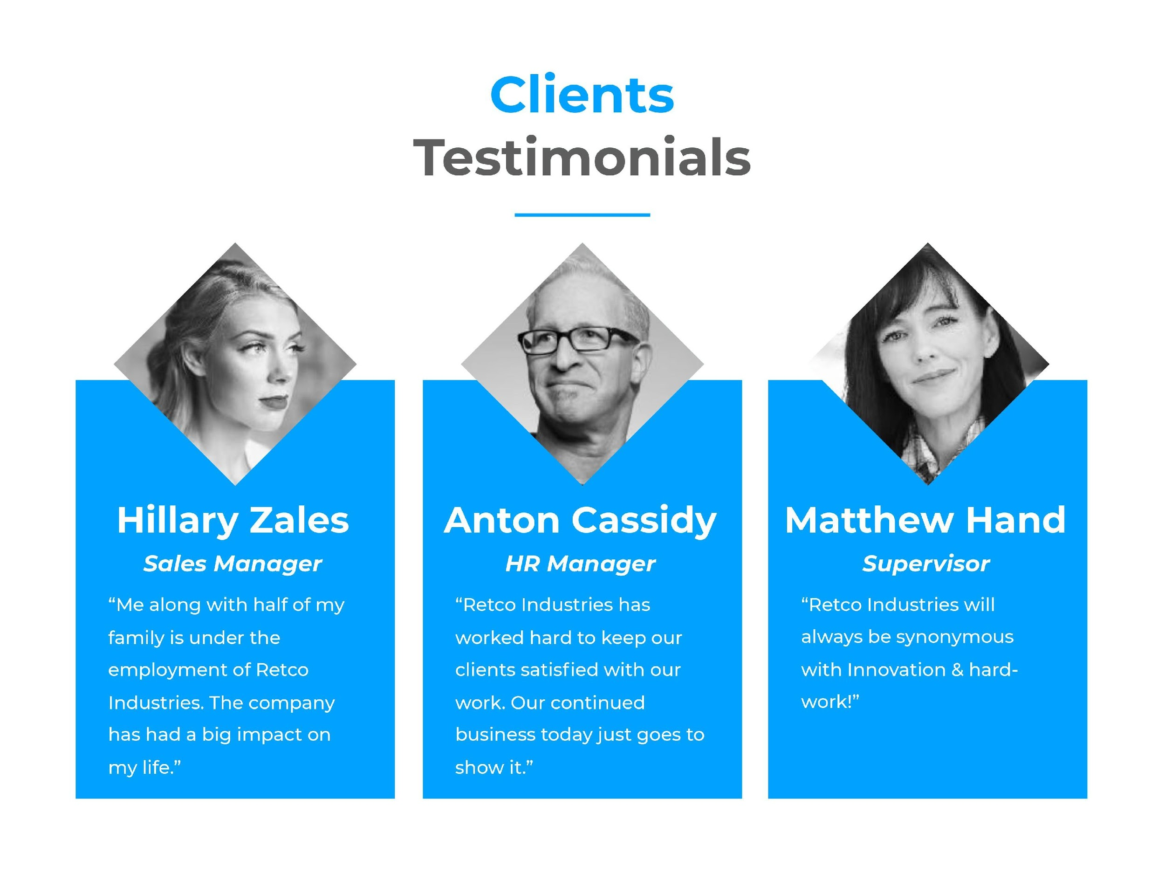
Clients
Testimonials
Hillary Zales
Anton Cassidy
Matthew Hand
Sales Manager
HR Manager
Supervisor
“Me along with half of my family is under the employment of Retco Industries. The company has had a big impact on my life.”
“Retco Industries has worked hard to keep our clients satisfied with our work. Our continued business today just goes to show it.”
“Retco Industries will always be synonymous with Innovation & hard-work!”

Slide 25
THANK
YOU!

