Slide 1

Marketing
Pitch deck
Presentation
This one day sale will be held at the Downtown Showroom on February 14, 2021 from 10am to 6pm. Tickets start at $39.99 each and will entitle attendees to an 80% discount on purchases worth $2000 and above.

Slide 2

PRIME SOLUTIONS AGENCY

Slide 3
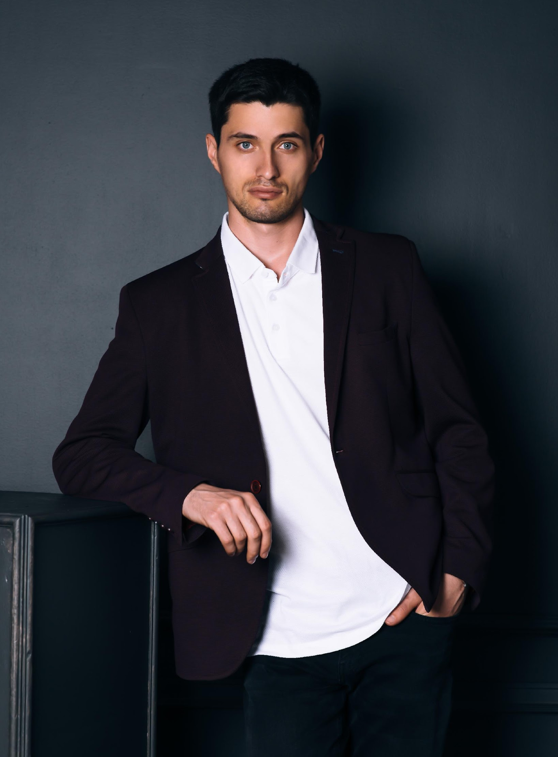
Gavin Hudson
The company
Offers & Services
Execution
Operational Plan
Start-up Summary
Testimonials
Founder & CEO
I am Gavin Hudson and I welcome you to Prime Solutions Agency.
This company is the fruit of all my struggles, pain and happiness in life. I am more than happy to introduce you the soon to be number 1 digital marketing agency in the country - Prime Solutions Agency.
The previous years gave us a glimpse of what this agency can claim and achieve. Now, this year holds a lot more challenges and expectations awaiting us. I am grateful to announce the new improvement plans and carefully planned events for all of our clients.
As a thanks to our loyal clients, we developed and organized events that would give them access to the best that we as a company have to offer. These events will provide them with amazing prices, discounts and gift coupons.
I believe that Prime Solutions Agency will continue to strive further towards development and success in the digital marketing industry.

Slide 4
What do
Costumers Want?
The company
Offers & Services
Execution
Operational Plan
Start-up Summary
Testimonials
01
More Value
This one day sale will be held at the Downtown Showroom on February 14, 2021 from 10am to 6pm. Tickets start at $39.99 each and will entitle attendees.
02
More Clients
Use the elements of value as a compass when deciding where to add value to their propositions.
03
More Profit
Use the elements of value as a compass when deciding where to add value to their propositions.

Slide 5

“Prime Solutions Agency is a company that is passionate in providing products and services geared towards those who need help in the marketing department.”
-Gavin Hudson, 59, Founder & CEO

Slide 6

History
First established in 2005 by Gavin Hudson, PRIME SOLUTIONS AGENCY is a proud provider of superior digital products and services. With over 13 years of experience in the digital marketing industry, Prime Solutions Agency currently has 3 fully operating branches in New Mexico, Illinois and Seattle.

Slide 7

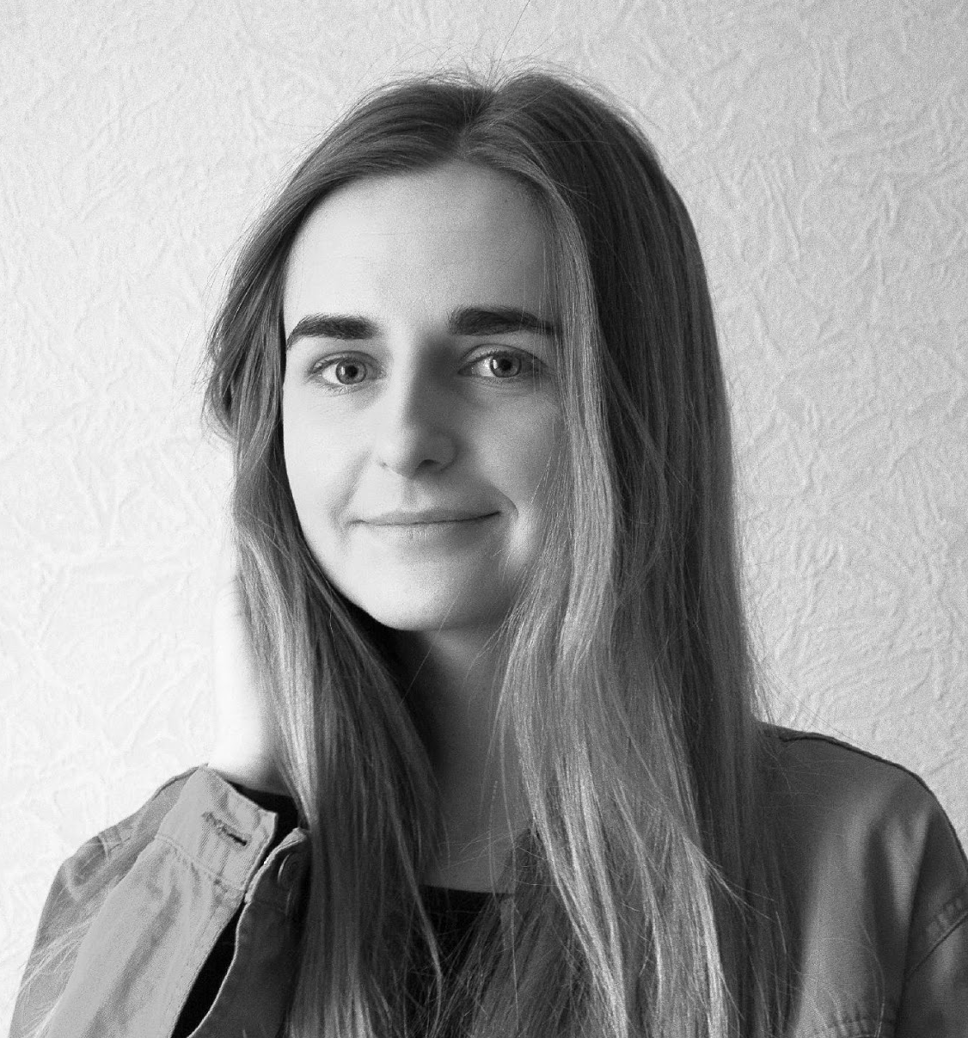
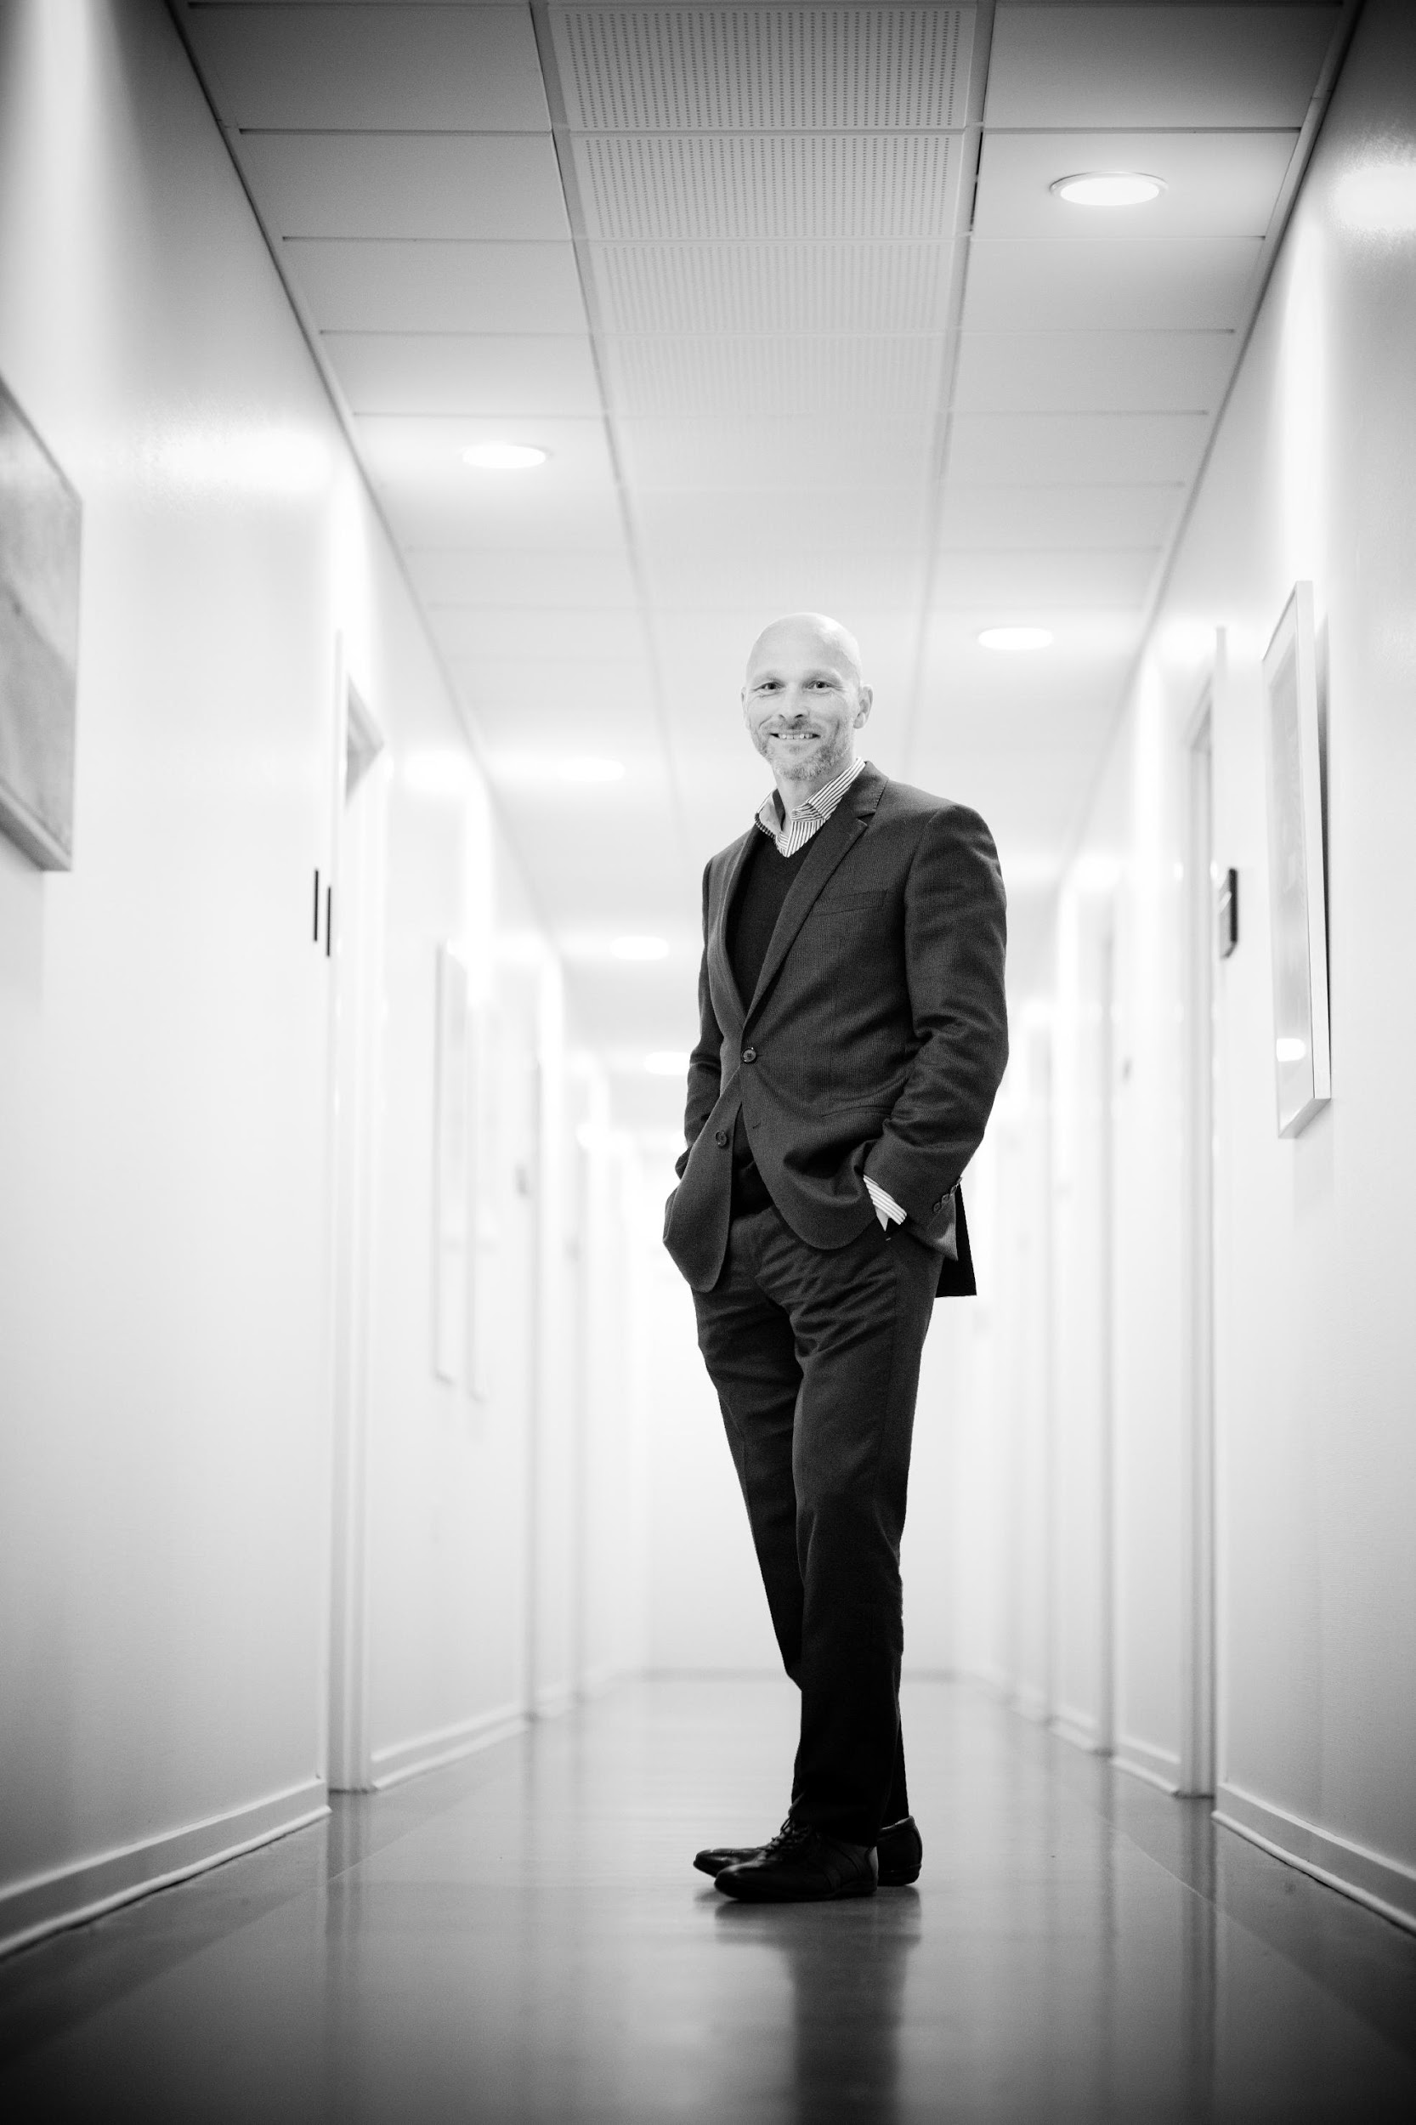
The company
Offers & Services
Execution
Operational Plan
Start-up Summary
Testimonials
Management
Iory Williams
Hailey Bush
Chad Mufeills
Chief Executive Officer
Chief Marketing Officer
Tech Consultant

Slide 8
OFFERS AND SERVICES

Slide 9

Full Service
Marketing
The company
Offers & Services
Execution
Operational Plan
Start-up Summary
Testimonials
We provide branding from the inside-out, so when it comes to creating a logo or other elements, we've got you covered.
Effective social media success takes effective planning and creative thinking to drive customers to buy.
Our expertise in consulting and training, for profit or not-for-profit businesses, allows us to be your guide.

Slide 10

Industries
The company
Offers & Services
Execution
Operational Plan
Start-up Summary
Testimonials
From procurement and cost management to supply chain efficiency and digital transformation, Bain works with companies in all industrial sectors to solve a broad range of management challenges. We help companies generate real results today and build a strategy that will endure well into the future.
Combine traditional and digital lean techniques to achieve new levels of performance and efficiency, on the shop floor and beyond.

Slide 11
EXECUTION

Slide 12

Strategy
The company
Offers & Services
Execution
Operational Plan
Start-up Summary
Testimonials
From procurement and cost management to supply chain efficiency and digital transformation, Bain works with companies in all industrial sectors to solve a broad range of management challenges. We help companies generate real results today and build a strategy that will endure well into the future.. Combine traditional and digital lean techniques to achieve new levels of performance and efficiency, on the shop floor and beyond.

Slide 13

Sustainability
The company
Offers & Services
Execution
Operational Plan
Start-up Summary
Testimonials
Sustainability efforts should be anchored in business fundamentals, demonstrate a clear return on investment, and be firmly embedded within your strategy and operations. We can help you address critical issues related to sustainability strategy, the environmental and social impact of operations, stakeholder engagement, and sustainability-related growth and cost opportunities. Our teams specialize in helping d efficiency, on the shop floor and beyond.

Slide 14

Main Goal
The company
Offers & Services
Execution
Operational Plan
Start-up Summary
Testimonials
Prime Solutions Agency commits itself to provide its clients with effective, efficient and reliable products and services for digital marketing developed to help boost every clients’ respective brand. This means working with management and staff to ensure every detail of “the experience” a client or customer may have meets and delivers on any promises made via the creative process. It also means being an integral part of the ongoing process, successes and failures.

Slide 15
OPERATIONAL PLAN

Slide 16
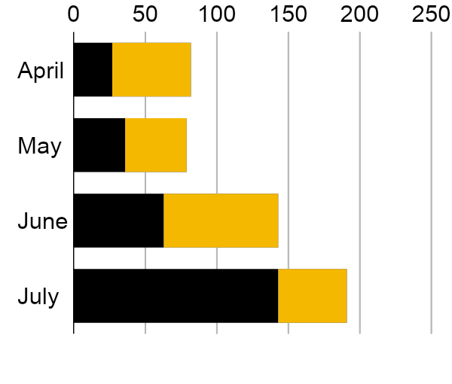
The company
Offers & Services
Execution
Operational Plan
Start-up Summary
Testimonials
Overview of Growth
60% increase in annual profits as of May 2021.
70% increase in satisfaction with developed website templates as of March 2021.
45% increase in clientele base as of March 2021.

Slide 17

The company
Offers & Services
Execution
Operational Plan
Start-up Summary
Testimonials
Pursue Investment

Slide 18
START-UP SUMMARY

Slide 19

The company
Offers & Services
Execution
Operational Plan
Start-up Summary
Testimonials
Startup
Requirements
Start-Up Expenses
Rent - 5 Months $20,000
Advertising $15,000
Legal Fees $5,000
Staff Training $5,000
Insurance $5,000
Other $0
Total Start-Up Expenses
$50, 0000

Slide 20
TESTIMONIALS

Slide 21

The company
Offers & Services
Execution
Operational Plan
Start-up Summary
Testimonials
Sophia Holiday, 31, Entrepreneur
Ben Aaron, 41, Developer
The place where champions are built, Prime Solutions Agency consistently provides me the most effective exercises to maintain my physique. Definitely the best place for all gym lovers!
As a stock broker, fitness has never been my priority because of my busy schedule. That is, until Prime Solutions Agency showed me the reason why I should value my physical health. They have a various worthwhile & effective programs for people who wish to attain their dream body.

Slide 22
THANK YOU!
PRIME SOLUTIONS AGENCY
(000) 111 2222 | dm@primesolutions.com

