Slide 1
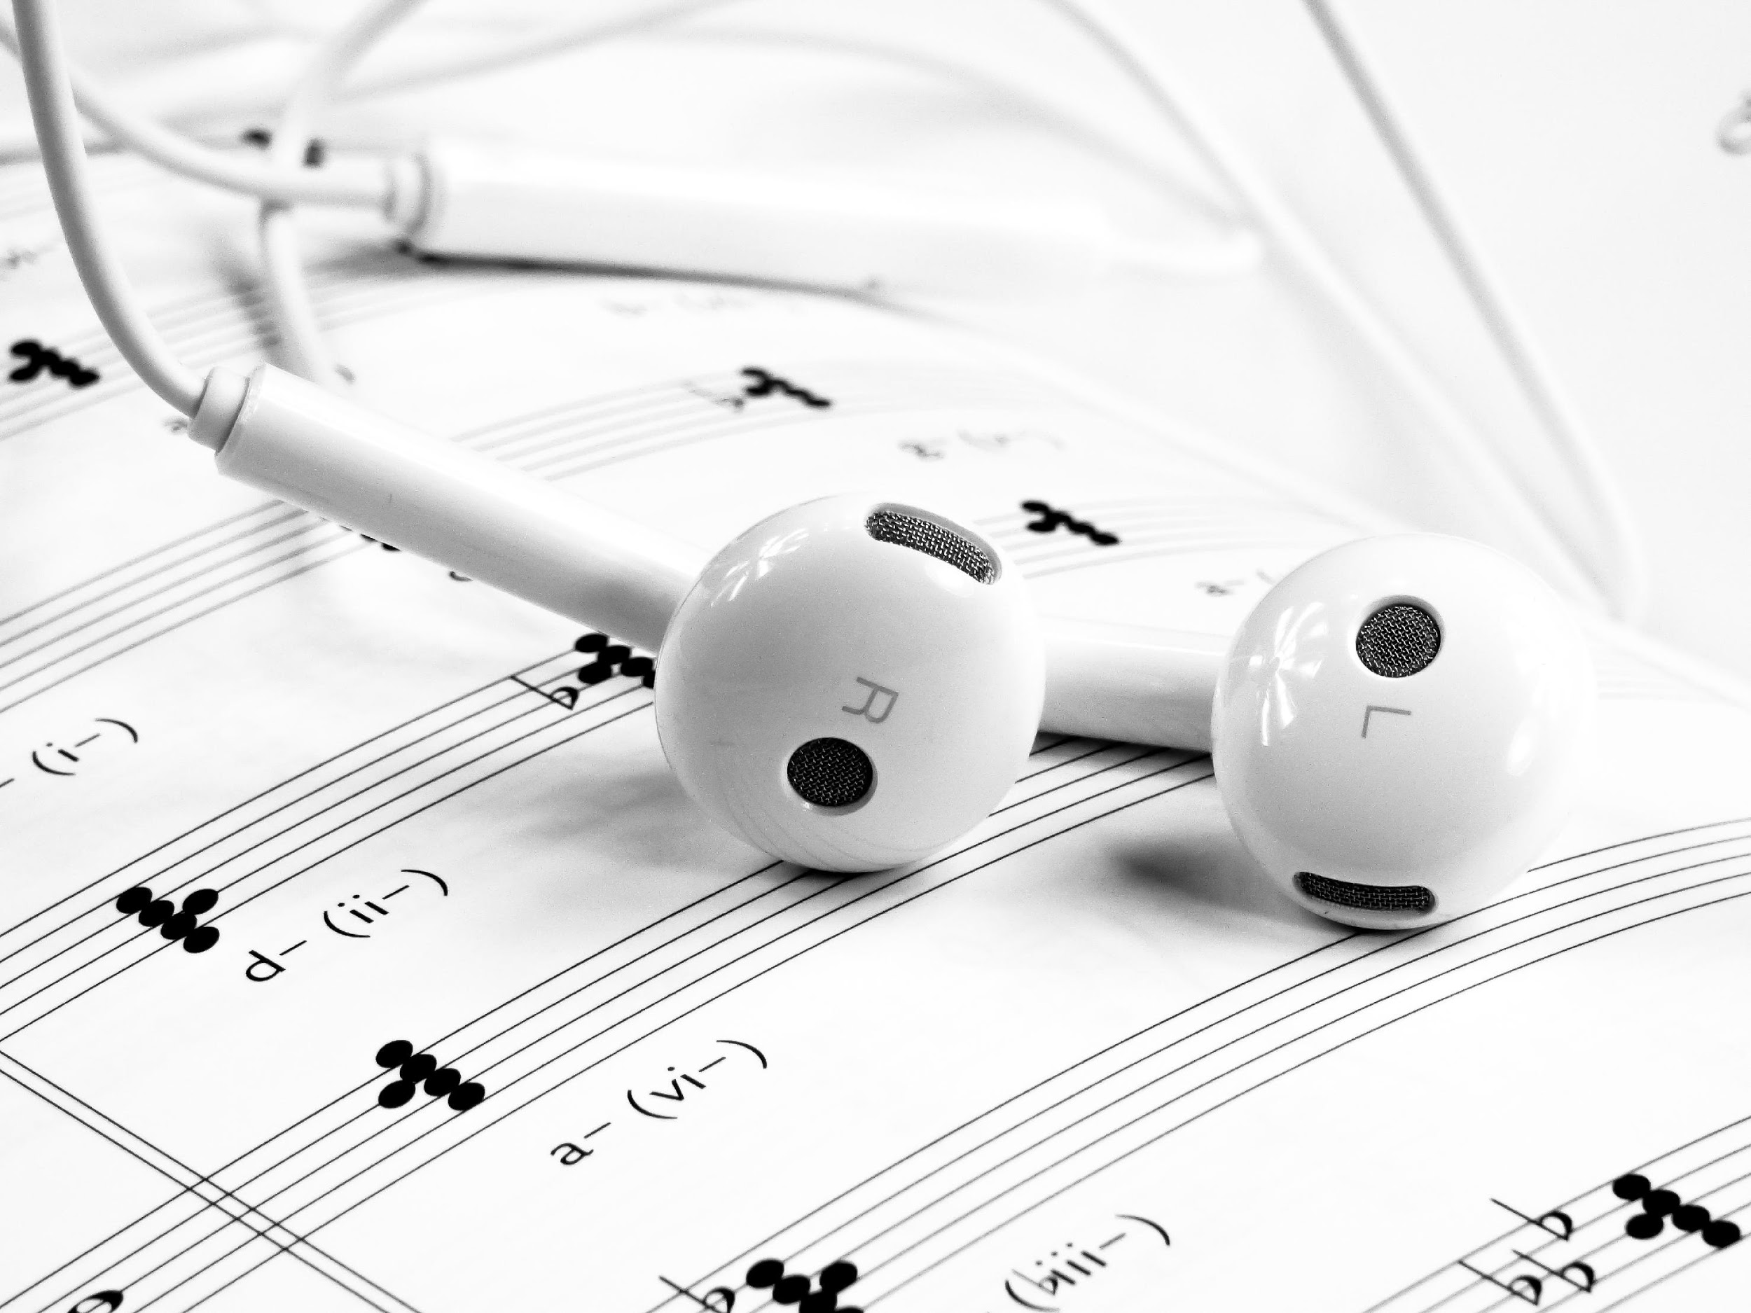
The Song-list Patch
Marisha Johnson
marishajohnson@electrolytepatch.com
729-501-3956
www.theelectrolytepatch.com
4515 Rafe Ln.,
Los Angeles, CA 10230, USA

Slide 2
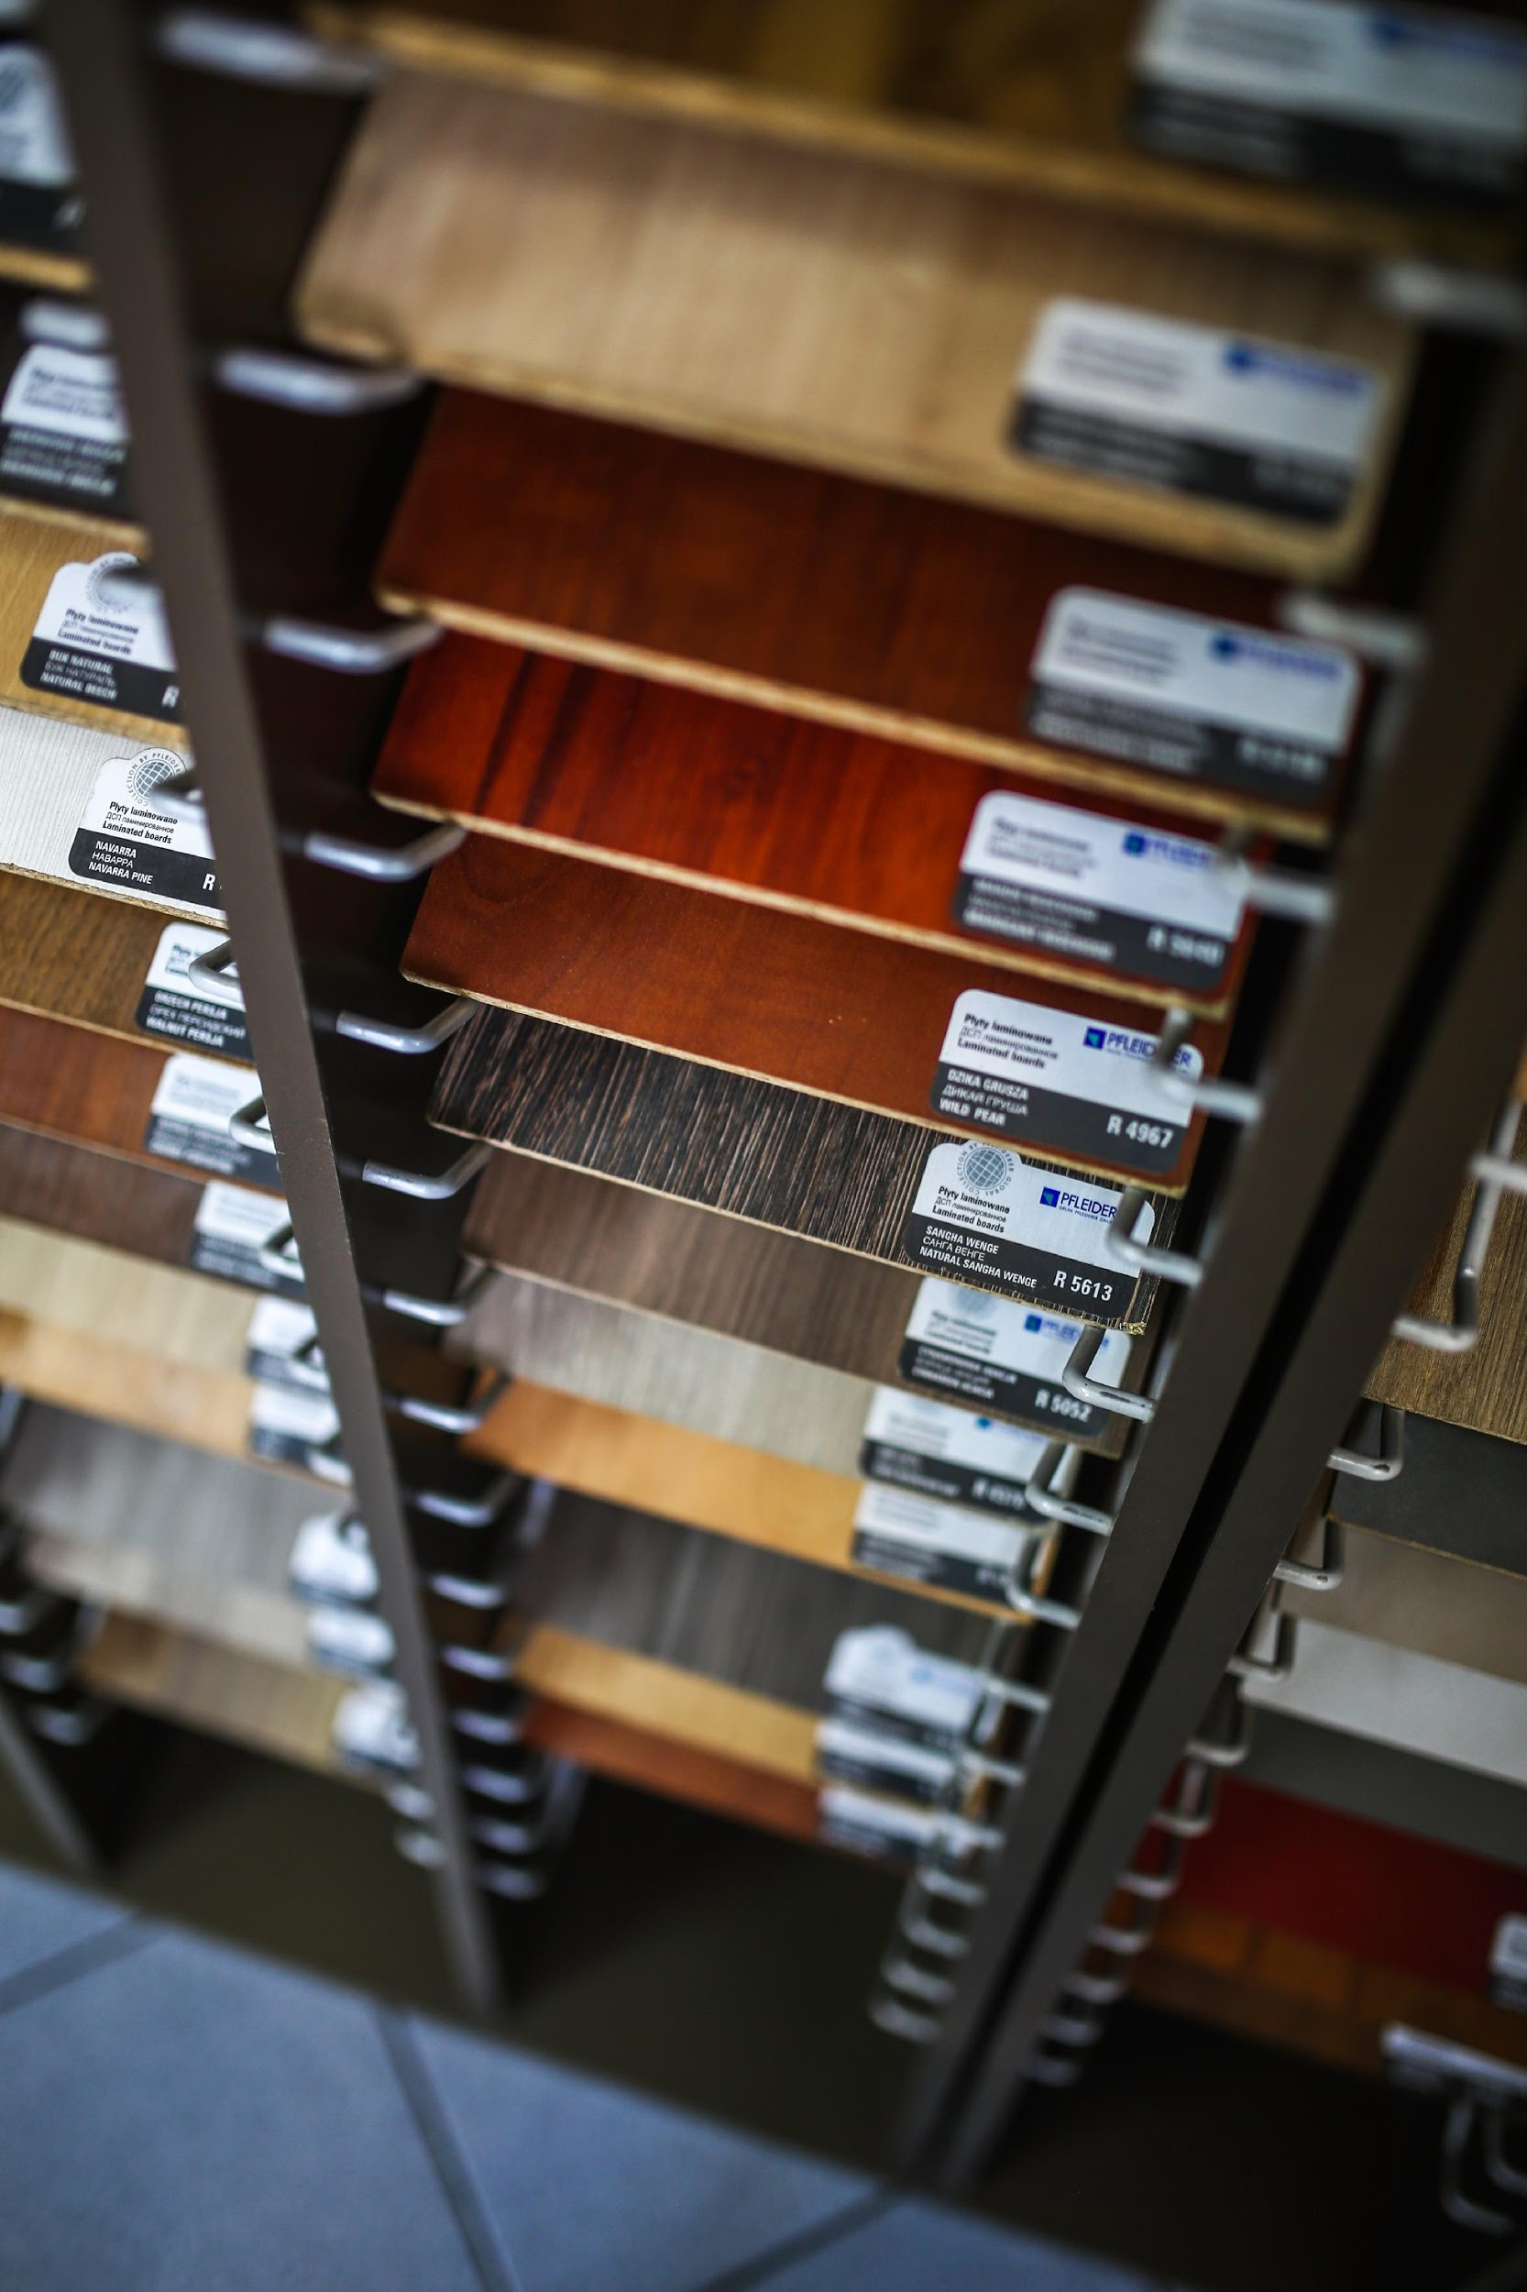
About
The Song-list Patch is a technological device that resembles a small cuboid patch that stores music files for the user to listen to.
Aims to be a convenient device for users who love to listen to music wherever & whenever they are.

Slide 3
MISSION
Our mission is to create a products that provide comfort & convenience to the public.
VISION
Our vision is to become one of the most advanced & gain the lead on cutting edge technology.
PHILOSOPHY
Our organization runs on the belief that both comfort & convenience can be achieved through the advancement of technology.
The Company

Slide 4
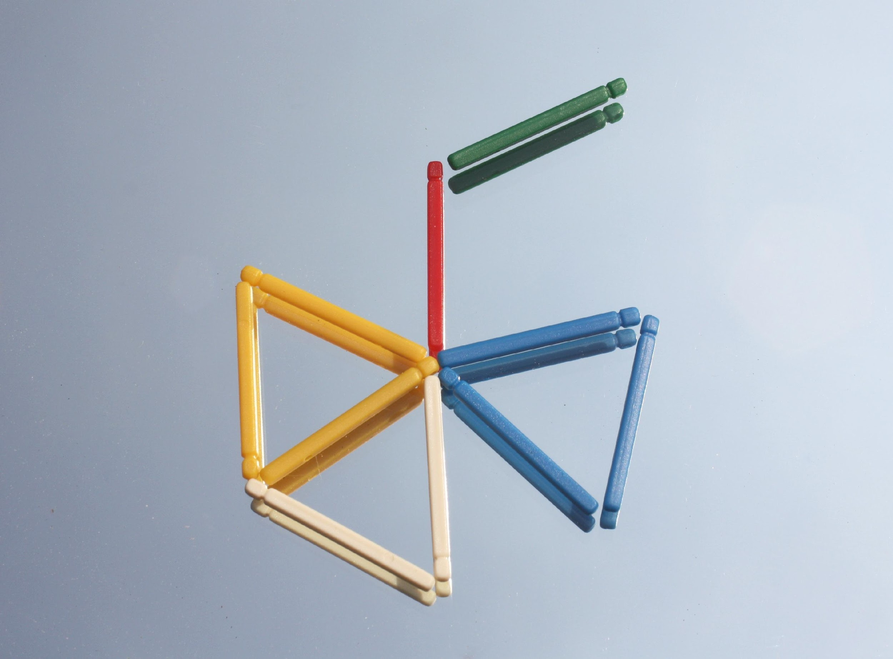
ORGANIZATIONAL
STRUCTURE
Type of Industry: Technology
Business Structure: Management
Ownership: President, Brian Willingham

Slide 5
MANAGEMENT TEAM
AImee M. Gregson General Manager
Wayne B. Fernandez Production Manager

Slide 6
UPCOMING PRODUCTS
The Song-list Patch is the first of many upcoming advanced tech products.
Some of them include:
Holo Communicator
Glass pane Phone
Smart Glove
Offers & Services

Slide 7
Execution
MARKETING PLAN
Our marketing strategy emphasizes the combination of traditional & millennial style of promoting the product.
Televised Commercials
Social Media Advertisements
Online Scientific Articles

Slide 8
Execution
MARKET RESEARCH
With the evolution of how information is disseminated, changing to new ways of promoting events became a substantial challenge for companies.
With the emergence of social media & internet,
online advertisement has become prevalent.

Slide 9
JANUARY 2041
Mass Production of
the Song-list Patch
FEBRUARY 2041
Screening & Checking
of the Products
APRIL 2041
Advertisements & Press
JUNE 2041
Launching the Products
Production Schedule

Slide 10
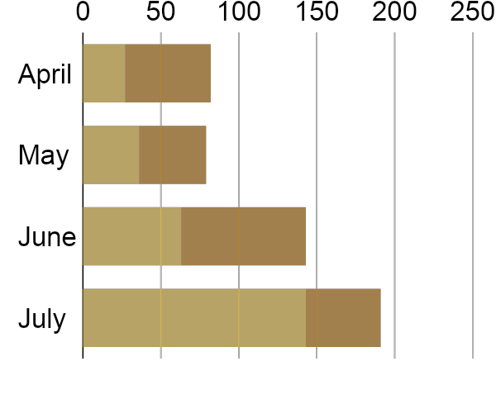
Start-Up Summary
60% increase in annual profits as of May 2021.
70% increase in satisfaction with developed website templates as of March 2021.
45% increase in clientele base as of March 2021.

Slide 11
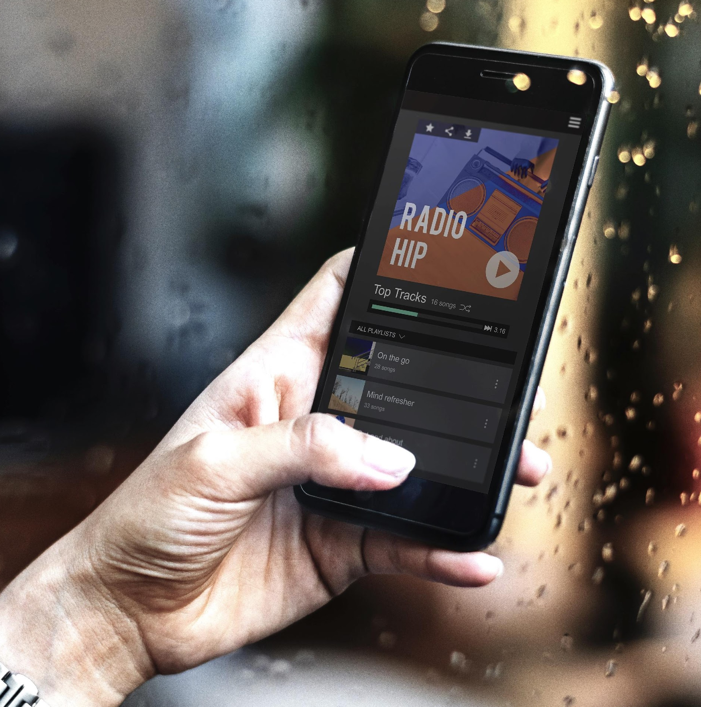
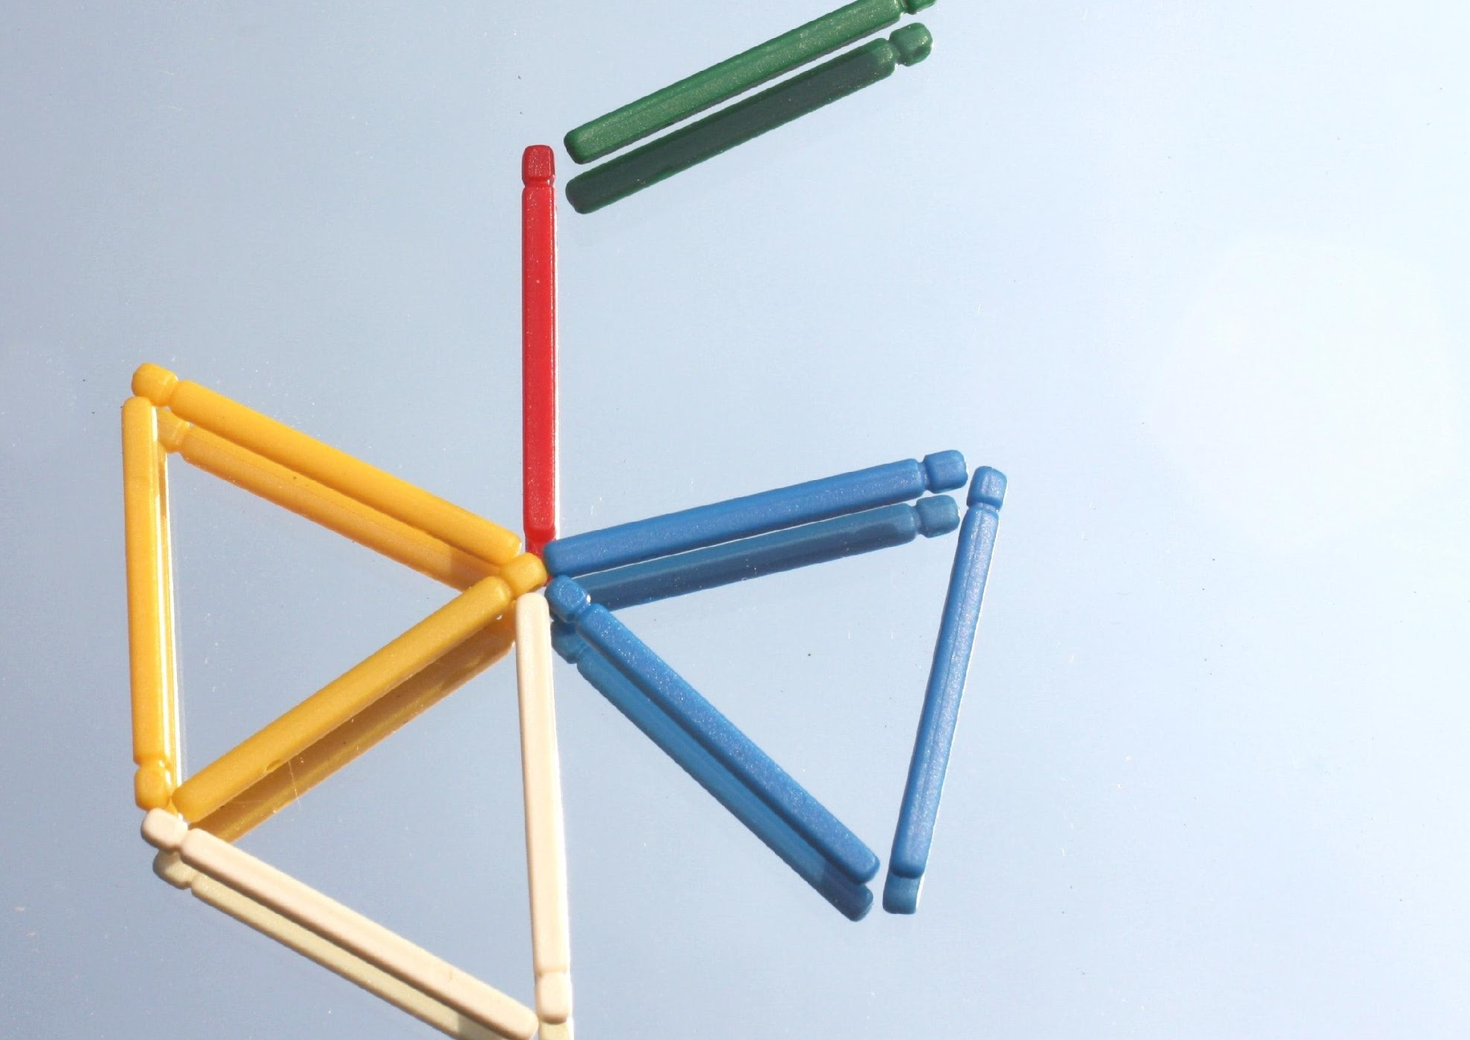
Image Gallery

Slide 12
TESTIMONIALS

Slide 13
The Song-list Patch is amazing! Just stick it on your arm & enjoy the music. Travis O’Brien, 27, Consumer
It’s one of my most prized possessions! The Song-list Patch is a brilliant invention. Phoebe Manning, 31, Consumer

Slide 14
Thank You!
marishajohnson@electrolytepatch.com
729-501-3956
www.theelectrolytepatch.com
4515 Rafe Ln.,
Los Angeles, CA 10230, USA

