Slide 1
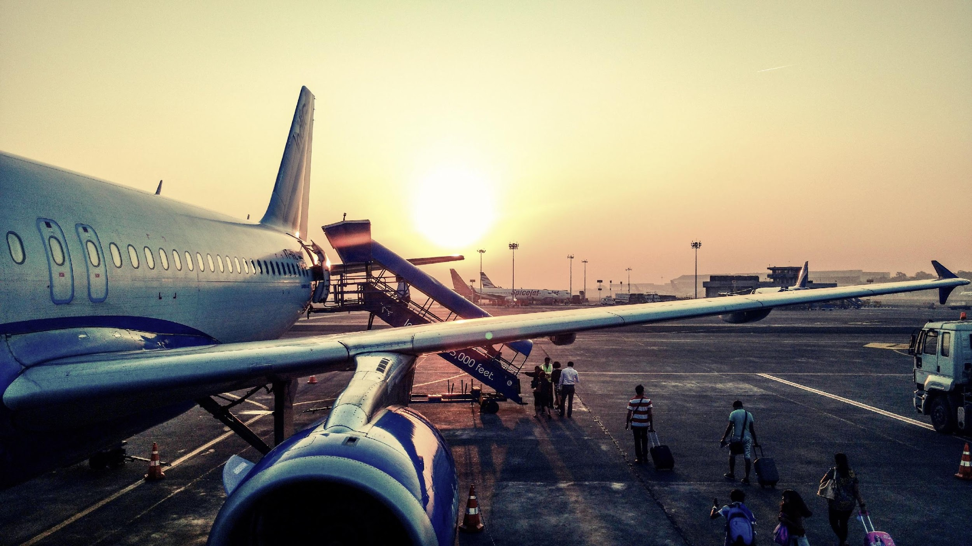
BEST TRAVEL AGENCY
94 Summit St. Davenport, IA 52807 | +9082 09284 | bt@agency.com

Slide 2

ALL EXPENSE
This will be held at United Grand Convention on September 23, 2022 from 9am to 6pm. Tickets start at $9.99 and will entitle all attendees to a free flight agent consultation and 10% off on selected flight packages. Profits gained will be utilized for the system upgrade and office renovation of Germany Kids Learning Center.
AROUND THE WORLD
This will be held at United Towers Hall on November 24, 2023 from 9am to 6pm. Tickets start at $29.99 and will entitle all attendees to a free flight agent consultation and a 20% discount on selected flight packages. 70% of profits will be donated to Save Earth Foundation. The other 30% of profits accumulated from this event will be used for the system upgrade and office renovation of Best Travel Agency.
Agenda
QUARTERLY BOARD MEETING
This quarterly meeting will be held at Excellent Restaurant on May 21, 2020 from 12pm to 6pm. This will serve as the first meeting for the year 2020 and will focus on discussing the agency’s future status and profit stabilization. This will also include the implementation of a new set of rules and regulations to be strictly implemented for the year 2022 to 2026.

Slide 3
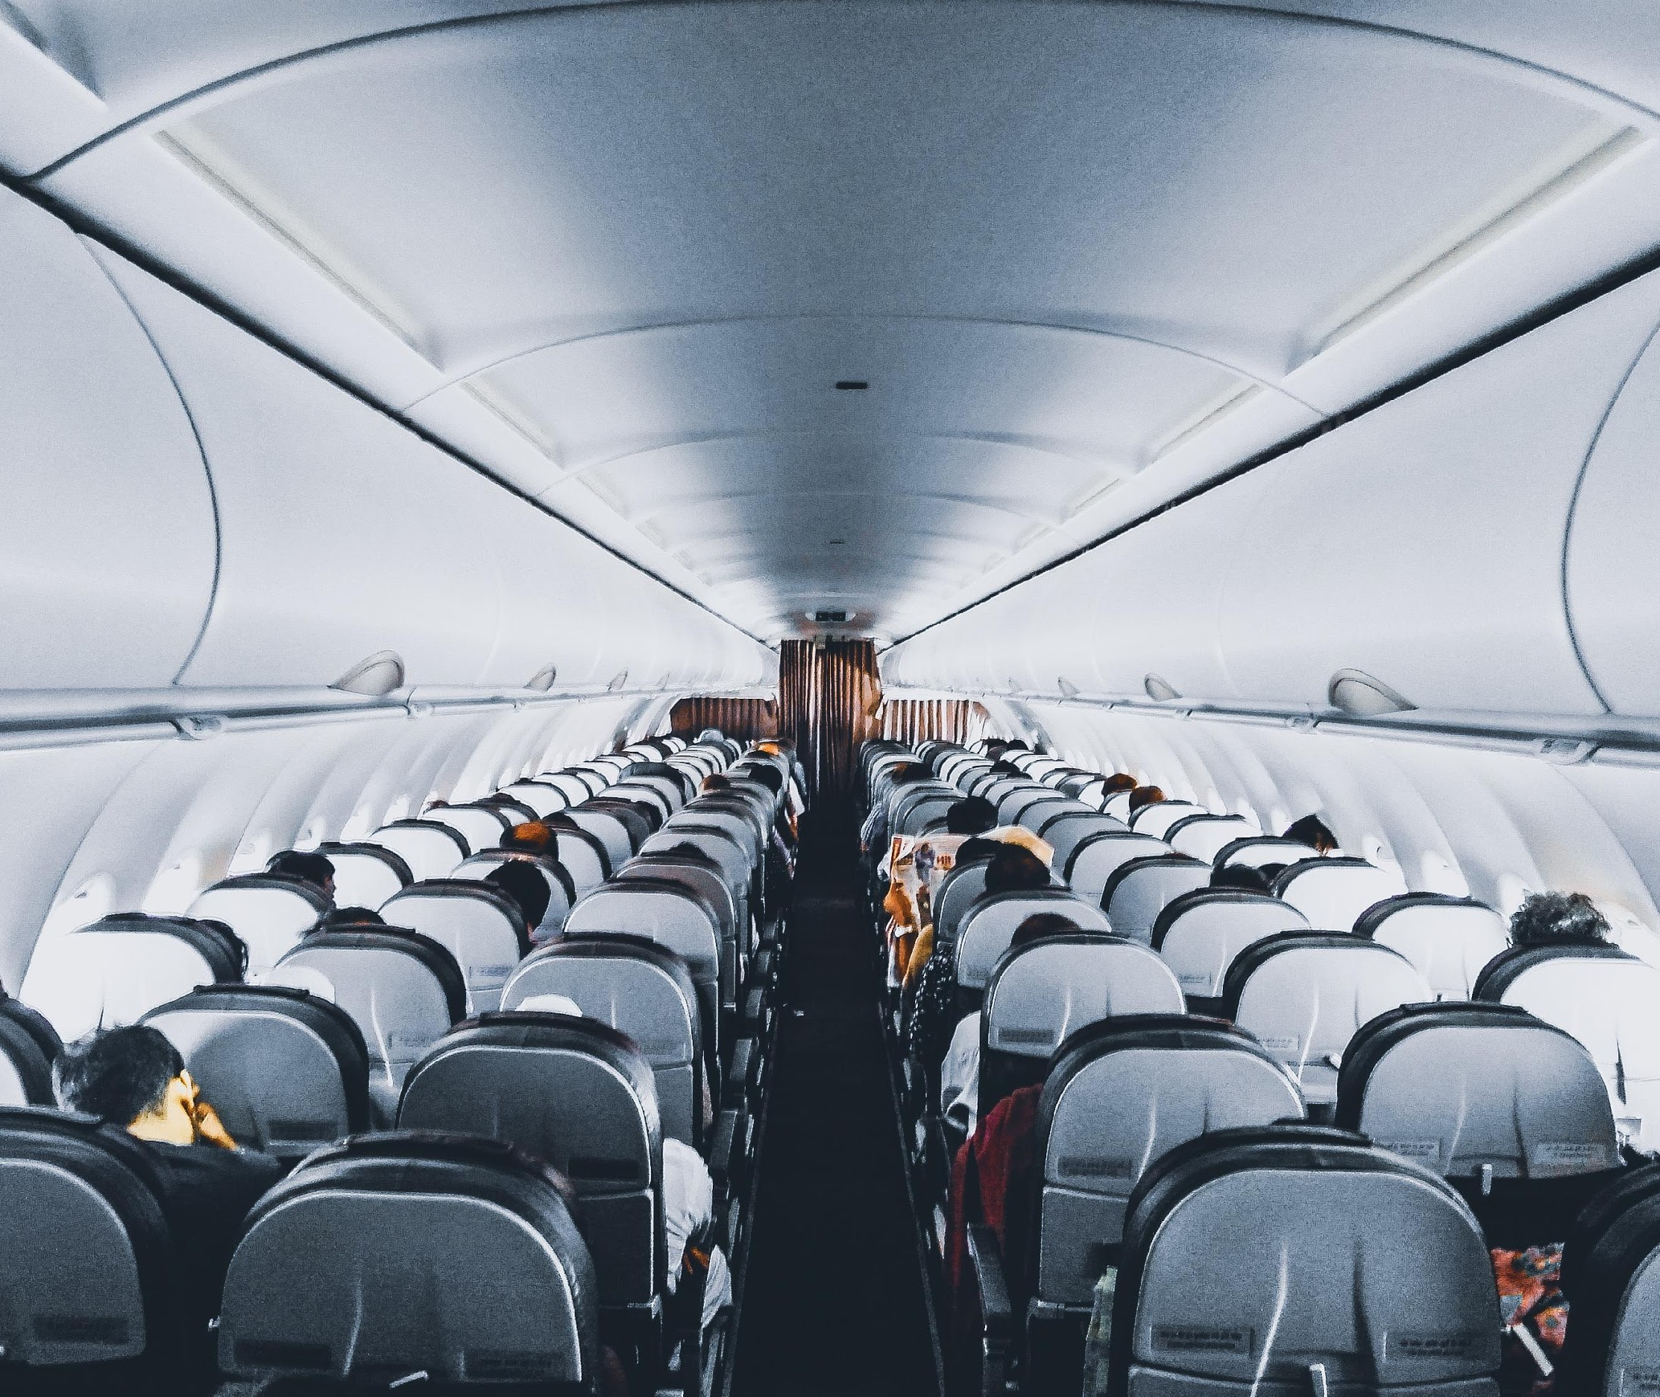
03
Best Travel Agency is a proud provider of travel packages since 2003. This company was first founded by Daisy Finn who was a former Business Management Professor, and now a philanthropist & entrepreneur. Today, the Best Travel Agency is a fully operating provider of traveling packages with at least 3 other store branches in Chicago, Minnesota, and Los Angeles.
About

Slide 4
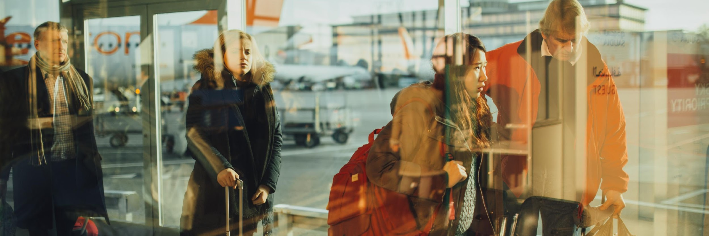
All Expense
04
United Grand Convention
September 23, 2022 | 9am to 6pm
Tickets start at $9.99 and will entitle all attendees to a free flight agent consultation and 10% off on selected flight packages. Profits gained will be utilized for the system upgrade and office renovation of Germany Kids Learning Center.

Slide 5
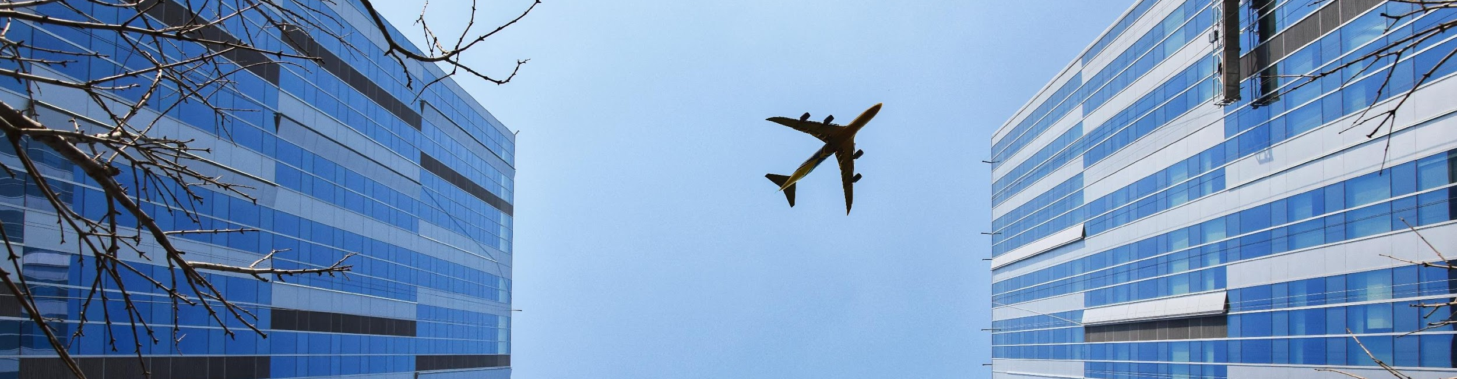
Tickets start at $29.99 and will entitle all attendees to a free flight agent consultation and a 20% discount on selected flight packages. 70% of profits will be donated to Save Earth Foundation. The other 30% of profits accumulated from this event will be used for the system upgrade and office renovation of Best Travel Agency.
United Towers Hall
November 24, 2023 | 9am to 6pm
Around The World

Slide 6

Quarterly Board Meeting
Excellent Restaurant
May 21, 2020 | 12pm to 6pm
This will serve as the first meeting for the year 2020 and will focus on discussing the agency’s future status and profit stabilization. This will also include the implementation of a new set of rules and regulations to be strictly implemented for the year 2022 to 2026.

Slide 7
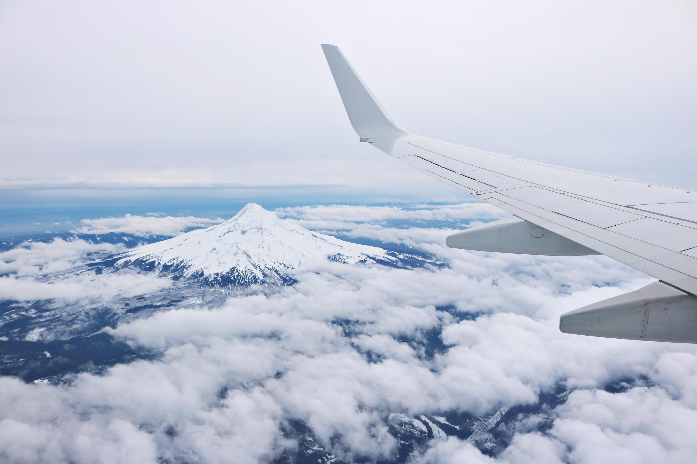
Best Travel Agency was founded by Daisy Finn in 2003 and is a proud provider of traveling package. This company made its first public appearance in 2003 and has garnered wide recognition from various institutions as a provider of traveling packages. During the late 2010’s, Best Travel Agency managed to successfully stabilize it average monthly profit in addition to winning the title of “Future Leading Provider of Travel Experience”. Today, it is now a fully operational provider of traveling packages with at least 3 different branches in Chicago, Minnesota & Los Angeles and is currently expanding its name and product availability worldwide.
History

Slide 8
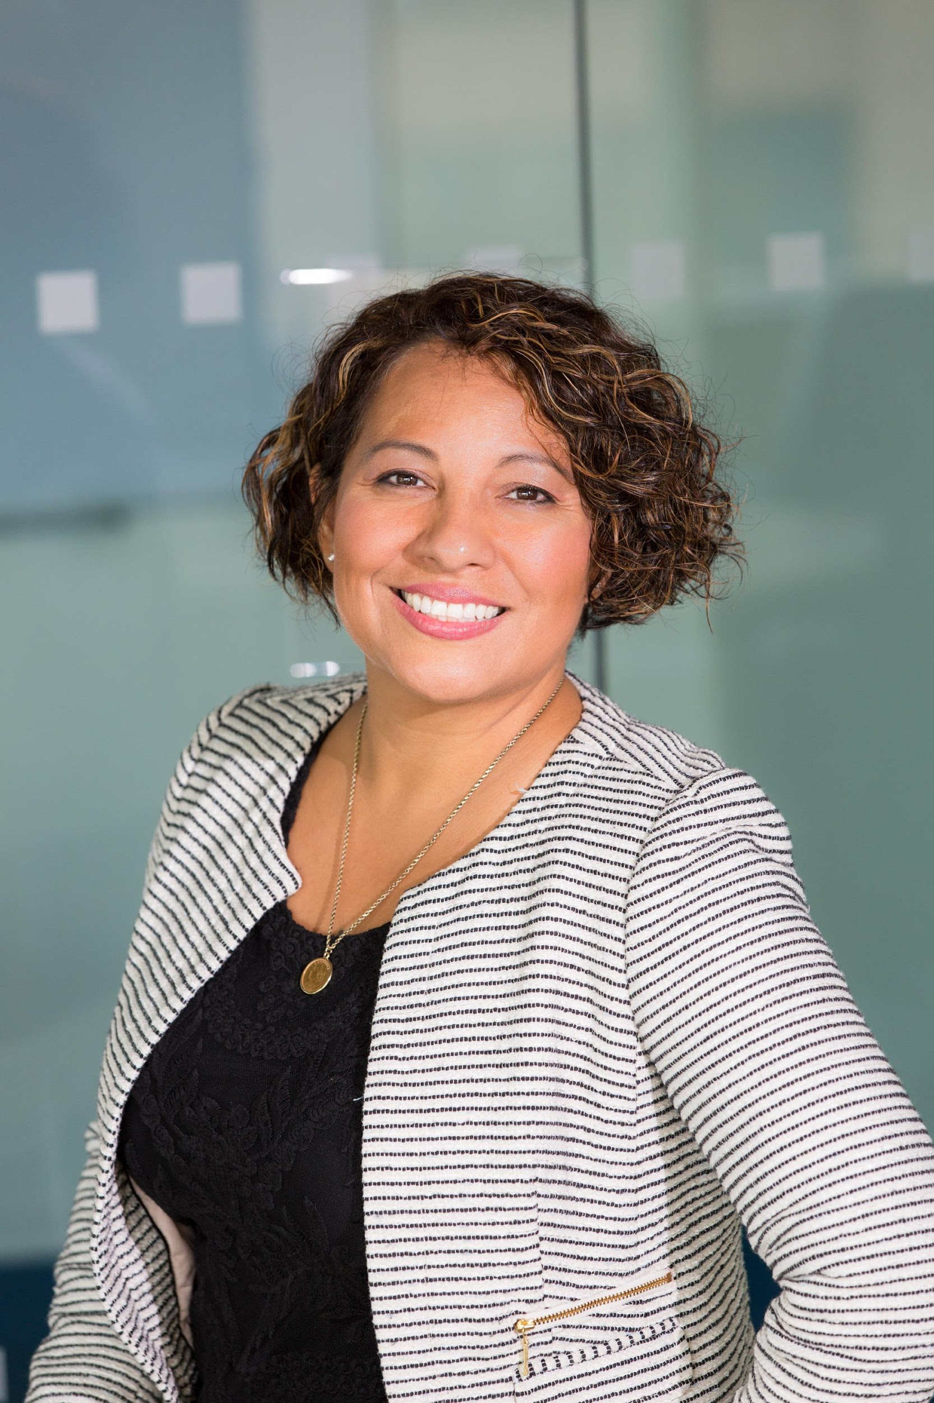
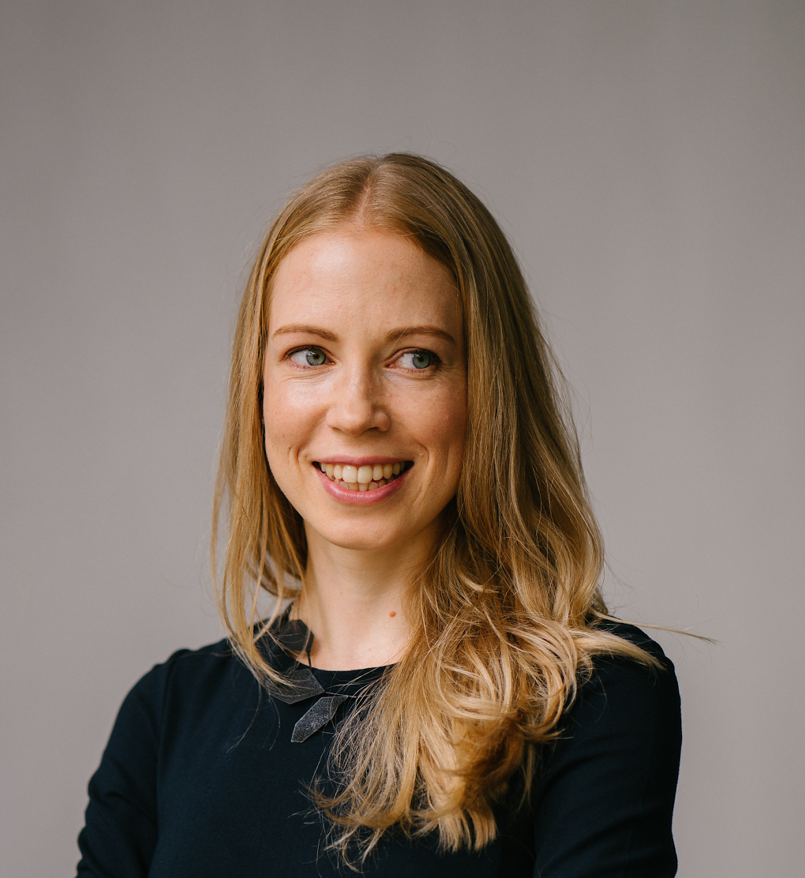
“
As the founder & chairman of Best Travel Agency, I am excited to announce our newly developed travel packages made available at affordable and convincing prices.
- Daisy Finn, 59, Chairman & CEO
Testimonials
“
If you are looking for the best and most formidable traveling products, Best Travel Agency is what you are looking for. From free visa assistance to travel package, it shows nothing but excellency and reliability in terms of quality and service.
- Kate Blane, 29, Tourist & Traveller

Slide 9

Main Goal
Best Travel Agency’s top most priority is to provide the best quality traveling packages and the most reliable customer care and service for all people who are in need of travel assistance.
09

Slide 10
Overview Of Growth
20%
30%
50%
Increase in annual profits as of May 2022
Increase in satisfaction with visa assistance as of March 2021
Increase in new clients as of February 2023

Slide 11
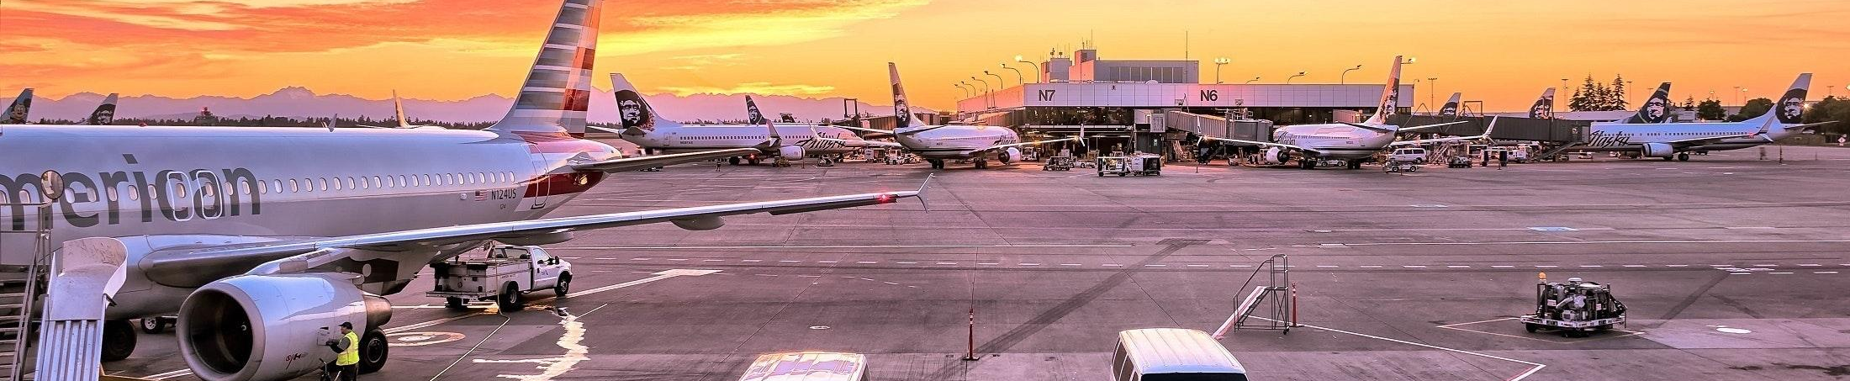




What We Offer
The Best
Traveling Products
Affordable and Reliable Traveling Package
Free Flight Agent Consultation
Friendly Customer
Care & Service

Slide 12
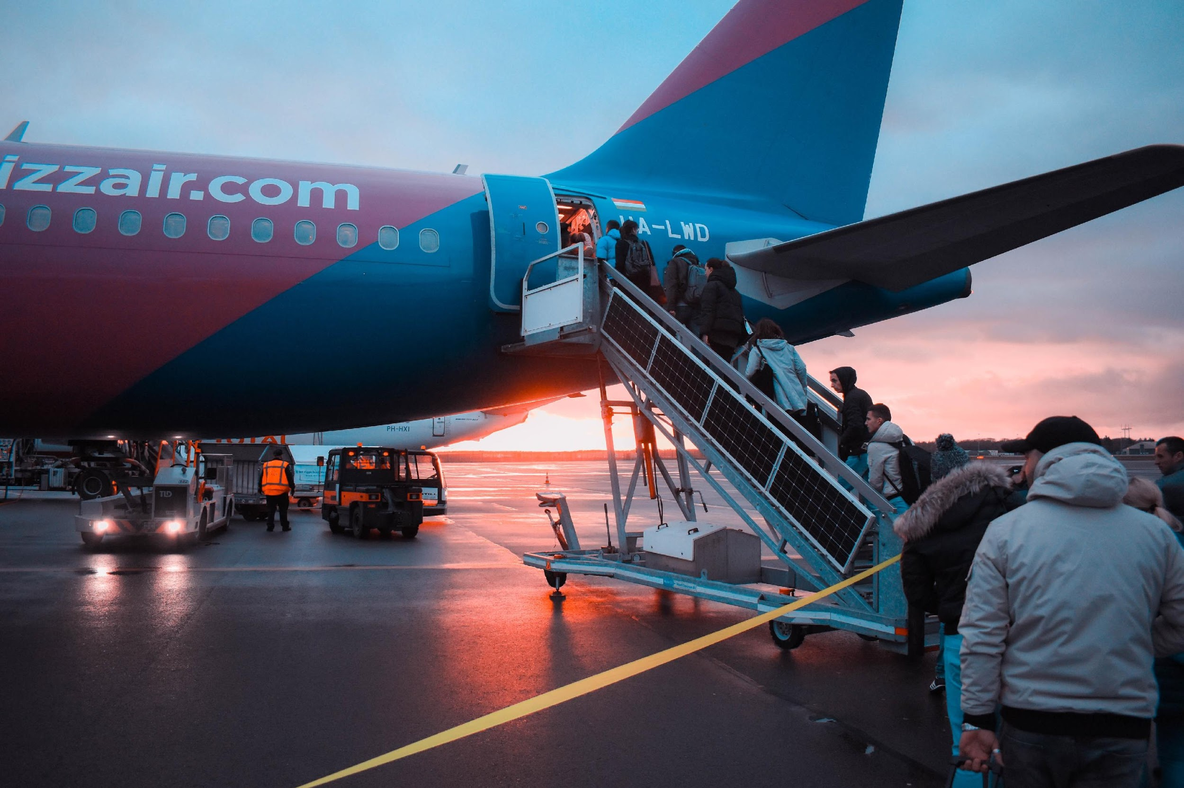
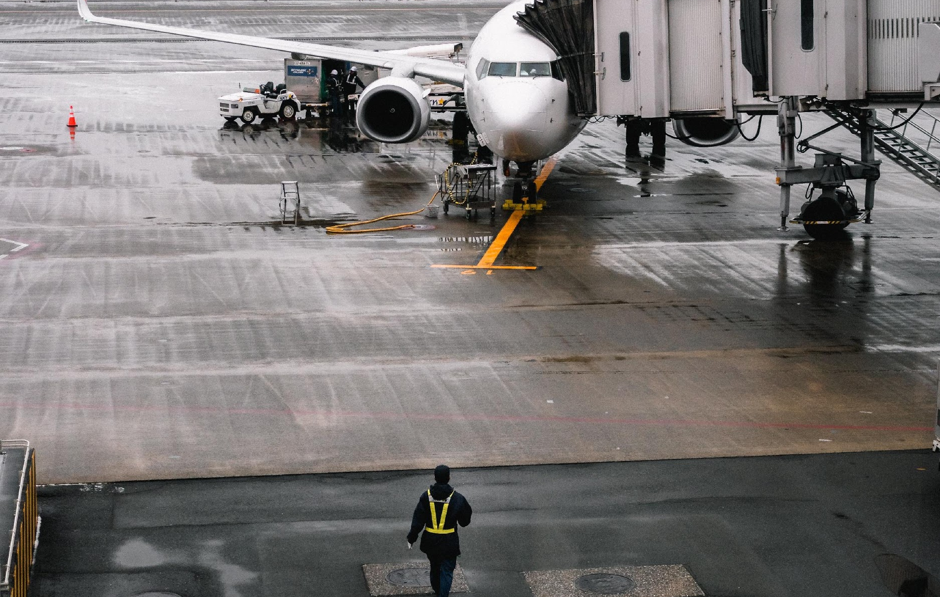
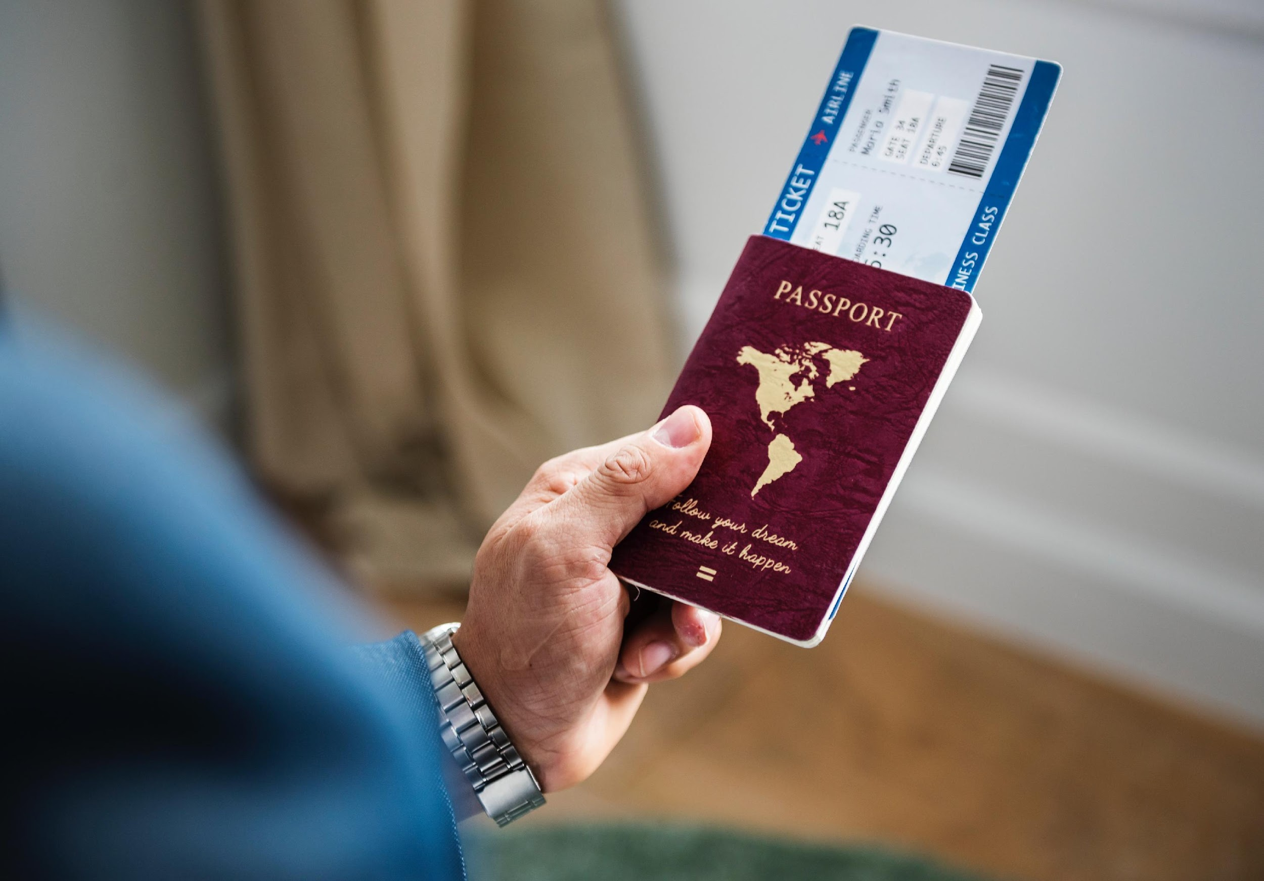
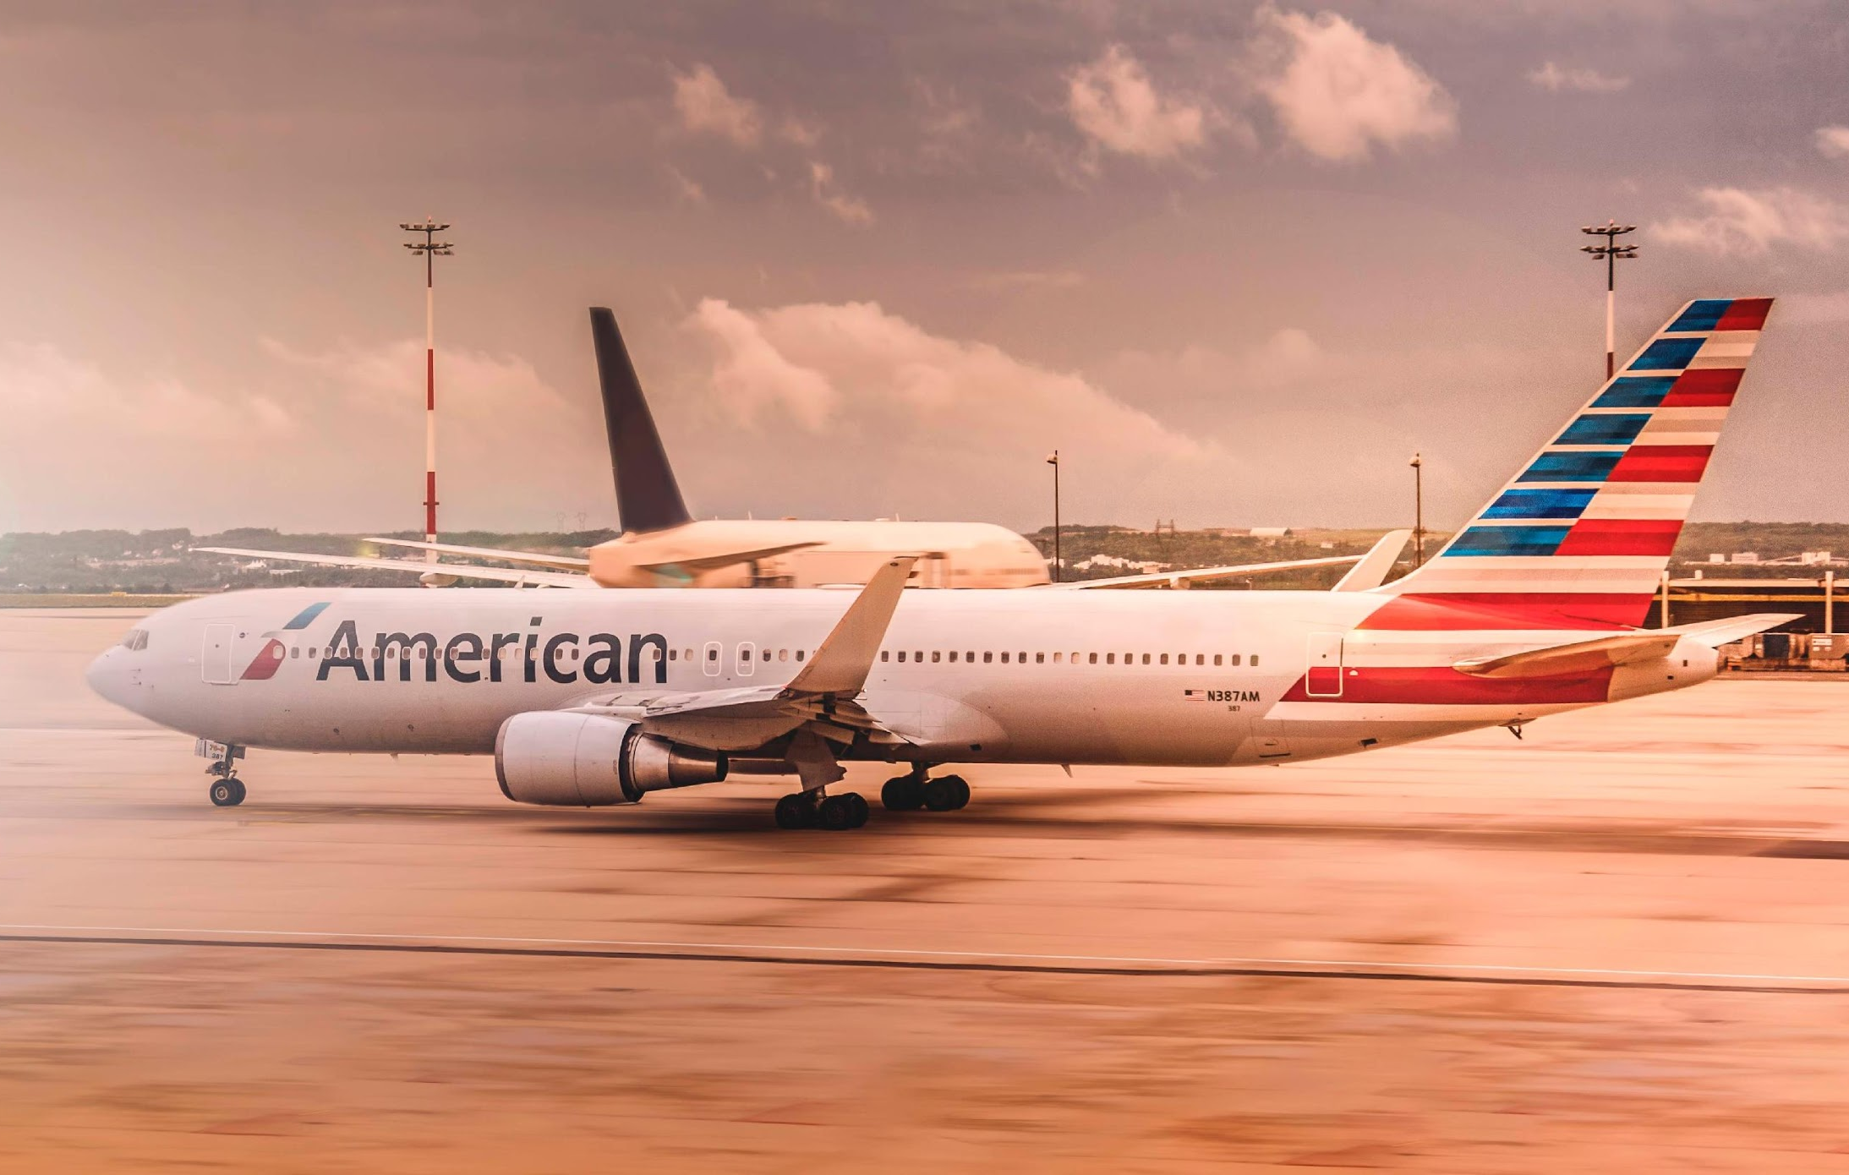
Image Gallery

Slide 13

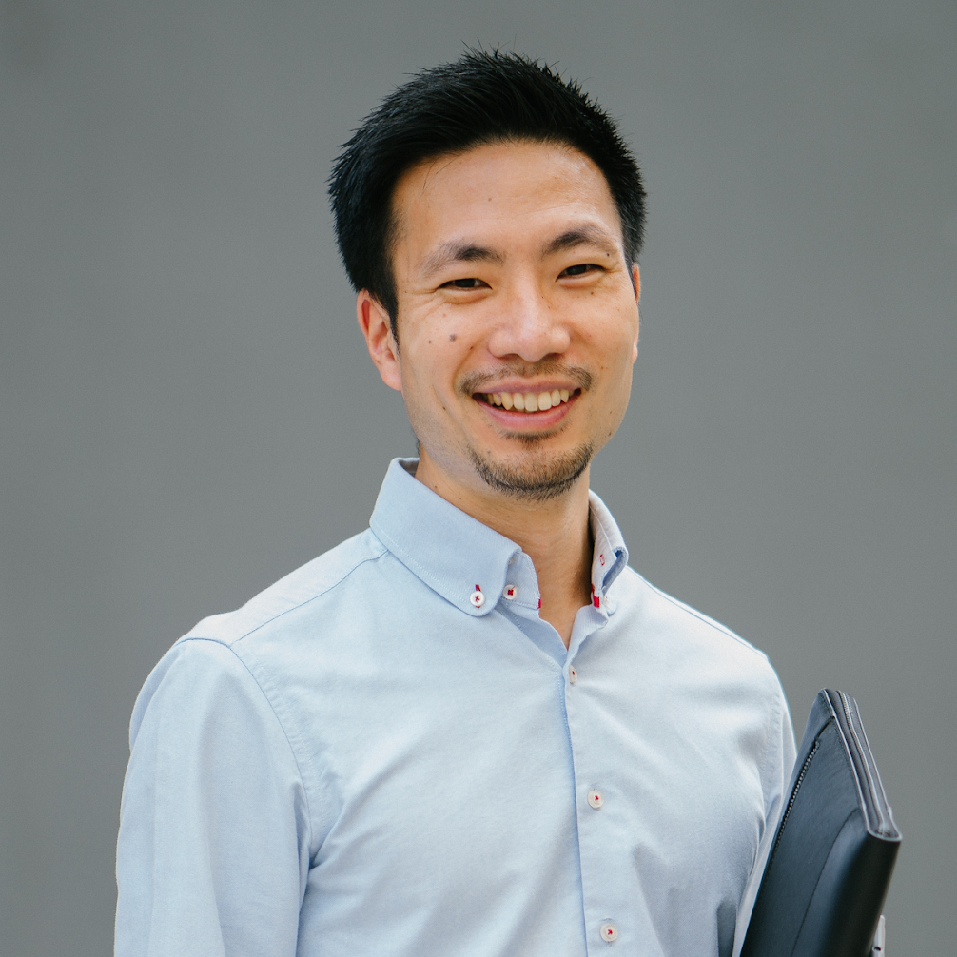
Daisy Finn
Jani Thor
Chairman & CEO
Chief Marketing Manager
13
McJames Steven
The Team
Chief Operating Officer

Slide 14
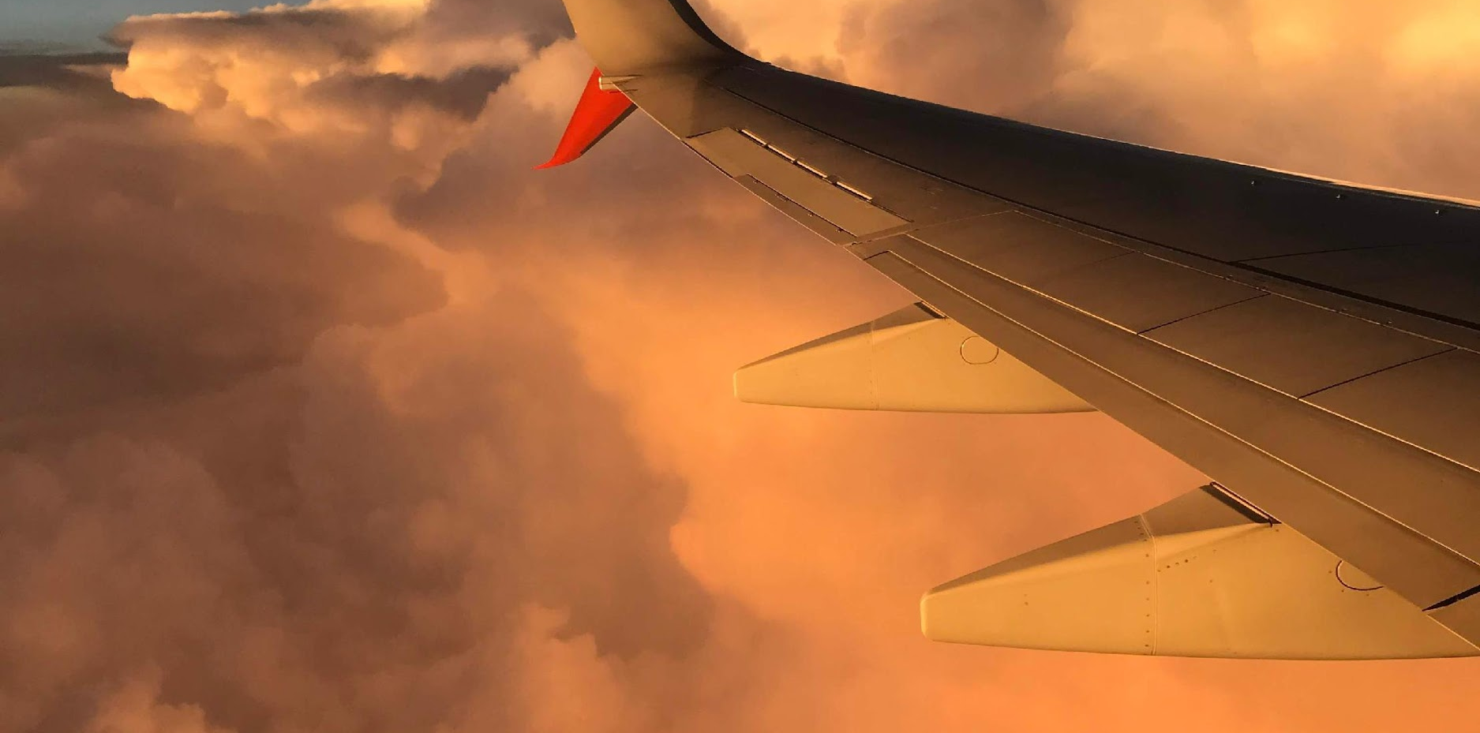
THANK YOU
94 Summit St. Davenport, IA 52807 | +9082 09284 | bt@agency.com

