Slide 1
Digital Aide
_{Digitalaide.com}

Slide 2
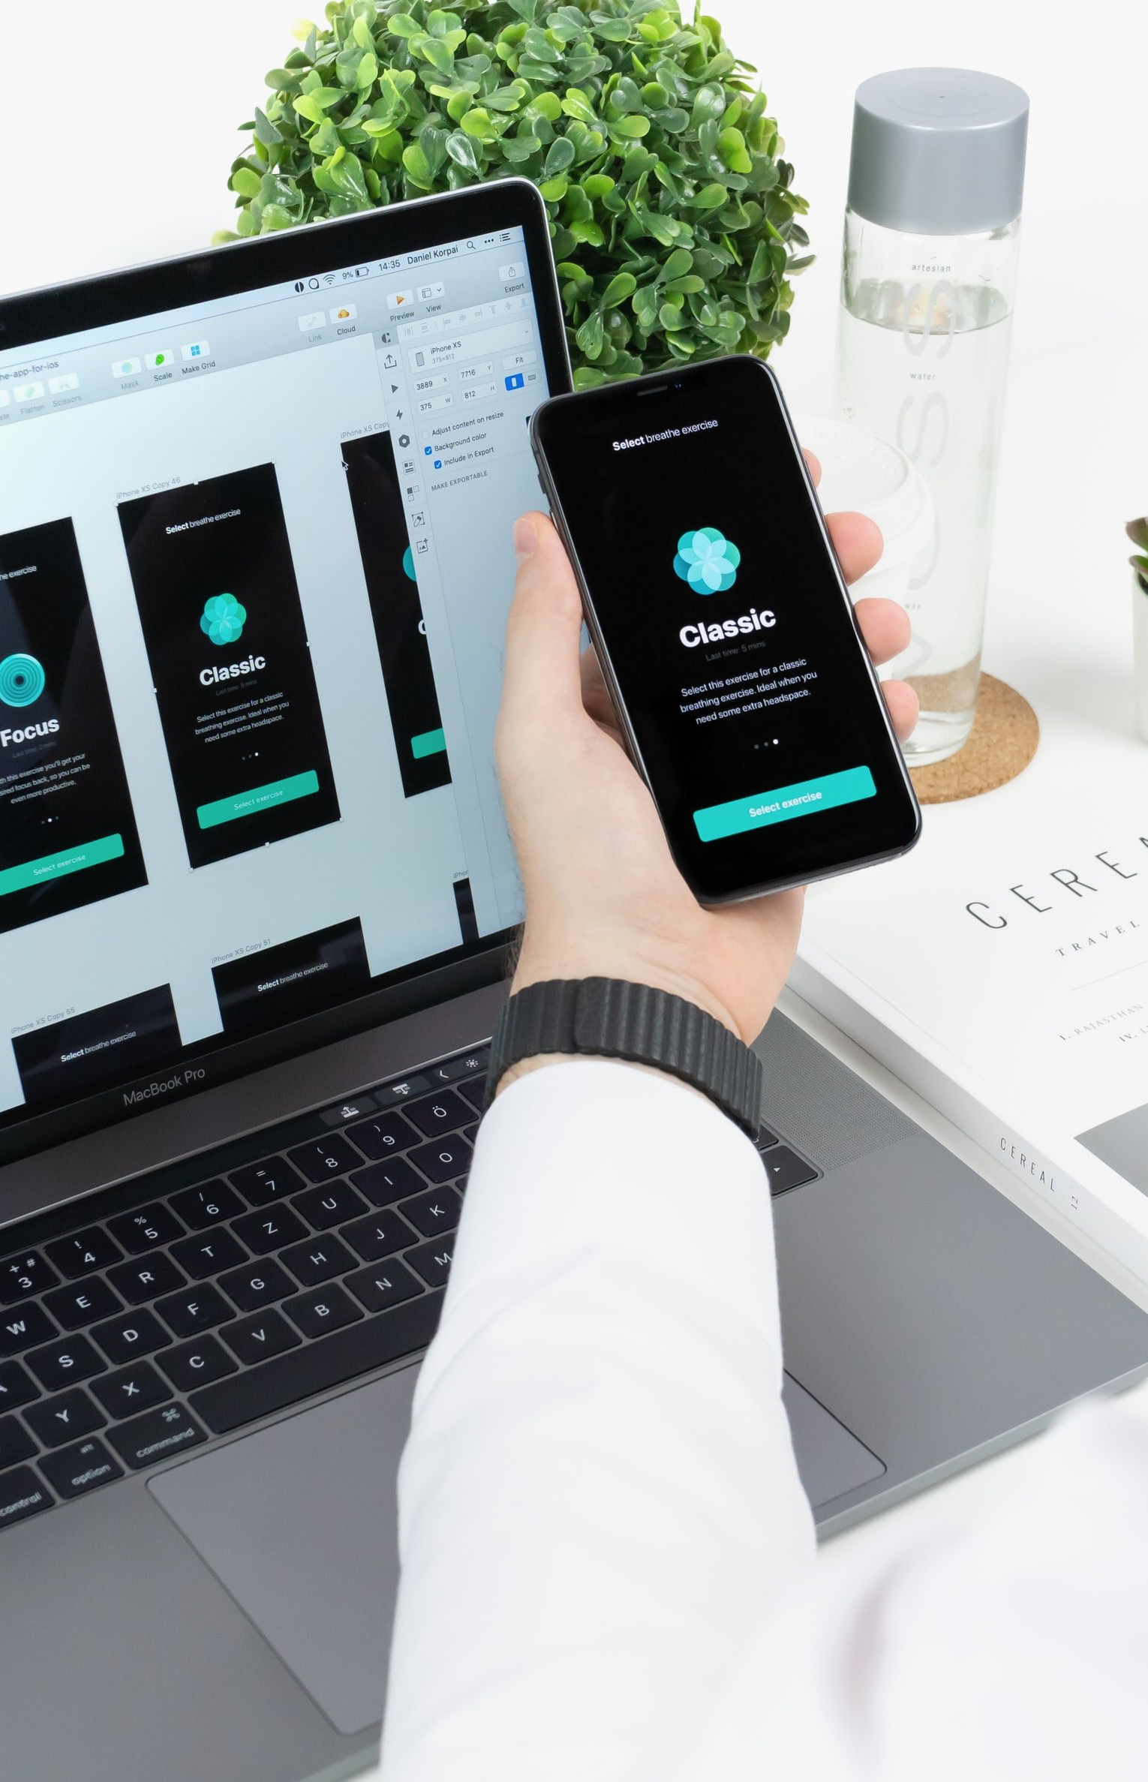
Digital Aide
The Company
Products & Services
Execution
Marketing Plan
Client Commentary

Slide 3
The Company
Executive Summary
Digital Aide is a mobile assistance app for older adults who need additional assistance in their daily activities. The app includes controls, options & features that are tailored to fit people of older age, making it a user-friendly app for them.
Digital Aide

Slide 4
The Company
Executive Summary
Digital Aide is the latest release from JH Mobile, a giant in the information technology industry. JH Mobile is a software company committed to providing the market with trusted, quality, & user-friendly apps for all kinds of demographics. The company’s previous releases are top-rated in multiple mobile app platforms.
Digital Aide

Slide 5
The Company
Mission
JH Mobile is committed to addressing market needs by manufacturing high-quality, affordable apps.
Vision
JH Mobile seeks to continue developing premier mobile application solutions for our valued customers & become a key player in the information technology industry.
Philosophy
JH Mobile places customer service & innovation at the heart of its business.
Digital Aide

Slide 6
The Company
Outlook
The use of mobile apps has been an essential part of the human lifestyle throughout the years. Information technology companies are neck & neck in competing with developing various apps to satisfy the needs of this exponentially growing consumer base. Companies with the most innovative & advanced mobile applications earn customer loyalty that makes them a remarkable success in the industry.
Digital Aide

Slide 7
The Company
Organizational Structure
CEO
Type of Industry:
Information Technology Industry
Business Structure:
App Development Head
Marketing Division Head
^{Sole Proprietorship}
Ownership:
^{Sole Proprietorship,}
Digital Aide

Slide 8
The Company
The CEO of the company is the head of operations. Under the CEO is the Marketing Division Head & App Development Division Head.
The head of the Marketing Division is responsible for creating & implementing marketing plans, strategies & market research. The team in this department also manages client concerns & collaborates with the App Development division in resolving any app issues.
The head of the App Development division is responsible for software development, app creation & app maintenance. Programmers & software engineers in the team works with the marketing team to develop the best apps that are sought-after by app users in the market.
Digital Aide

Slide 9
The Company
Robert Cressman
Chief Operating Officer
John Newman
The
Team
Founder & CEO
Faye Crest
Chief Marketing Officer
Digital Aide

Slide 10
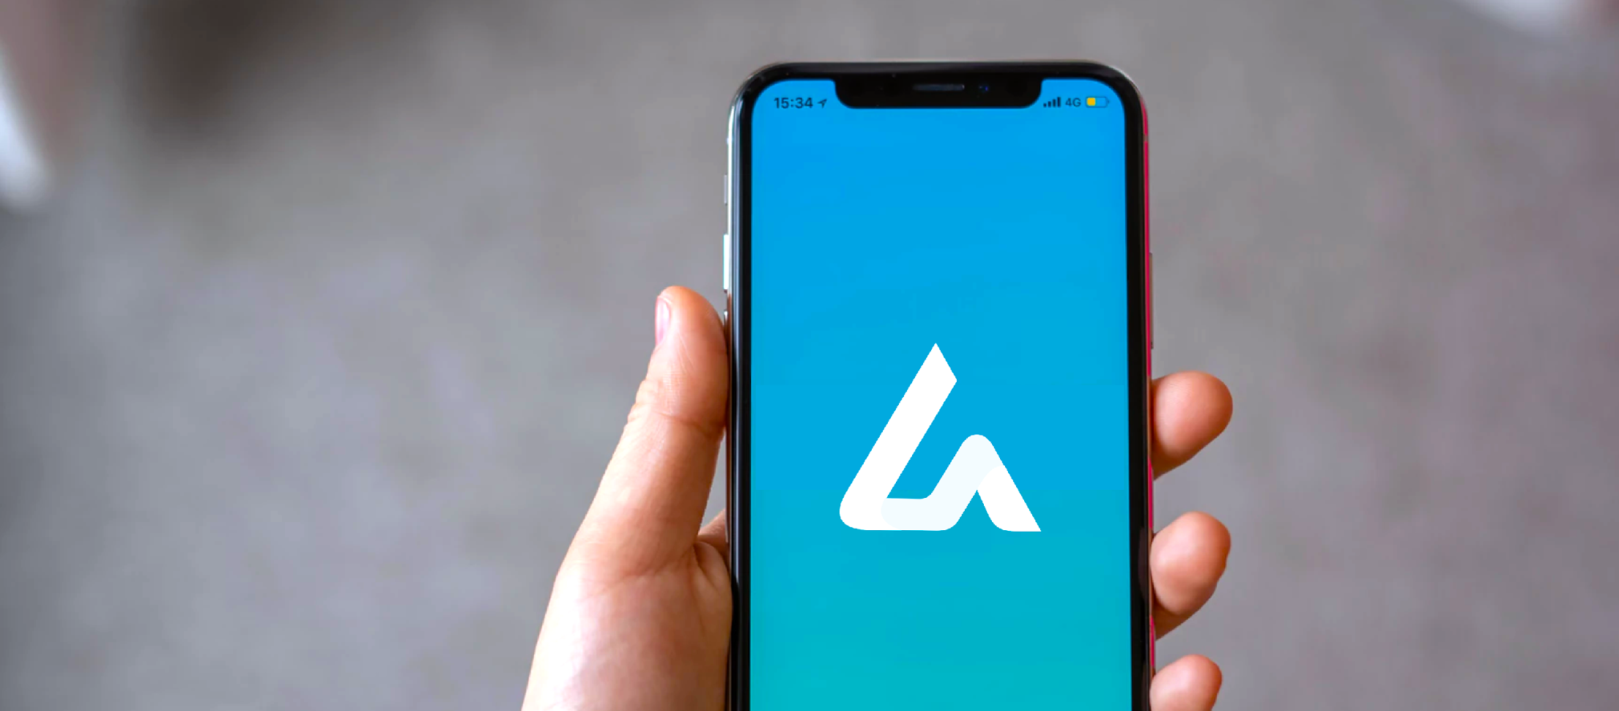
Product & Services
Latest in store
Description
Digital Aide’s innovative features include itinerary makers, quick contact, daily reminders & location sharing created for emergency situations. It also presents a simple, fully customizable interface designed for its target audience & consumers. The app can also be synced & connected to another phone, which allows any family member to keep track of the information stored by the main user.
Digital Aide
Digital Aide

Slide 11
Product & Services
Value Proposition
Pricing Strategy
Digital Aide’s interface & features are tailored according to the health specifications of its target users. The features & designs are based after the results of a series of consultations with medical professionals.
Digital Aide uses a cost-plus pricing strategy. The app is accessible & affordable to more users in the target demographic.

Slide 12
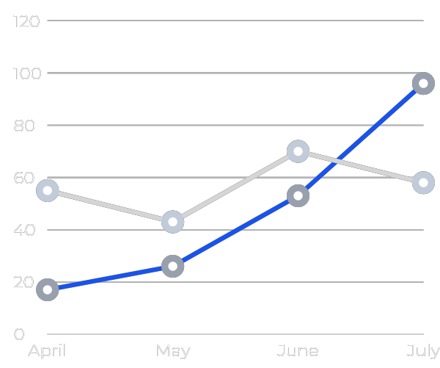
Execution
Marketing Analysis
The information technology industry is one of the major driving forces for economic growth on a global scale. This is due to the prevalence of the use of the Internet, apps, & mobile gadgets. Since the preferences of consumers are diverse, the challenge for app developers is to come up with solutions that suit their wants & needs.
Digital Aide

Slide 13
Execution
Market Segmentation
JH Mobile will market Digital Aide mostly to customers who are between the ages of 50-90. That said, the company will also be catering to customers between the ages of 30-55, who are most likely to recommend the app to their parents & older friends.
21%
54%
25%
²¹ ⁻ ³⁰
³⁰ ⁻ ⁵⁵
⁵⁰ ⁻ ⁹⁰

Slide 14
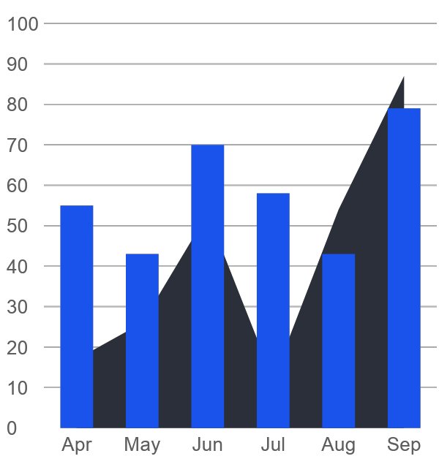
Marketing Plan
Market Research
Digital Aide will post promotional videos on its site & social media accounts to create interest for the app. The videos will consist of advertisements in the form of short films featuring stories of the target clients using the app, app reviews & promotions pertaining to the free, unique features of the app.
Digital Aide

Slide 15
Marketing Plan
Marketing Strategy
Video Promotions | Press releases
Marketing team will create the promotional videos | Reached 50% of audience target.
The marketing team will write the press release | Publishing of app reviews & press releases
Credible online personalities | Press release distributed to multiple organizations.
media publications will be contacted | Contract signing on February 2027
Brand expansion in New York & New Jersey | Budget proposal drafted as of July 2026
Digital Aide

Slide 16
Client Commentary
“ Digital Aide was a worthwhile investment for me. Knowing that I can’t do many of the things I used to do when I was younger, I needed all the help I could get. Now I can with Digital Aide! ”
^{Cyndia D. Thomas, 53, Nurse}
Digital Aide

Slide 17
Client Commentary
“My dad isn’t getting any younger. I needed as much assistance as I could in terms of keeping his medical check ups alongside his medication without having to take up too much of my personal work as well. I’d highly recommend this to any elderly (or those assisting the elderly) any day.”
^{Wylang J. Wyans, 32, Engineer}
Digital Aide

Slide 18
Thank You!
Digital Aide
646-512-2945
3644 Northridge Lane
New York, NY 10013, USA

